Slide 1
Food Security Assessment of South Sudanese Refugees in White Nile
May 2015
For internal use

Slide 2
Overview
Introduction
The objective of the assessment was to better understand the food security and livelihood situation among South Sudan refugees living in seven camps in White Nile state.
Data collection took place in in the first week of May 2015.

Slide 3
Summary of findings
The food security situation in Alagaya and Um Sangoor was alarming.
A majority of households were food insecure. (Only one of the locations 103 surveyed in the February 2015 Darfur FSMS had worse food security results.)
Household and child food consumption was extremely poor in Alagaya and Um Sangoor
By comparison, not one of the 103 locations covered in the most recent round of the Darfur Food Security Monitoring System (FSMS) had worse household food consumption.
The lack of livelihood options, high food prices and restrictions in physical movement severely impacted purchasing power.
More than 90 percent of households in Alagaya and Um Sangoor could not afford the local food basket.
Female headed households were 5-17 percentage points more food insecure

Slide 4
Summary of findings
Continued
Households were supposed to receive a 575 gram GFD basket of sorghum, pulses, salt and oil. In practise, pipeline breaks and/or partner capacity interfered with both GFD and supplementary feeding in some locations.
Distribution of pulses was insufficient or non-existent in Alagaya and Um Sangoor
GFD coverage in Alagaya was less than 50% in the last few months
EBSFP coverage in Alredais 2, Alagaya and Um Sangoor was below 15 percent
Female headed household accounted for a majority of the population
Livelihoods
Alagaya relied on sale of food assistance, especially female headed households
Um Sangoor relied on transfers, especially female headed households
Poor sanitation practices were widespread, especially in Um Sangoor
Major accountability problems were encountered (knowledge about entitlements was low etc.)
No major protection problems were encountered

Slide 5
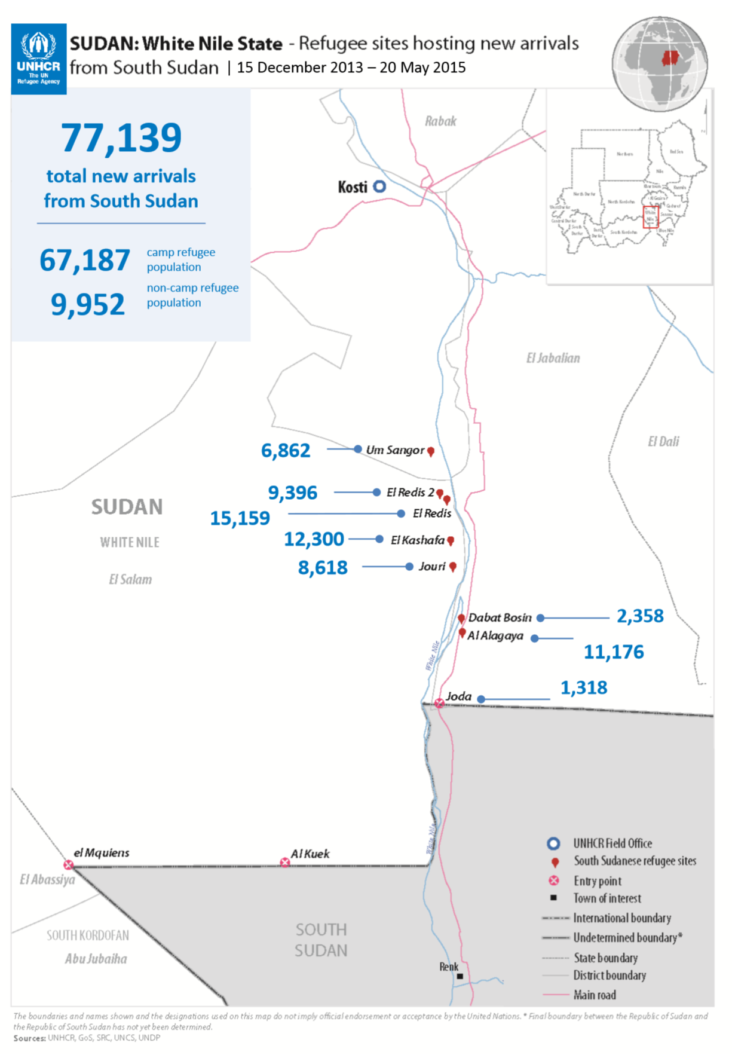
Overview
Methodology
The following camps were sampled:
Jory
Kashafa
Alredais 1
Alredais 2
Alagaya 1
Alagaya 2
Um Sangoor
Alagaya 2 and Um Sangoor were established in 2015
Alagaya 1, Jory, Kashafa and Alredais were established in 2014
The movement of inhabitants in some locations was restricted

Slide 6
Overview
Methodology
The survey clustered sites into three domains:
Jory, Kashafa, Alredais (1 and 2)
Alagaya (1 and 2)
Um Sangoor
1,050 households were sampled in total

Slide 7
Demographics

Slide 8
Female headed households

Slide 9
Gender Analysis
Water containers

Slide 10
Toilet facilities

Slide 11
Livelihoods

Slide 12
Livelihoods
Main livelihood

Slide 13
Livelihoods
Gender differences

Slide 14
Livelihoods
Secondary livelihood

Slide 15
Livelihoods
Livelihoods constraints

Slide 16
Decision making about income and household resources

Slide 17
Food consumption

Slide 18
Household food consumption
A measurement of household food consumption
Dietary diversity and food frequency is used as a proxy to measure household food access.
Using a 7-day recall period, information was collected on the variety and frequency of different foods and food groups to calculate a weighted food consumption score. Weights were based on the nutritional density of the foods.
Households were then classified as having either ‘poor’, ‘borderline’ or ‘acceptable’ consumption based on the analysis of the data.
http://www.wfp.org/content/technical-guidance-sheet-food-consumption-analysis-calculation-and-use-food-consumption-score-food-s

Slide 19
Household food consumption

Slide 20
Household food consumption
Gender differential

Slide 21
Household food consumption
Number of days per week consumed

Slide 22
Household food consumption
Food sources

Slide 23
Household food consumption
Food sources – detailed

Slide 24
Child food consumption
Minimum acceptable diet for children 6-23 months

Slide 25
Child food consumption
Minimum acceptable diet for children 6-23 months

Slide 26
Household expenditure

Slide 27
Expenditure
Itemized breakdown

Slide 28
Purchasing power

Slide 29
Purchasing power
Gender differences

Slide 30
Share of expenditure on food

Slide 31
Food security

Slide 32
Food security

Slide 33
Food security
Gender differences

Slide 34
Program indicators

Slide 35
Program indicators
UNHCR registration card coverage

Slide 36
Program indicators
Food assistance coverage in the last 3 months

Slide 37
Program indicators
How long did the following GFD food items last

Slide 38
Program indicators
Who typically collects food assistance from the distribution site

Slide 39
Program indicators
Household decision making over WFP food assistance

Slide 40
Program indicators
Sale of food aid

Slide 41
Program indicators
Reason for selling/exchanging the food ration

Slide 42
Program indicators
Proportion of cereal ration that was sold

Slide 43
Program indicators
EBSPF coverage and participation

Slide 44
Protection and accountability

Slide 45
Protection and accountability
97% of households did not report experiencing safety problems travelling to, from or at WFP program sites
78% of interviewed beneficiaries were not able to describe how they were selected
44% knew their entitlements
33% knew where and how to make a complaint
Notes:
Results for the safety indicator show that an average 97% of interviewed South Sudanese beneficiaries across all three clusters did not report experiencing any safety problems travelling to, from or at WFP program sites. This represents 17 points above the corporate SRF target of 80% and thus, constitutes a very satisfactory outcome for WFP operations in White Nile. T

Slide 46
Summary

Slide 47
Summary of findings
The food security situation in Alagaya and Um Sangoor was alarming.
A majority of households were food insecure. (Only one of the locations 103 surveyed in the February 2015 Darfur FSMS had worse food security results.)
Household and child food consumption was extremely poor in Alagaya and Um Sangoor
By comparison, not one of the 103 locations covered in the most recent round of the Darfur Food Security Monitoring System (FSMS) had worse household food consumption.
The lack of livelihood options, high food prices and restrictions in physical movement severely impacted purchasing power.
More than 90 percent of households in Alagaya and Um Sangoor could not afford the local food basket.
Female headed households were 5-17 percentage points more food insecure

Slide 48
Summary of findings
Continued
Households were supposed to receive a 575 gram GFD basket of sorghum, pulses, salt and oil. In practise, pipeline breaks and/or partner capacity interfered with both GFD and supplementary feeding in some locations.
Distribution of pulses was insufficient or non-existent in Alagaya and Um Sangoor
GFD coverage in Alagaya was less than 50% in the last few months
EBSFP coverage in Alredais 2, Alagaya and Um Sangoor was below 15 percent
Female headed household accounted for a majority of the population
Livelihoods
Alagaya relied on sale of food assistance, especially female headed households
Um Sangoor relied on transfers, especially female headed households
Poor sanitation practices were widespread, especially in Um Sangoor
Major accountability problems were encountered (knowledge about entitlements was low etc.)
No major protection problems were encountered

Slide 49
Food Security Assessment of South Sudanese Refugees in White Nile
May 2015
For internal use

