Slide 1
Information collection and analysis plan
Initial EFSAs - Training for NDMAs
Day 2 - Topic 1

Slide 2
Learning objectives
Understand the use of an Analysis Plan and be able to develop one
Understand the importance of secondary data analysis
Identify information gaps and chose most appropriate primary data collection tools

Slide 3
Focusing on the essentials
ToR – Key analytical questions
Food security and nutrition
What you know already vs. What you need to know
What you want to know

Slide 4
Step 1. What information is needed?
The Analysis Plan

Slide 5
The Analysis Plan
A simple table listing the information to be collected from primary and secondary sources, guiding its analysis;
Prepared BEFORE designing any data collection tools;
Helps to ensure efficiency and keep the process and analysis focused.

Slide 6
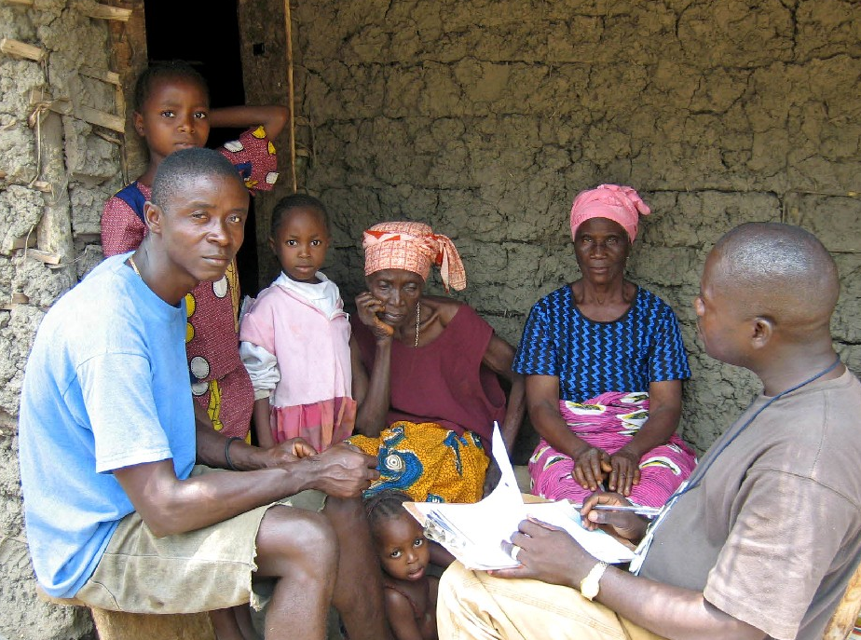
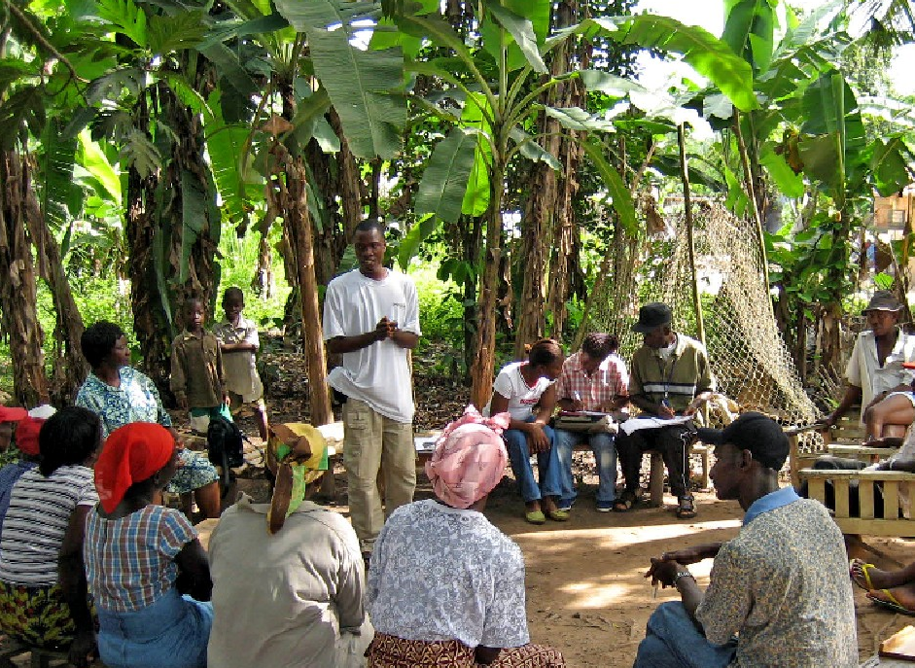
How is the Analysis Plan prepared?
The following questions will have to be asked:
Which information is needed to reach the assessment’s objectives?
From which source(s) can the information be collected?
How can the information be collected? Which tools to be used?

Slide 7
Content of the Analysis Plan
Objective/Key questions
Number of HHs in need
Information required
Vulnerable HHs
Indicator
% of HHs with members < 5 yrs and/or +65 yrs
Source
Census, Key Informants interview

Slide 8
Example of Analysis Plan

Slide 9
Step 2. Secondary data collection and analysis

Slide 10
What is secondary data?
Information that has been collected by others but relevant to the current assessment, e.g.:
  Population and demography
  Health & nutrition indicators
  Socio-economic situation
  Livelihood systems
  Health indicators
  Consumer price index
  Production data

Slide 11
Why use Secondary data?
Save time: why collect information twice?
Help form „initial hypothesis“
Enable to focus on potential information gaps
Reduce „assessment fatigue“ among affected communities
Enhance cooperation and coordination among main stakeholders

Slide 12
Criteria to assess secondary data
Relevance: Is the information relevant/important/ updated?
Reliability: Is the information source reliable?
Time factor: Is the information recent?

Slide 13
Consolidation of secondary data
Appraise all secondary information for relevance and reliability;
Analyse information according to assessment objectives;
Consolidate information into an accessible format (database, report);
Identify information gaps that must be filled, cross-checked;

Slide 14
Examples of secondary data sources
Monitoring reports
Maps and atlases
National surveys
NGO reports
Media
…..

Slide 15
Step 3. Information gaps & primary data collection tools

Slide 16
Information gaps
When information gaps cannot be filled by secondary data, primary data is advised to be collected on those missing issues, if deemed possible and feasible.

Slide 17
Primary data collection tools
Household survey
Key informant interview
Focus group discussion
Community group discussion
Observation
Each has pros and cons, so it is important to combine
or triangulate different approaches when possible!

Slide 18
Comparing key primary data collection tools
 | Questionnaire | Semi-structured interview
Usage | Household surveys or Key Informants | Focus or community groups, households
Type of data | Quantitative | Mainly qualitative
Approach | Standard set of questions for all respondents | Checklist with broad questions to guide discussion

Slide 19
Filling the gaps - Examples
Indicator (linked to the Analysis Plan) | Secondary data | Primary data
Number of shock-affected population | Unknown | Semi structured interviews with KIs to get estimates
Percentage of households with poor food consumption | 27% (latest CFSVA) | Focus group discussion to cross-check if recent shock has worsened the food security situation
Extent of infrastructures destroyed | Initial report from NDMA indicates 20% of roads out of use | Observation during field visits and cross-checking with KIs

Slide 20

Questions?

Slide 21
Data collection approaches by EFSA types
Initial EFSA: rapid appraisal techniques i.e. interviews with key informants, focus groups and community groups and households
Rapid and In-depth EFSAs: household survey questionnaires, depending on available time/resources/EFSA objectives
In-depth EFSAs: combination of rapid appraisal and survey techniques, however, time-consuming and therefore possibly not practical for intial EFSAs

