Slide 1
Open Data Kit
Session 1.3
Mobile Data Collection
Considerations

Slide 2

What is MDC?
Mobile data collection is the method of gathering any type of information using a mobile device, such as a smartphone or tablet. It is the intersection of :
“Data + Mobile Technology + Population”
where population refers to people, or statistically speaking, your sample

Slide 3










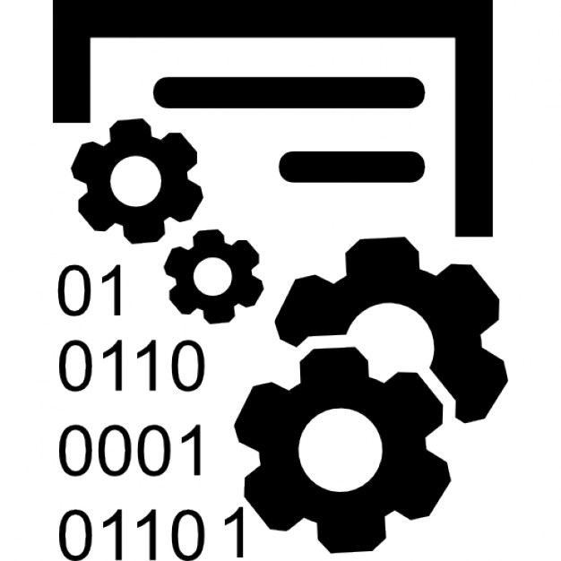
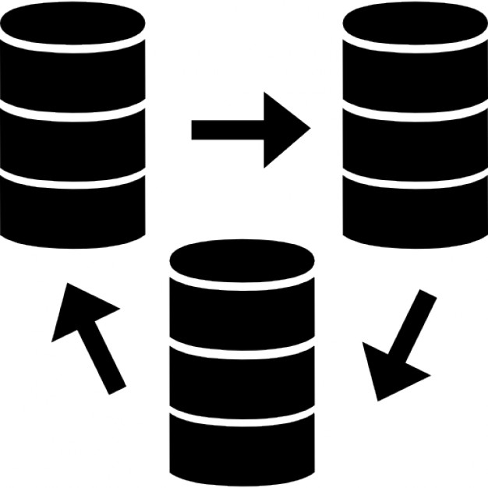

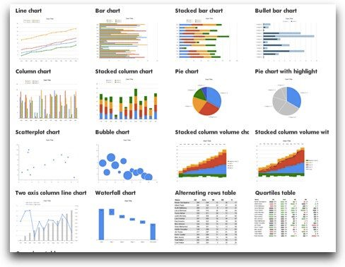
MDC PLATFORM - Functionalities
Mobile
based
Questionnaire
based
Data quality
control
Open source (Free)
Different data formats supported
Data collection process management
Data Management
Notes:
Questionnaire based.
Looks and feels like a questionnaire
Incorporates data auditing features
that improve the quality of the data and help standardization.(Eg. mandatory fields, rejecting or querying values outside a defined range, calculations
Open source
and highly extensible (Free)
Supports
GPS tagging, Barcodes, Video, Audio, Pictures, e
Improvement in Data Management
Because the data are entered into the main database at the same time as they are collected, the long process of transcribing and double-entering responses is eliminated. Data can be analyzed as soon as collection is done.
Manage the data collection process is easier.
Data are submitted in real time, allowing managers to see the pace of data collection, the coverage, and which data collectors are submitting data when and from where.
Technology by itself is generally NOT a solution
•Magnify Human resources through Technology
•Technology requires support infrastructure

Slide 4
Before approaching to any mobile data collection tool remember!
Technology by itself is generally NOT a solution

Slide 5
Mobile data collection tool use: list few pros and cons of the use of mobile data collection.
Pros
Cons

Slide 6
Mobile data collection tool use:
Pros
Cons
Better data quality (input controls)
Faster data entry
Easier to modify and analyze
Cheaper if used frequently
One tool for pictures, GPS, videos, bar codes, etc.
Longer training (initially)
Survey is not as visual as it can be on paper
Fragile technology and expensive at first

Slide 7
Why do mobile data collection?
Improvement in Timeliness
Reduced cost
Improvement in Data Quality
Real-time analysis

Slide 8
Improvement in Timeliness
Data is entered directly into an electronic form that can be exported into a statistical package or information management system, so access to data become instantaneous eliminating the time consuming and expensive data entry process.
With the use of Internet technology, access may not only be real time but also global.

Slide 9
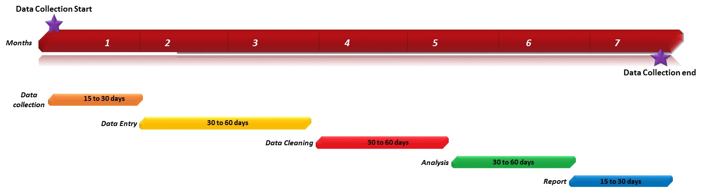
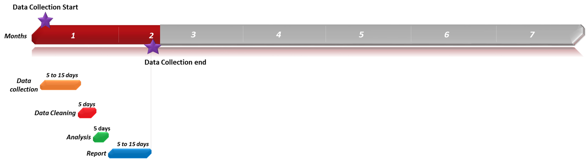
PAPER vs MOBILE - Timeliness
Paper
data collection
Mobile
data collection

Slide 10
Improvement in Data Quality
Using paper brings the risk that errors will be made when data is transcribed into a digital format. Smartphones can reduce the number of these data transcription errors.
Digital data collection forms can also incorporate data auditing features that improve the quality of the data and help standardization. (Eg. mandatory fields, rejecting or querying values outside a defined range, calculations.)

Slide 11
Reduced Costs
Compared with traditional data collection tools ODK constitutes a saving because of re-usability of technology and reduced staffing time.

Slide 12
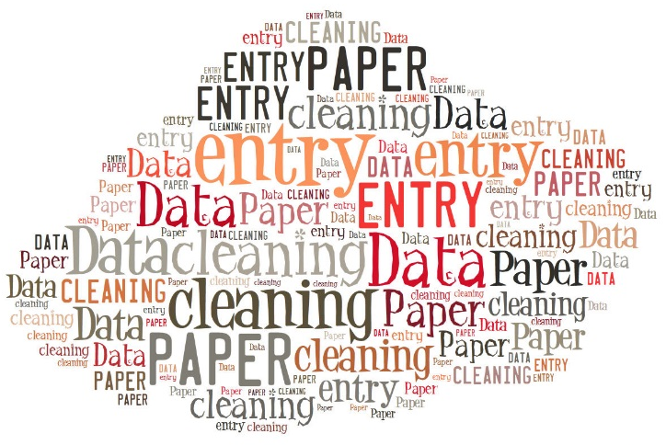


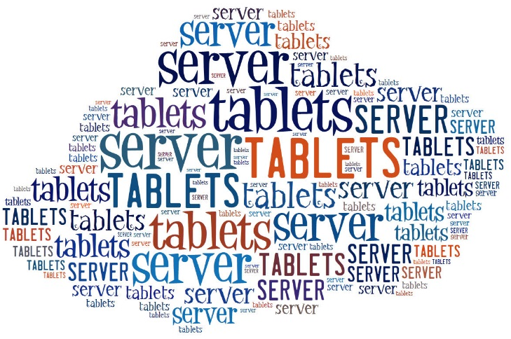
PAPER vs MOBILE – Initial Costs
Notes:
Initial costs might be higher when you witch from paper to mobile data collection….WFP is covering the it equipment costs!

Slide 13
PAPER vs MOBILE – Long term Costs
Notes:
If long-term use is planned for the devices, costs would be recouped through the savings made on data entry and paper within a relatively short period of time.

Slide 14

Real-time analysis
Data can be synchronized to the server right after being collected, allowing real time analysis.

Slide 15
Open Data Kit
Session 1.4
Presentation of ODK

Slide 16
Exercise1:
What are the main phases of a mobile data collection campaign for you?

Slide 17



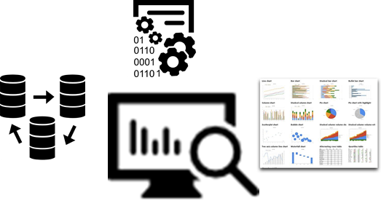


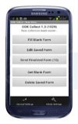
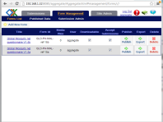
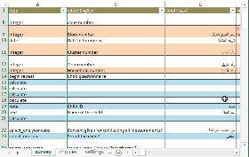
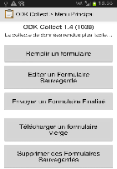



Phases of MDC
Planning
Collect
Manage
Analyse
XLS Forms
ODK Collect
Aggregate
Analysis tools
Notes:
Planning phase:
Collect:
Manage:
Analyze:

Slide 18
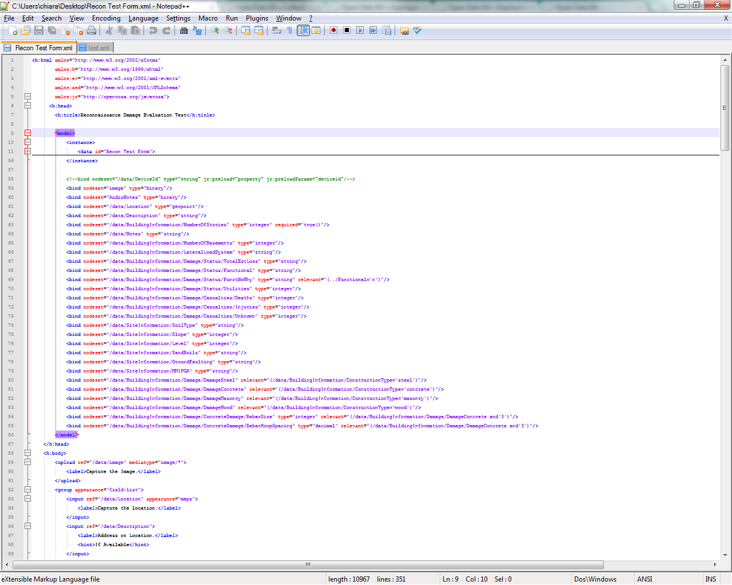
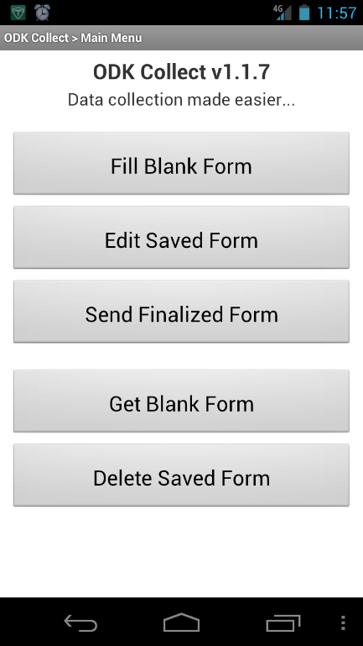
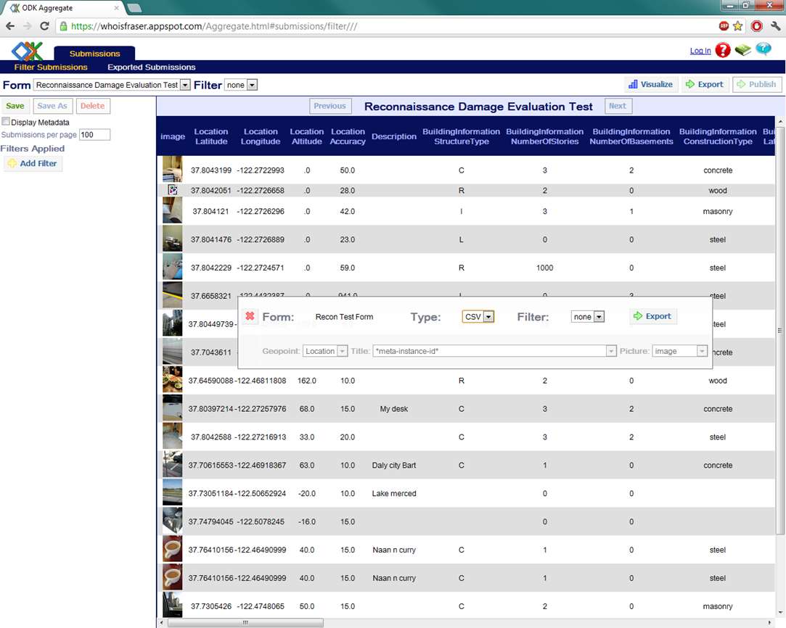
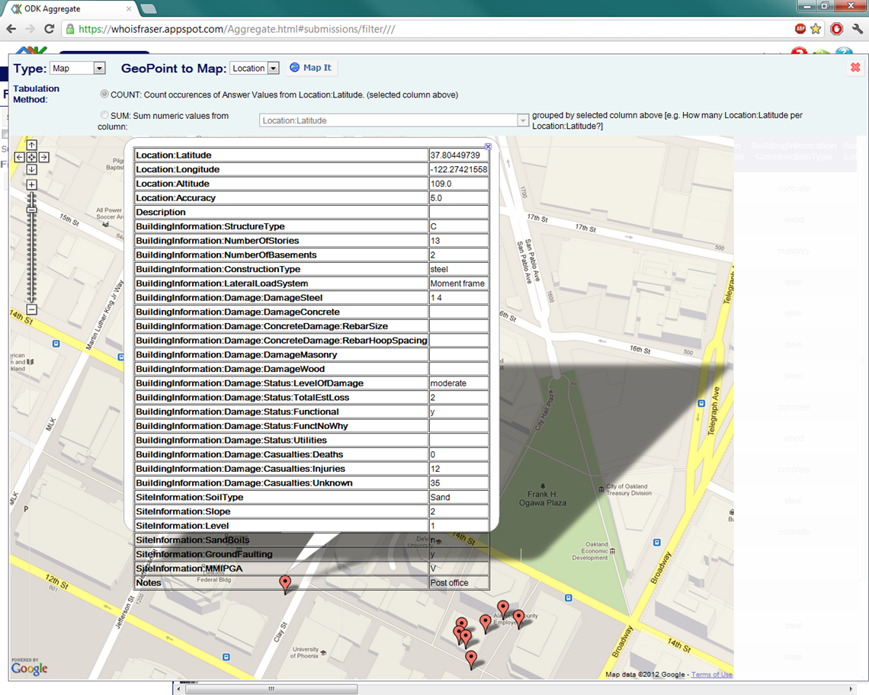
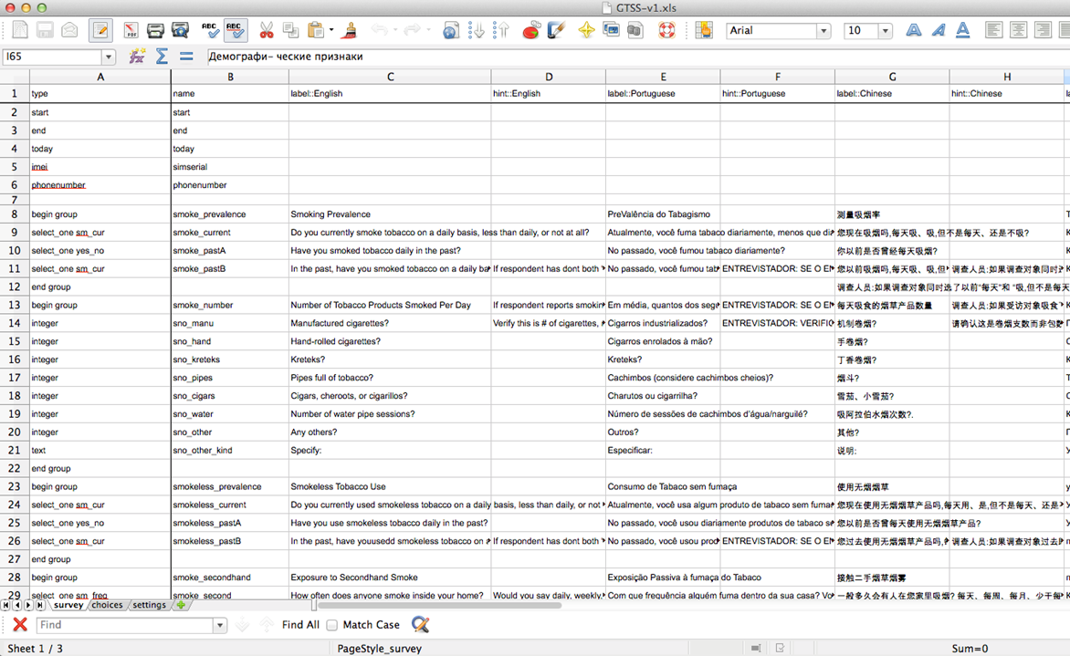
ODK: Open Data Kit
ODK What is ODK?
Xls form
Questionnaire design
ODK Aggregate
Data curation and Data management
ODK Collect
Mobile data collection
Notes:
Open Data Kit (ODK) is a free and open-source set of tools which help author, field, and manage mobile data collection solutions. ODK provides an out-of-the-box solution for users to:
Build a data collection form or survey (XLSForm is recommended for larger forms);
Collect the data on a mobile device and send it to a server; and
Aggregate the collected data on a server and extract it in useful formats.
ODK is a set of tools that allow questionnaire design, data collection, transmission and analysis in real-time through the use of mobile devices such as smartphones and tablets

Slide 19
ODK- Xls form
XLSForm is a standard Excel form created to help simplify coding forms for ODK in Excel.
It makes easy to share and discuss forms with others.
Xls form

Slide 20
ODK- ODK collect
ODK Collect allows users to download forms from ODK Aggregate Server;
The forms can be filled in from mobile devices and submitted to the server for analysis;
The data collection (interview) is an offline process.
ODK Collect
Notes:
A

Slide 21
ODK- ODK Aggregate
ODK Aggregate runs on a server, it allows the users to view, export and report on the data collected;
The GPS position of the teams can be monitored and viewed on a map as soon as data is being submitted.
ODK Aggregate
Notes:
A

Slide 22
ODK data collection:
Roles and responsibilities

Slide 23
Open Data Kit
Session 1.5
Roles and responsibilities

Slide 24

ODK-Roles and responsibilities
Improvement in timeliness
Data Collection
Manager
Field supervisor
Data
Analyst
IT
Focal Point
Enumerators
Improvement in data quality

Slide 25
Data Collection Manager
Planning
Collect
Manage
Analyse
Design/edit forms.
Ensure that core questions are added to the xls questionnaire.
Upload it to the ODK server.
Support Filed Supervisors during the data collection activities.
Support Field Supervisors during data upload.
Check if the responses are correctly sent and received to the server
Check on the data quality.
Report data quality issue to the Field Supervisors.
Check final results

Slide 26
Data Analyst
Planning
Collect
Manage
Analyse
Create the xls form
Edit the xls form
Test the form and eventually apply changes.
Access the data collected through ODK Aggregate platform;
Monitor the incoming data
Export the data from odk aggregate into csv format
Import the data in spss
Run the analysis
Create the graphs and charts
Create maps
Prepare the report

Slide 27
IT Focal Point
Planning
Collect
Manage
Analyse
Ensure that the odk serve is online.
Ensure that the mobile devices are functioning.
Provide support to Supervisors and Enumerators on mobile troubleshooting (both software and hardware);
sd
Ensure that backup of the sercver is done in timely manner.

Slide 28
Field Supervisor
Planning
Collect
Manage
Analyse
Refresh Training to enumerators-social workers.
Check that the tablets are working properly.
Supervise enumerators in the field and at SDC site
Support/troubleshoot any problems
Check data quality before submitting.
Submit responses to the ODK server

Slide 29
Enumerator/ Social Worker
Planning
Collect
Manage
Analyse
Check the battery status before starting off
Put the tablet in airplane mode
Active the gps trigger only when needed.
Take care of the device
Collect data at SDCs and Household level.
Save the form as finalized

Slide 30
ODK- Open Data Kit Workflow
Exercise : assign to each task the responsible role/person
Design/edit forms.
Upload it to the ODK server.
Test the form and eventually apply changes.
Refresh Training to enumerators.
View and Export data from ODK aggregate
Submit responses to the ODK server
Check data quality before submitting
Collect data at SDCs and Household level

Slide 31
ODK- Open Data Kit Workflow
7. Implementation phase
Design/edit forms.
Upload it to the ODK server.
Test the form and eventually apply changes.
Refresh Training to enumerators.
  Data Collection manager
  Data collection Manager
  Data collection manager
  Data analyst
  Field Work coordinator
View and Export data from ODK aggregate
Submit responses to the ODK server
Check data quality before submitting
Collect data at SDCs and Household level
  Data Analyst
  Field Work coordinator
  Field Work coordinator
  Social Worker/Enumerator

