Slide 1

Odk Collect

Slide 2
ODK Collect: Installation
1. Download "ODK Collect" from the Google Play Store onto the tablet.
2. Open ODK Collect. The main menu will present some of the following options: "fill in blank form”; “edit saved form”; “send finalized form etc". Click on the three vertical dots on the top right and select “general settings”

Slide 3
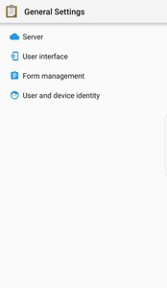
General Settings
To access General Settings: → General Settings

Slide 4
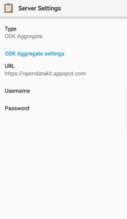
Server settings
Server Settings
Server settings control the connection to an Aggregate or OpenRosa server or a Google Drive account.

Slide 5
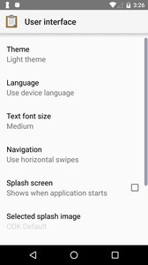
User Interface
User Interface settings control Collect’s appearance and behavior.
To access User Interface settings: → General Settings → User Interface

Slide 6
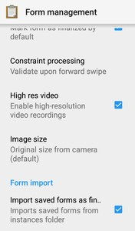
Form Management Settings
Form Management settings control default behavior when editing, ﬁnalizing, and importing forms.
To access Form Management settings: → General Settings → Form Management

Slide 7
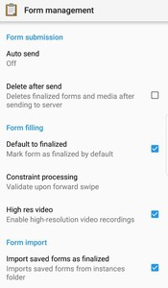
Form Management Settings
Form Management settings control default behavior when editing, ﬁnalizing, and importing forms.
To access Form Management settings: → General Settings → Form Management
Auto send When enabled, forms are sent immediately when they are ﬁnalized, if the device can connect to the internet. You can specify whether to send over WiFi, cellular data, or both.
Delete after send When enabled, form instances are deleted once they are sent.
Default to ﬁnalized When enabled, forms are automatically ﬁnalized upon reaching the end of the form. You can opt out of this on any speciﬁc form during form completion.
Constraint processing Sets when form responses are validated against constraints.
Options:
Upon forward swipe. (That is, right after the question is answered.)
At ﬁnalization.
High res video When enabled, Video widget widgets will record high resolution video if possible.

Slide 8
Main menu
Fill Blank Form Lists available blank forms and lets you select a form to begin ﬁlling out.
Edit Saved Form Lists completed and saved forms and lets you select a form to edit.
Send Finalized Form Lists ﬁnalized but unsent forms and lets you select forms to send to the server.
View Sent Form Lists forms that have been sent, even if they were deleted.
Get Blank form Lists blank forms available on the server and lets you download them.
Delete Saved Form Lists all the Saved and Blank Forms and lets you delete them.

