Slide 1

ODK Aggregate

Slide 2
ODK Aggregate
ODK Aggregate is an open source Java application that stores, analyzes, and presents XForm survey data collected using ODK Collect or other OpenRosa-compliant applications.
With Aggregate, data collection teams can:
Host blank XForms used by ODK Collect or other OpenRosa clients
Store and manage XForm submission data
Visualize collected data using maps and simple graphs
Export and publish data in a variety of formats
Aggregate can be hosted on Google App Engine, Amazon Web Services, or your own local or cloud server.
There’s also a pre-conﬁgured virtual machine image that is ready to deploy on any computer.

Slide 3

Managing Forms in Aggregate
You can add, download and delete forms, export data into useful formats, publish data into another service, manually upload submissions and view the published data.
ODK Aggregate provides all these options under the Form Management tab.

Slide 4
Working with Submitted Data in Aggregate
You can ﬁlter the submissions, visualize them using pie chart, bar graph or map, export the submissions into useful formats and publish the submitted data into another service.
You can also view all the exported submissions. ODK Aggregate provides all these options under the Submissions tab.

Slide 5

Filtering Submissions
Submissions from ODK collect can be ﬁltered to view or hide a speciﬁc subset of data by creation of ﬁlters.
Filters give you the ability to see a subset of your data. You can have a single ﬁlter as well as multiple ﬁlters.
You can create a single or multiple ﬁlters depending on the subset of data you want to view or hide.
Creating a ﬁlter like Display Rows where column Gender EQUAL male speciﬁes that you want to get a list of all rows where gender column has value as male i.e you want to obtain information about all male people in your data.
Unless the ﬁlter is saved, it is temporary. You can save a ﬁlter to make it permanent. Any ﬁlter can be deleted if it is no longer needed.

Slide 6

Visualizing Submissions
ODK Aggregate provides a quick means for basic data visualization. This Visualize functionality is meant to provide a quick means to view early data results in meaningful ways but is not meant to provide complex data analysis functionality. You can view your data in bar graph, pie chart or on a map.
In both Pie chart and bar graph visualization you can either count the number of times a unique answer occurs in a speciﬁed column or calculate sum of values in one column grouped by a value in another column. You can choose a column that you want to map in map visualization.

Slide 7

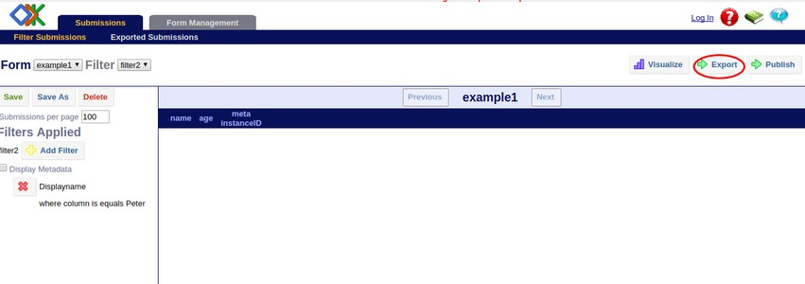
Export Submission
Click on Export option to export submitted data into useful formats and choose the format in which you want to export data. You can also choose a ﬁlter which you have saved earlier to export only a certain subset of data

Slide 8
Exporting
The easiest way to get data from Aggregate is by using its ‘Export’ feature. Export allows the user to manually export all of the data (or ﬁltered data) at any time into one of the following formats:
CSV (comma separated values)
CSV ﬁles are a text only, tabular representation of the data. Multimedia ﬁles are represented by including standard web links to the ﬁles. Repeats are also represented with links to the underlying data. Grouping information is not preserved. Metadata is only preserved if a ﬁlter is created with the metadata.

Slide 9
KML (Keyhole Markup Language)
KML is a text only representation of the data similar to XML, but used for mapping appli- cations like Google Earth.
Multimedia ﬁles are represented by including standard web links to the ﬁles hosted on the server.
Pictures will appear embedded in popup windows (when pushpins are clicked) in programs that render .kml ﬁles. Repeats and grouping information is not preserved.
Metadata is only preserved if a ﬁlter is created with the metadata.

Slide 10
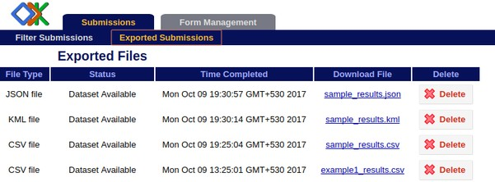
Viewing Exported Submissions
You can to view the list of exported ﬁles under the Exported Submissions tab
File Type speciﬁes whether ﬁle is .csv or .kml or .json ﬁle.
Status will state whether the ﬁle being made is in progress, or is now available for viewing.
Time Completed shows the time when the Export task is complete and the ﬁle is ready.
Click on the link in Download File to see your exported ﬁle.
Select delete box in the Delete column if you want to delete your exported ﬁle.

Slide 11
Odk aggregate permissions
You can specify additional usernames with browser access to the server under the Permissions
sub-tab. Privileges are as follows:
• Data Collector: able to download forms to ODK Collect and submit data from ODK Collect to ODK Aggregate.
• Data Viewer: able to log onto the ODK Aggregate website, ﬁlter and view submis- sions, and generate csv or kml ﬁles for download.
• Form Manager: all the capabilities of a Data Viewer plus the abilities to upload a form deﬁnition, delete a form and its data, and upload submissions manually through the ODK Aggregate website.
• Site Administrator: all the capabilities of a Form Manager plus the ability to add users, set passwords, and grant these capabilities to other users.

Slide 12
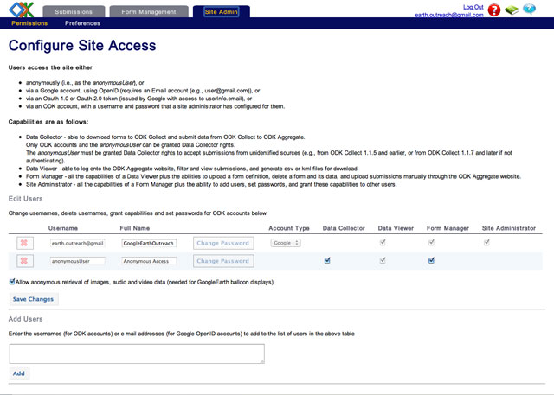
Setting up User Access Lists and Admin Settings
ODK Aggregate allows you to control who has access to your data in versions 1.0.n and newer. You can decide who can submit data, who can view data, who can manage forms, and who can be a site admin.
The first time you set up access permissions to your ODK Aggregate instance, you must login with the Google Account you used to set up the AppEngine instance. Select "Sign in with Google."
Now, you should see another tab next to "Submissions" and "Form Management," called "Site Admin." Open the

Slide 13
Getting Help in Aggregate
Aggregate provides three kinds of help accessible by pressing one of three buttons in the upper righthand corner.
The red question mark will give you instructions for the tab you are currently viewing. When you click the button, a help panel will appear at the bottom of the screen. To hide the help panel, simply click the red question mark again.

