Slide 1

Import forms to ODK Aggregate

Slide 2
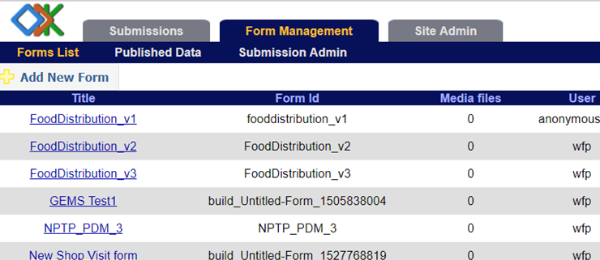
Managing Forms in Aggregate
You can add, download and delete forms, export data into useful formats, publish data into another service, manually upload submissions and view the published data.
ODK Aggregate provides all these options under the Form Management tab.

Slide 3

View blank form list
The form list displays the following information about each form.
  Form Id is the unique name for the form.
  Media Files is the count of media ﬁles associated with the form.
  User is the user who uploaded the form
Click on Forms list tab to see a list of all your forms.
From here, you can add new forms, delete forms, download forms as well as restrict submissions for a form.

Slide 4
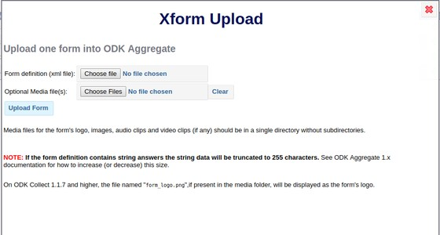
View blank form list
Under the Form list tab, you will see Add New Form button to upload a new form deﬁnition to ODK Aggregate.
When you click on it a box will open asking for details of the form. Form Deﬁnition is required and Media File(s) is optional.
Choose the .xml ﬁle that will be used. You can also choose the appropriate media ﬁles for the form.

Slide 5
Disabling or enabling submission of a form
To disable or enable the ability of Collect or other clients to submit completed instances of a form, toggle the checkbox in the Accept Submissions column of the blank forms list.

