Slide 1
Recap on basic SPSS and statistics
4th - 8th November 2016, Cairo

Slide 2
Purpose of this session
Prepare dataset for SPSS analysis
Recap and practice the initial steps of SPSS analysis

Slide 3
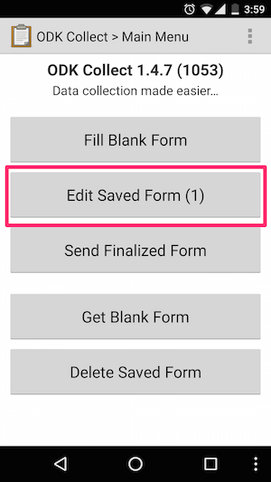
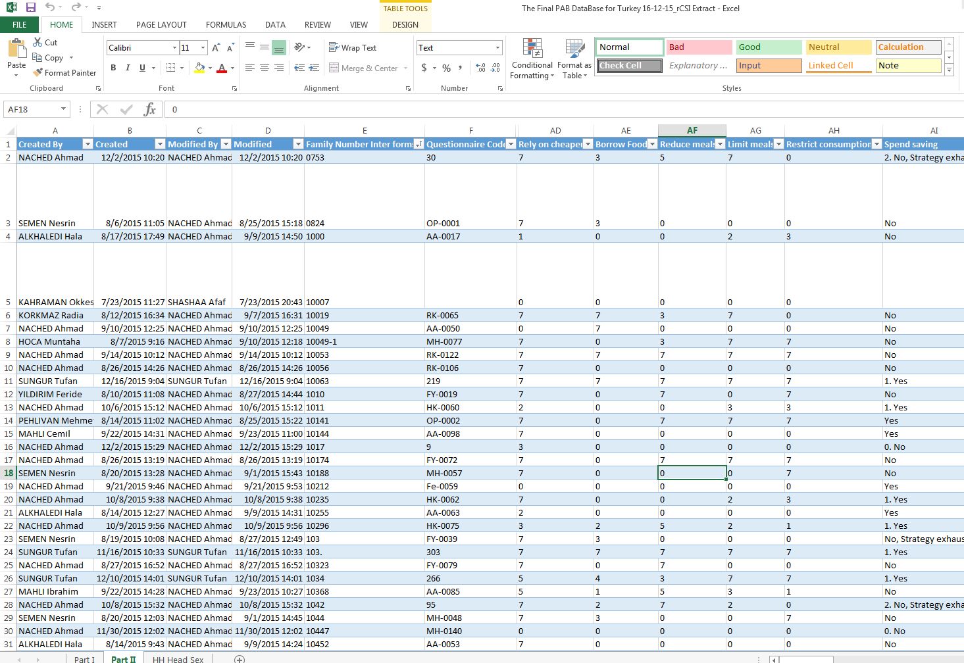
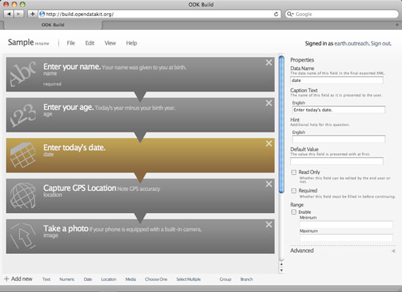
What data do we analyze? Where do they come from?
Excel Files: raw, cleaned
Tablet App: ODK, GRASP etc.

Slide 4
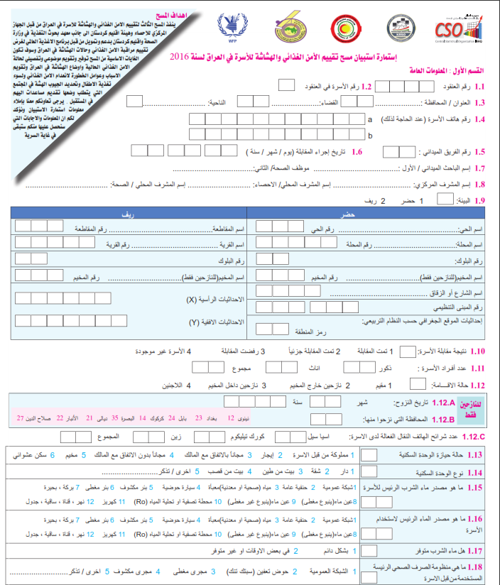
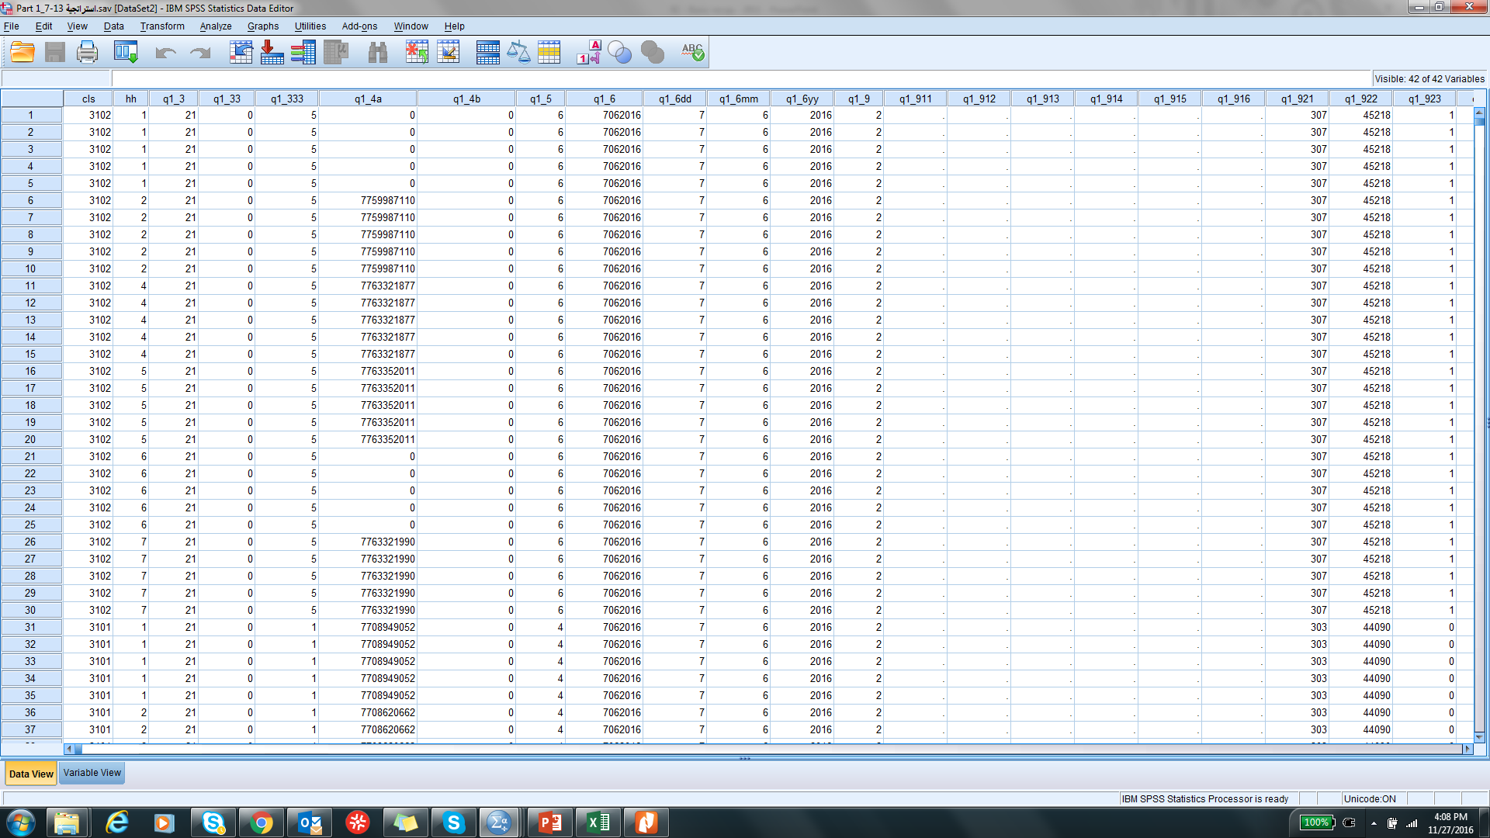
Paper based questionnaire
SPSS files (raw or cleaned)
Online questionnaire

Slide 5
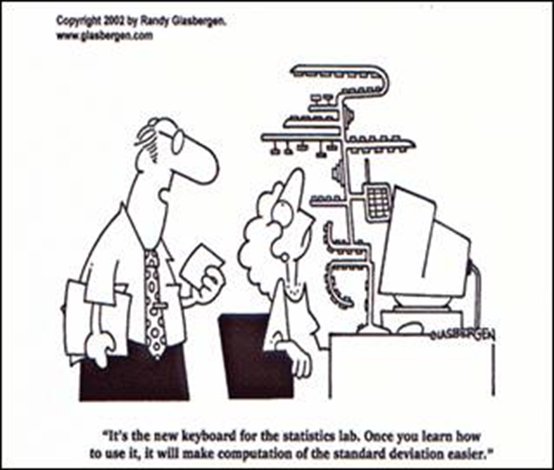
Manage the database
Import / export file
Understand how the data is organized
Determine how to prepare data for analysis

Slide 6
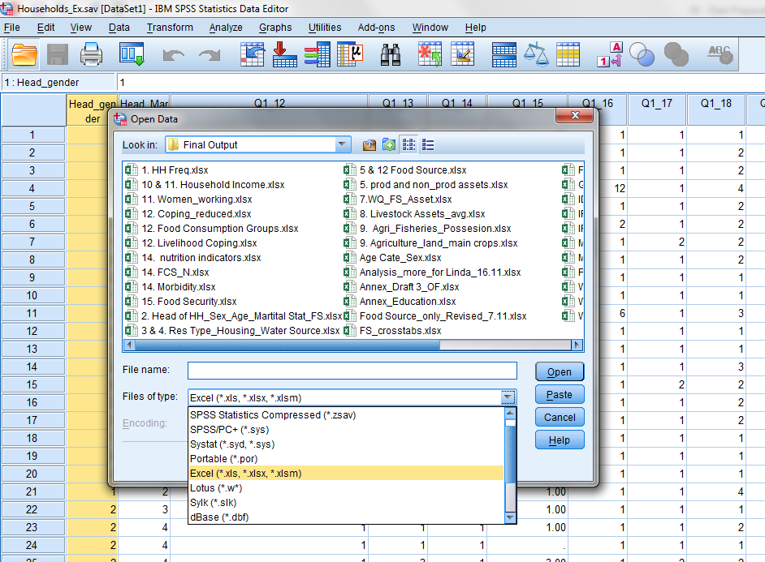
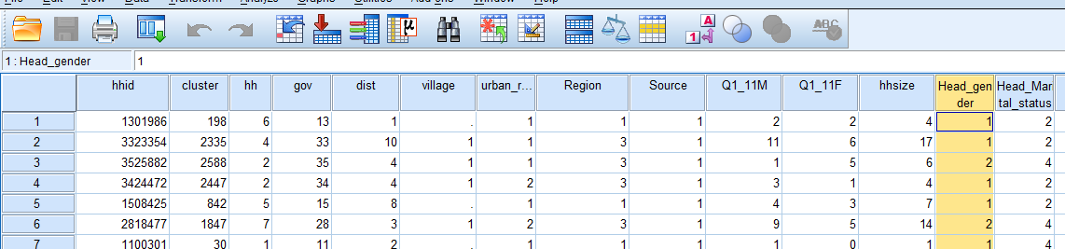
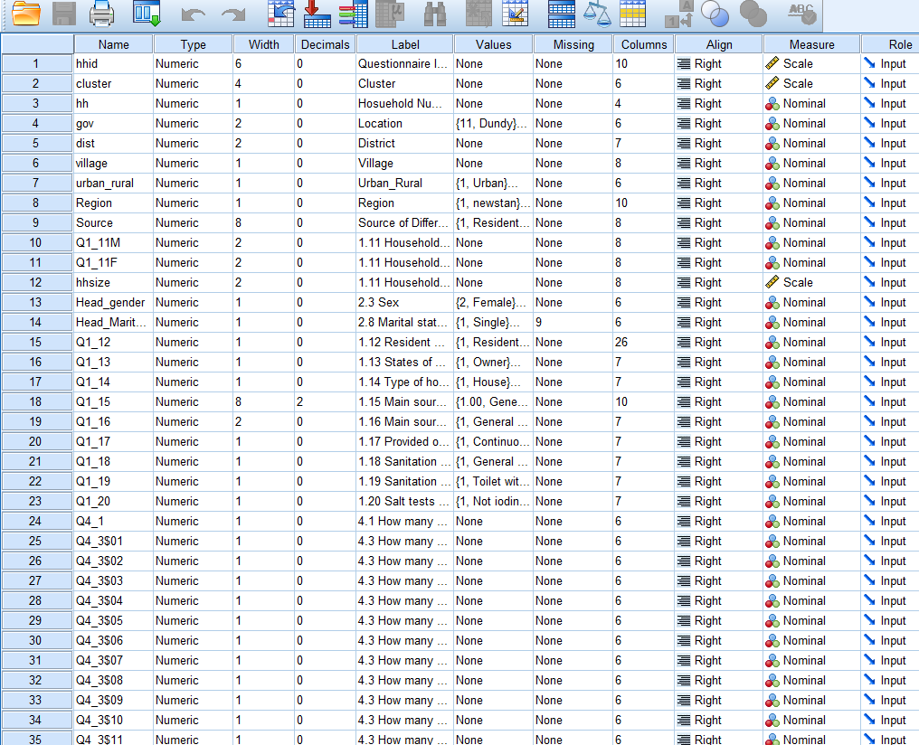
1Open Data, check file type. Open file.
2
Check top row
3Check variable View

Slide 7
What do we see here?
Variables
Cases

Slide 8
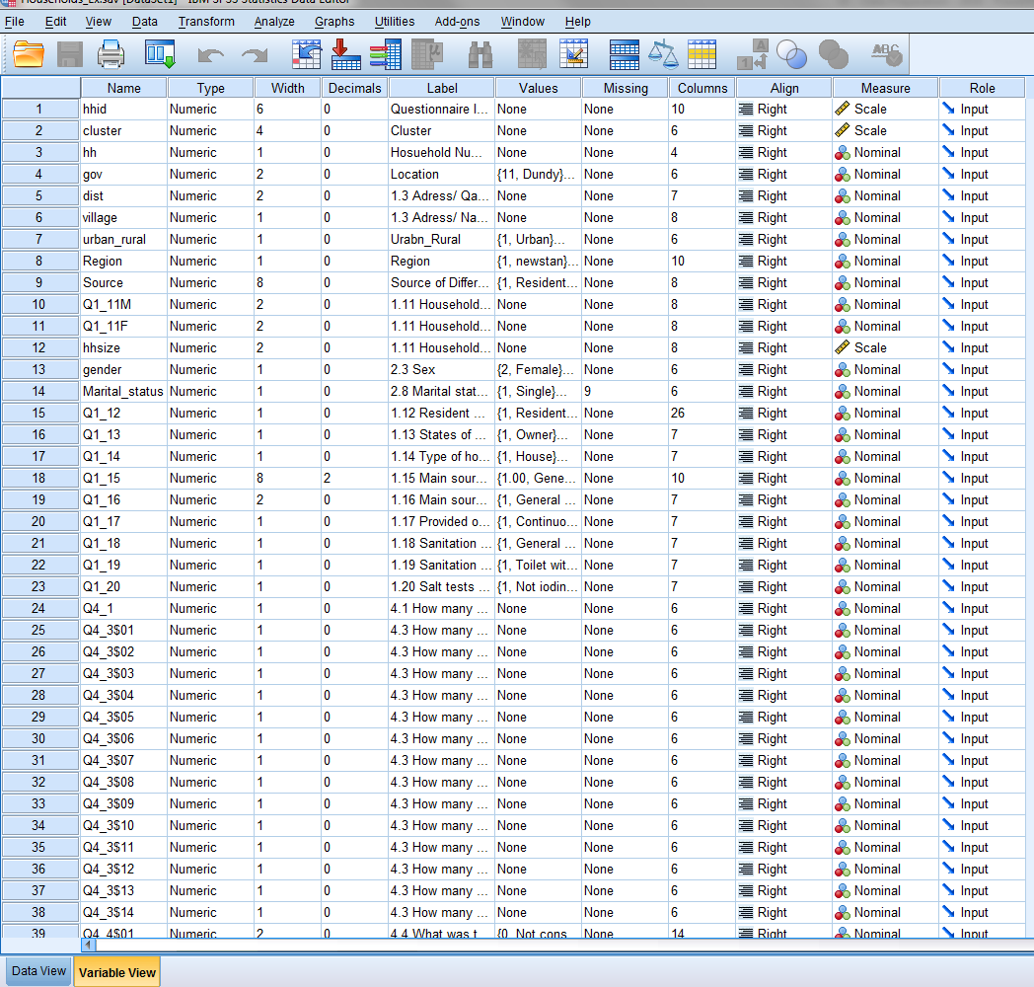
What do we see here?
Create clear labels
Make sure ‘measures’ are right
You can re-arrange the variable orders by dragging up and down
Most frequently used tabs are: Data, Transform and Analyze

Slide 9
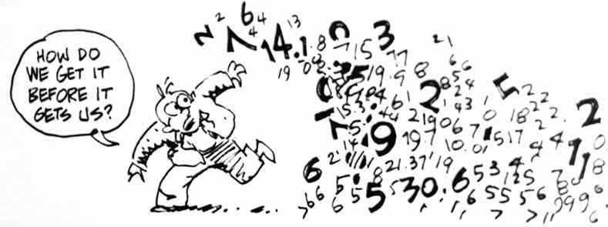
Data cleaning s
Unique ID
Missing data
Frequency sorting
Outliers
Define variable properties
Scatterplot /histograms

Slide 10
What to check for cleaning?
If there is an Unique ID
If there are unexpected values
Outliers
Value Labels?
Frequencies

Slide 11
Missing values and data cleaning
Cleaning data can be a painful process
Being systematic about cleaning data from the beginning of the process can save hours of work later in the analysis
There are few key tools to use in SPSS to clean data:
  Sorting cases – allows you to quickly see within a variable if there are problematic cases
  Indentify duplicate cases – shows cases which have the same unique identifier
  Histograms and scatter plots – visually identify problematic variables and cases
Notes:
Show each in SPSS

Slide 12
Missing values and data cleaning
The data cleaning process will also reveal cases where values are missing for certain variables
This is often expected (though in some cases may have been an error)
Handling missing values in SPSS is a simple matter of telling the software what values to handle as missing in the variable view
Notes:
Show in SPSS

Slide 13
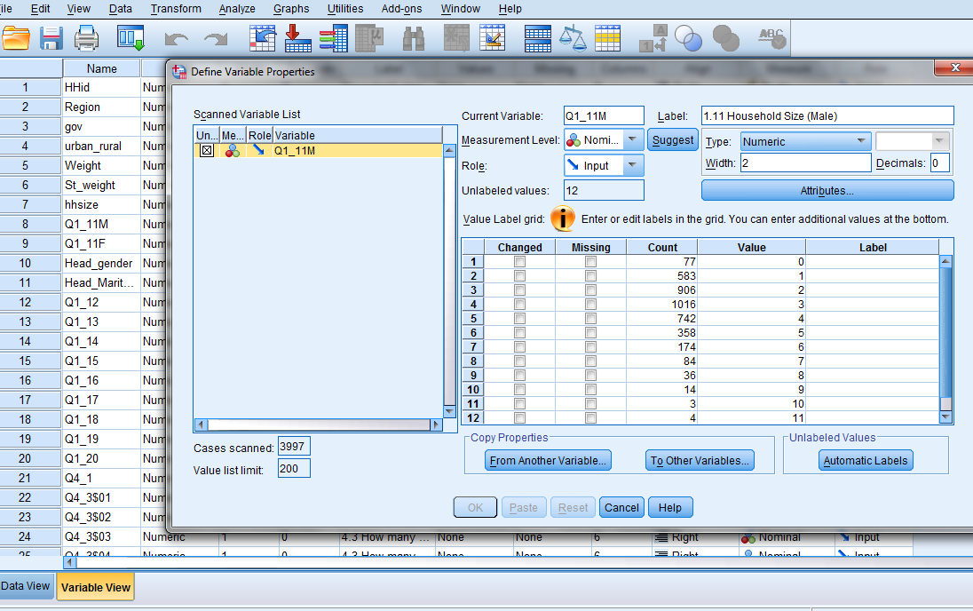
Define Variable Properties

Slide 14
Can we do some cleaning now?

Slide 15
Go to Variable View
Check the name of the Variables
What can be used as a reference for cleaning?
Check the Values, see if these are expected?
Sort Resident status, Gender, urban_rural
Check Income of HH head Variables, make a histogram
Missing values, how can you define them?
  Using Variable Properties
  Using ‘Missing Tab’

Slide 16
Type of variables
We work with two types of variables
Continuous
(Scale)
Categorical
Interval
ex. Age 1 to n
Nominal
The categories are not ranked ex. 1=female, 2=male
Ratio
ex. Percentage of expenditure 0% to 100%
Ordinal
The categories are ranked
ex. 1=poor, 2=medium, 3= good

Slide 17
Type of variables
 | Type of variables
 | Quantitative | Qualitative
 |  | Ordinal | Nominal
Do arithmetic operations on values make sense? | Yes | No | No
Are values ordered? | Yes | Yes | No
Types of values | Numeric | Alphanumeric codes | Alphanumeric codes

Slide 18
Descriptive statistics
Continuous
Categorical
  Range
  Mean
  Median
  Mode
  Frequencies
  Crosstabs

Slide 19
Break

Slide 20
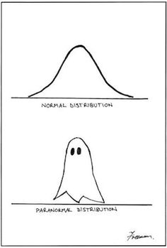
Variables
Create new variables
  Recode
  Count
  Compute
  Rank cases (quintiles)
  Aggregate

Slide 21
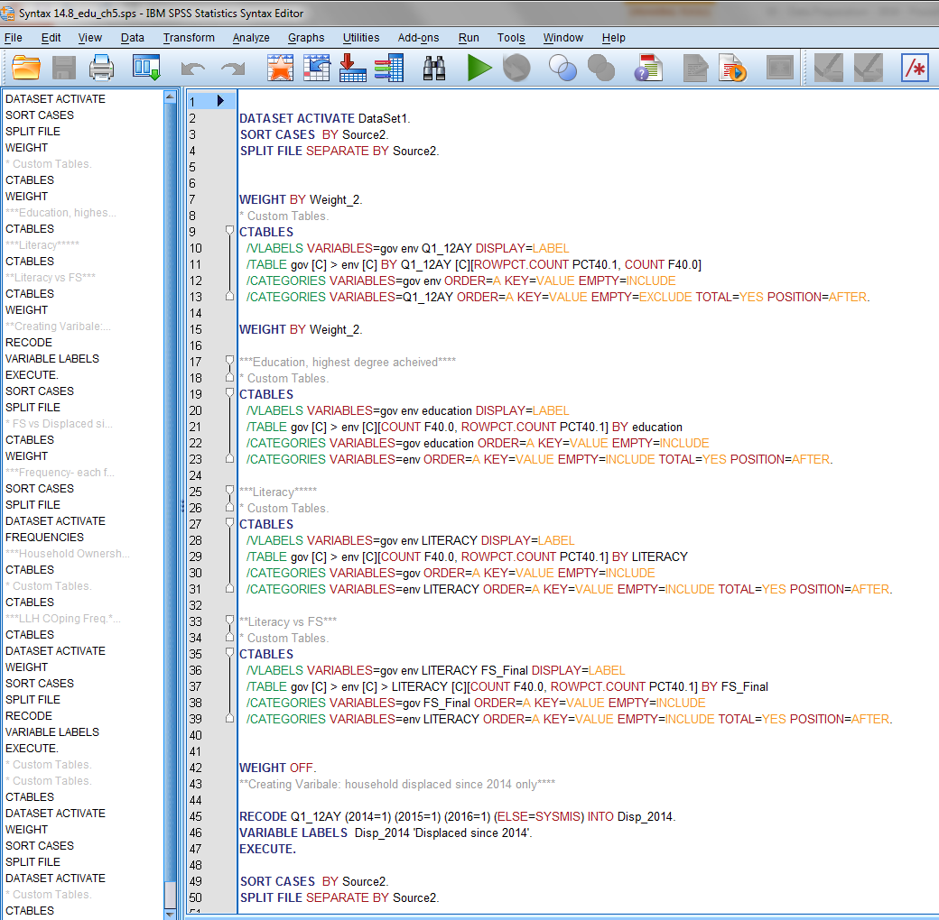
Using Syntax
What is Syntax?
Keep this in mind, and observe how we build Syntax.
Syntax is a very important part of keeping record of analysis steps.

Slide 22
Create new variables using recode
Recoding a variable is most commonly used to take a categorical variable and to re-categorize it’s values.
For example – source of drinking water is a standard question in household surveys with several options that are adapted for the local context.
When describing water sources in analysis, we usually will compare improved vs. unimproved water sources
In the example on the right, the top box represents a module in the household questionnaire and the bottom box represents the categorization of improved vs. unimproved water sources. If we want to recode the question responses into a bi-variate variable, how do we do so in SPSS?
1 = General Network
6 = Well (covered)
5 = Well (uncovered)
4 = Water tanker
3 = Bottle water
2 = Tap water
1.16 What is the main source of drinking water for your household?
Code:
7 = Lake
8 = Covered spring
9 = Uncovered spring
10 = RO
11 = Kahriz
12 = Stream, river
Improved source | Unimproved source
List improved sources | List unimproved sources

Slide 23
Transform a new variable using count
Steps:
Identify the variables first
Check variable properties
Go to ‘Transform’
Select ‘Count Values Within Cases’
What should be your ‘Target Variable’?
Put Label
Select variables
Define Values
Paste?
Q. 8.4/ 8.5/ 8.6 No. of Income Sources What is your first/ second and third main income source? We would like to see How many households have single income source, 2 income sources and 3 or more income sources.

Slide 24
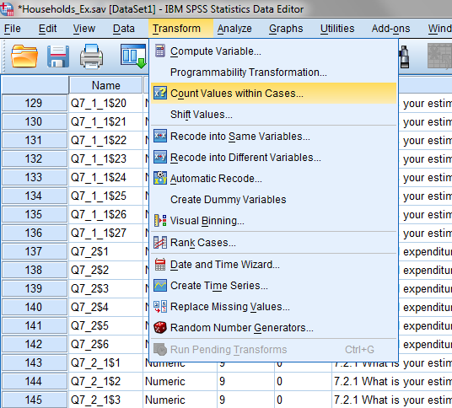
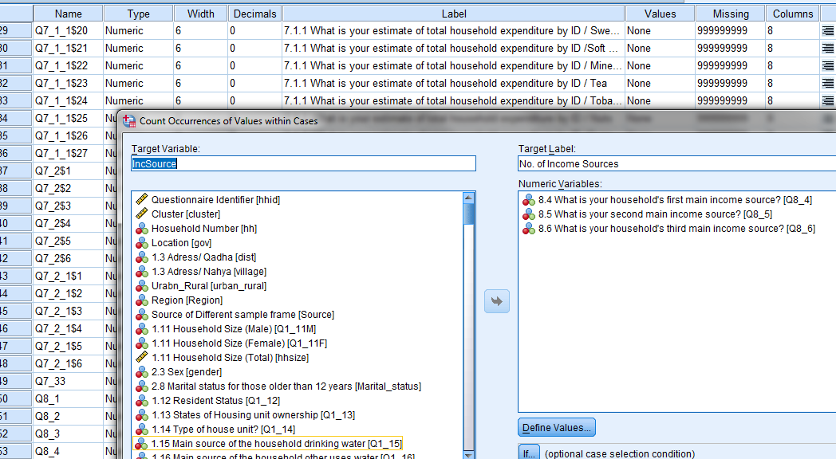
Select ‘Transform’
Select \Count Values within Cases’
1
2
3
4 define values

Slide 25
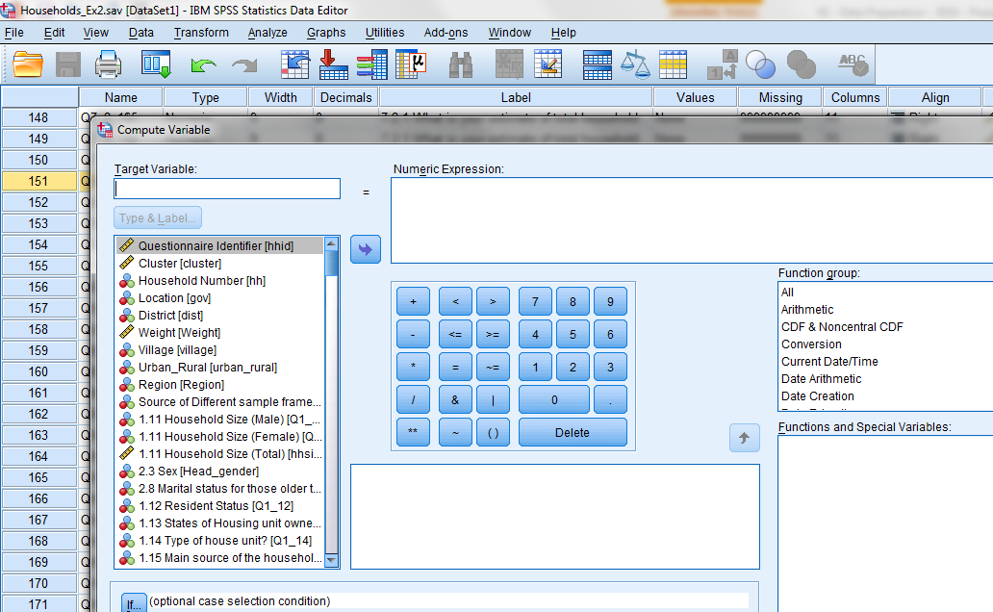
Compute: Total HH Income
Identify the variables you need to use to make a total
Compute by using _____________?

Slide 26
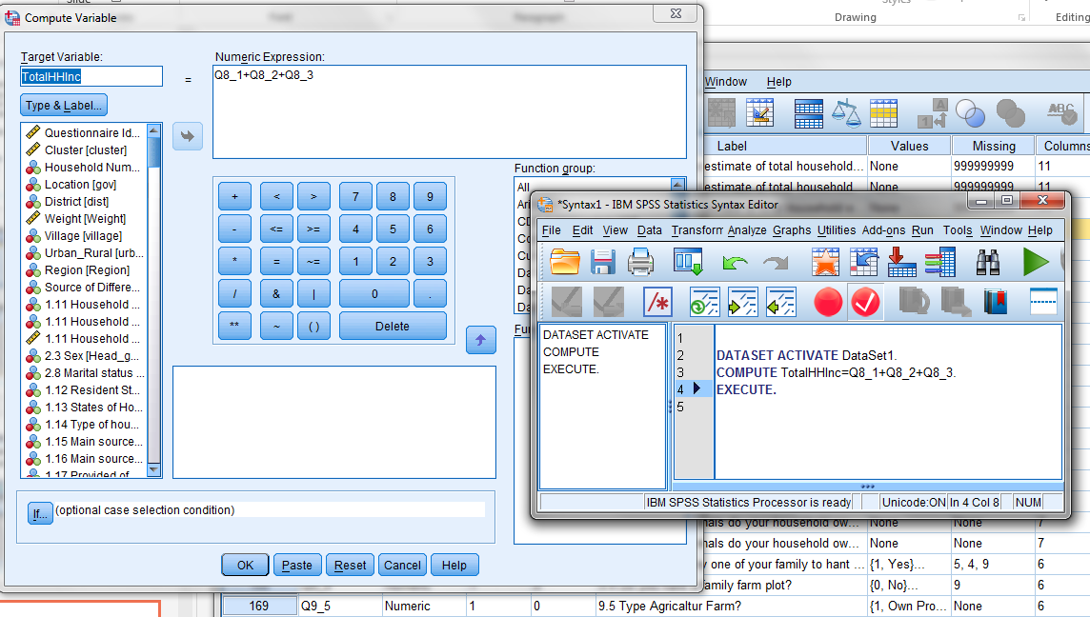
Compute: Total HH Income (cont.)

Slide 27
Can you COMPUTE % of HH income by Female only?

Slide 28
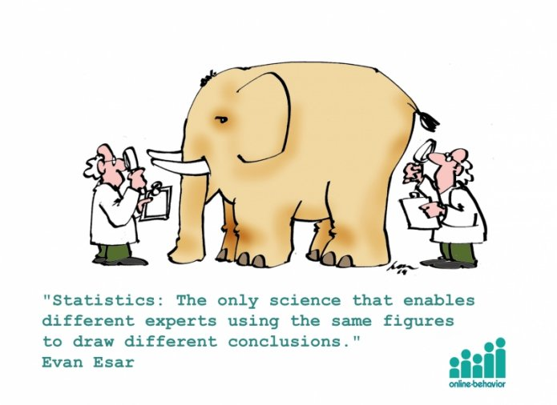
Best practices
Using syntax
Keep copies of files/outputs
Keep the survey questionnaire handy at all time
Check the version of the software, sometime few option varies in different versions (e.g. Merging)
[Add More]

