Slide 1
Descriptive statistics in SPSS
4-8 December 2016, Cairo

Slide 2
Outline / GETTING to know our data
Descriptive statistics
Frequency (and histograms)
Cross tabs
Multiple response contingency table

Slide 3
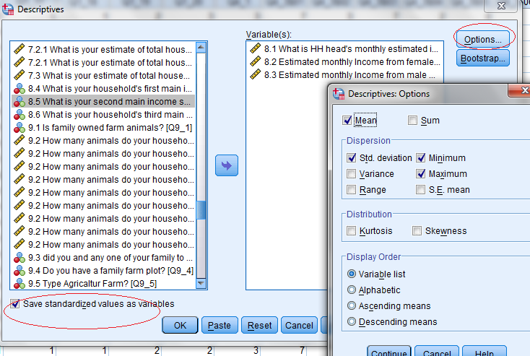
Analyse –> Descriptive Statistics ->Descriptives
useful for quick look at continuous variables
Notes:
No Median
Save stand. values -

Slide 4
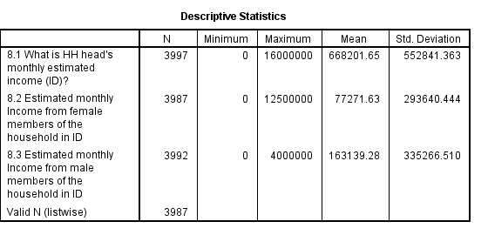
Analyse –> Descriptive Statistics ->Descriptives
Limited number of statistics (Missing median)
Quick and easy to use
Notes:
Save stand. Values –

Slide 5
Analyse –> Descriptive Statistics ->Descriptives
Syntax:
DESCRIPTIVES VARIABLES=hhsize Q8_3 Q8_2 Q8_1
/STATISTICS=MEAN STDDEV MIN MAX.

Slide 6
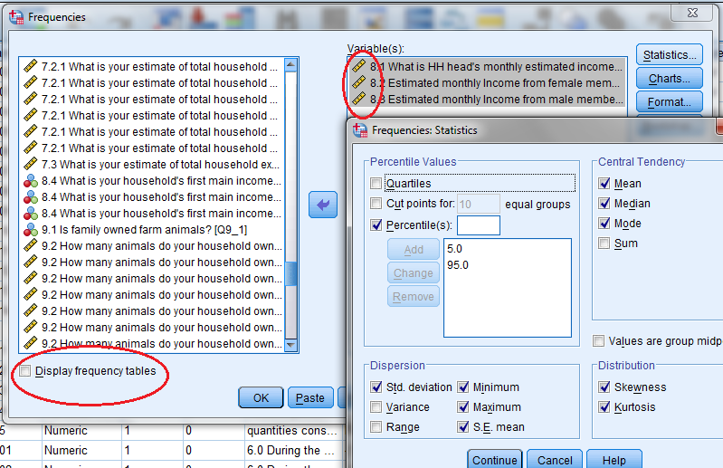
Analyse –> Descriptive Statistics -> Frequencies
Continuous variables – REMOVE ‘Display frequency table’
Notes:
Can use with CONTINUOUSE/scale variables, but uncheck the frequency table!!

Slide 7
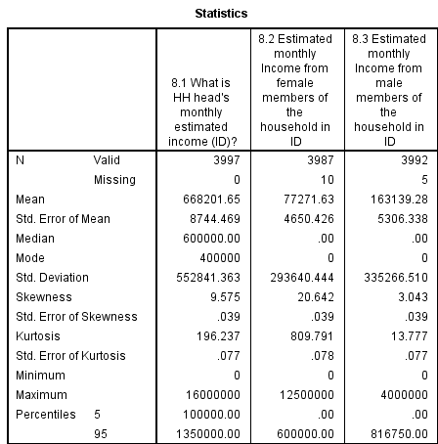
Analyse –> Descriptive Statistics -> Frequencies
Continuous variables

Slide 8
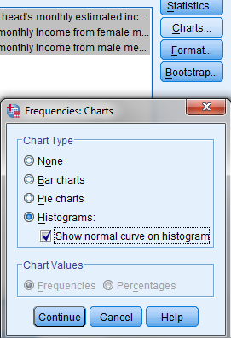
Analyse –> Descriptive Statistics -> Frequencies
Charts – a useful option for looking at our date
Notes:
Look at the histogram w normal dis

Slide 9
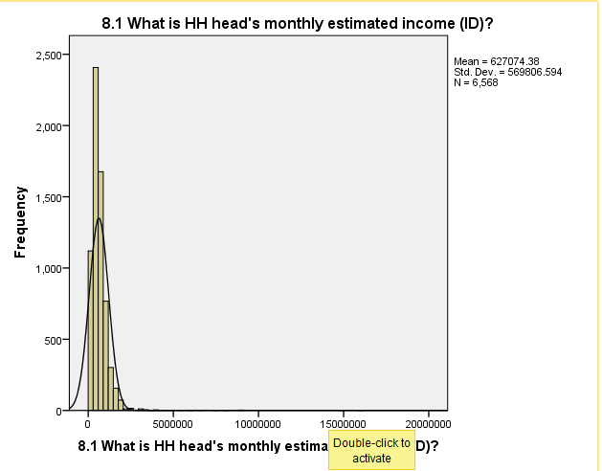
Analyse –> Descriptive Statistics -> Frequencies
Histogram, with normal curve
Notes:
Double click allows adjusting graph
See immediately that we have outliers, and skewed: right or left tail?
Median might be more robust in this case.

Slide 10

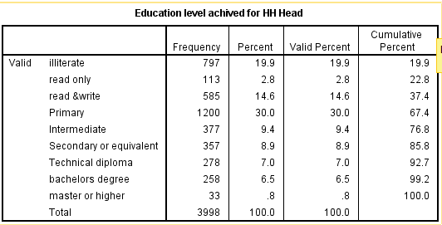
Analyse –> Descriptive Statistics -> Frequencies
Categorical variable - > ADD FREQUENCY TABLE:
Notes:
Difference between valid percent and percent. When do you use which one? Cumulative?
(old dataset)

Slide 11
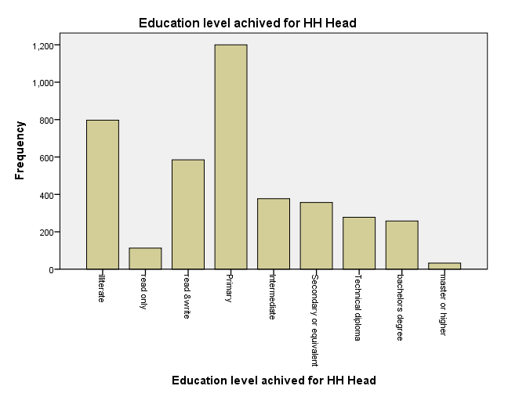
Analyse –> Descriptive Statistics -> Frequencies
Notes:
Bar chart – immediately see largest groups. Many small groups, can we recategorize into fewer groups? Higher education?

Slide 12
Analyse –> Descriptive Statistics -> Frequencies
Syntax:
FREQUENCIES VARIABLES=Q8_1 Q8_2 Q8_3
/PERCENTILES=5.0 95.0
/STATISTICS=STDDEV MINIMUM MAXIMUM MEAN MEDIAN MODE
/HISTOGRAM NORMAL
/ORDER=ANALYSIS.
FREQUENCIES VARIABLES=Education_HHHead
/BARCHART FREQ
/ORDER=ANALYSIS.

Slide 13
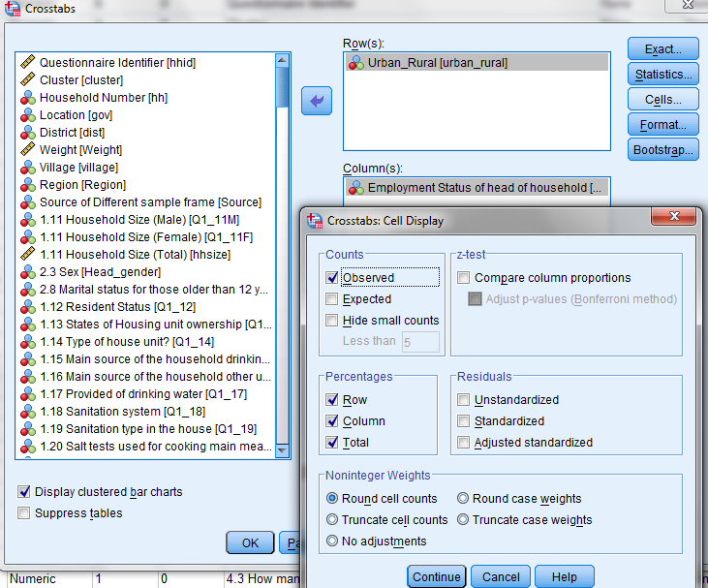
Analyse –> Descriptive Statistics -> Cross tab

Slide 14
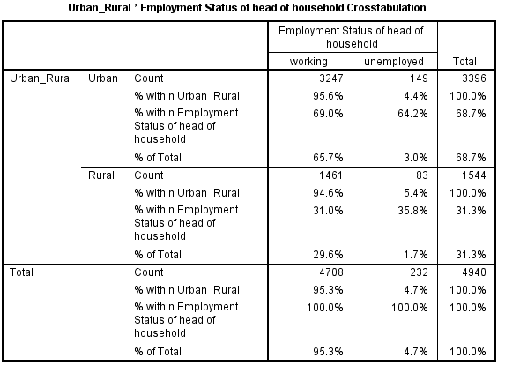
Analyse –> Descriptive Statistics -> Cross tab

Slide 15
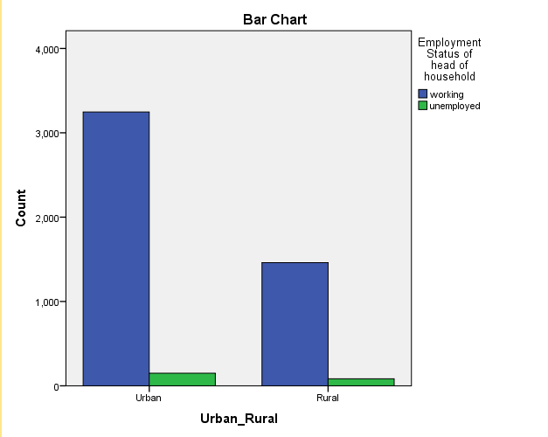
Analyse –> Descriptive Statistics -> Cross tab
Notes:
Bar chart

Slide 16
Analyse –> Descriptive Statistics -> Cross tab
Syntax:
CROSSTABS
/TABLES=urban_rural BY Head_Emp_status
/FORMAT=AVALUE TABLES
/CELLS=COUNT ROW COLUMN TOTAL
/COUNT ROUND CELL
/BARCHART.

Slide 17
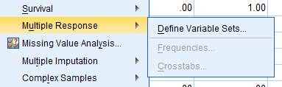
Multiple response analysis
Sometimes we have to analyze categorical data, when households are able to give more than one response to a question (ex. livelihoods, coping strategies)
Analyzing such data requires a multiple response analysis
Analyse –> Multiple response -> Define Variable set

Slide 18
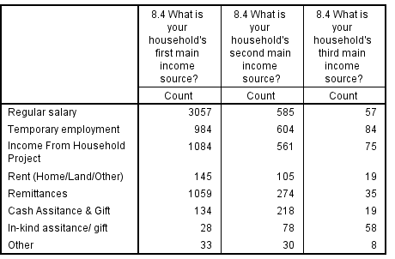
Multiple response question
The household reports the three main income sources, as shown in table below
How can we estimate the % of households by income activity in SPSS?
6568 HH in total
9334 income sources reported
Notes:
Other data

Slide 19
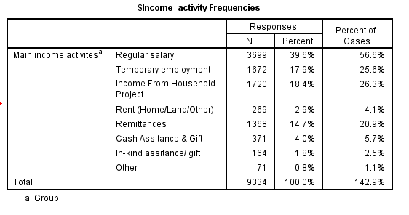
Multiple response analysis: frequencies
Notes:
OLD dataset

Slide 20
Multiple response analysis: frequencies
N is the number of households that reported income source. In our example, each household can report up to 3 types of income. This figures is therefore higher than the total number of households in the survey.
The Percent column reports the percentage for each income source over the total responses N (9334).
The Percent of Cases is the percentage for each income source over the total cases in the survey (6568).

Slide 21
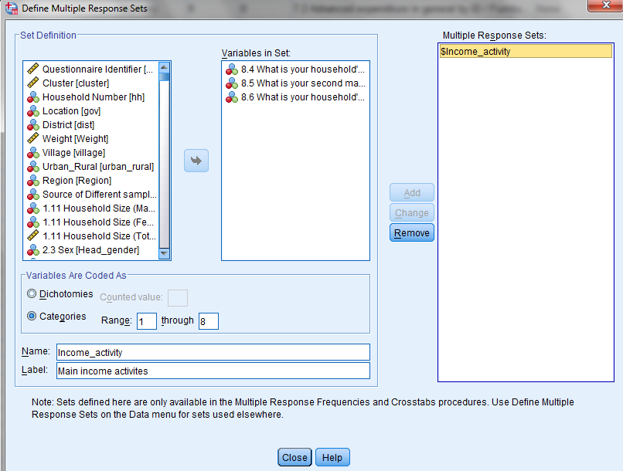
Analyse –> Multiple response -> Define..
STEP 1: Define the multiple response set – decide on which variables to include

Slide 22
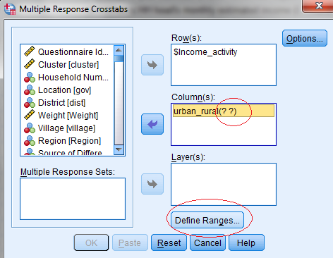
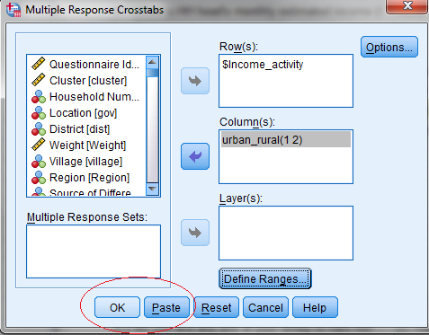
Analyse –> Multiple response -> Crosstabs
Step 2: Choose Frequency or Crosstabs analysis
Ex: Crosstabs
Notes:
Using the MRD

Slide 23
Syntax
Define dataset and run frequencies:
  MULT RESPONSE GROUPS=$Income_source (q8_4 q8_5 q8_6 (1,9))
  /FREQUENCIES=$Income_source
Define dataset and run crosstab
  MULT RESPONSE GROUPS=$Income_activity 'Main income activites' (Q8_4 Q8_5 Q8_6 (1,8))
  /VARIABLES=urban_rural(1 2)
  /TABLES=$Income_activity BY urban_rural
  /CELLS=ROW
  /BASE=CASES.

Slide 24
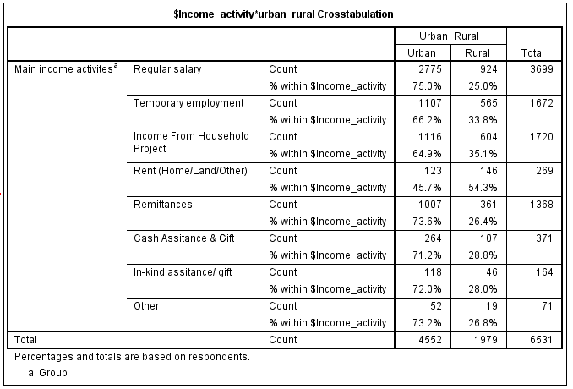
Multiple response – Step 2: Crosstabs
Notes:
Other data

Slide 25
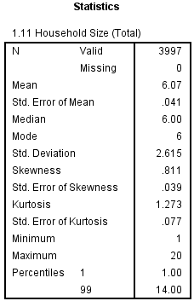
Exercise 1
Replicate the table
Use the information to describe the distribution of the variable.

Slide 26
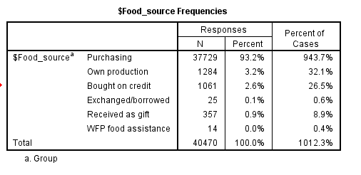
Exercise 2
Replicate the table below (4.4 What is the main source of food)?
Notes:
If time allow, compare results with different weights.

Slide 27
Thank you!

