Slide 1
Recap Basic Statistical Concepts
4th - 8th December 2016, RBC

Slide 2

Statistics

Slide 3
Descriptive stats or Univariate Stats
Central Tendency Measures
  Mean
  Median
  Mode
  SD
Question to Lyubomyr…? How far is Anastahseia ? How far is James? How far am I ?

Slide 4

Descriptive stats or Univariate Stats
Central Tendency Measures
  Mean (Average Value)
Subject ID | 1 | 2 | 3 | 4 | 5 | 6 | 7 | 8 | 9 | 10
Number of Siblings | 3 | 2 | 2 | 1 | 3 | 6 | 3 | 3 | 4 | 2
Mean is 2.9

Slide 5
Descriptive stats or Univariate Stats
Central Tendency Measures
  Median (Middle point among the ranked cases)
Subject ID | 1 | 2 | 3 | 4 | 5 | 6 | 7 | 8 | 9 | 10
Number of Siblings | 3 | 2 | 2 | 1 | 3 | 6 | 3 | 3 | 4 | 2
Subject ID | 1 | 2 | 3 | 4 | 5 | 6 | 7 | 8 | 9 | 10
Number of Siblings (Ranked) | 1 | 2 | 2 | 2 | 3 | 3 | 3 | 3 | 4 | 6
Median is 3

Slide 6
Descriptive stats or Univariate Stats
Central Tendency Measures
  Mode (Most frequent value among the distribution)
Subject ID | 1 | 2 | 3 | 4 | 5 | 6 | 7 | 8 | 9 | 10
Number of Siblings | 3 | 2 | 2 | 1 | 3 | 6 | 3 | 3 | 4 | 2
Number of Siblings | Frequency
1 | 1
2 | 3
3 | 4
4 | 1
6 | 1
Mode is 3

Slide 7
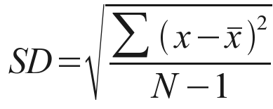
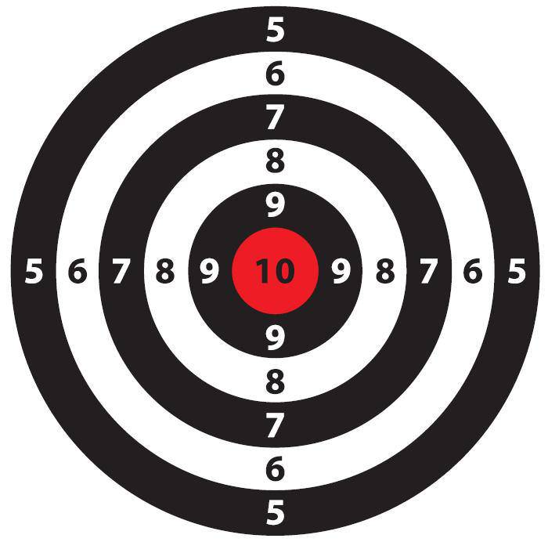
Descriptive stats or Univariate Stats
Central Tendency Measures
  SD (Location From Center)
  The standard deviation is the average error between the mean and the observations made (and so is a measure of how well the mean describes the actual data).
Subject ID | 1 | 2 | 3 | 4 | 5 | 6 | 7 | 8 | 9 | 10
Number of Siblings | 3 | 2 | 2 | 1 | 3 | 6 | 3 | 3 | 4 | 2
SD is 1.37

Slide 8
Descriptive stats or Univariate Stats
Central Tendency Measures
Subject ID | 1 | 2 | 3 | 4 | 5 | 6 | 7 | 8 | 9 | 10
Number of Siblings | 3 | 2 | 2 | 1 | 3 | 6 | 3 | 3 | 4 | 2
Mean is 2.9
Median is 3
Mode is 3
SD is 1.37

Slide 9
Distributions
Normal Distribution
Distribution Anomalies
Skewness
Outliers

Slide 10
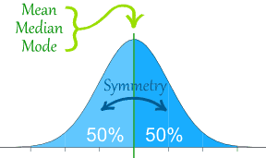
Distributions
Normal Distribution (Symmetry on the both sides of the central point)

Slide 11
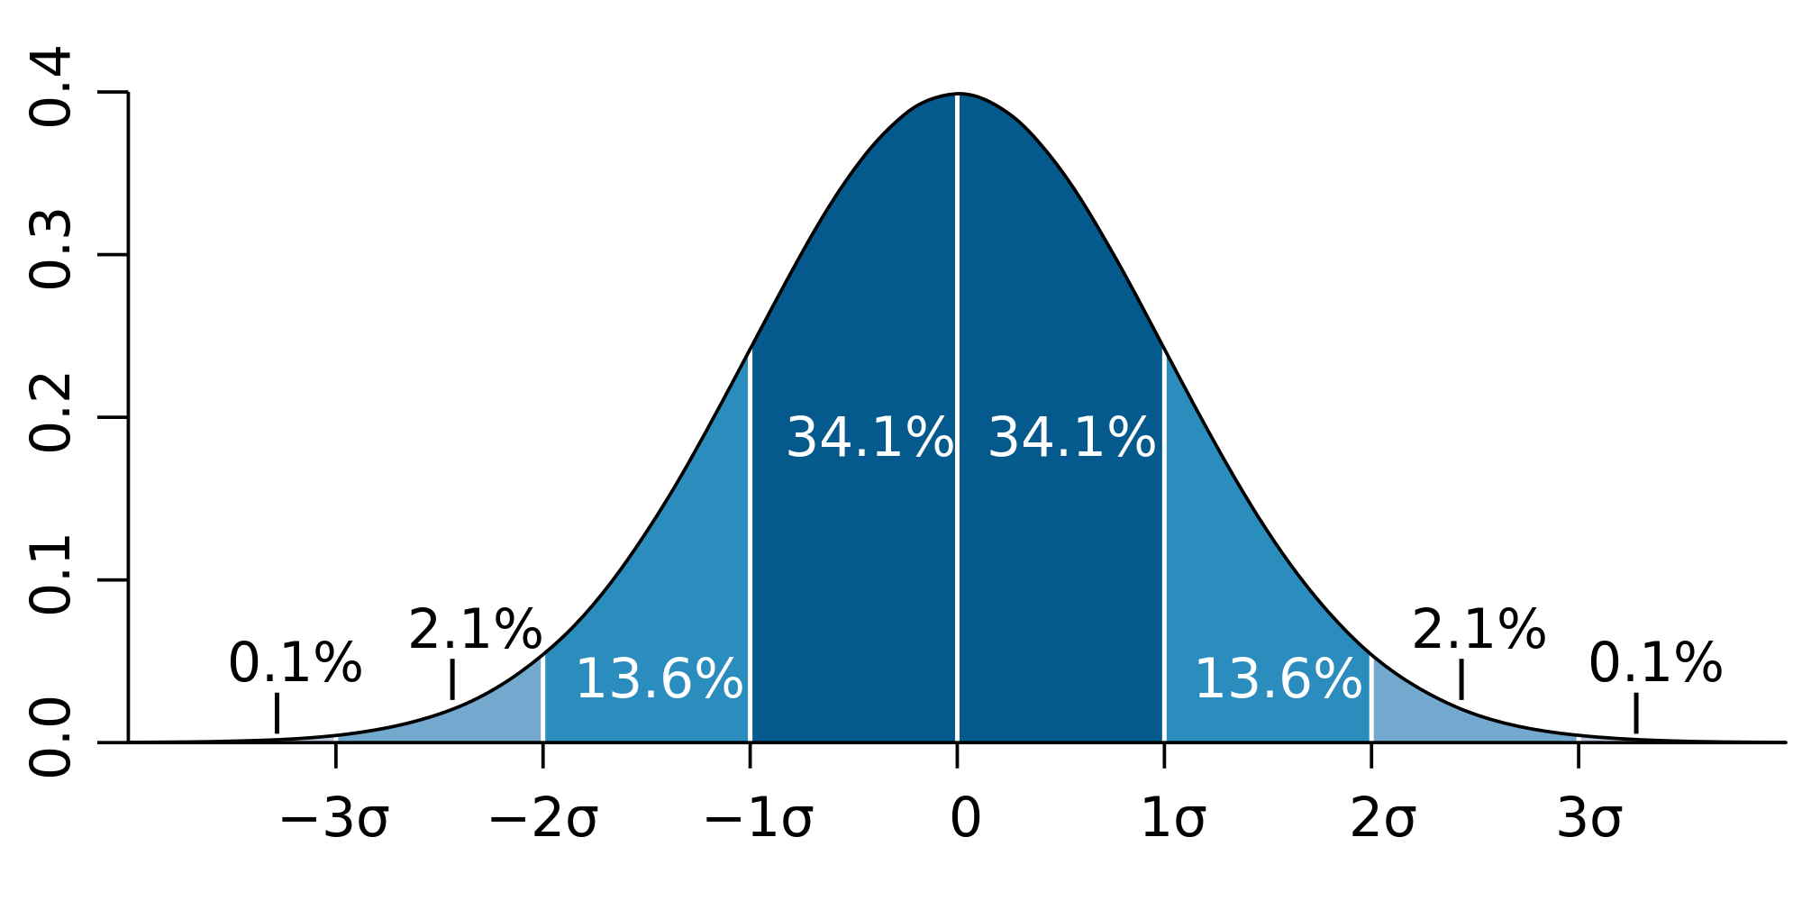
Distributions
Normal Distribution (Symmetry on the both sides of the central point)
95.4%
68.2%
x̅
99.7%

Slide 12
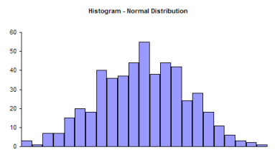
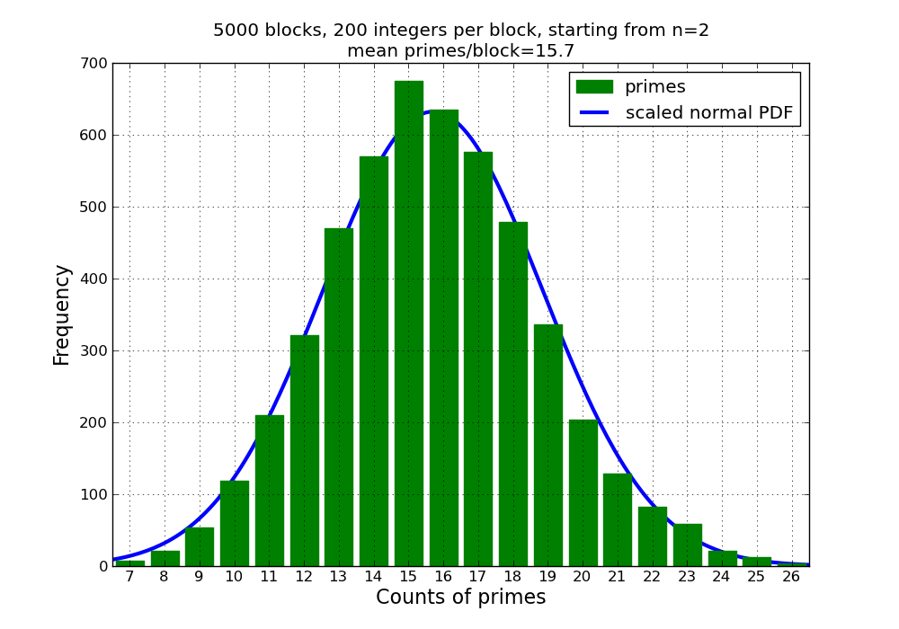
Distributions
Normal Distribution (Symmetry on the both sides of the central point)

Slide 13
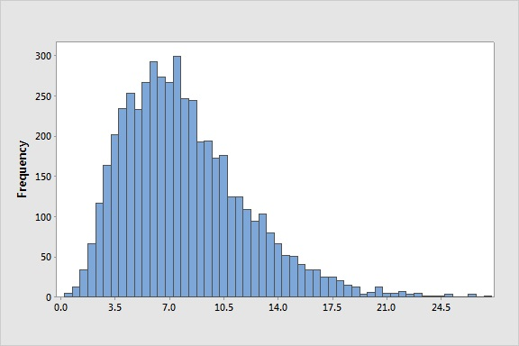
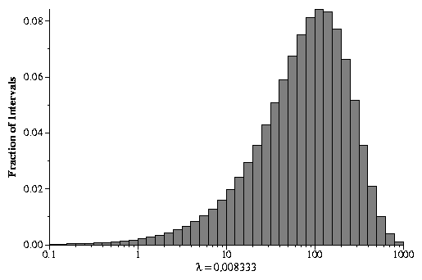
Distributions
Distribution Anomalies
  Skewness
  Outliers
Skewed to the right: a tail extends out to the right.
Skewed to the left: a tail extends out to the left.

Slide 14
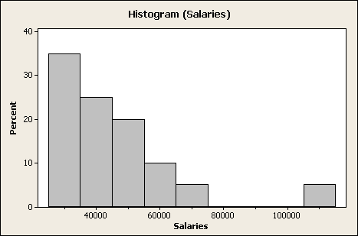
Distributions
Distribution Anomalies
  Outliers (Histogram)

Slide 15
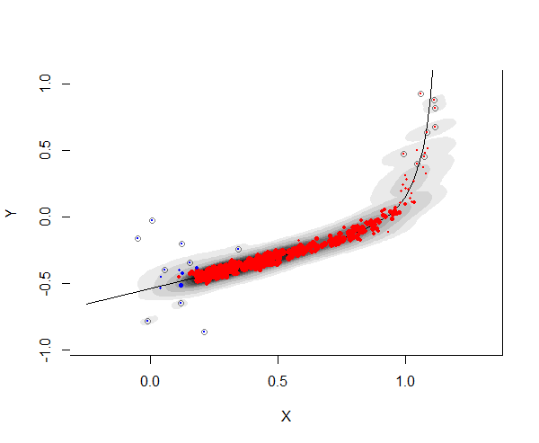
Distributions
Distribution Anomalies
  Outliers (Scatterplot)

Slide 16
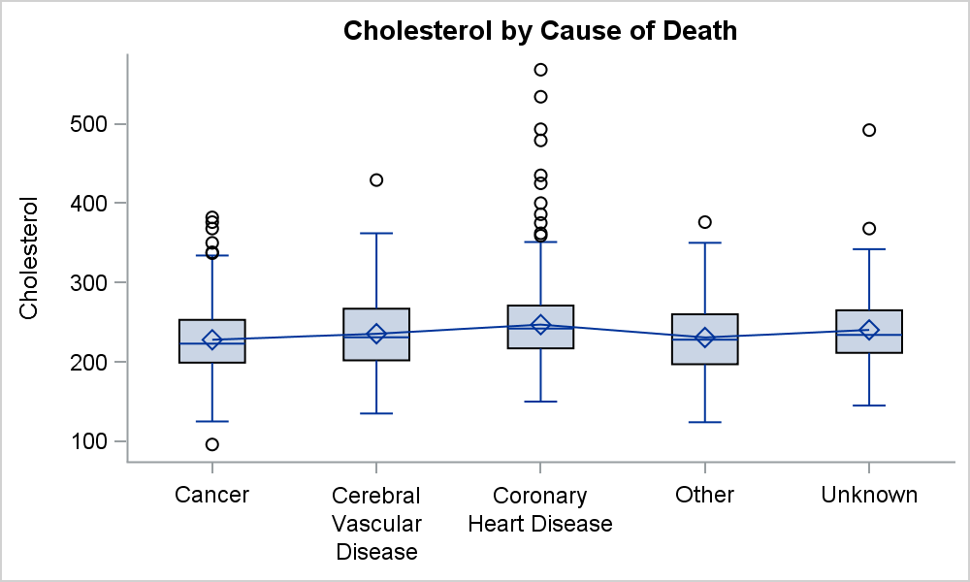
Distributions
Distribution Anomalies
  Outliers (Boxplot / Box and Whisker Diagram)

Slide 17
Lets do one histogram…

Slide 18
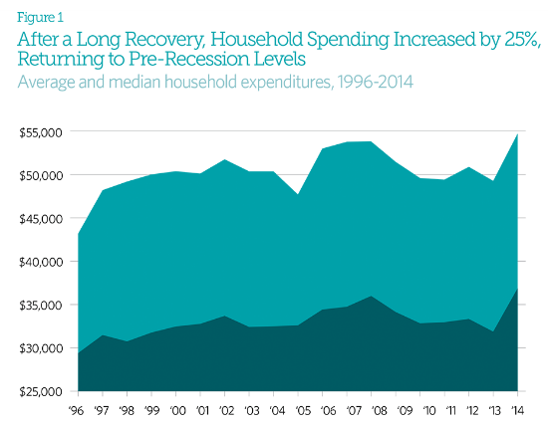



Mean Value
Median Value

Slide 19
Resources
http://www.mathsisfun.com/data/index.html
http://blogs.psy.gla.ac.uk/stats/
http://www.davidmlane.com/hyperstat/probability.html
http://www.ats.ucla.edu/stat/spss/

