Slide 1
Recap Statistical Tests
4th - 8th December 2016, RBC

Slide 2

Statistical Analysis

Slide 3
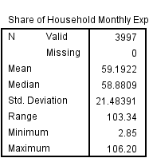
Variables
Continuous or numerical (age, income, expenditure…etc)

Slide 4
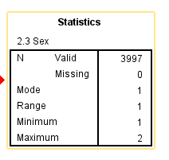
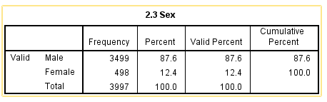
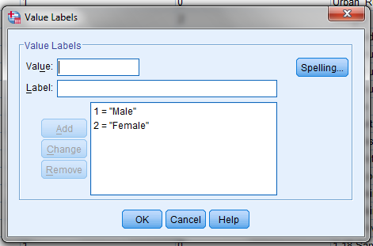
Variables
Dichotomous or Binary or Dummy or two categories categorical variable (Either 0 or 1, 1 or 2 , yes or no): Ex (Sex..)

Slide 5
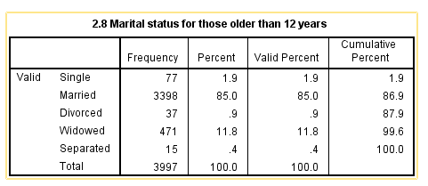
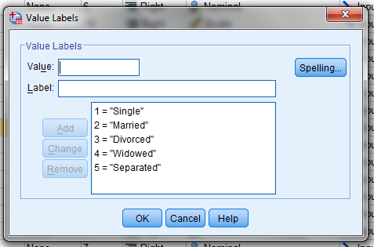
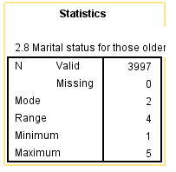
Variables
Categorical variable (can take on one of a limited, and usually fixed, number of possible values) (we care here about more than 2 categories)

Slide 6
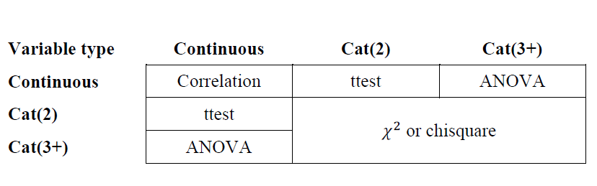
Bivariate Statistical Matrix

Slide 7
Confidence interval
We want to use the sample mean as an estimate of the population mean, but we know each sample mean would be different.
We use the SE to calculate boundaries within which we believe the true mean will fall
95 % of the time, the true estimate (mean?) will fall within these limits
If the CI is small, the sample mean must be very close to the true mean.
Notes:
If we take 100 samples, 95 of the constructed CI’s will contain the true mean

Slide 8
Significant test statistic ( P value)
Is the test statistics result is due to chance?
This probability is referred to as p-value or significance level (sig.) and is expressed a decimal percent (ie. p=0.05)
Non-significant results
  If p > 0.05 we consider the results is not statistically significant.
  It is significant if p <0.05
Notes:
The test statistics has known properties, so we know how frequently different values occur. That allows is to establish how likely it is to obtain a ts of a certain size if there were no effect (if the null hypothesis was true).
Why 0.05? Fishers criterion
Probabilistic reasoning – if the null hypothesis is correct, the this test statistics is highly unlikely
(the H0 can never be true)

Slide 9
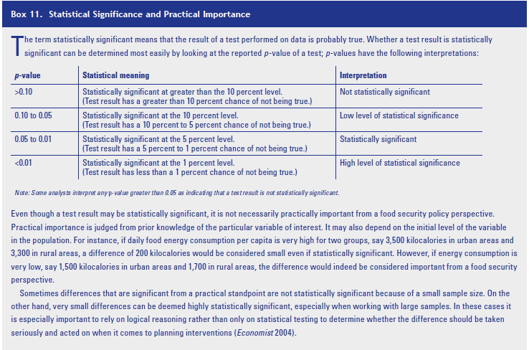
Statistical significance

Slide 10
Is there a statistically significant association between two variables?
How earns more? Young or old people?
How to know?
Lets try HH expenditure share on food & HHsize

Slide 11
Bivariate Statistical Matrix

Slide 12
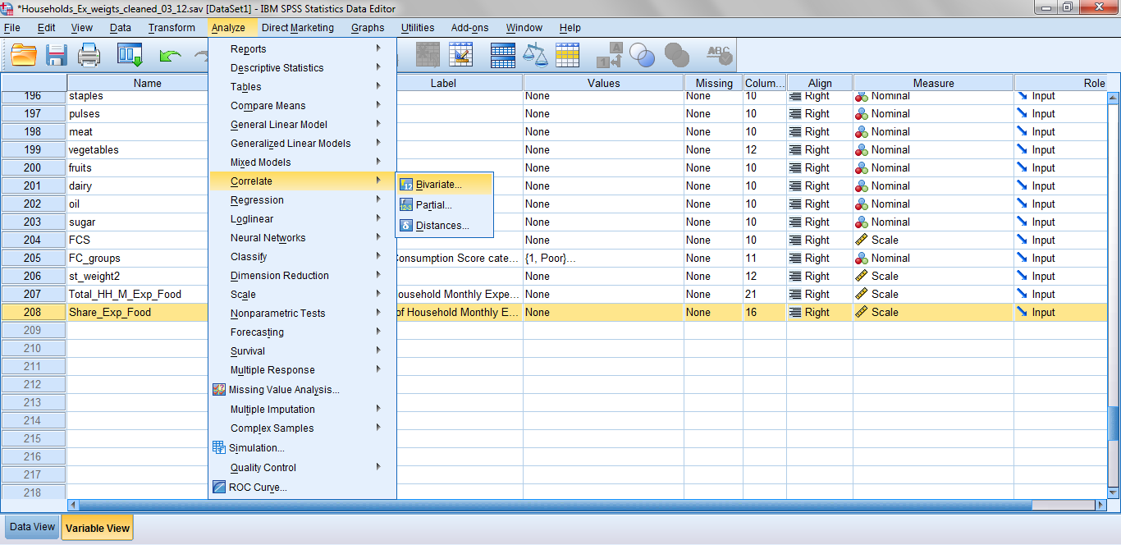
Correlation
Is there a statistically significant association between numerical (continuous) variables?
Ex: HH expenditure share on food & HHsize
Analyze => Correlate => Bivariate

Slide 13
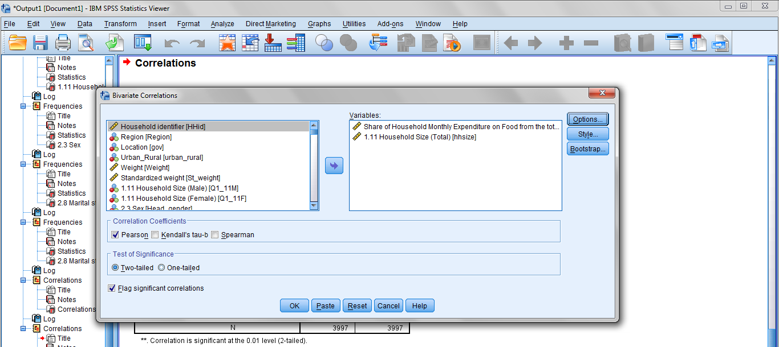
Correlation
Is there a statistically significant association between numerical (continuous) variables?
Ex: HH expenditure share on food & HHsize
Analyze => Correlate => Bivariate

Slide 14
Correlation
What to look at ?
1- Correlations Coefficient - r
In a range from -1 to +1 (Direction) moving in the same direction or opposite direction.
r= 0.2 (weak + association or correlation)
r= - 0.8 (strong - association or correlation)
2- P < 0.05 (significance cutoff point)
3- Interpretation
The variables are significantly associated (or behaving together ) either at the same direction or in opposite direction. NO CAUSALITY.. ! No one makes the other to happen..!

Slide 15
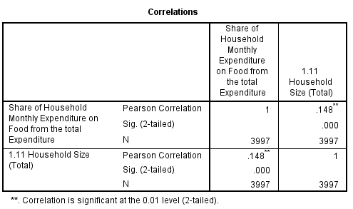
Correlation SPSS Output
Is there a statistically significant association between numerical (continuous) variables?
Ex: Age and income
Analyze => Correlate => Bivariate
Correlations Coefficient - r
P < 0.05

Slide 16
Correlation
Syntax
CORRELATIONS
/VARIABLES=Share_Exp_Food hhsize
/PRINT=TWOTAIL NOSIG
/MISSING=PAIRWISE.

Slide 17
Is there a statistically significant association between two variables?
How earns more? Men or Women?
How to know?
Lets try HH expenditure share on food & HH Head Gender

Slide 18
Bivariate Statistical Matrix
Share of expenditure on food (Dependent or test variable)
HH head gender (1 is Male and 2 is Female) / independent or grouping variable)

Slide 19
T-test
The independent t-test compares two means have come from different groups (Males Vs Females)
HH expenditure share on food & HH Head Gender
Click on “Analyze” drop down menu
Click on “Compare Means”
Click on “Independent- Sample T-Test…”
Move the independent or grouping (2Cat variable) and dependent or test (continuous) variable into proper boxes
Define groups
Click “OK”

Slide 20
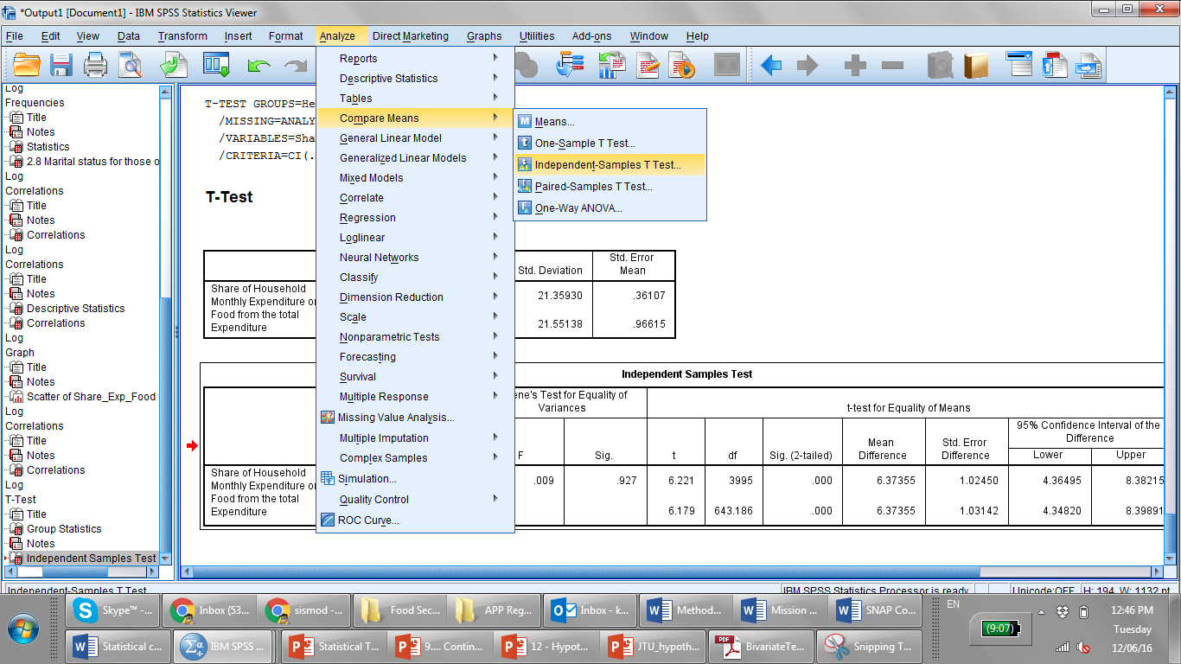
T-test
The independent t-test compares two means have come from different groups (Males Vs Females)
HH expenditure share on food & HH Head Gender

Slide 21
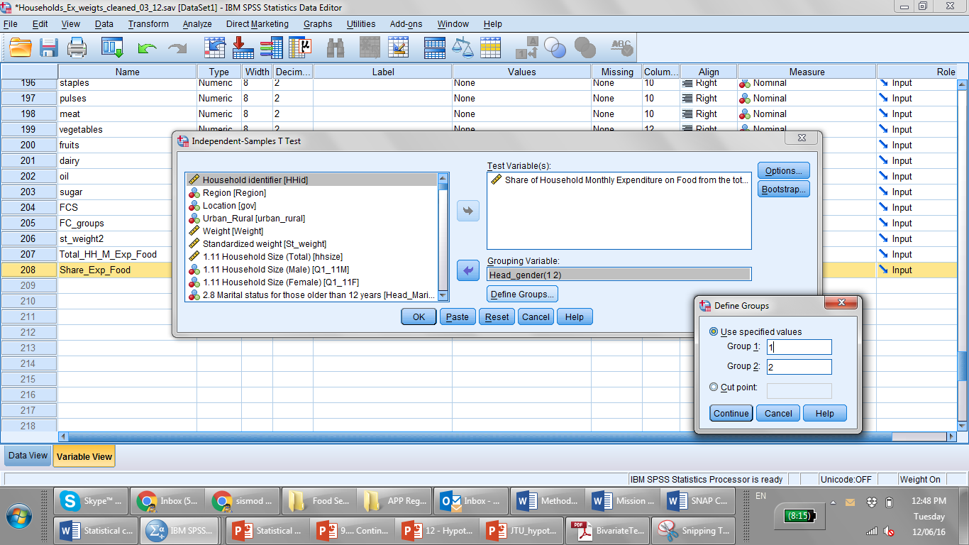
T-test
The independent t-test compares two means have come from different groups (Males Vs Females)
HH expenditure share on food & HH Head Gender

Slide 22
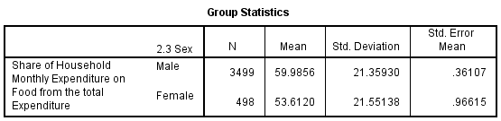
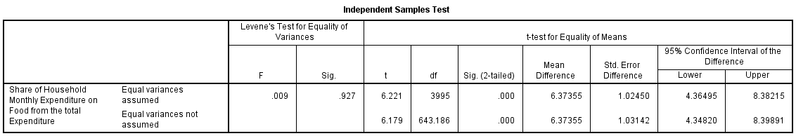
T-test (Output)
HH expenditure share on food & HH Head Gender
If more than 0.05 look
Interpretation: Male headed households spends on food significantly higher than the female headed households by average of 6.3 % of the total HH expenditure.

Slide 23
T-test
Syntax
T-TEST GROUPS=Head_gender(1 2)
/MISSING=ANALYSIS
/VARIABLES=Share_Exp_Food
/CRITERIA=CI(.95).

Slide 24
Bivariate Statistical Matrix
Share of expenditure on food (Dependent or test variable)
Marital Status (1-5 values) / independent or grouping variable)

Slide 25
ANOVA
It is the same concept of T-test of comparing the mean difference of the continuous variable between the groups of
the categorical variables (3+ categorical variables)
In SPSS, one-way ANOVAs are run using the following steps:
Click on “Analyze” drop down menu
Click on “Compare Means”
Click on “One-Way ANOVA…”
Move the independent and dependent variable into proper boxes (dependent variable into Factor box)
Chose ‘Option’ and ‘Post Hoc’ for additional statistics
Click “OK”

Slide 26
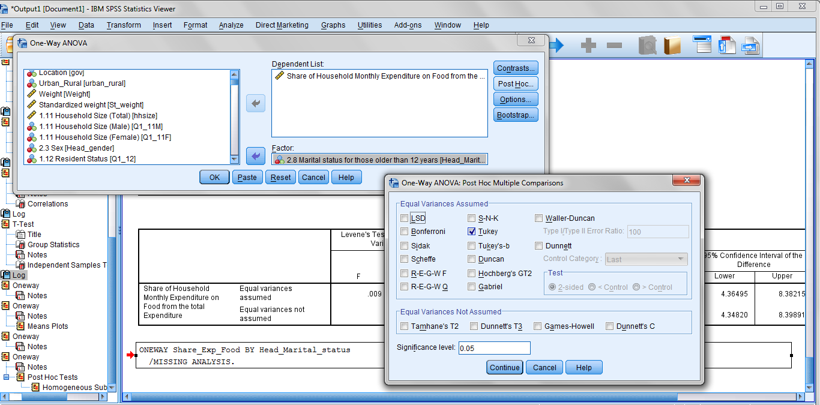
ANOVA
It is the same concept of T-test of comparing the mean difference of the continuous variable bewen the groups of
the categorical variables (3+ categorical variables)

Slide 27
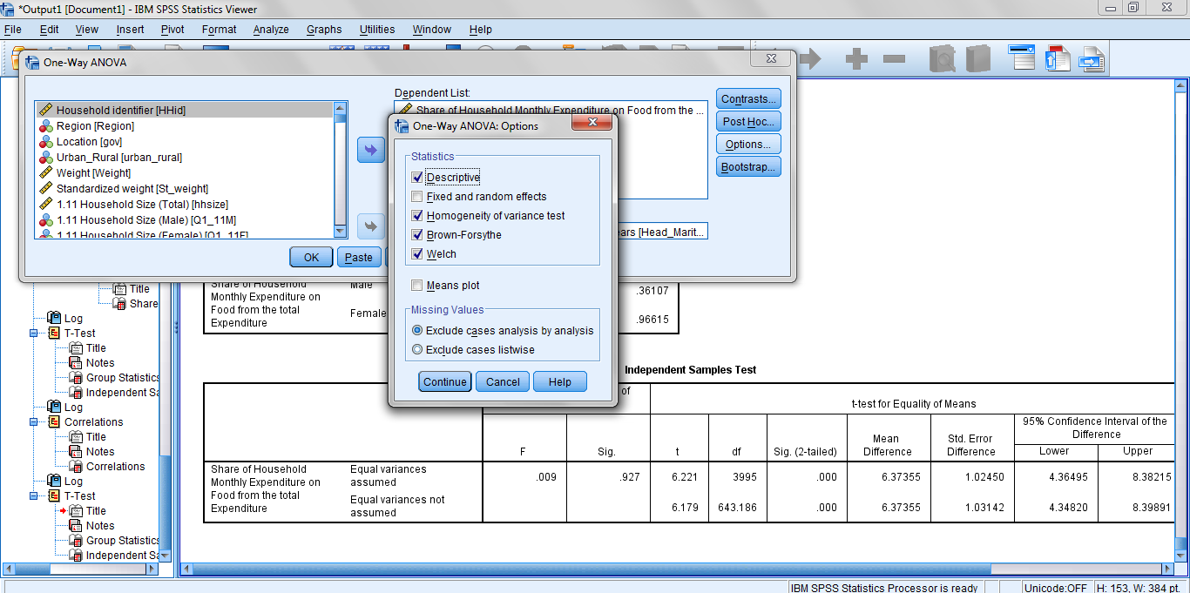
ANOVA
It is the same concept of T-test of comparing the mean difference of the continuous variable between the groups of
the categorical variables (3+ categorical variables)

Slide 28
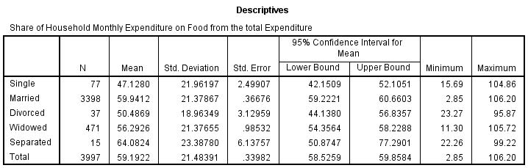
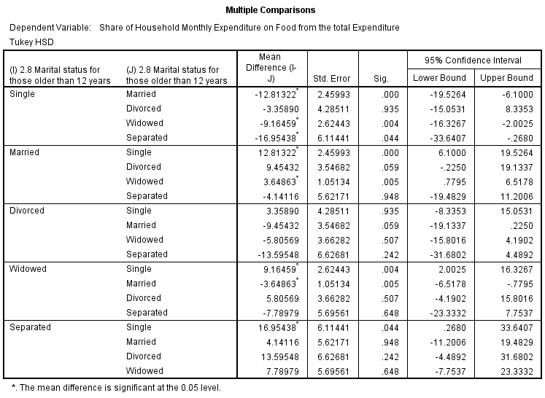
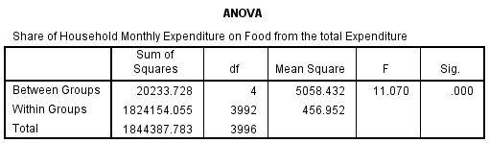
ANOVA SPSS Output
( - )
Reference
Comparison group
=
P <0.05

Slide 29
ANOVA
Syntax
ONEWAY Share_Exp_Food BY Head_Marital_status
/STATISTICS DESCRIPTIVES WELCH
/MISSING ANALYSIS
/POSTHOC=TUKEY ALPHA(0.05).

Slide 30
Bivariate Statistical Matrix
Marital Status (Nominal/ Categorical)
FCS (Nominal/ Categorical)

Slide 31
Chi-square
Chi-square used to analyse the relationship between categorical variables (ex Marital Status and FSC in nominal scale)
Frequencies in each group is used instead of mean.
Chi-square compares the observed frequency among the groups or (categories)
Chi-square calculated from the crosstabs menu
Chi-square is not easy to interpret and report on. So, it is a common practice to recode the categorical into binary variables and use T-test

Slide 32
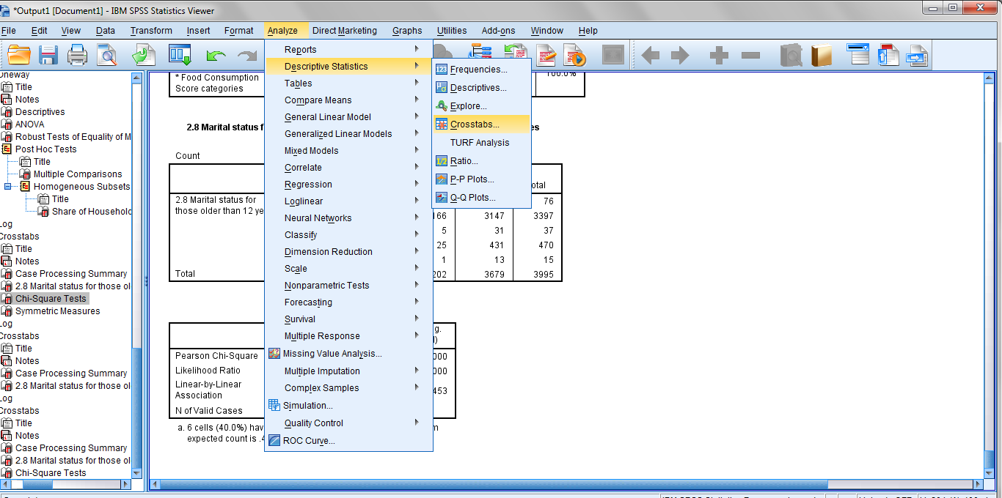
Chi-square

Slide 33
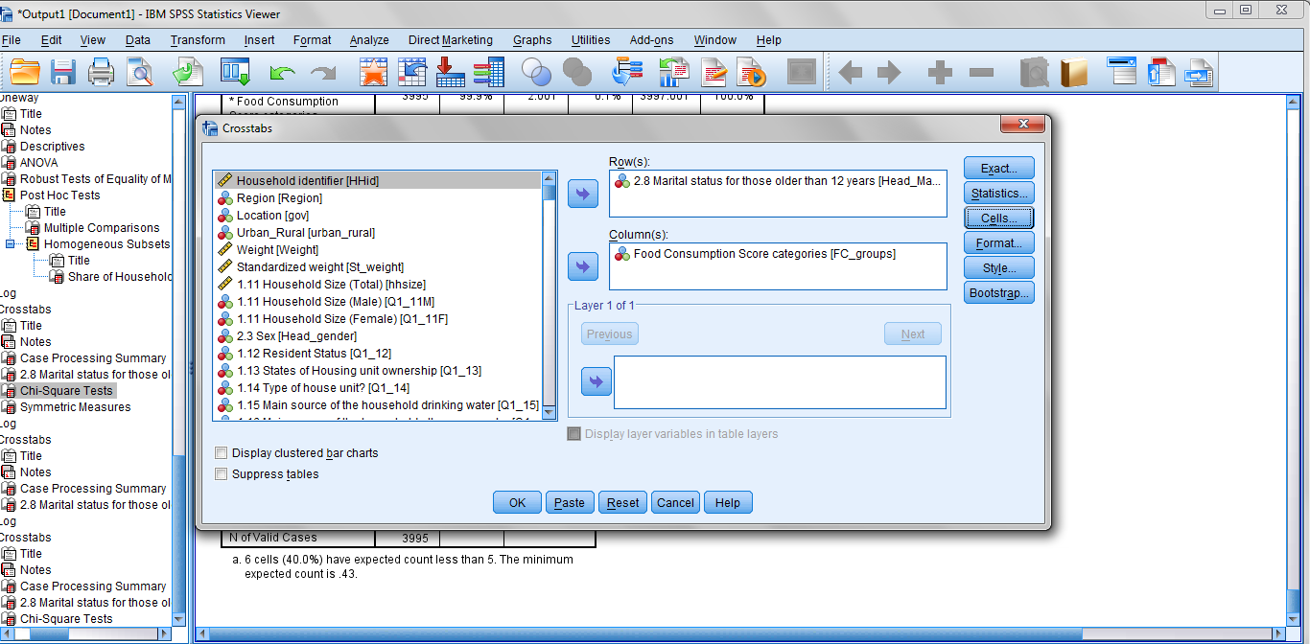
Chi-square

Slide 34
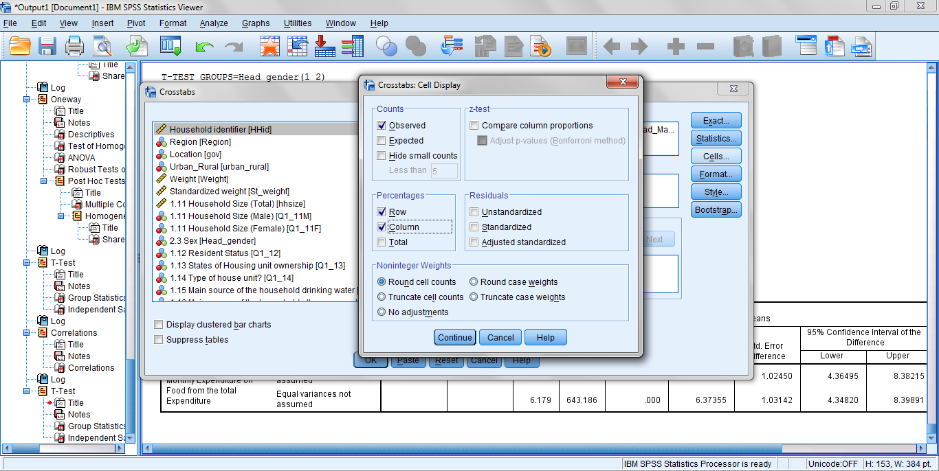
Chi-square

Slide 35
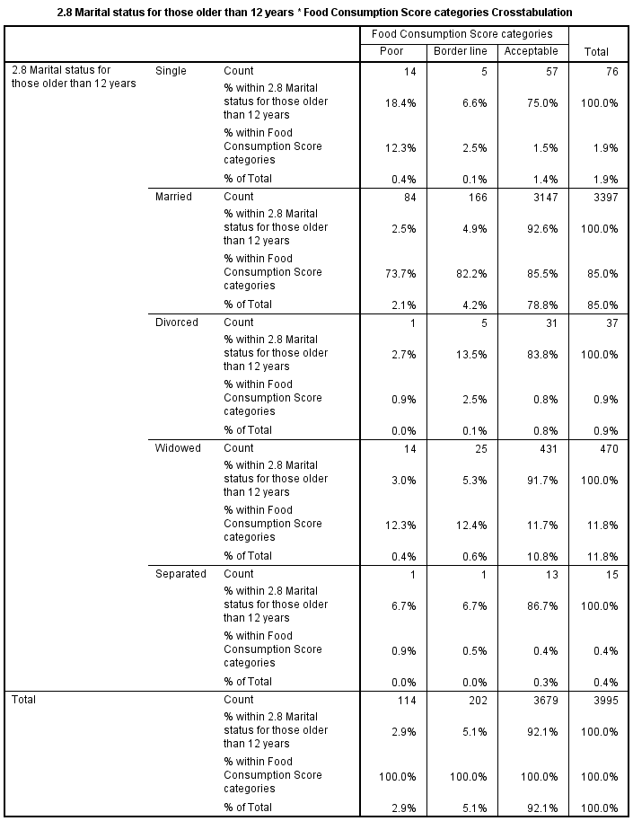
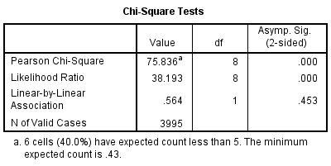
Chi-square Output
P <0.5

Slide 36
Chi-Square
Syntax
CROSSTABS
/TABLES=Head_Marital_status BY FC_groups
/FORMAT=AVALUE TABLES
/STATISTICS=CHISQ
/CELLS=COUNT
/COUNT ROUND CELL.

Slide 37
Regression
Regression analysis is the statistical test used to assess the CAUSALITY .. How variable affect the other.
Regression analysis is the test to be used to say that the variable X induce the variable Y to happen with the magnitude of Z.
We are using a simple linear regression to assess the impact of one independent variable on another dependent variable.
How the HH size impact the FCS or the expenditure on food…?

Slide 38
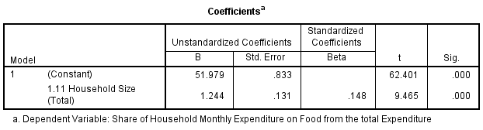
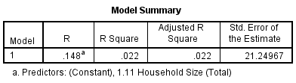
Regression
How the HH size impact the FCS or the expenditure on food…?

Slide 39
Resources
https://statistics.laerd.com/statistical-guides/types-of-variable.php
https://statistics.laerd.com/spss-tutorials/independent-t-test-using-spss-statistics.php
https://statistics.laerd.com/spss-tutorials/pearsons-product-moment-correlation-using-spss-statistics.php
https://statistics.laerd.com/spss-tutorials/one-way-anova-using-spss-statistics-2.php
https://statistics.laerd.com/spss-tutorials/chi-square-test-for-association-using-spss-statistics.php#procedure
http://www.ats.ucla.edu/stat/spss/

