Slide 1
Tabulation in SPSS
4-8 December 2016, Cairo

Slide 2
Customs tables - the CTABLES procedure
A tabulation procedure that combines several other tabulation procedures in SPSS
Part of the TABLES add-on option in SPSS
More flexible than the other tabulation procedures
More complex than the other tabulation procedures
The CTABLES window is found under:
  Analyze
    Tables
      Custom Tables
Notes:
Get the same tables as seen in the previous session.

Slide 3
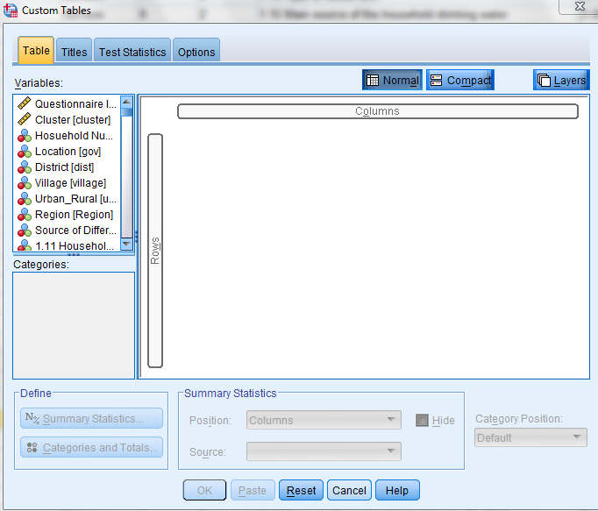
Analyze –> Tables - > Custom tables
The CTABLES window

Slide 4
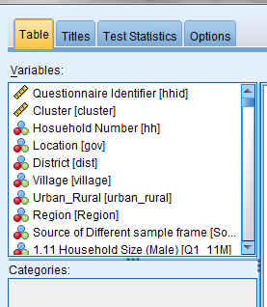
The CTABLES, variables
Two kind of variable types
Continuous (scale) is for data measured on an interval or ratio continuous, where the data values indicate both the order of values and the distance between values (for example height and weight).
Categorical is data with a limited number of distinct values or categories (for example gender or marital status). SPSS refers to categorical variable as nominal and ordinal.
Right-click on variable to choose the right kind for your table

Slide 5
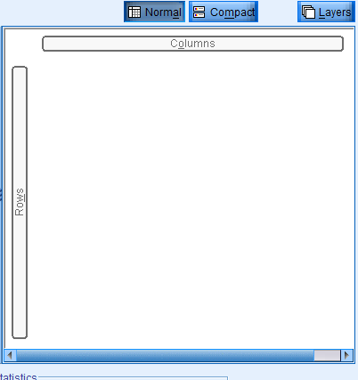
The CTABLES procedure, build the table
3 dimensions; rows, columns, layers
We use mainly 2 dimensions, rows and columns
We build the table by dragging and dropping variables
When the variables are in the right places we can decide on totals, statistics and so on

Slide 6
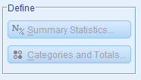
The CTABLES procedure, summary statistics
Different statistics for categorical and scale variables
For categorical variables
Categorical
  Count
  Percentages
Scale
  Count
  Percentages
  Sum
  Mean
  Standard deviation
  Median
  ….
Order of appearance of values
Totals and subtotal definition

Slide 7
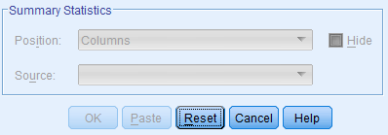
The CTABLES procedure, position of summary statistics
Columns
Rows
Hidden (suitable if only one kind of statistics is used for the whole table)

Slide 8
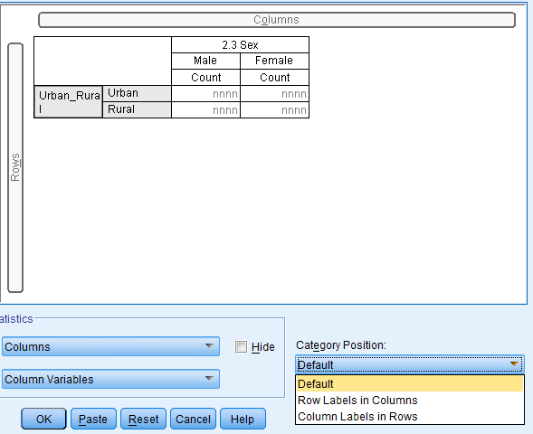
The CTABLES procedure, category position
Define where to place the values for the variables
Easier to move the variable instead

Slide 9
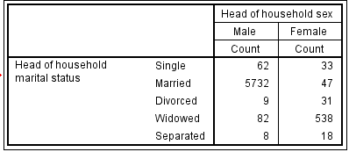
A simple table
Two categorical variables
Sex in the columns
Marital status in the rows
Count of heads in the table cells

Slide 10
A simple table, the generated syntax
GET
FILE='C:\Country\Data\Head.sav'.
* Custom Tables.
CTABLES
/VLABELS VARIABLES=H_Marital H_sex DISPLAY=LABEL
/TABLE H_Marital [C] BY H_sex [C][COUNT F40.0]
/CATEGORIES VARIABLES=H_Marital H_sex ORDER=A KEY=VALUE EMPTY=INCLUDE.

Slide 11
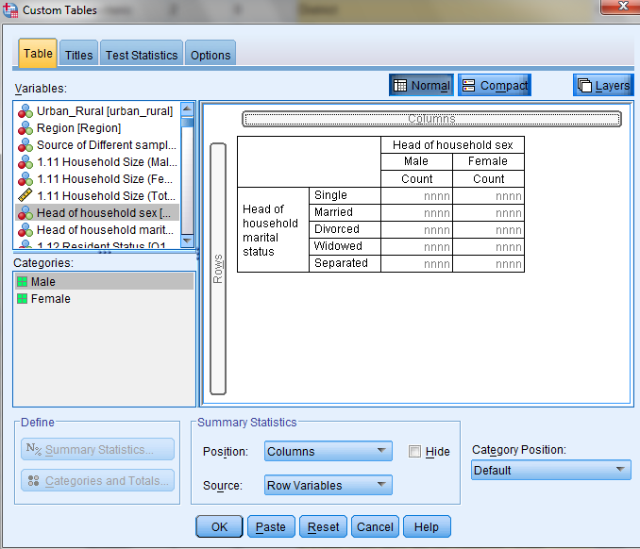
The TABLE subcommand
/TABLE H_Marital [C] BY H_sex [C][COUNT F40.0]
0 decimals.
For 1 decimal, F40.1
For 2 decimal, F40.2

Slide 12
The VLABELS subcommand
/VLABELS VARIABLES=H_Marital H_sex DISPLAY=LABEL
Right-click on variable and choose between
  Variable name (default)
  Both variable name and label
  Variable label
  None
Right-click on variable and choose between
  Scale, categorical or nominal
  Order of variables
  Display of variable or label name

Slide 13
The CATEGORIES subcommand
/CATEGORIES VARIABLES=H_Marital H_sex ORDER=A KEY=VALUE EMPTY=INCLUDE.
Click on Categories and totals to see available options:

Slide 14
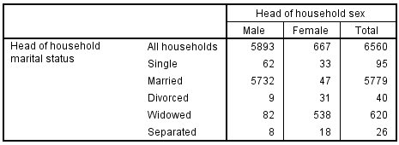
Add totals and hide statistics
One total for marital status defined in the Categories and totals window
One total for sex defined in the Categories and totals window
Hide statistics
    Tick the Hide option in summary statistics

Slide 15
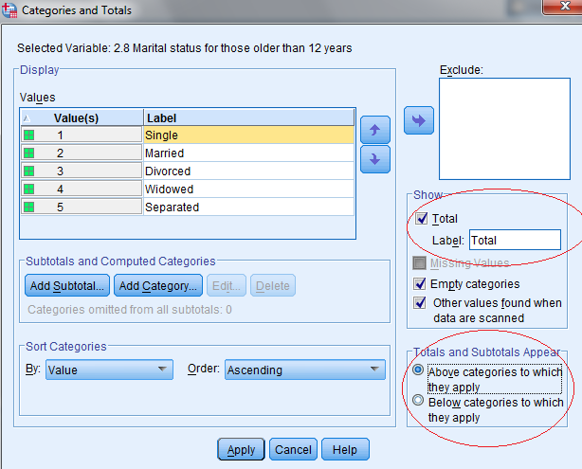
Totals
Added or changed in the categories and totals window
The totals will be connected to a variable
Change label name here

Slide 16
Totals, the generated syntax
CTABLES
/VLABELS VARIABLES=H_Marital H_sex DISPLAY=LABEL
/TABLE H_Marital [C][COUNT F40.0] BY H_sex [C]
/SLABELS VISIBLE=NO
/CATEGORIES VARIABLES=H_Marital ORDER=A KEY=VALUE EMPTY=INCLUDE TOTAL=YES LABEL=‘All households'
POSITION=BEFORE
/CATEGORIES VARIABLES=H_sex ORDER=A KEY=VALUE EMPTY=INCLUDE TOTAL=YES POSITION=AFTER.

Slide 17
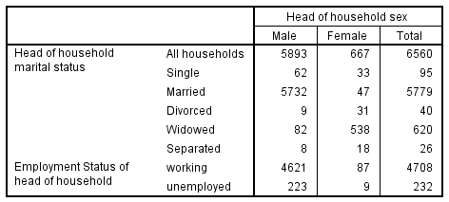
Stacking variables
Right-click on variable name in the variable list
    If it is not a categorical variable, right click on the variable name and choose Categorical
    Drag the variable to the row column
    Release it where there is a horizontal square underneath the Marital status variable

Slide 18
Stacking variables, the generated syntax
CTABLES
/VLABELS VARIABLES=H_Marital Head_Emp_status H_sex DISPLAY=LABEL
/TABLE H_Marital [C][COUNT F40.0] + Head_Emp_status [COUNT F40.0] BY H_sex [C]
/SLABELS VISIBLE=NO
/CATEGORIES VARIABLES=H_Marital ORDER=A KEY=VALUE EMPTY=INCLUDE TOTAL=YES LABEL='All households'
POSITION=BEFORE
/CATEGORIES VARIABLES=Head_Emp_status ORDER=A KEY=VALUE EMPTY=INCLUDE
/CATEGORIES VARIABLES=H_sex ORDER=A KEY=VALUE EMPTY=INCLUDE TOTAL=YES POSITION=AFTER.

Slide 19
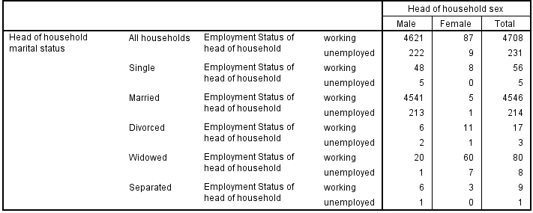
Nesting variables
Right-click on variable name in the variable list
    If it is not a categorical variable, right click on the variable name and choose Categorical
    Drag the variable to the row column
    Release it where there is a vertical square to the right of the Marital status variable

Slide 20
Nesting variables, the generated syntax
* Custom Tables.
CTABLES
/VLABELS VARIABLES=H_Marital Head_Emp_status H_sex DISPLAY=LABEL
/TABLE H_Marital [C] > Head_Emp_status [C][COUNT F40.0] BY H_sex [C]
/SLABELS VISIBLE=NO
/CATEGORIES VARIABLES=H_Marital ORDER=A KEY=VALUE EMPTY=INCLUDE TOTAL=YES LABEL='All households'
POSITION=BEFORE
/CATEGORIES VARIABLES=Head_Emp_status ORDER=A KEY=VALUE EMPTY=INCLUDE
/CATEGORIES VARIABLES=H_sex ORDER=A KEY=VALUE EMPTY=INCLUDE TOTAL=YES POSITION=AFTER.

Slide 21
Stacking and nesting, syntax
The difference in the syntax is very small
  + between two variables: Stacking
  > between two variables: Nesting
Stacking
  /TABLE H_Marital [C][COUNT F40.0] + Head_Emp_status [COUNT F40.0] BY H_sex [C]
Nesting
  /TABLE H_Marital [C] > Head_Emp_status [C][COUNT F40.0] BY H_sex [C]

Slide 22
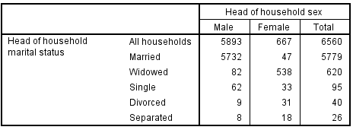
Changing the order of values
Choose the variable to which we will change the value order
Click on Categories and totals
Click on the up or down arrows to move the values
Here we can also exclude values if we like

Slide 23
Changing the order of values, the generated syntax
CTABLES
/VLABELS VARIABLES=H_Marital H_sex DISPLAY=LABEL
/TABLE H_Marital [C][COUNT F40.0] BY H_sex [C]
/SLABELS VISIBLE=NO
/CATEGORIES VARIABLES=H_Marital [2, 4, 1, 3, 5, OTHERNM] EMPTY=INCLUDE TOTAL=YES LABEL='All '+
'households' POSITION=BEFORE
/CATEGORIES VARIABLES=H_sex ORDER=A KEY=VALUE EMPTY=INCLUDE TOTAL=YES POSITION=AFTER.

Slide 24
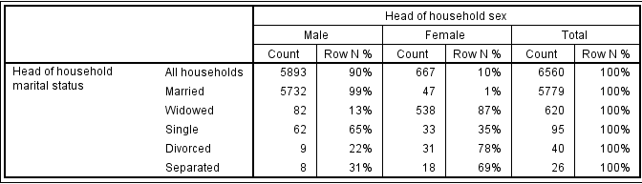
Row percentages
Choose the variable Head of household marital status
Click on Summary statistics
Choose row percentages and click on arrow
Here we can also change labels, format and decimals
Now we should not hide the statistics label anymore

Slide 25
Row percentages, the generated syntax
CTABLES
/VLABELS VARIABLES=H_Marital H_sex DISPLAY=LABEL
/TABLE H_Marital [C][COUNT F40.0, ROWPCT.COUNT PCT40.0] BY H_sex [C]
/CATEGORIES VARIABLES=H_Marital [2, 4, 1, 3, 5, OTHERNM] EMPTY=INCLUDE TOTAL=YES LABEL='All '+
'households' POSITION=BEFORE
/CATEGORIES VARIABLES=H_sex ORDER=A KEY=VALUE EMPTY=INCLUDE TOTAL=YES POSITION=AFTER.

Slide 26
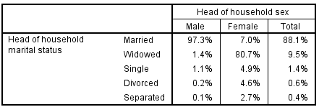
Column percentages
Choose the variable
Click on Summary statistics
Choose column percentages and click on arrow
Here we can also change labels, format and decimals
We can omit the other calculations if we like
Notes:
Can you replicate this table?

Slide 27
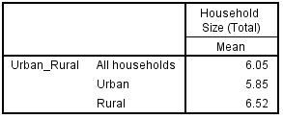
Continuous variables
Possible to calculate sum, mean etc.
Remove table parts that we won’t use (drag and drop them outside of the table preview
Choose a scale variable
Choose summary statistics and add and change if needed
A variable may be used either as scale or category in a table

Slide 28
Continuous variables, the generated syntax
* Custom Tables.
CTABLES
/VLABELS VARIABLES=urban_rural hhsize DISPLAY=LABEL
/TABLE urban_rural [C] BY hhsize [MEAN F40.2]
/CATEGORIES VARIABLES=urban_rural ORDER=A KEY=VALUE EMPTY=INCLUDE TOTAL=YES LABEL='All '+
'households' POSITION=BEFORE.

Slide 29
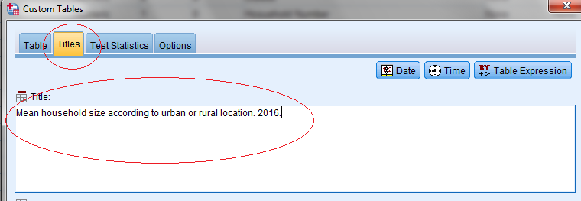
Table titles
Click on the Title tab
Type in the title
Click on the Table tab (or Paste if table setup is finished)
Can choose date or time from the right corner.

Slide 30
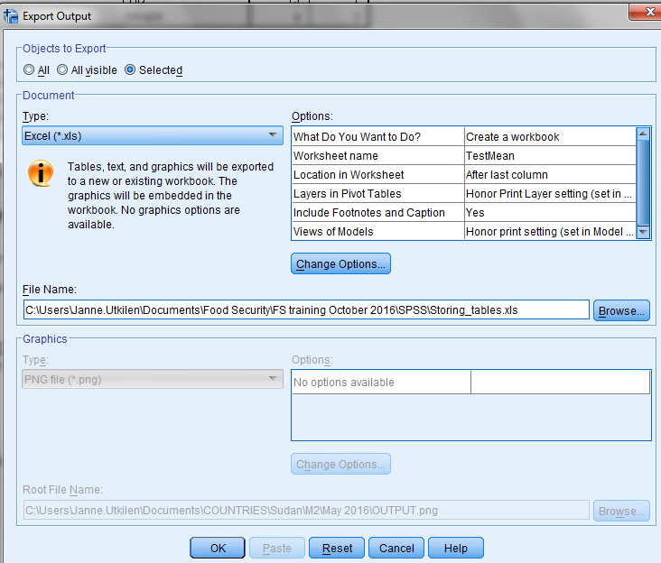
Storing the tables
When the table is final, we are ready to store it
Right-click on the table in the viewer and export it as an excel spreadsheet or a word document
It is not possible to paste any syntax for this operation. From File tab/export, you can use the paste function.

Slide 31
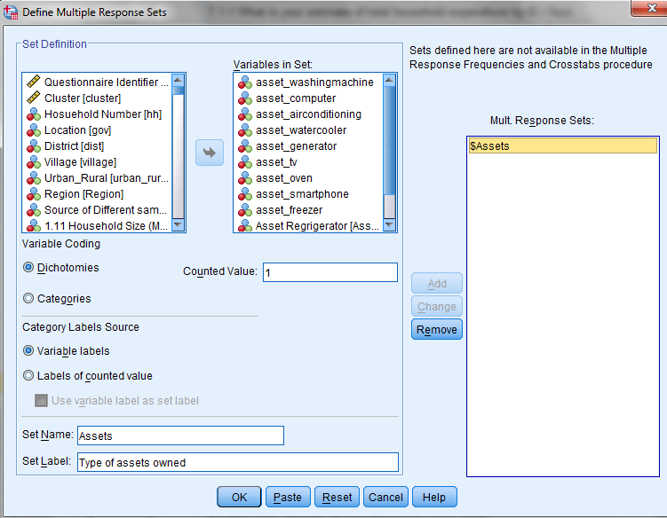
Define multiple response sets
  Analyze
    Tables
      Define Multiple Response Set
Choose variables
Choose Counted Value
Give Set a name and a label
Add it to the sets of multiple response variables
Paste the syntax

Slide 32
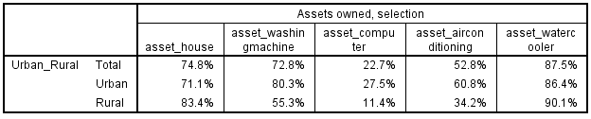
Multiple response variables used in a table
Use the multiple response variable as a categorical variable
Choose row percent of total N
Notes:
Compare results with frequency function. Note that frequencies only shows total figures, not by categories. But will automatically show the valid and missing observations.

Slide 33
Multiple response variables, the syntax
MRSETS
/MDGROUP NAME=$Assets LABEL='Assets owned, selection' CATEGORYLABELS=VARLABELS
VARIABLES=asset_house asset_washingmachine asset_computer asset_airconditioning asset_watercooler
VALUE=1
/DISPLAY NAME=[$Assets].
* Custom Tables.
CTABLES
/VLABELS VARIABLES=$Assets urban_rural DISPLAY=LABEL
/TABLE urban_rural [C] BY $Assets [C][ROWPCT.COUNT PCT40.1]
/SLABELS VISIBLE=NO
/CATEGORIES VARIABLES=urban_rural ORDER=A KEY=VALUE EMPTY=INCLUDE TOTAL=YES POSITION=BEFORE
/CATEGORIES VARIABLES=$Assets EMPTY=INCLUDE.
Notes:
How do you remove the % sign from the table?

Slide 34
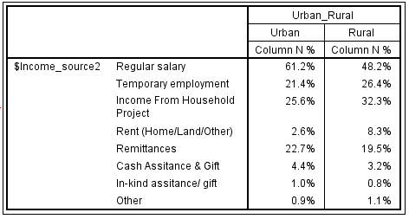
Thank you! - Exercise
Replicate the following table:

