Slide 1
FOOD SECURITY INDICATORS
Day 1 – Topic 3
Initial EFSAs - Training for NDMAs

Slide 2
Learning objectives
Understand the purpose of the most common key indicators and proxies to analyze and determine household food security, including:
  Food consumption score (access)
  Coping strategy index (access)
  Expenditures (access)
  Malnutrition (utilization)
Get a brief insight into how these indicators are calculated and analyzed

Slide 3
Food Security Analysis – Key principles
There is NO one single indicator to measure food security but a number of PROXY indicators
Focus on food security outcomes (food consumption, food access, nutrition, etc.) in order to assess the food security status of households
Several indicators are looked at together as food security is a multidimensional issue.

Slide 4
Measuring Food Security Indicators
FOOD CONSUMPTION
FOOD ACCESS
NUTRITION

Slide 5
Food Consumption Indicator
Food Consumption Score (FCS)

Slide 6
Food Consumption Score (FCS)
Proxy indicator for current HH food access based on
  Dietary diversity: number of individual foods consumed over a reference period
  Food frequency: number of days (in the past week) that a specific food item has been consumed
  Nutritional importance: food groups are weighted to reflect their nutritional importance

Slide 7
Food Consumption Score (FCS)
The higher the FCS, the higher the dietary diversity and the frequency of those foods consumed.
A high food consumption score increases the possibility that a household achieves nutrient adequacy.

Slide 8
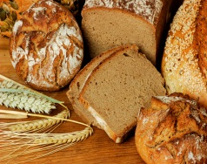
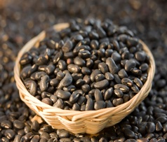

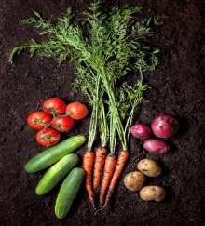
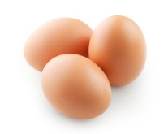

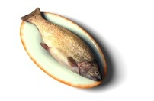
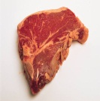
From food items to food groups
Classify the food items into 8 food groups
Cereal | Pulse | Fruit | Vegetable | Meat, fish, eggs | Dairy | Sugar | Oil
Food consumption score (FCS)
Food Consumption Groups (FCG)
Poor | Borderline | Acceptable
Notes:
Food consumption information is typically available in the majority of WFP-surveys
(weights intended to better capture dimensions of both quantity and quality)
Food consumption score (FCS)= a1x1+ a1x1+ …+ a1x1 ,
i=1,2…8 foodgroups, x=frequency (0.7), a= weight (max = 112)

Slide 9
Food groups and weights
 | Food Item (customize for local context) | Food groups | Weight
1 | Maize , maize porridge, rice, sorghum, millet pasta, bread and other cereals | Cereals and Tubers | 2
2 | Cassava, potatoes and sweet potatoes
3 | Beans. Peas, groundnuts and cashew nuts | Pulses | 3
4 | Vegetables and leaves | Vegetables | 1
5 | Fruits | Fruit | 1
6 | Beef, goat, poultry, pork, eggs and fish | Meat and fish | 4
7 | Milk yogurt and other diary | Milk | 4
8 | Sugar and sugar products | Sugar | 0.5
9 | Oils, fats and butter | Oil | 0.5
10 | Condiments | Condiments | 0

Slide 10
Food groups | Weight | Justification
Main staples | 2 | Energy dense, protein content lower and poorer quality (PER less) than legumes, micro-nutrients (bound by phytates).
Pulses | 3 | Energy dense, high amounts of protein but of lower quality (PER less) than meats, micro-nutrients (inhibited by phytates), low fat.
Vegetables | 1 | Low energy, low protein, no fat, micro-nutrients
Fruit | 1 | Low energy, low protein, no fat, micro-nutrients
Meat, poultry, fish, eggs | 4 | Highest quality protein, easily absorbable micro-nutrients (no phytates), energy dense, fat. Even when consumed in small quantities, improvements to the quality of diet are large.
Milk/dairies | 4 | Highest quality protein, micro-nutrients. However, milk could be consumed only in very small amounts and should then be treated as condiment and therefore re-classification in such cases is needed.
Sugar | 0.5 | Empty calories. Usually consumed in small quantities.
Oil | 0.5 | Energy dense but usually no other micro-nutrients. Usually consumed in small quantities

Slide 11
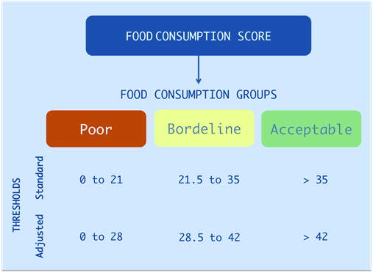
Food groups
The FCS is used to classify households into three food consumption groups:

Slide 12
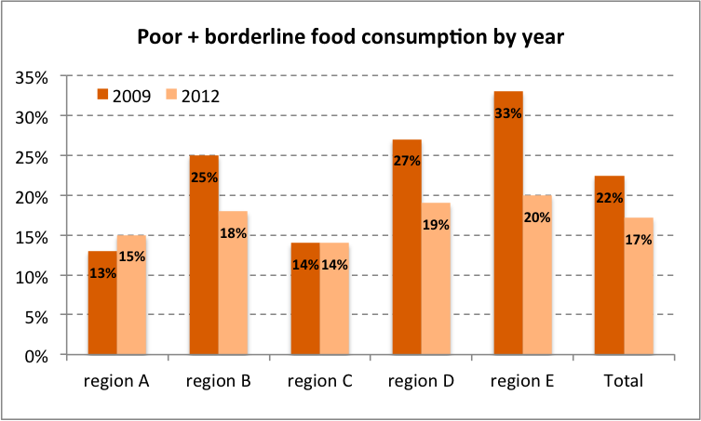
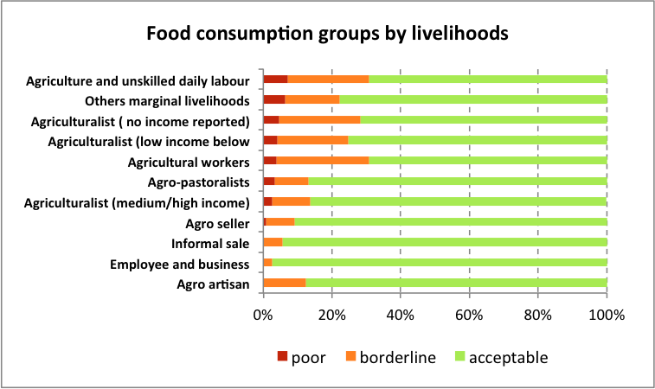
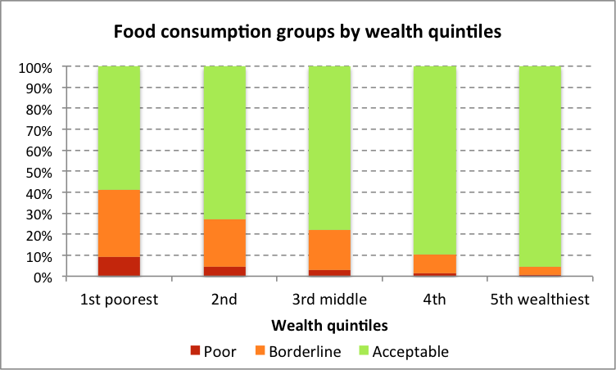
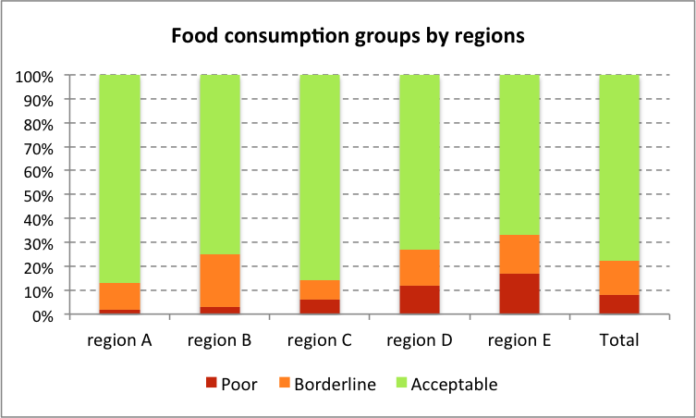

Slide 13
EXERCISE : how to calculate the FCS

Slide 14
Food Access Indicators
Coping Strategy Index (CSI)
Expenditure

Slide 15
COPING STRATEGY INDEX (CSI)
The CSI is providing an insight into how households manage and cope in times of limited access to food.
The CSI is based on the frequency and severity of different types of coping strategies.
The higher the CSI score, the more likely it is that the household is affected by food insecurity.

Slide 16
Types of CSI
Country-specific CSI
“Reduced” CSI
Is based on a series of context-specific strategies and context-specific severity scores
Relies on same short list of five coping strategies and the same severity weights.
Allows comparison among areas and countries

Slide 17
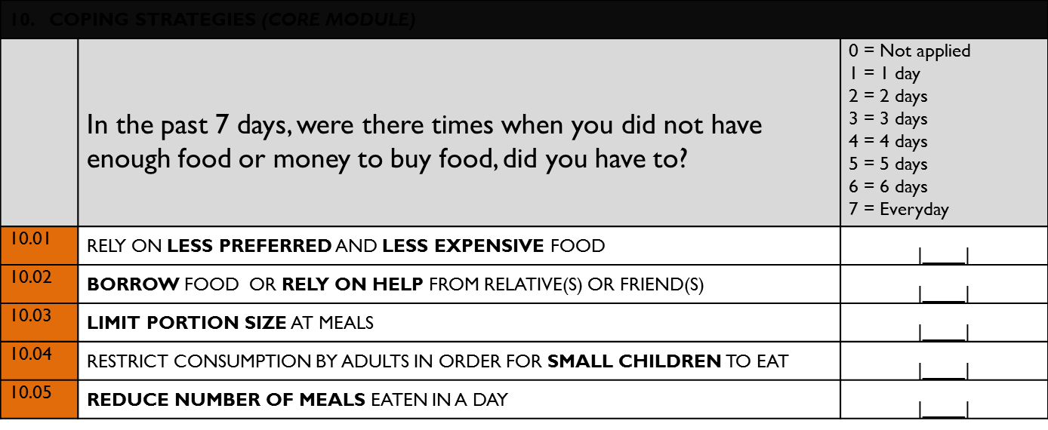
Standard (reduced) CSI questions

Slide 18
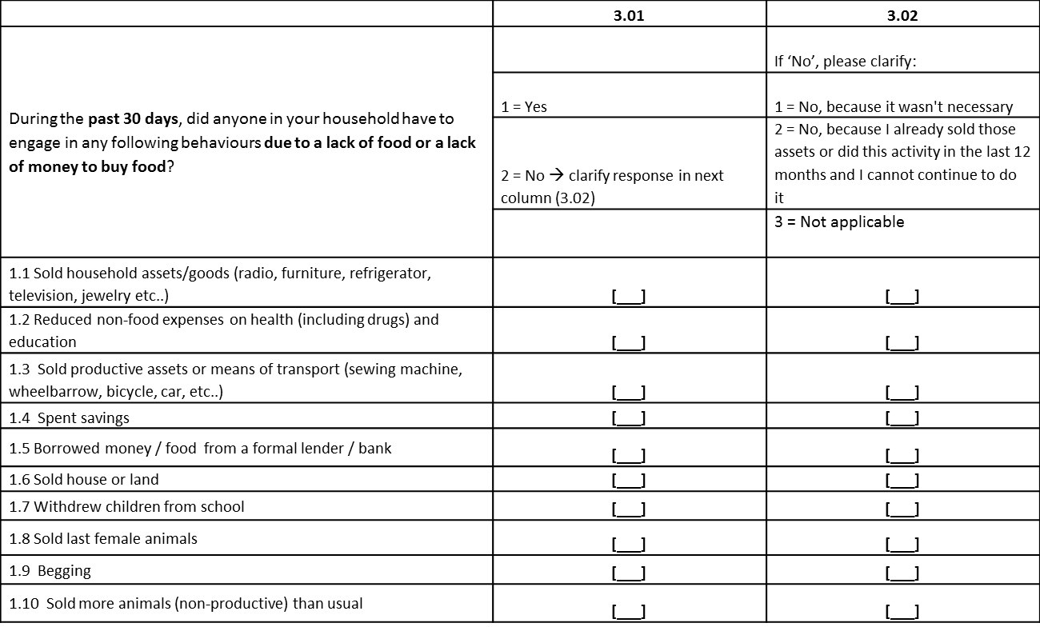
Country-specific livelihood coping strategies

Slide 19
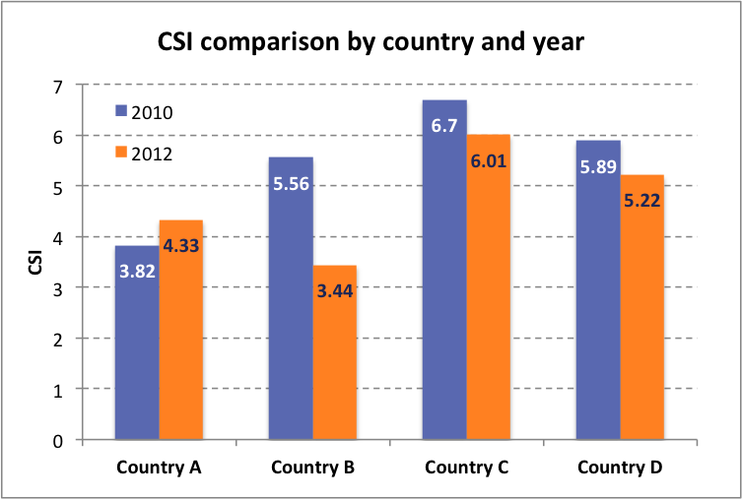
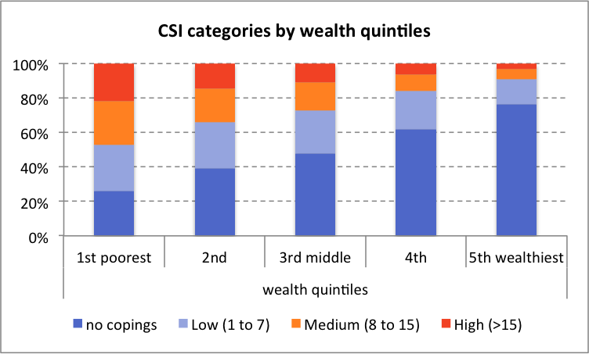
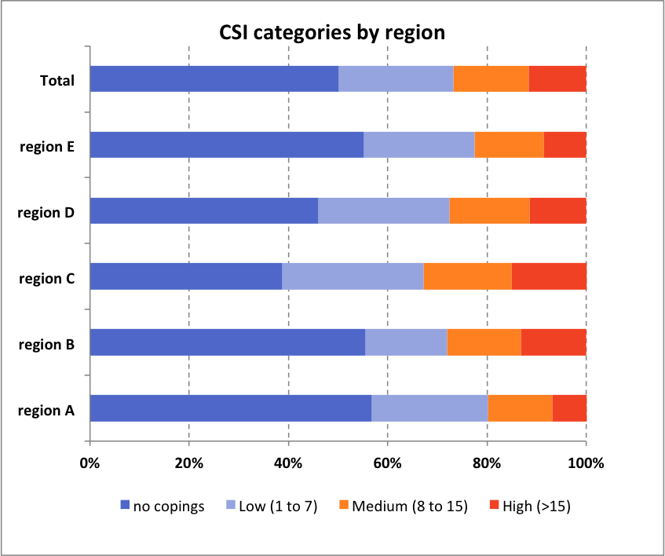
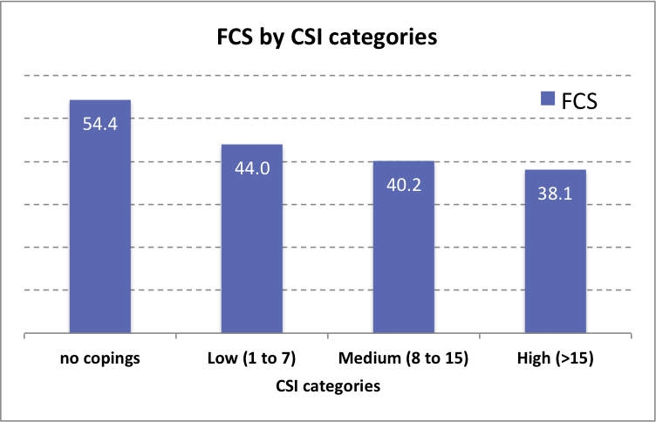
How to interpret the CSI

Slide 20
EXPENDITURE
Household expenditure information is uses as a proxy of purchasing power.
Understanding household expenditures provides an insight into how households allocate scarce resources and give priority to competing needs.

Slide 21
EXPENDITURE
Share of expenditure on food
“Households that spend a large proportion of their income on food are vulnerable to food deprivation because, regardless of their current food consumption status, if they were to experience a reduction in income it would likely be accompanied by a reduction in food consumption or the quality of food eaten.”

Slide 22
Household expenditure

Slide 23
Share of expenditure on food
75+: very high (very vulnerable to food insecurity)
65–75: high
50–65: medium
<50: low

Slide 24
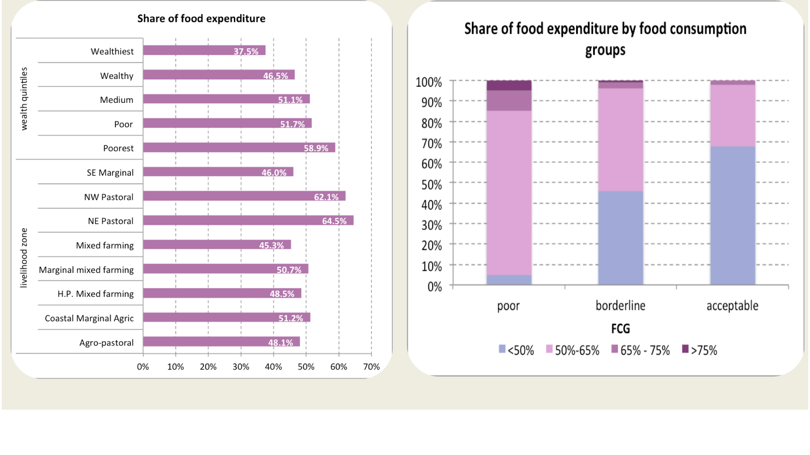
How to interpret expenditure

Slide 25
Nutrition indicators
Acute malnutrition (wasting)
Chronic malnutrition (stunting)
Underweight

Slide 26
Assessing nutritional status
Acute Malnutrition Wasting (and oedema)
  Result of deficiencies in any or all nutrients (includes micronutrients, as well as macronutrients)
Chronic Malnutrition Stunting
  Result of long-term nutrient deficiencies and/or repeated infections with insufficient catch-up growth
  Underweight Wasting + stunting

Slide 27
Children with Malnutrition all suffer growth failure either:
Wasting (thinness) | Acute malnutrition | Why? Recent rapid weight loss or failure to gain weight Measured by weight for height
Stunting (shortness) | Chronic malnutrition | Why? Inadequate nutrition over long time and/or frequent infections & insufficient catch-up growth Measured by height for age
or:
or both together = Underweight
Notes:
Stunting is a form of chronic malnutrition. Measured by comparing a child’s height to the child’s age against standard growth patterns. If a child is not tall enough for his/her age, we say the child is stunted.
There is moderate stunting and severe stunting. These combined give us global stunting.
Stunting is not just “being short” but it indicates an ongoing or older nutritional problem. Children who are stunted have a hard time ever “catching-up” the lost height and health and development. Special focus is given to children under 2 because they can regain the lost linear growth.

Slide 28
Types of Malnutrition

Slide 29
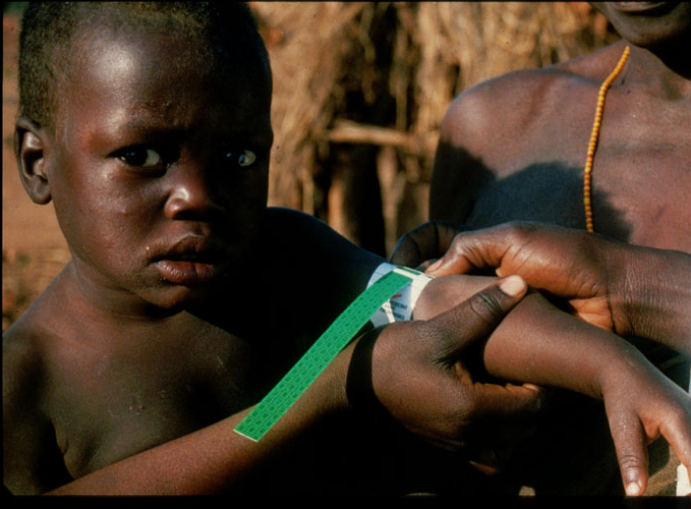
Mid-Upper Arm Circumference (MUAC)
Global underweight
MUAC < 12.5 cm in children
MUAC < 22.5 cm in women

Slide 30
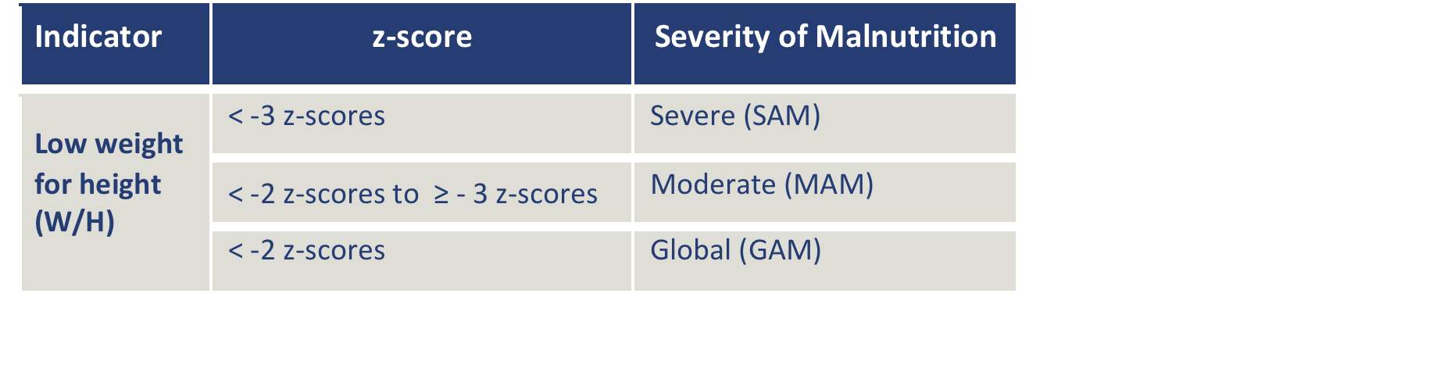
Wasting

Slide 31
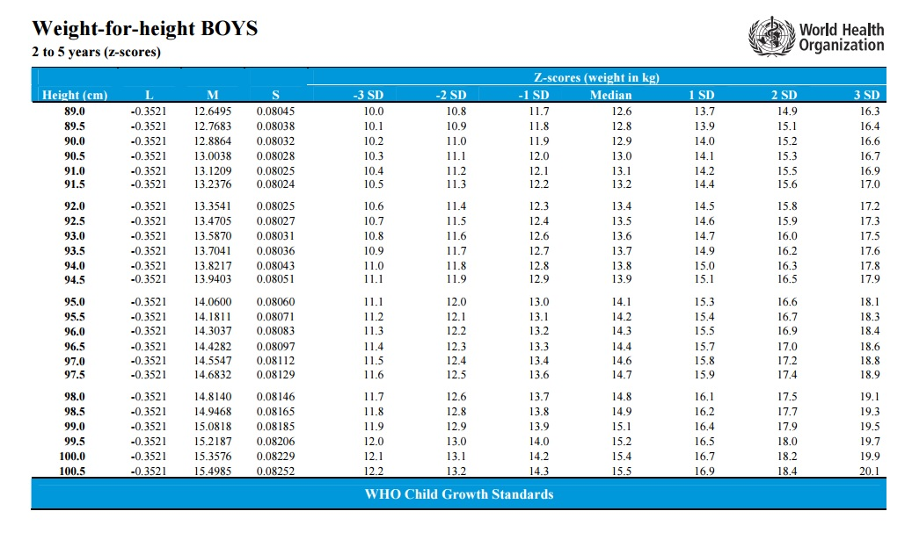
Wasting?
Boy
Age: 4 years old
Height: 97.5 cm
Weight: 11.8 kg
MAM

Slide 32
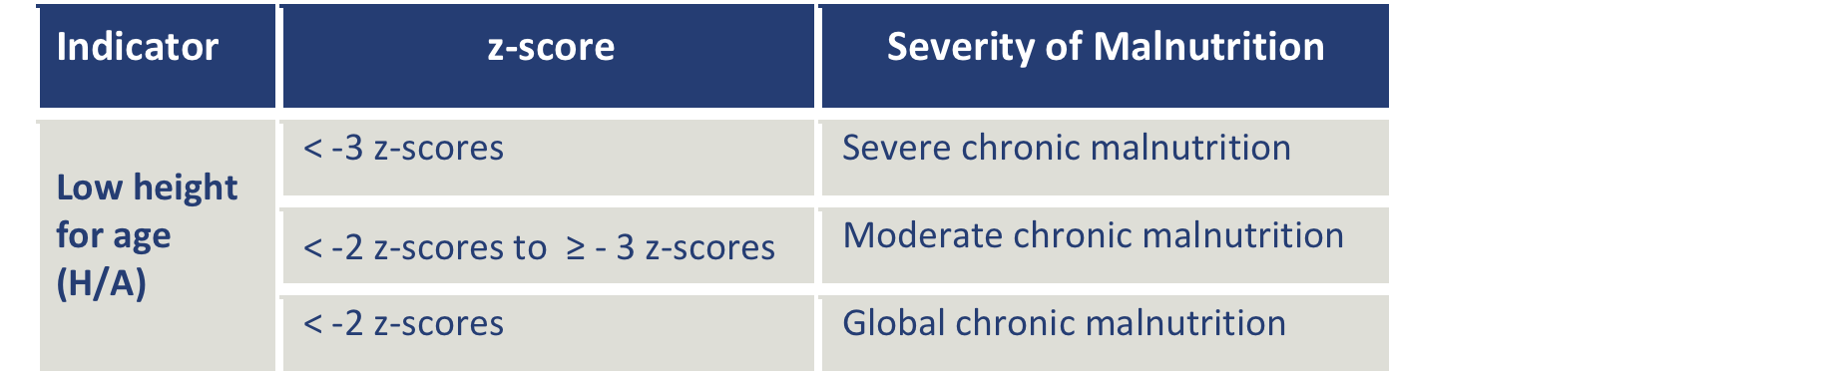
Stunting

Slide 33
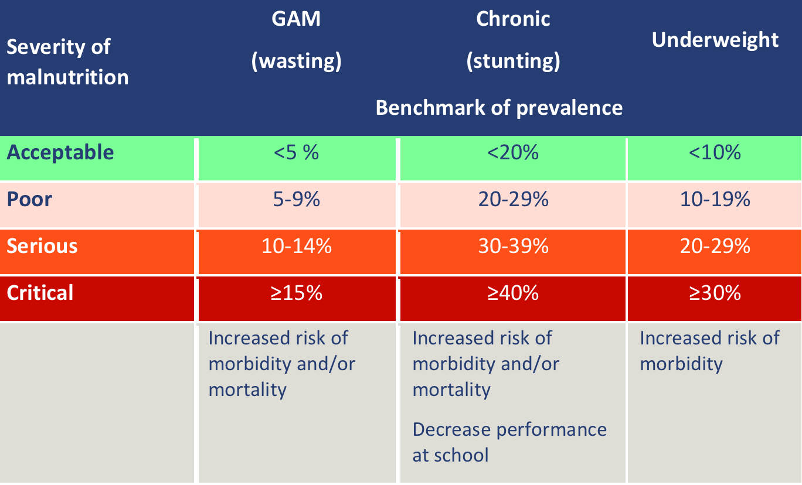
Benchmarks of prevalence at the population level (WHO)

Slide 34
The three most useful nutrition indicators
As a general guide, the following thresholds can be used to define risks to lives at the individual level:
Wasting: Weight-for-height < -2z for children
MUAC: < 12.5 cm for children and <22.5 cm for women
BMI: < 16.0 (combined with an infectious disease such as HIV/AIDS or tuberculosis)

Slide 35
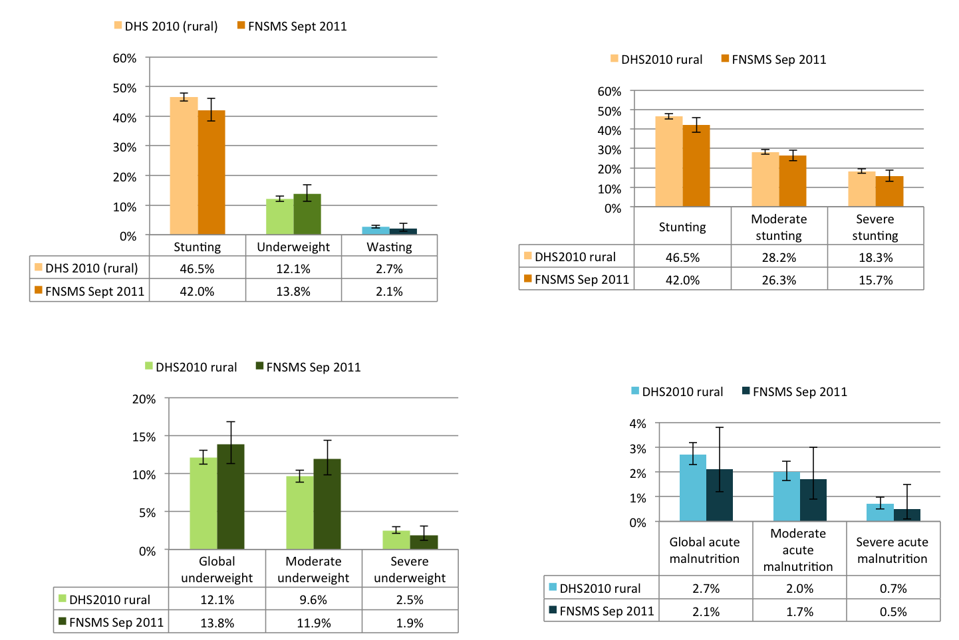
How to interpret nutrition indicators

