Slide 1

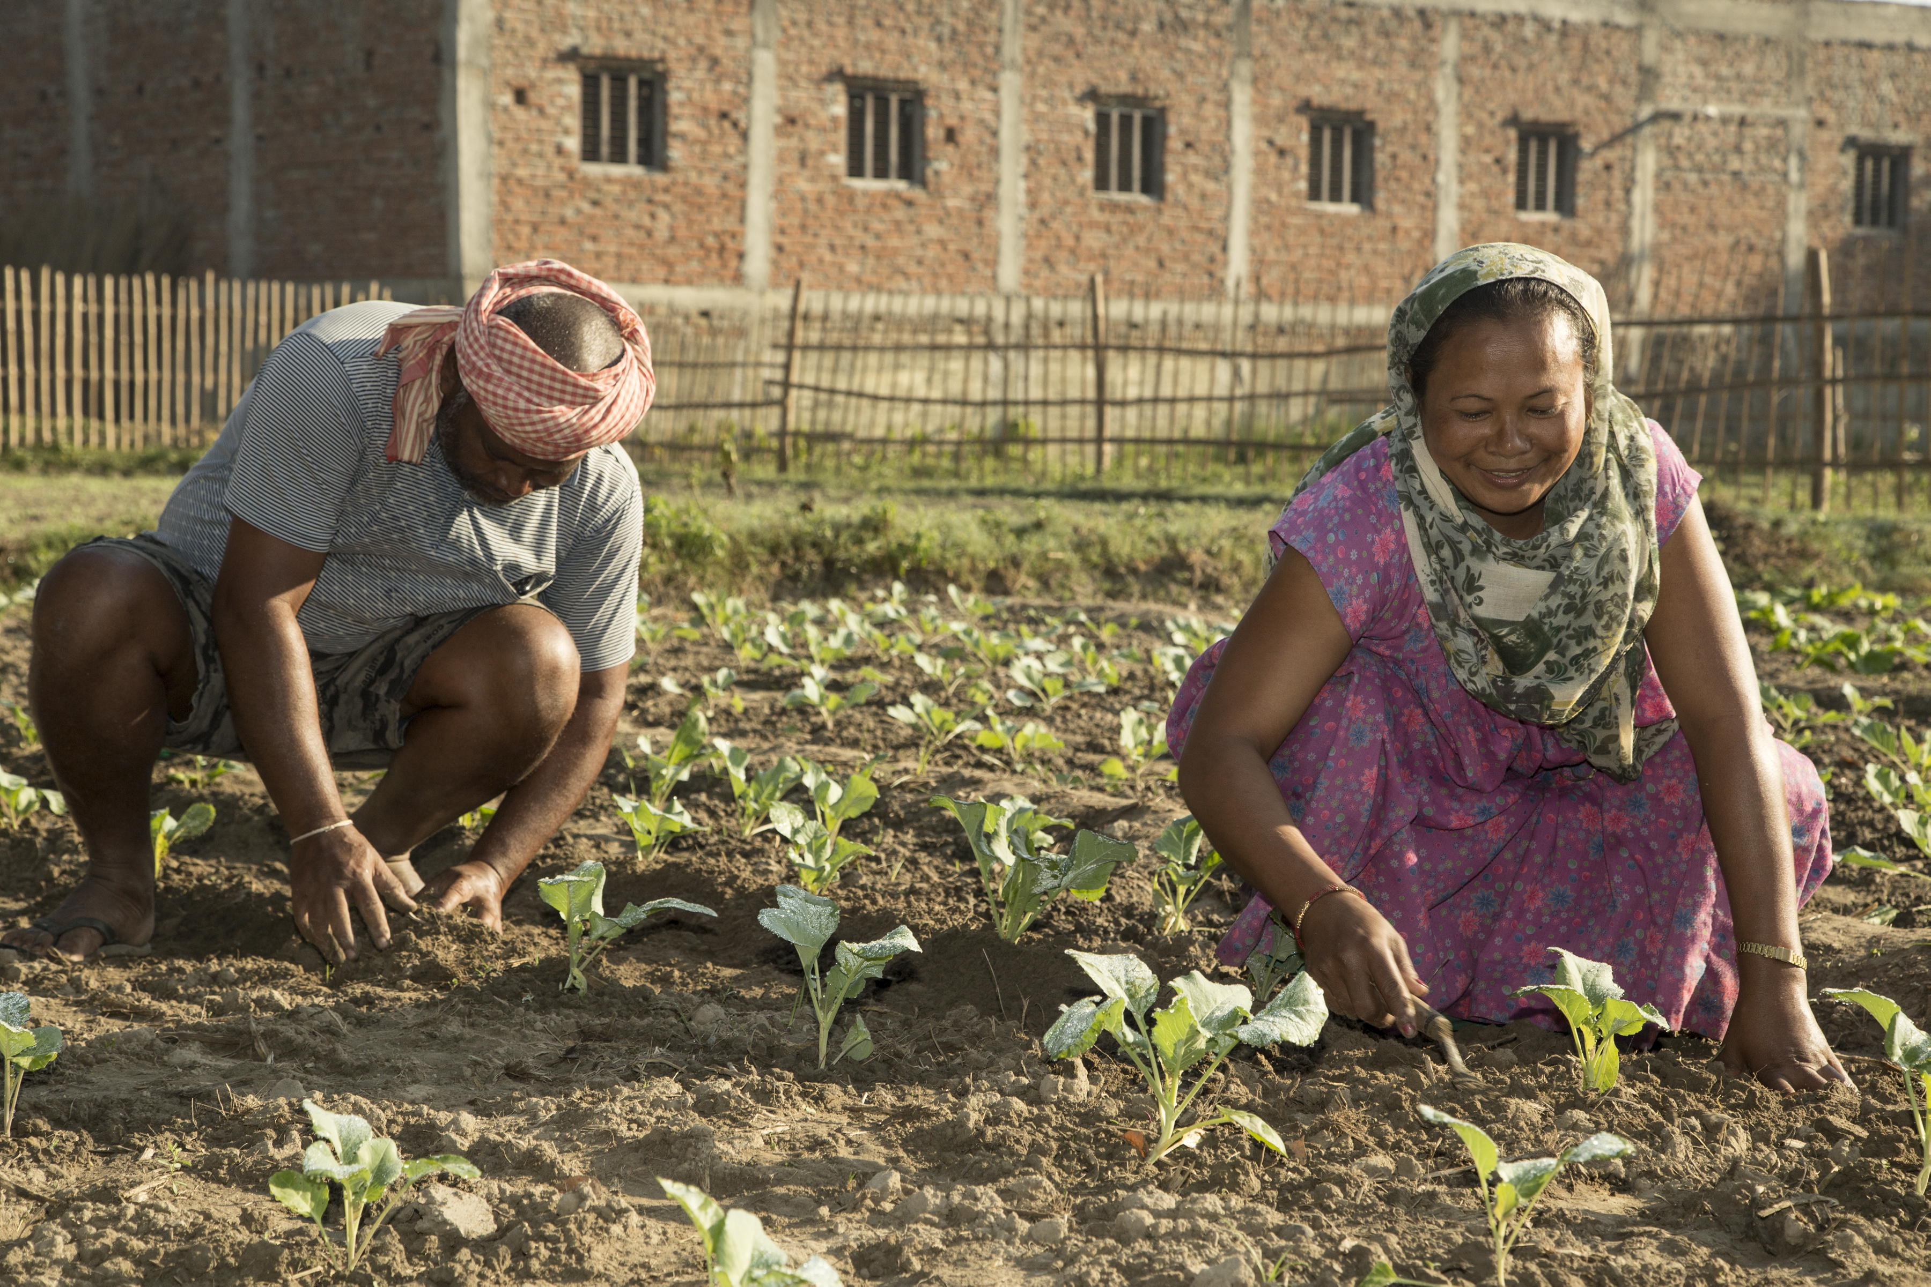
Accelerating Progress Towards Gender Equality
and Women's Empowerment
WFP Gender Policy 2022
Elizabeth Burges-Sims
WFP Senior Gender Advisor

Slide 2
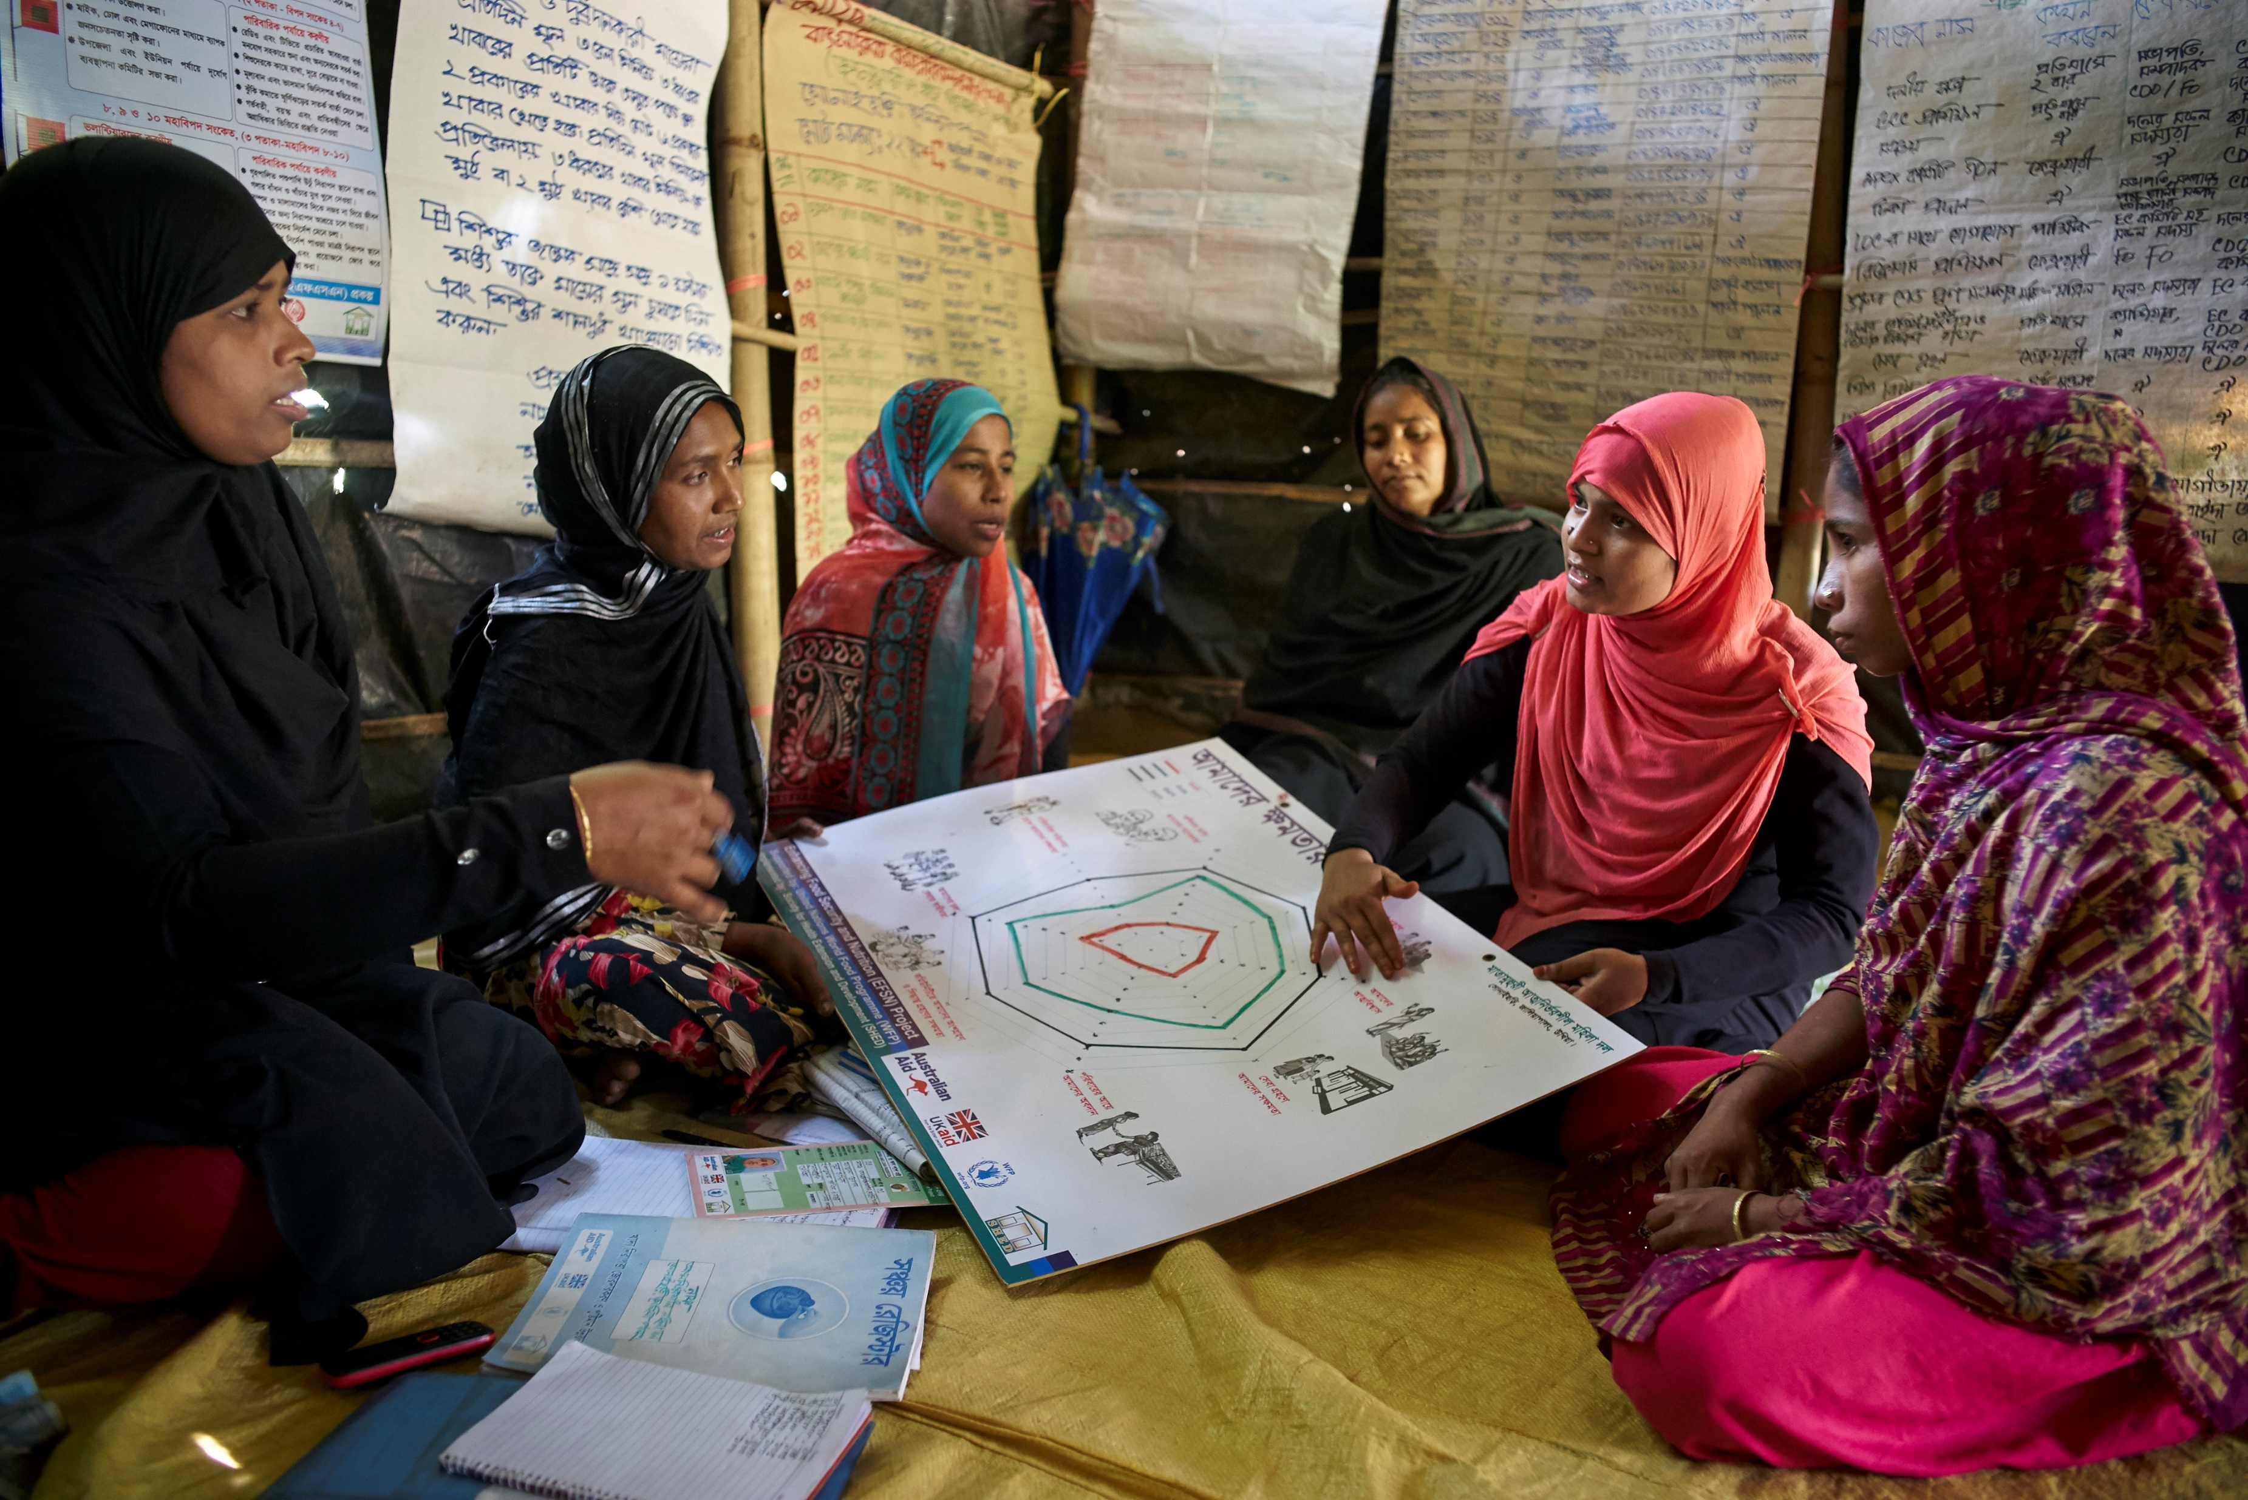
Gender equality is enhanced, and women are empowered
WFP’s Strategic Plan & CRF 2022-2025
WFP’s Environmental and Social Safeguards 2021
WFP’s Protection & Accountability Policy 2020
WFP’s People Policy 2021

Slide 3
Gender Policy 2022: The Headlines
People centered: diversity, equality & inclusion
01
02
Gender analysis: informs policies and programmes
The Headlines
04
03
Partnerships: at the heart of our programming
CSPs: entry-points for gender analysis and action

Slide 4
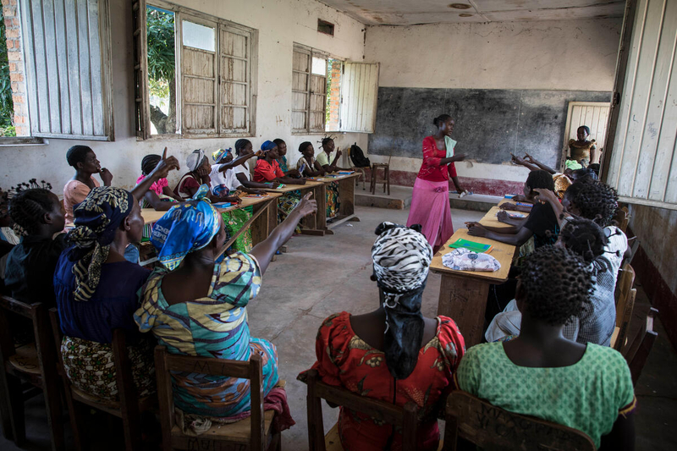
Gender Policy 2022: Three Objectives
Achieve equitable access to and control over food security and nutrition
Address the root causes of gender inequalities that affect food security and nutrition
Advance the economic empowerment of women and girls in food security and nutrition

Slide 5
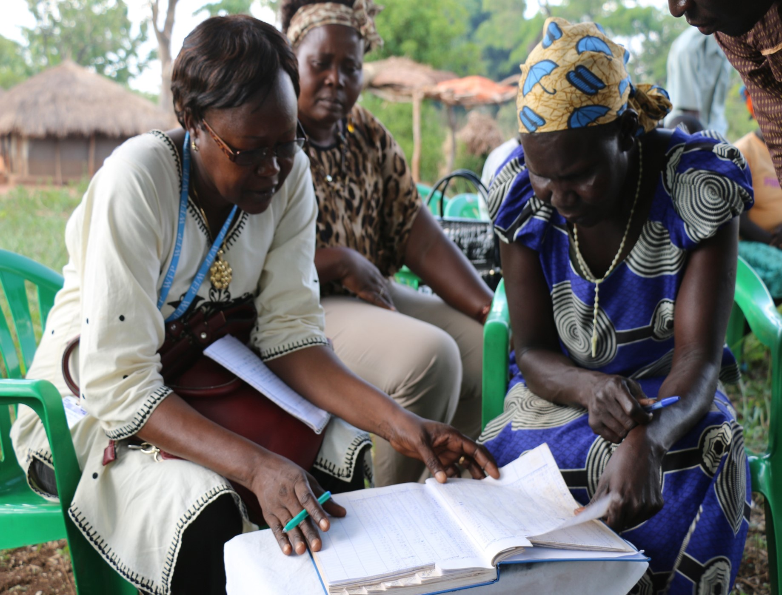
Gender Policy 2022: Key Priorities
Enhanced and equitable participation
Strengthened leadership and decision making
Enhanced protection to ensure safety, dignity and meaningful access
Transformative action on social norms and structural barriers

Slide 6
Gender Policy 2022: Essential Enablers
Human &
Financial Resources
Data
Monitoring
Partnerships
Capacity Strengthening
Accountability
Communications

Slide 7
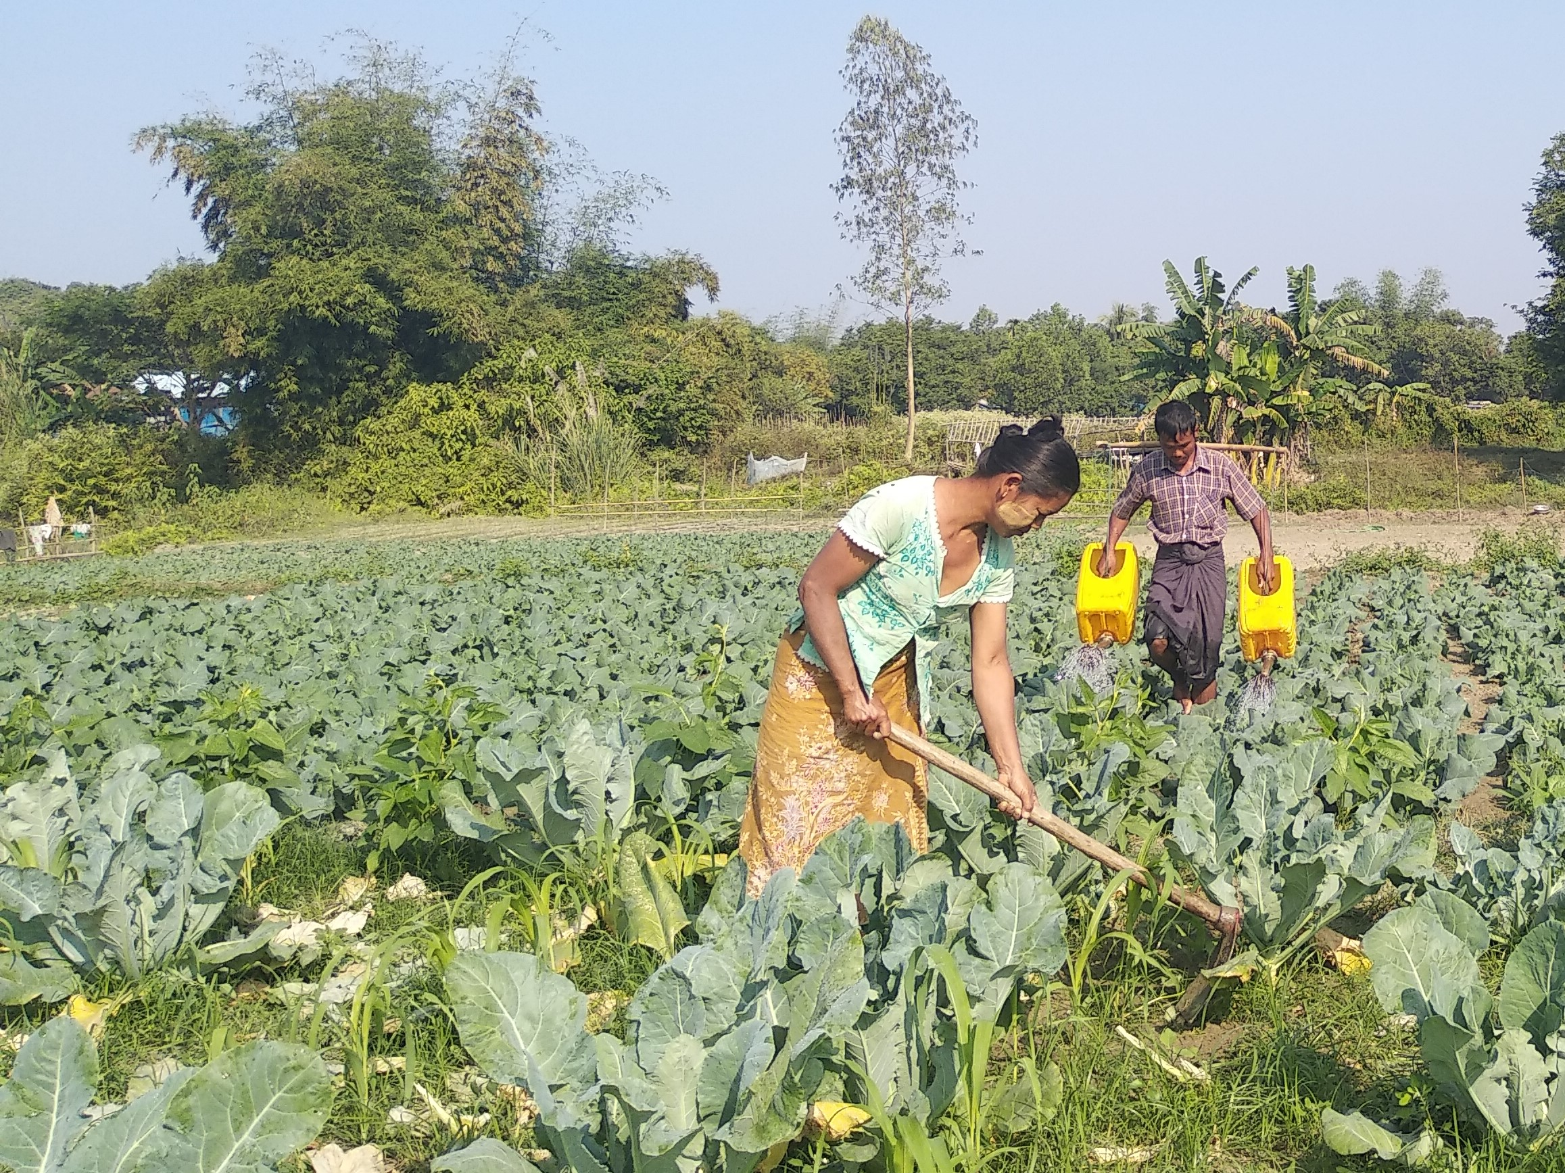
Policy Implementation
Updated FLA Clause 2.1 c
Gender Results
Partnerships
Advocacy
Accountability

Slide 8
The Gender Office looks forward to engaging with all of you to support the opportunities that you identify for accelerating progress in gender equality and women’s empowerment in the regions and countries where WFP works.

