Slide 1
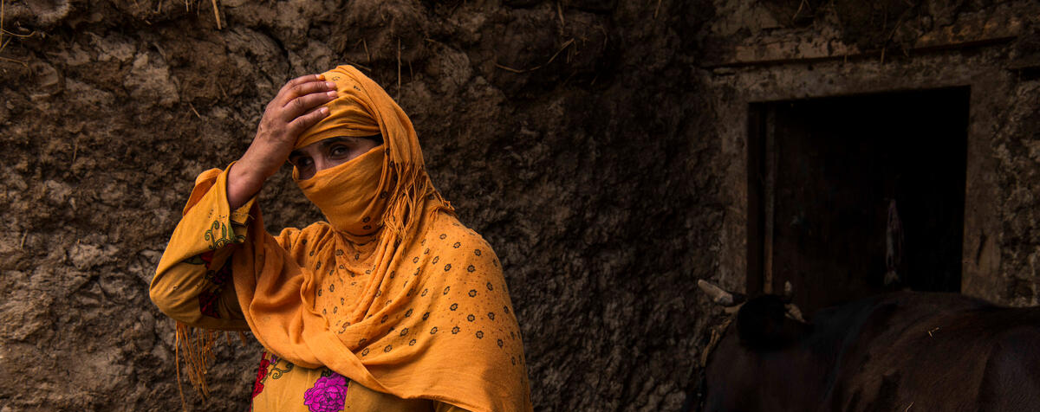

Reduced Coping Strategies Index (rCSI)
Needs Assessments & Targeting Unit
2024 June

Slide 2

AUDIENCE
The audience of this PowerPoint can range from enumerators to RAM and Programme staff in various offices. It can also be used for the training of partners or service providers.
Slide sections have been inserted to assist in the selection of material.

Slide 3
Introduction

Slide 4
RCSI: training instructions 1
Discuss the objectives of the module, i.e., to gain information on the reduced or consumption-based coping strategies applied by households in the targeted population. Explain the role of this indicator in food insecurity figures and the use of information, internally and externally. This gives the enumerators a clear understanding of the importance of the data they would be soon collecting.

Slide 5
RCSI: What is it?
The reduced Coping Strategies Index, also called Consumption-based CSI, is used to assess a household’s stress level due to a food shortage.
The rCSI measures behavioural strategies that people apply when they cannot access enough food or when they foresee a decrease in food.
The rCSI contains five standard strategies – facilitating the comparison over space, time and between groups.
The rCSI is highly correlated with other food security proxy indicators, including the Food Consumption Score, and Vitamin A, Protein-rich and Hem Iron intake.
Notes:
The higher the stress, the higher the behavioural responses and the index.

Slide 6
RCSI: USEs OF this indicator
The rCSI can be used in a range of ways, including for programme activity monitoring, determining the food security situation, and population-level targeting.
The rCSI indicator plays a part in classifying households according to their level of food security, through Consolidated Approach for Reporting on food Insecurity (CARI).
This rCSI is one of the food security outcome indicators in the Integrated Food Security Phase Classification (IPC) acute food insecurity reference table.

Slide 7
The reduced Coping Strategies Module

Slide 8
rcsi: training instructions 2
Note how the main question is worded (on the next slide). The question is referring to the number of days where the household applied each of the coping strategies.
Be sure the question includes a recall period of 7 days and not “last week”. We are always asking about the same period beginning from today and counting backwards (i.e., “the last 7 days” not “the past week,” or “last week”). Interviewees could get confused if the timeframe is not specific.

Slide 9
RCSI MODULE: MAIN QUESTION
Now I will ask you about the number of days, in the last 7 days, that your household may have done some of the following actions to cope with lack of food or money to buy food. Not for the enumerator: Please read out all the strategies. | Frequency (Number of days from 0 to 7)
Now I will ask you about the number of days, in the last 7 days, that your household may have done some of the following actions to cope with lack of food or money to buy food.

Slide 10
Rcsi: strategy 1
DIETARY CHANGE
After experiencing a shock, households may change their diet. For instance, households might switch from more preferred foods to cheaper, less preferred substitutes.
Now I will ask you about the number of days, in the last 7 days, that your household may have done some of the following actions to cope with lack of food or money to buy food. Not for the enumerator: Please read out all the strategies. |  | Frequency (Number of days from 0 to 7)
1. | During the last 7 days, were there days (and, if so, how many) when your household had to rely on less preferred and less expensive food to cope with a lack of food or money to buy it? | |____|
2. | During the last 7 days, were there days (and, if so, how many) when your household had to borrow food or rely on help from a relative or friend to cope with a lack of food or money to buy it? | |____|
3. | During the last 7 days, were there days (and, if so, how many) when your household had to limit portion size of meals at mealtimes to cope with a lack of food or money to buy it? | |____|
4. | During the last 7 days, were there days (and, if so, how many) when your household had to restrict consumption by adults in order for small children to eat to cope with a lack of food or money to buy it? | |____|
5. | During the last 7 days, were there days (and, if so, how many) when your household had to reduce number of meals eaten in a day to cope with a lack of food or money to buy it? | |____|
Notes:
Household makes changes to type of food consumed in order to manage the shortfall of food. This question is concerned with the types of foods consumed rather than the quantities consumed

Slide 11

Rcsi: strategy 1 PROBING example
Probing questions should be applied during interviews to better understand unusual household coping behaviours.
For example, if a household reported relying on less preferred and less expensive food daily in the past 7 days, then probe:
“Is this commonly done by your household?”
“And how does this compare with the most recent shock?"
Notes:
It is possible that this strategy has become common practice – especially in prolonged and repetitive crises. Enumerators and respondents must understand the question and timeframe and refer to the most recent shock. E.g., Lebanon has been exposed to the economic crisis of 2019, then the COVID-19 pandemic in 2020, Beirut’s port explosion, and then the collapse of the financial/banking system.

Slide 12
Rcsi: strategy 1 (CONTINUED)
DIETARY CHANGE
If a household is used to buying a certain quality of foods such as vegetables and fruits, but due to lack of money, the household had to purchase less fresh or poorer quality substitutes as they are usually cheaper
If a household does not prefer a specific type of food and does not like to eat it at all but has to do so due to a shortfall in food or money, then this strategy can be considered as applied.
If a household is buying cheaper or low-quality foods as a normal practice or out of lack of knowledge about healthy habits (not due to food shortages), then it is NOT counted as an applied strategy.

Slide 13
Rcsi: strategy 2
INCREASING FOOD AVAILABILITY
Second, a household can attempt to increase its food supplies using short-term strategies that are not sustainable over a long period. Typical examples include borrowing or purchasing on credit.
Now I will ask you about the number of days, in the last 7 days, that your household may have done some of the following actions to cope with lack of food or money to buy food. Not for the enumerator: Please read out all the strategies. |  | Frequency (Number of days from 0 to 7)
1. | During the last 7 days, were there days (and, if so, how many) when your household had to rely on less preferred and less expensive food to cope with a lack of food or money to buy it? | |____|
2. | During the last 7 days, were there days (and, if so, how many) when your household had to borrow food or rely on help from a relative or friend to cope with a lack of food or money to buy it? | |____|
3. | During the last 7 days, were there days (and, if so, how many) when your household had to limit portion size of meals at mealtimes to cope with a lack of food or money to buy it? | |____|
4. | During the last 7 days, were there days (and, if so, how many) when your household had to restrict consumption by adults in order for small children to eat to cope with a lack of food or money to buy it? | |____|
5. | During the last 7 days, were there days (and, if so, how many) when your household had to reduce number of meals eaten in a day to cope with a lack of food or money to buy it? | |____|
Notes:
Household increases the short-term food availability by relying on help from friends or relatives in the form of food or money to buy food.

Slide 14
Rcsi: strategy 2 PROBING example
If a household reported borrowing food or relying on help from friends or relatives in the past 7 days, then probe:
“What was the main reason for this?”
“Is this commonly done by your household?”

Slide 15
Rcsi: strategy 2 (CONTINUED)
DIETARY CHANGE
If a household reported having to rely on this strategy in the last 7 days due to their inability to acquire food during this time, then this household had relied on this strategy.
However, if a household had to borrow some vegetables from a neighbour or friend because they had forgotten to buy them from the market, then it is NOT considered a strategy (as it was not due to a lack of money to purchase them).

Slide 16
Rcsi: strategy 3
MANAGING AVAILABLE FOOD
Third, households can attempt to manage the shortfall by rationing the food available to them by cutting the portion size of meals. This allows them to stretch out the available food.
Now I will ask you about the number of days, in the last 7 days, that your household may have done some of the following actions to cope with lack of food or money to buy food. Not for the enumerator: Please read out all the strategies. |  | Frequency (Number of days from 0 to 7)
1. | During the last 7 days, were there days (and, if so, how many) when your household had to rely on less preferred and less expensive food to cope with a lack of food or money to buy it? | |____|
2. | During the last 7 days, were there days (and, if so, how many) when your household had to borrow food or rely on help from a relative or friend to cope with a lack of food or money to buy it? | |____|
3. | During the last 7 days, were there days (and, if so, how many) when your household had to limit portion size of meals at mealtimes to cope with a lack of food or money to buy it? | |____|
4. | During the last 7 days, were there days (and, if so, how many) when your household had to restrict consumption by adults in order for small children to eat to cope with a lack of food or money to buy it? | |____|
5. | During the last 7 days, were there days (and, if so, how many) when your household had to reduce number of meals eaten in a day to cope with a lack of food or money to buy it? | |____|
Notes:
A rationing strategy in which the amount of food eaten at a meal is reduced in order to manage the shortfall of food.

Slide 17
Rcsi: strategy 3 PROBING example
For example, if a household reported reducing the portion size of meals within the last 7 days, then probe:
“Is this the usual portion of food that the household used to consume?”
“Why did you reduce the portion of food (was it due to lack of food or money?)”
Notes:
It is possible that this is a common practice – especially among mothers.

Slide 18
Rcsi: strategy 3 (CONTINUED)
MANAGING AVAILABLE FOOD
If a household used to cook and eat 5 cups of rice, but due to lack of food or money, they had to cook 3 cups of rice, then the household had applied this coping strategy.
If the household reduced the portion of staples (or any other food group) in their household, due to health reasons, or because they are on diet, then the strategy is NOT considered as used.

Slide 19
Rcsi: strategy 4
MANAGING AVAILABLE FOOD
Fourth, and the most severe of all reduced coping strategies is the reduction in quantities consumed by adults (often mothers) to leave enough food for children in the household.
Now I will ask you about the number of days, in the last 7 days, that your household may have done some of the following actions to cope with lack of food or money to buy food. Not for the enumerator: Please read out all the strategies. |  | Frequency (Number of days from 0 to 7)
1. | During the last 7 days, were there days (and, if so, how many) when your household had to rely on less preferred and less expensive food to cope with a lack of food or money to buy it? | |____|
2. | During the last 7 days, were there days (and, if so, how many) when your household had to borrow food or rely on help from a relative or friend to cope with a lack of food or money to buy it? | |____|
3. | During the last 7 days, were there days (and, if so, how many) when your household had to limit portion size of meals at mealtimes to cope with a lack of food or money to buy it? | |____|
4. | During the last 7 days, were there days (and, if so, how many) when your household had to restrict consumption by adults in order for small children to eat to cope with a lack of food or money to buy it? | |____|
5. | During the last 7 days, were there days (and, if so, how many) when your household had to reduce number of meals eaten in a day to cope with a lack of food or money to buy it? | |____|
Notes:
A rationing strategy in which the food consumption of adults is restricted so that small children will have to eat.

Slide 20
Rcsi: strategy 4 PROBING example
For example, if a household reported that the adults had restricted their consumption in the past 7 days to allow children to eat, then probe:
“Do you have children in your household?”
“Why did the adults in the household eat less in the past 7 days?”
Notes:
It is possible that this is a common practice – especially among mothers.

Slide 21
Rcsi: strategy 4 (CONTINUED)
MANAGING AVAILABLE FOOD
If the household does not have children, the answer should be zero.
If adults within the household, such as mothers, do this as a normal practice and did not lack food then the household did NOT apply this strategy.

Slide 22
Rcsi: strategy 5
MANAGING AVAILABLE FOOD
Fifth, if the available food is still inadequate to meet needs, households can try to reduce the number of meals eaten per day. For example, skipping breakfast and extending the time until lunch in order to have two meals instead of three per day.
Now I will ask you about the number of days, in the last 7 days, that your household may have done some of the following actions to cope with lack of food or money to buy food. Not for the enumerator: Please read out all the strategies. |  | Frequency (Number of days from 0 to 7)
1. | During the last 7 days, were there days (and, if so, how many) when your household had to rely on less preferred and less expensive food to cope with a lack of food or money to buy it? | |____|
2. | During the last 7 days, were there days (and, if so, how many) when your household had to borrow food or rely on help from a relative or friend to cope with a lack of food or money to buy it? | |____|
3. | During the last 7 days, were there days (and, if so, how many) when your household had to limit portion size of meals at mealtimes to cope with a lack of food or money to buy it? | |____|
4. | During the last 7 days, were there days (and, if so, how many) when your household had to restrict consumption by adults in order for small children to eat to cope with a lack of food or money to buy it? | |____|
5. | During the last 7 days, were there days (and, if so, how many) when your household had to reduce number of meals eaten in a day to cope with a lack of food or money to buy it? | |____|
Notes:
A rationing strategy in which most household members consume fewer meals in the day to manage the shortfall of food

Slide 23
Rcsi: strategy 5 PROBING example
If a household reported reducing the number of meals in the last 7 days, then probe:
“How many meals does your household normally consume?”
"Why did the household eat less meals this week than normal?”

Slide 24
Rcsi: strategy 5 (CONTINUED)
MANAGING AVAILABLE FOOD
If a household used to eat 3 meals a day in recent times, but due to lack of food or money, they had to eat 1 or 2 meals on any of the days within the past 7 days, then this strategy was applied.
If a household reduced the number of meals due to health issues or dieting, then is strategy is NOT considered as applied.
If a household ate fewer meals in the past 7 days during a fasting period, and not due to lack of food or money to buy food, this should NOT be counted.
Notes:
It is always useful to prob a question after asking the main question, for example, what is the usual number of meals a day does the household eat? If the respondent answers with 2 meals a day, then the first example should NOT be considered as used strategy.

Slide 25
SEVERITY Weights

Slide 26
rcsi: severity weights
The frequency of each strategy is multiplied by the standard weights (based on the well-established perceived severity of each behaviour), and this is summed up across all the coping behaviours.

Slide 27
How do they all come together?

Slide 28
rcsi: CALCULATION
Multiply the value obtained for each strategy by its weight and sum the weighted scores, thus creating the reduced Coping Strategies Index.
Now I will ask you about the number of days, in the last 7 days, that your household may have done some of the following actions to cope with lack of food or money to buy food. Not for the enumerator: Please read out all the strategies. |  | Weight | Weight | Frequency (Number of days from 0 to 7) | Frequency (Number of days from 0 to 7) | Frequency x weight
1. | During the last 7 days, were there days (and, if so, how many) when your household had to rely on less preferred and less expensive food to cope with a lack of food or money to buy it? | 1 | 1 | |__5__| | |__5__| | 5
2. | During the last 7 days, were there days (and, if so, how many) when your household had to borrow food or rely on help from a relative or friend to cope with a lack of food or money to buy it? | 2 | 2 | |__2__| | |__2__| | 4
3. | During the last 7 days, were there days (and, if so, how many) when your household had to limit portion size of meals at mealtimes to cope with a lack of food or money to buy it? | 1 | 1 | |__7__| | |__7__| | 7
4. | During the last 7 days, were there days (and, if so, how many) when your household had to restrict consumption by adults in order for small children to eat to cope with a lack of food or money to buy it? | 3 | 3 | |__2__| | |__2__| | 6
5. | During the last 7 days, were there days (and, if so, how many) when your household had to reduce number of meals eaten in a day to cope with a lack of food or money to buy it? | 1 | 1 | |__5__| | |__5__| | 5
rCSI |  |  |  |  |  | 27

Slide 29
Enumerator’s Quality Checks

Slide 30

Enumerator’s notes
Enumerators and field supervisors should take notes about any irregular consumption-based coping patterns that may stand out during the pilot or actual data collection phases.
Enumerators’ notes should be presented and discussed during debriefing sessions, along with observational information.

Slide 31
Module Design

Slide 32
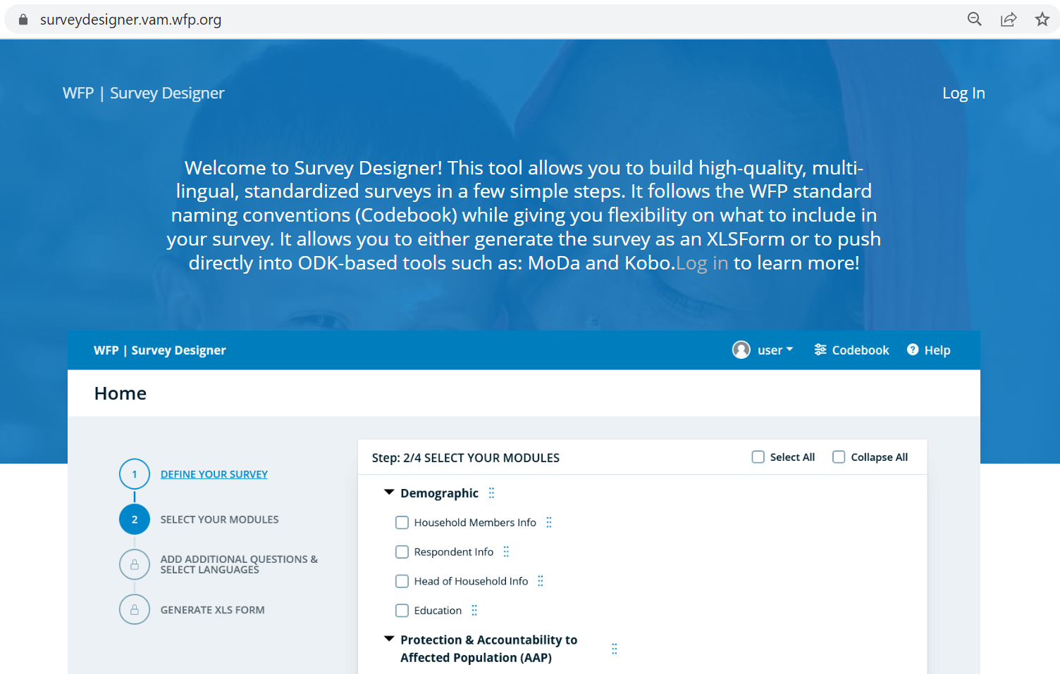
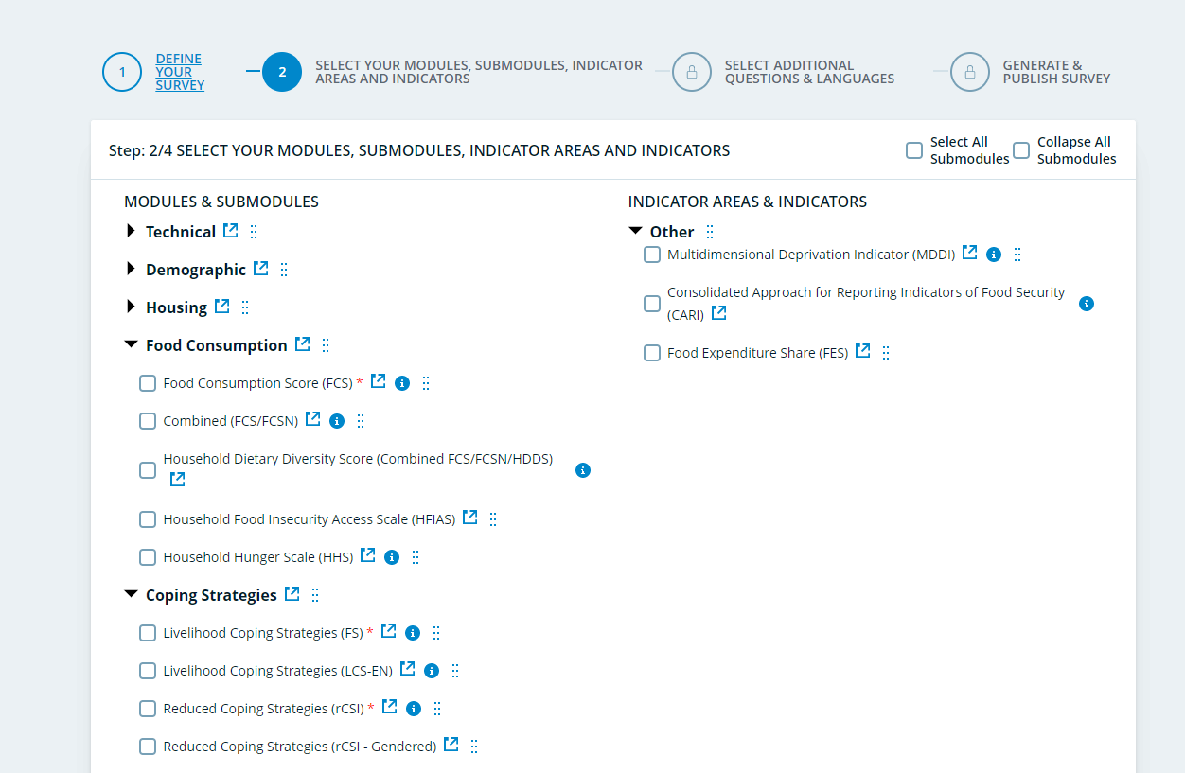
RCSI: Survey Designer
rCSI Codebook (Survey Designer)

Slide 33
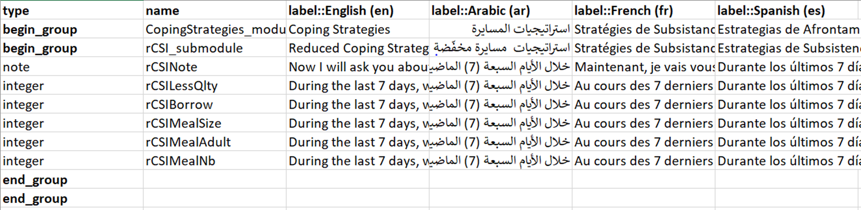
RCSI: Survey Designer

Slide 34
RCSI: Module design
When designing your questionnaire, including the rCSI module, please refer to the Survey Designer as it offers the WFP’s standard modules in XLSform and Word formats.
Additional consumption-based coping strategies can be included depending on the country context, but the core module must reflect the standard main question and strategies.
If you must rely on data collection tools and platforms that do not support XLSforms, then you must replicate the standard module correctly, including the visibility and validation constraints.
Notes:
If this opportunity is missed during the data cleaning phase, data analysts must ensure data quality through the triangulation of responses. Refer to the data quality assurance guidance note for more information.

Slide 35
Analysis

Slide 36
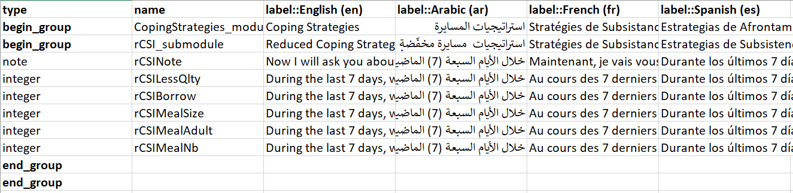
rCSi: Survey Designer
Find the latest standard rCSI module in XLSform on
Survey Designer

Slide 37
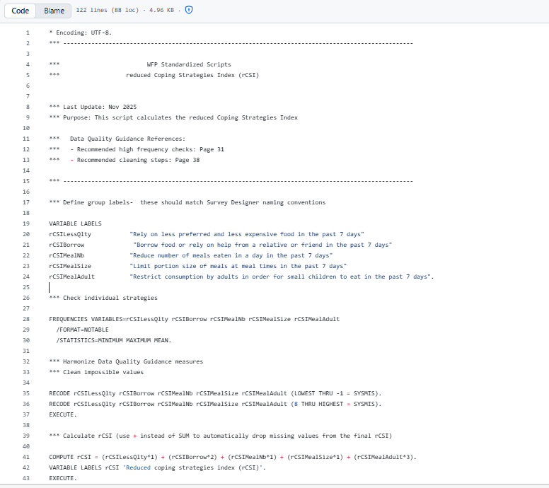
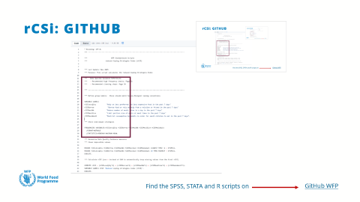
rCSi: GITHUB
Find the SPSS, STATA and R scripts on
GitHub WFP

Slide 38
Reporting

Slide 39
RCSI: REPORTING EXAMPLE
The usage of food-based coping strategies increased in frequency/severity from 2023 to 2024, reflected in an increase in rCSI from 12.1 in 2023 to 16.5 in 2024.
Women-headed households showed a higher level of coping in comparison to male-headed households (18.9 vs. 15.2).
A majority of the households limited their portion size of meals. Furthermore, nearly two-thirds of households had to restrict adult consumption of food to allow small children to eat in the previous week.

Slide 40
RCSI: REPORTING EXAMPLE

Slide 41
Available Resources

Slide 42
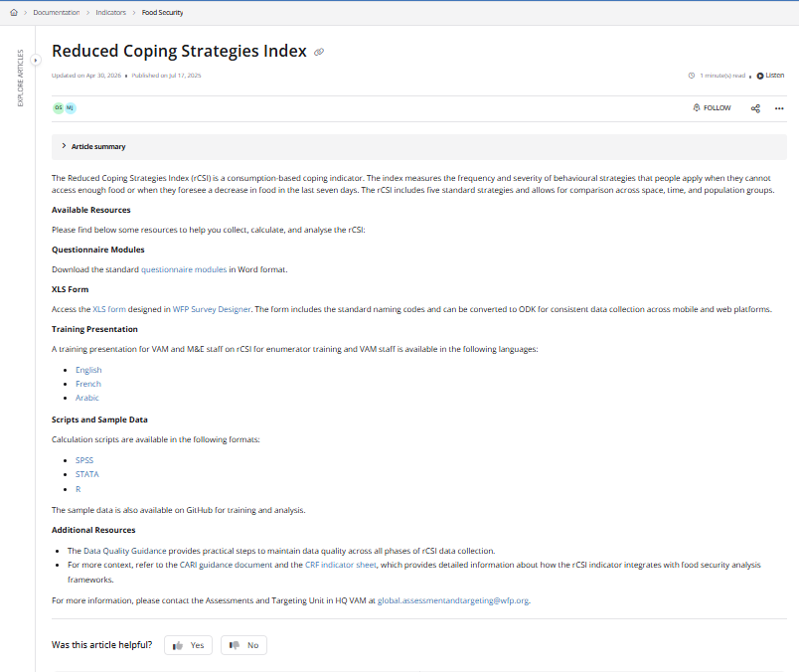
rCSi: VAM Resource Centre
For more information and guidance go to rCSI (Resource Centre)

Slide 43
Thank You!

