Slide 1


WFP/Badre Bahaji
Livelihood Coping Strategies for Essential Needs (LCS-EN) Needs Assessments & Targeting Unit
2024 August

Slide 2

AUDIENCE
The audience of this PowerPoint can range from enumerators to RAM and Programme staff in various offices. It can also be used for the training of partners or service providers.
Slide sections have been inserted to assist in the selection of relevant material based on the audience.

Slide 3

Guidance Note for LCS-EN
Please refer to the guidance note and list of strategies in the VAM Resource Center to explore the livelihood coping strategies for essential needs, as well as their explanations and relevance.

Slide 4
Introduction

Slide 5
LCS-EN: training instructions 1
Discuss the objectives of the module, i.e., to gain information on the livelihood coping strategies (for essential needs) applied by households in the targeted population. This includes the households’ capacity to deal with recent shocks and ability to overcome future shocks.
Explain the role of this indicator and the use of information, internally and externally. This gives the enumerators a clear understanding of the importance of the data they would be soon collecting.

Slide 6
Livelihood Coping Strategies (LCS) indicators
The Livelihood Coping Strategies (LCS) indicators are household-level indicators that are relatively simple to collect, and correlate with other measures of food security and vulnerability.
They are based on a series of questions about how households manage to cope with shocks that put stress on their livelihoods.
The LCS indicators assess the medium and longer-term household coping and productive capacities and their future impact on food and other essential needs.
Notes:
Last point: At an early onset of an emergency, households tend to resort to shorter-term consumption-based coping strategies to overcome immediate challenges in food shortages. If the situation persists, households begin seeking other outlets to meet their basic food or other essential needs. LCS indicators specifically aim at capturing these behaviors.

Slide 7
LCS: LCS-FS & LCS-EN
The livelihood coping strategies indicator exists in two versions: one for food security (LCS-FS) and another for essential needs (LCS-EN).
Essential needs version (LCS-EN) | Food Security version (LCS-FS)
Is to be used in essential needs assessments, or whenever the scope of an assessment is broader than food security. | Is to be used when the objective of a data collection exercise has a specific focus on food security.

Slide 8
LCS: USEs OF these indicators
LCS-FS | LCS-EN
Programme activity monitoring (food, cash for food); assessment of the food security situation of a population; and population-level targeting. | Programme activity monitoring (multi-purpose cash); assessment of vulnerability to meet essential needs of a population; and population-level targeting.
Used to classify households according to their level of food security, through Consolidated Approach for Reporting on food Insecurity (CARI). | Used to classify households according to their vulnerability to meet essential needs in the ENA vulnerability classification method.
One of the food security outcome indicators in the Integrated Food Security Phase Classification (IPC) acute food insecurity reference table. | One of the indicators used to determine the intersectoral severity in the Joint and Intersectoral Analysis Framework (JIAF)
Notes:
The LCS-EN can be used in a range of ways, including for programme activity monitoring, determining the food security and vulnerability situation of a population, and population-level targeting.
The LCS-EN is used to classify households according to their vulnerability to meet essential needs in the ENA vulnerability classification method.
The LCS-EN provides information on which gaps in essential needs drive the adoption of negative coping strategies.

Slide 9
LCS: What iS LCS measuring?
The LCS indicators measure the most severe livelihood coping strategy applied by the household during the 30 days prior to the interview or have exhausted by the household within the 12 months prior to the interview, as a response to….
LCS-FS: lack of food or money to purchase food
LCS-EN: lack of resources to access essential needs (e.g. food, housing, education and health services, etc.)
Notes:
**Mohamed**
This involves longer-term alteration of income-earning or food production patterns and one-off responses such as asset sales.

Slide 10
LCS-EN: What is it?
The LCS-EN measures the extent to which households have applied livelihood coping strategies as a response to a lack of resources to access essential needs (e.g. food, shelter, education, health services, etc.) during the last 30 days prior to the survey.
This involves a longer-term alteration of income-earning activities and one-off responses such as asset sales due to a lack of resources to meet essential needs.
The LCS-EN helps to assess longer-term household coping and productive capacities and their future impact on access to essential needs.

Slide 11
The LCS-EN Module

Slide 12
LCS-EN: training instructions 2
Note how the main question is worded (on the next slide). The question refers to whether the household applied each livelihood coping strategy in the last 30 days.
Explain the rationale behind each coping strategy in the questionnaire module by referring to the list of strategies.
Explain each of the answers and what they mean, while ensuring that potential follow-up questions and clarifications are understood.
Probing should be carried out during data collection to capture the most accurate responses.

Slide 13
LCS-EN MODULE: main question
During the past 30 days, did anyone in your household have to engage in any of the following activities due to a lack of resources to access essential needs (e.g., food, shelter, education, health services, etc.) ? | 10 = No, because we did not need to 20 = No, because we already sold those assets or have engaged in this activity within the last 12 months and cannot continue to do it 30= Yes 9999= Not applicable (don’t have access to this strategy) | Indicative severity of the strategy (Country office to attribute the relevant severity, the following is just an example) | Variable names
1.1 Sold household assets/goods (radio, furniture, television, jewellery, etc.) due to a lack of resources to access essential needs | | __ | | Stress | Lcs_stress_DomAsset
1.2 Borrow money to cover essential needs | | __ | | Stress | Lcs_stress_BorrowCash
1.3 Spent savings due to a lack of resources to access essential needs | | __ | | Stress | Lcs_stress_Saving
1.4 Sell, share, or exchange in-kind assistance due to a lack of resources to access essential needs | | __ | | Stress | Lcs_stress_SellRation
1.5 Sold productive assets or means of transport (sewing machine, wheelbarrow, bicycle, car, etc.) due to a lack of resources to access essential needs | | __ | | Crisis | Lcs_crisis_ProdAssets
1.6 Reduced expenses on essential health (including medicines) due to a lack of resources to access essential needs | | __ | | Crisis | Lcs_crisis_Health
1.7 Withdrew children from school due to a lack of resources to access essential needs | | __ | | Crisis | Lcs_crisis_OutSchool
1.8 Mortgaged/sold the house where the household was permanently living or land due to a lack of resources to access essential needs | | __ | | Emergency | Lcs_em_ResAsset
1.9 Begged (asked strangers for money/food on the streets) or scavenged due to a lack of resources to access essential needs | | __ | | Emergency | Lcs_em_Begged
1.10 Engage in socially degrading, high-risk, exploitive or life-threatening jobs or income-generating activities (e.g., smuggling, theft, joining armed groups, prostitution) due to a lack of resources to access essential needs | | __ | | Emergency | Lcs_em_IllegalAct
During the past 30 days, did anyone in your household have to [ … ] due to a lack of resources to access essential needs (e.g., food, shelter, education, health services, etc.) ?

Slide 14

LCS-EN MODULE: main question
…Due to a lack of resources
… to access essential needs (e.g., food, shelter, education, health services, etc.) ?
What do we mean by a “lack of resources”
What do we mean by “essential needs”?
Lack of resources includes both when households do not have direct access to essential goods and services (e.g. own-production of food and fuels; free public health services), or when they do not have the money to buy these essential goods and services.
Essential needs are “the goods, utilities, services or resources required on a regular, seasonal, or exceptional basis by households for ensuring survival and minimum living standards, without resorting to negative coping mechanisms or compromising health, dignity, and essential livelihood assets”
Although examples of common essential needs are provided in the main question, what counts as essential will depend on the context.
Notes:
The question on LCS-EN requires a bit of clarification:
1) Lack of resources means either lack of direct access to good and services or lack of money to buy them…the rational is the same than for FS
2) But what do we mean by essential needs? We have a general definition here, but as you can imagine, what is defined as ‘essential’ is somehow subjective and depends on the context, but typically refers to food, shelter, education, health services, etc.

Slide 15
LCS-EN MODULE: Follow-up Question
 | 10 = No, because we did not need to 20 = No, because we already sold those assets or have engaged in this activity within the last 12 months and cannot continue to do it 30= Yes 9999= Not applicable (don’t have access to this strategy) | Indicative severity of the strategy (Country office to attribute the relevant severity, the following is just an example) | Variable names
1.1 Sold household assets/goods (radio, furniture, television, jewellery, etc.) | | __ | | Stress | Lcs_stress_DomAsset
1.2 Borrow money to cover food needs | | __ | | Stress | Lcs_stress_BorrowCash
1.3 Spent savings | | __ | | Stress | Lcs_stress_Saving
1.4 Sent household members to eat elsewhere | | __ | | Stress | Lcs_stress_EatOut
1.5 Sold productive assets or means of transport (sewing machine, wheelbarrow, bicycle, car, etc.) | | __ | | Crisis | Lcs_crisis_ProdAssets
1.6 Reduced expenses on health (including drugs) | | __ | | Crisis | Lcs_crisis_Health
1.7 Withdrew children from school | | __ | | Crisis | Lcs_crisis_OutSchool
1.8 Mortgaged/sold the house where the household was permanently living or land | | __ | | Emergency | Lcs_em_ResAsset
1.9 Begged (asked strangers for money/food on the streets) or scavenged | | __ | | Emergency | Lcs_em_Begged
1.10 Engage in socially degrading, high-risk, exploitive or life-threatening jobs or income-generating activities (e.g., smuggling, theft, joining armed groups, prostitution) | | __ | | Emergency | Lcs_em_IllegalAct
What are the main reasons - i.e. to access which essential needs – that you or other members in your household applied these coping strategies? Note to enumerator: do not list the below as options to the respondent. Instead, mark all those that apply based on the answer provided. |  | LhCSIEnAccess
 |  | 1 To buy food 2 To pay for rent 3 To pay school, education costs 4 To cover health expenses 5 To buy non-food items (clothes, small furniture...) 6 To access water/sanitation facilities 7 To access essential dwelling services (electricity, energy, waste disposal…) 8 To pay for existing debts 999 Other specify
During the past 30 days, did anyone in your household have to engage in any of the following activities due to a lack of resources to access essential needs (e.g., food, shelter, education, health services, etc.) ?
What are the main reasons - i.e. to access which essential needs – that you or other members in your household applied these coping strategies?
Notes:
Back to the structure of the module, another difference of the EN version of the LCS module is that the module must include an additional final question asking the main reasons for adopting the strategies. We will come back to this later.

Slide 16
LCS-EN MODULE: response options
During the past 30 days, did anyone in your household have to engage in any of the following activities due to a lack of resources to access essential needs (e.g., food, shelter, education, health services, etc.) ? | 10 = No, because we did not need to 20 = No, because we already sold those assets or have engaged in this activity within the last 12 months and cannot continue to do it 30= Yes 9999= Not applicable (don’t have access to this strategy) | Indicative severity of the strategy (Country office to attribute the relevant severity, the following is just an example) | Variable names
1.1 Sold household assets/goods (radio, furniture, television, jewellery, etc.) due to a lack of resources to access essential needs | | __ | | Stress | Lcs_stress_DomAsset
1.2 Borrow money to cover essential needs | | __ | | Stress | Lcs_stress_BorrowCash
1.3 Spent savings due to a lack of resources to access essential needs | | __ | | Stress | Lcs_stress_Saving
1.4 Sell, share, or exchange in-kind assistance due to a lack of resources to access essential needs | | __ | | Stress | Lcs_stress_SellRation
1.5 Sold productive assets or means of transport (sewing machine, wheelbarrow, bicycle, car, etc.) due to a lack of resources to access essential needs | | __ | | Crisis | Lcs_crisis_ProdAssets
1.6 Reduced expenses on essential health (including medicines) due to a lack of resources to access essential needs | | __ | | Crisis | Lcs_crisis_Health
1.7 Withdrew children from school due to a lack of resources to access essential needs | | __ | | Crisis | Lcs_crisis_OutSchool
1.8 Mortgaged/sold the house where the household was permanently living or land due to a lack of resources to access essential needs | | __ | | Emergency | Lcs_em_ResAsset
1.9 Begged (asked strangers for money/food on the streets) or scavenged due to a lack of resources to access essential needs | | __ | | Emergency | Lcs_em_Begged
1.10 Engage in socially degrading, high-risk, exploitive or life-threatening jobs or income-generating activities (e.g., smuggling, theft, joining armed groups, prostitution) due to a lack of resources to access essential needs | | __ | | Emergency | Lcs_em_IllegalAct
There are only 4 possible standard response options for each strategy:
10 = No because we did not need to.
20 = No because we already sold those assets or have engaged in this activity within the last 12 months and cannot continue to do it.
30= Yes
9999= Not applicable (don’t have access to this strategy)
Notes:
Codes are standard for questionnaire module design and analysis

Slide 17

LCS-EN MODULE: response options
There are only 4 possible standard response options for each strategy:
10 = No because we did not need to.
20 = No because we already sold those assets or have engaged in this activity within the last 12 months and cannot continue to do it.
30= Yes
9999= Not applicable (don’t have access to this strategy)
Demonstrates two different scenarios:
The household did not need to rely on a strategy because they did not face a lack of resources to access essential needs, OR
The household relied on a different livelihood coping strategy to overcome the lack of access to essential needs.
If a household respondent says "no", we need to ask why, so that we can choose the most appropriate response option.

Slide 18
LCS-EN MODULE: response options
There are only 4 possible standard response options for each strategy:
10 = No because we did not need to.
20 = No because we already sold those assets or have engaged in this activity within the last 12 months and cannot continue to do it.
30= Yes
9999= Not applicable (don’t have access to this strategy)
Again, if a household respondent says “no” then we must introduce probing to understand why that is, to select the most appropriate response option.
It means that a household may not be able to apply a coping strategy as it was applied and exhausted before the 30 days (but within the last 12-month timeframe), due to a lack of resources to access essential needs.
If a household indicates they exhausted a strategy, then
ensure to capture the reason. If it is NOT related to a lack of resources to access essential needs, then the appropriate response is “No because we did not need to”.
Make sure this happened within the last 12 months. Otherwise, the appropriate answer is “Not applicable…”
Ensure that exhaustion is possible, e.g., it is rarely possible to exhaust begging.

Slide 19
LCS-EN MODULE: response options
There are only 4 possible standard response options for each strategy:
10 = No because we did not need to.
20 = No because we already sold those assets or have engaged in this activity within the last 12 months and cannot continue to do it.
30= Yes
9999= Not applicable (don’t have access to this strategy)
If a household respondent says “yes” then we must introduce probing to understand why that is and select the most appropriate response option.
It may be that a household has adopted a coping strategy or activity for some other reason unrelated to the lack of resources to access essential needs.
It means that a household applied a coping strategy within the last 30 days due to a lack of resources to access essential needs.

Slide 20
LCS-EN MODULE: response options
There are only 4 possible standard response options for each strategy:
10 = No because we did not need to.
20 = No because we already sold those assets or have engaged in this activity within the last 12 months and cannot continue to do it.
30= Yes
9999= Not applicable (don’t have access to this strategy)
The household respondent may say “no” or this does not apply. We must use probing to understand why that is and select the most appropriate response. In this case, the strategy may not be applicable to their household.
It means that a household is not able to rely on a coping strategy as it does not apply to them because they don’t have access to this strategy (e.g., there are no children in the household to withdraw from school), or that the household exhausted the strategy more than 12 months ago.

Slide 21


LCS-EN MODULE: lookouts!
There are only 4 possible standard response options for each strategy:
10 = No because we did not need to.
20 = No because we already sold those assets or have engaged in this activity within the last 12 months and cannot continue to do it.
30= Yes
9999= Not applicable (don’t have access to this strategy)
For some strategies, such as begging or stealing, it is rare to fully exhaust these strategies (unless the household is in extremely isolated areas where there is no one else to beg from or steal from).
Additionally, for some strategies, the option "Not Applicable" is not an option because, regardless of how "socially unacceptable" these strategies may be, they are still applicable. For these strategies, the answer should either be "Yes" or "No, we didn't need to (or applied other strategies)."

Slide 22
LCS-EN MODULE:FOLLOW-UP QUESTION
Note that LCS-EN has a follow-up question that must be asked as part of the core module.
At the end of the module, if the respondent reported to have applied or exhausted at least one strategy, this follow up question is asked:
Purpose:
Gather insights into the main unmet essential needs in the population
Be able to use LCS-EN module to calculate LCS-EN indicator, when this is needed (i.e., to be able to compute CARI or for IPC exercise)
2. What are the main reasons - i.e., to access which essential needs - that you or other members in your household applied these coping strategies?
1 To buy food 2 To pay for rent or access adequate shelter 3 To pay for school fees or other education costs 4 To cover health expenses 5 To buy essential non-food items (clothes, small furniture...) 6 To access water/sanitation facilities 7 To access essential dwelling services (electricity, energy, waste disposal…) 8 To pay for existing debts 999 Other, specify
The enumerator should not list these options to the respondent. Instead, should mark all those that apply based on the answer provided.

Slide 23
SEVERITY levelS of lcs strategies
Notes:
**Mohamed**

Slide 24
LCS-EN MODULE: COPING STRATEGIES
During the past 30 days, did anyone in your household have to engage in any of the following activities due to a lack of resources to access essential needs (e.g., food, shelter, education, health services, etc.) ? | 10 = No, because we did not need to 20 = No, because we already sold those assets or have engaged in this activity within the last 12 months and cannot continue to do it 30= Yes 9999= Not applicable (don’t have access to this strategy) | Indicative severity of the strategy (Country office to attribute the relevant severity, the following is just an example) | Variable names
1.1 Sold household assets/goods (radio, furniture, television, jewellery, etc.) due to a lack of resources to access essential needs | | __ | | Stress | Lcs_stress_DomAsset
1.2 Borrow money to cover essential needs | | __ | | Stress | Lcs_stress_BorrowCash
1.3 Spent savings due to a lack of resources to access essential needs | | __ | | Stress | Lcs_stress_Saving
1.4 Sell, share, or exchange in-kind assistance due to a lack of resources to access essential needs | | __ | | Stress | Lcs_stress_SellRation
1.5 Sold productive assets or means of transport (sewing machine, wheelbarrow, bicycle, car, etc.) due to a lack of resources to access essential needs | | __ | | Crisis | Lcs_crisis_ProdAssets
1.6 Reduced expenses on essential health (including medicines) due to a lack of resources to access essential needs | | __ | | Crisis | Lcs_crisis_Health
1.7 Withdrew children from school due to a lack of resources to access essential needs | | __ | | Crisis | Lcs_crisis_OutSchool
1.8 Mortgaged/sold the house where the household was permanently living or land due to a lack of resources to access essential needs | | __ | | Emergency | Lcs_em_ResAsset
1.9 Begged (asked strangers for money/food on the streets) or scavenged due to a lack of resources to access essential needs | | __ | | Emergency | Lcs_em_Begged
1.10 Engage in socially degrading, high-risk, exploitive or life-threatening jobs or income-generating activities (e.g., smuggling, theft, joining armed groups, prostitution) due to a lack of resources to access essential needs | | __ | | Emergency | Lcs_em_IllegalAct
Instructions:
For your country-level presentation, ensure that the strategy statements presented (in grey) are updated with your final module.
Refer to the available materials on the VAM Resource Centre.
4 stress
3 crisis
3 emergency

Slide 25
LCS-EN : severity - Stress
Stress
indicates a reduced ability to deal with future shocks due to a current reduction in resources or increase in debts.
For example, the first action a household would take when faced with a shock or stressor is the gradual disposal of assets - for example, spending of savings, selling simple assets, or borrowing money.

Slide 26
LCS-EN : severity – Crisis
Stress
indicates a reduced ability to deal with future shocks due to a current reduction in resources or increase in debts.
If the situation persists or worsens, then they would resort to crisis coping strategies, and when, for example, productive assets are sold or essential healthcare/medication expenditures are reduced, it becomes more difficult for the person or household to return to a pre-crisis state.
Crisis
directly reduces future productivity, including human capital formation.

Slide 27
LCS-EN : severity – Emergency
Stress
indicates a reduced ability to deal with future shocks due to a current reduction in resources or increase in debts.
Finally, the household may resort to selling their only house/land, beg or scavenge, sell their last productive female animal which reduces future productivity and difficult to reverse or they are humiliating and dramatic in nature.
Crisis
directly reduces future productivity, including human capital formation.
Emergency
affects future productivity but are more difficult to reverse or more dramatic in nature.

Slide 28
LCS-EN: severity LEVELS
Stress
indicates a reduced ability to deal with future shocks due to a current reduction in resources or increase in debts.
The adoption of stress, crisis and emergency livelihood coping strategies occurs in a sequence form, rather than simultaneously.
Crisis
directly reduces future productivity, including human capital formation.
Emergency
affects future productivity but are more difficult to reverse or more dramatic in nature.

Slide 29
How do they all come together?

Slide 30
LCS-EN : classification of households
If a household had relied on one or more stress coping strategy (ies) in the last 30 days or had exhausted this strategy(ies) in the previous 12 months
Household is applying stress coping
If the same household had relied on one or more crisis coping strategy(ies) in the last 30 days or had exhausted this (or these) strateg(ies) in the previous 12 months
Household is applying crisis coping
If the same household had relied on one or more emergency coping strategy(ies) in the last 30 days or had exhausted this (or these) strategy(ies) in the previous 12 months
Household is applying emergency coping

Slide 31
The livelihood coping strategies

Slide 32
LCS-EN: training instructions 3
Depending on the time available for the enumerator training, it is suggested to review each of the list of strategies and potential lookouts and verification examples.
Review the list of strategies to include the tables with the 10+ relevant strategies selected for your country context as individual slides (see the following three slides as examples)
Be sure to highlight key elements, including what each of the response options mean for each question and verification examples and probing strategies.
Note that if time does not allow for this, then the information should at least be included in the enumerator training manual.

Slide 33
EXAMPLE DESCRIPTION OF A STRESS COPING STRATEGY
Stress
(Variable name: LcsEN_stress_Saving) During the past 30 days, did anyone in your household have to spend savings due to a lack of resources to access essential needs?
Rationale/Use | What does each response option mean? | Verification examples
Rationale: Spending savings weakens the ability of households to fall back on readily available cash, unlike assets that require liquidation. Savings are understood as money or other valuables (i.e., gold jewellery) put aside for future use/consumption. For example, cash that is put aside for household emergencies, ceremonies, schooling, or other large expenditures. Savings could be also intended for future investments (e.g., family business, buying land livestock etc.). Lookouts: It is vital to ask about the spending of savings, rather than the spending of the household’s income. Be careful about the use of this strategy in a protracted displacement setting, as most of the households would have exhausted this strategy more than 12 months ago; thus, this strategy would not apply to most households. Note that for the case of gold jewellery, there can be some overlap with “DomAsset,” & “Pawn,” thus, it is advised to avoid using more than one of these strategies in the same module. Severity: Almost always has a stress severity. | No, there was no need to spend savings because the household did not face a lack of resources to access essential needs or had applied another livelihood coping strategy. | Probing is needed to ensure the selection of the most appropriate response. 1) does your household have savings? 2) why did you not spend the savings (or not)?
 | Yes, the household needed to spend savings in the last 30 days due to a lack of resources to access essential needs. | Ensure that the household spent savings to be able to afford essential needs, and not for other reasons.
 | No, because the household had already spent its savings within the last 12 months, and now the household ran out of savings. | If the household responds, “we used to have savings but had to spend them before the past 30 days but within the last year” then the appropriate response option is “no because it had already been exhausted in the last 12 months”.
 | Not applicable as the household has not had savings in over 12 months. | If the household responds, “we do not have savings and did not have savings in the last year, as our income barely covers our expenditures” then the appropriate response choice is “not applicable”.
Notes:
Saving is that part of income which is not spent on current consumption. Saving - gradually putting money or gold aside, typically into a bank account. People generally save for a particular goal, like paying for a car, a down payment on a house, or any emergencies that might come up. It provides a person or a household with some financial security.
Income is money received, especially on a regular or irregular basis, from work or through investments.

Slide 34
EXAMPLE DESCRIPTION OF A CRISIS COPING STRATEGY
Crisis
(Variable name: LcsEN_crisis_OutSchool) During the past 30 days, did your household have to withdraw children from school (compulsory education) due to a lack of resources to access essential needs (e.g., food, shelter, education, health services, etc?
Rationale/Use | What does each response option mean? | Verification examples
Rationale: This decreases human capital, so is considered a crisis strategy, removing children from school will have a huge influence on their future productivity and it is a violation of their right to education. Lookouts and use: This strategy is relevant for households with children who are of school age for compulsory education (normally this is ages 6-16). If a household withdrew children from high school or vocational high education to contribute to household income, this is not considered under this coping strategy. Severity: Normally the severity is ‘crisis’ for this strategy, but in certain contexts, it could be considered ‘emergency’ severity level. | No, there was no need to withdraw children from school because the household did not face food shortages or lack of resources to access essential needs or had applied another livelihood coping strategy. | Probing is needed to ensure the selection of the most appropriate response. 1) do you have any school-aged children? 2) why did you need to apply this strategy (or not)?
 | Yes, the household needed to withdraw children from school in the last 30 days due to a lack of resources to access essential needs. | Ensure that they withdrew children from school due to lack of resources to access essential needs.
 | No, because the household had already withdrawn children from school within the last 12 months. | If the household already withdrew all their school-aged children from school due to lack of money before the 30 days, and within the last 12 months.
 | Not applicable as the household does not have school-aged children and did not in the last 12 months. It is also possible that the household has school-aged children who have never been enrolled in school or have withdrawn from school more than 12 months ago. | The not applicable response is only relevant if the household: 1) does not have children within the school-age category. 2) never enrolled their children in school or the children were withdrawn more than 12 months prior to the interview. 3) there are no schools around.

Slide 35
EXAMPLE DESCRIPTION OF AN EMERGENCY COPING STRATEGY
Emergency
(Variable name: LcsEN_em_IllegalAct) During the past 30 days, did anyone in your household have to engage in socially degrading, high-risk, exploitive or life-threatening jobs or income-generating activities (e.g., smuggling, theft, joining armed groups, prostitution) due to a lack of resources to access essential needs (e.g., food, shelter, education, health services, etc.)?
Rationale/Use | What does each response option mean? | Verification examples
Rationale: This coping strategy is referring to income-generating activities that are high risk or socially degrading - thus, leading to loss of human dignity and posing protection risks to involved household members. Lookouts and use: Need to emphasise the reasons for engaging in illegal activities: often it could be financially rewarding (e.g., smuggling, selling drugs) and people do it because of that, not because they are desperate or in need of food and/or other essential goods and services. Avoid using this strategy in contexts where households would be fearful of reporting such activities. Some activities are illegal by law, but they are still considered normal activities such as charcoal production, or refugees who are by law not allowed to work outside camps. Given that these activities are regularly accepted, they would not be qualified as an emergency strategy. Severity: The severity of this strategy is almost always ‘emergency’. | No, there was no need to engage in socially degrading, high-risk, exploitive or life-threatening jobs or income-generating activities because the household did not face a lack of resources to access essential needs or had applied another livelihood coping strategy. | Probing is needed to ensure the selection of the most appropriate response. Probing should be context-specific and refer to commonly used socially degrading, risky or exploitative activities. For example, if smuggling is a common activity for vulnerable households, then probing should focus on this, among others. Different terms can be used to describe these activities to soften the language. For example, smuggling can be rephrased as crossing the border with unregistered goods. Another example: joining armed groups could be reformulated as participating in groups to protect their families/communities.
 | Yes, the household needed to engage in socially degrading, high-risk, exploitive or life-threatening jobs or income-generating activities in the last 30 days due to a lack of resources to access essential needs. | Ensure that this strategy was applied due to a lack of resources to access essential needs.
 | No, because the household has already engaged in socially degrading, high-risk, exploitive or life-threatening jobs or income-generating activities within the last 12 months and this strategy has been exhausted as continuation would have more severe consequences.
 | This response option does not apply to this specific strategy. | ‘Not applicable' is not an option for this question because technically it could be applicable to all households if they are truly in need. While households that apply this strategy might have concerns about responding to this question, it is necessary to ask in order to understand if they have reached a level of emergency and have employed such a strategy.

Slide 36
Crosscheck the information in the LCS with the information in the rest of the sections.
Inconsistencies between household demographic information and coping strategies: If the household reports not having children, coping strategies related to children, such as pulling children out of school, transferring children to a less expensive school, child marriage, and child labor, should be marked as "Not Applicable." However, it is possible that family members mentioned in the coping strategies related to children were not counted in the demographics section if they had already left due to migration, marriage, or being sent to live elsewhere.
Inconsistencies between assets and coping strategies: If the household reports currently owning assets such as household items or electrical appliances, or means of transportation, then coping strategies related to domestic and productive assets cannot be recorded as exhausted. Also, if the household reports relying on coping strategies specific to rural areas, such as selling animals, there should be some consistency in the ownership of agricultural assets.
Researchers should use observation and visual signals to probe and verify the responses.

Slide 37
Module Design

Slide 38
LCS-EN: Module design
When designing your questionnaire, including the LCS-EN module, please refer to the Survey Designer as it offers the WFP’s standard modules in XLSform and Word formats.
Additional livelihood coping strategies can be included but the core module must reflect the standard main question and strategies.
If you rely on data collection tools and platforms that do not support XLSforms, you must replicate the standard module correctly.
Notes:
An XLS Form is the Excel format of the content in a Survey questionnaire It contains all the questions and
the answer of each survey in chosen languages the skip logic and the rules that will inform the data
collection This allows transferring questions selected in the Survey Designer to online ODK tools for data
collection coded in a standardised way and facilitates data analysis following the data collection exercise

Slide 39
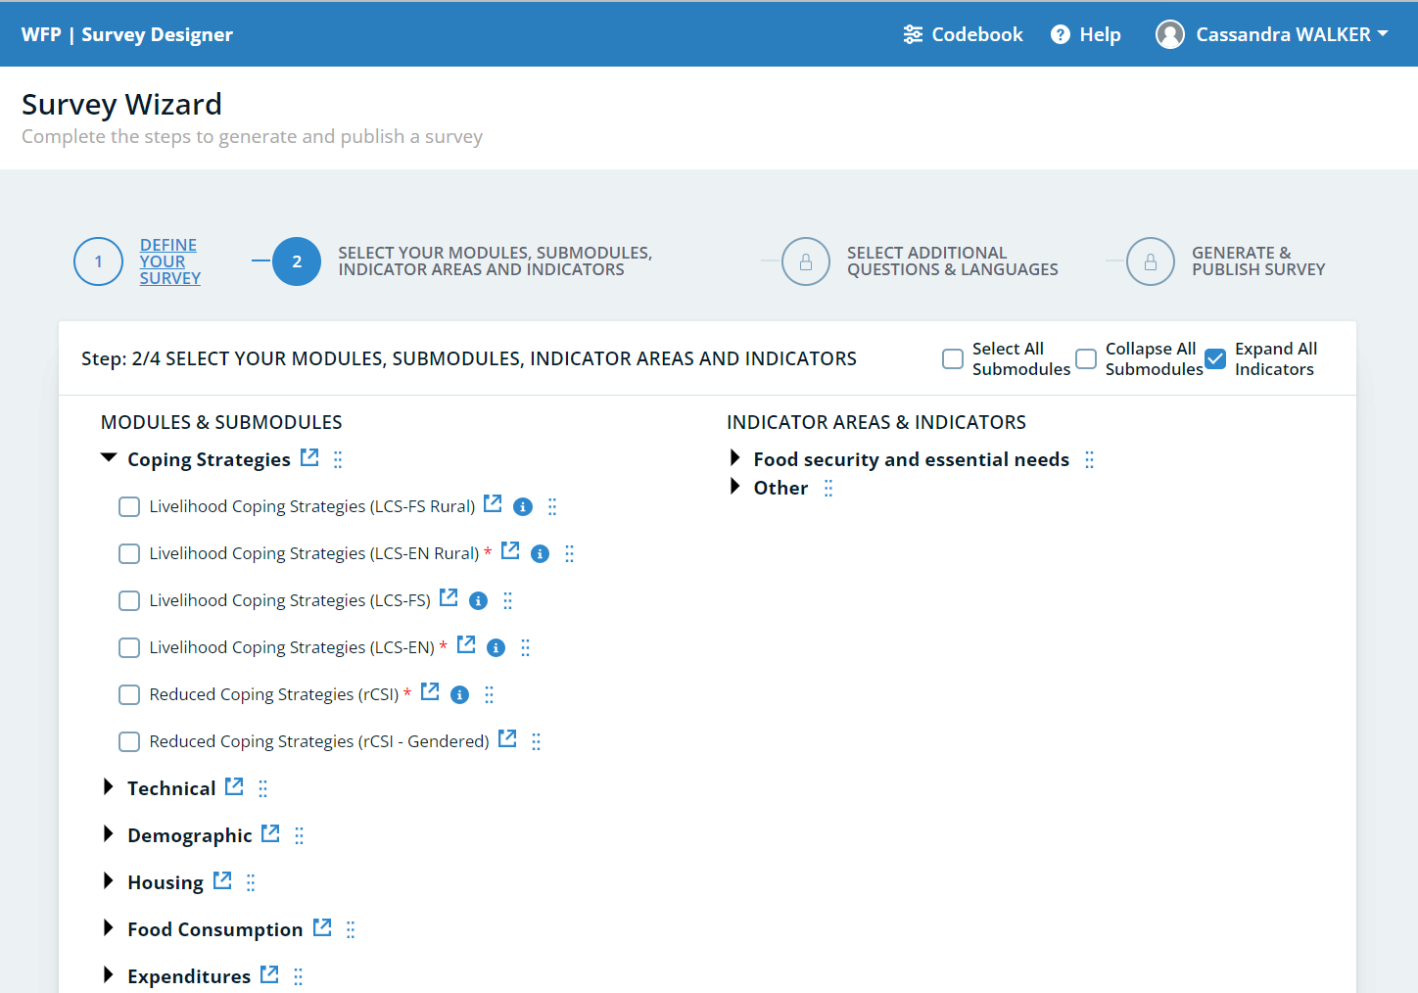
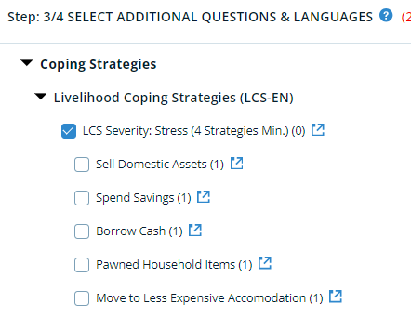
LCS-EN: Survey Designer
LCS-EN (Survey Designer)
Two steps:
1) Select the right LCS module
2) Choose the appropriate and relevant strategies for your context in each severity level
Important: ensure the inclusion of the minimum mandatory number of strategies: 4 stress, 3 crisis and 3 emergency
Notes:
The Survey Designer is WFP’s web-based tool that allows users to build tailored assessment, monitoring, and market-based questionnaires using standardized content in multiple languages.

Slide 40
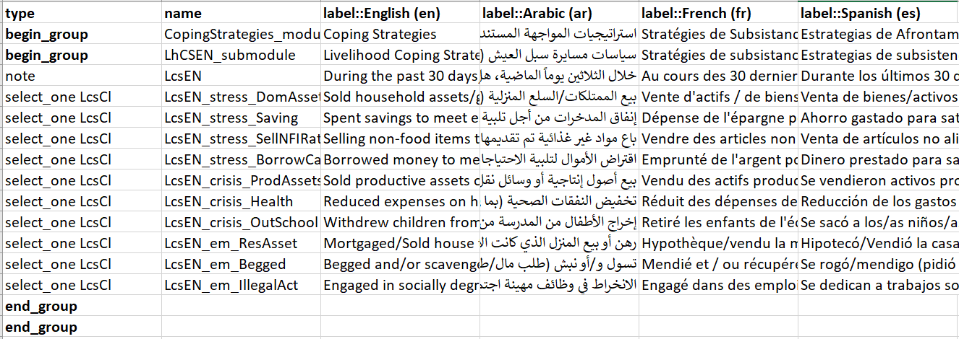
LCS-EN: Survey Designer
After selecting a minimum of 4 stress, 3 crisis and 3 emergency coping strategies, relevant to your context, and adding the local language(s), you can move to the final step in the Survey Designer where the XLSForm can be generated.
Find the latest standard LCS-EN strategies in XLSform on Survey Designer

Slide 41
Contextualising the module
Notes:
**Mohamed**

Slide 42
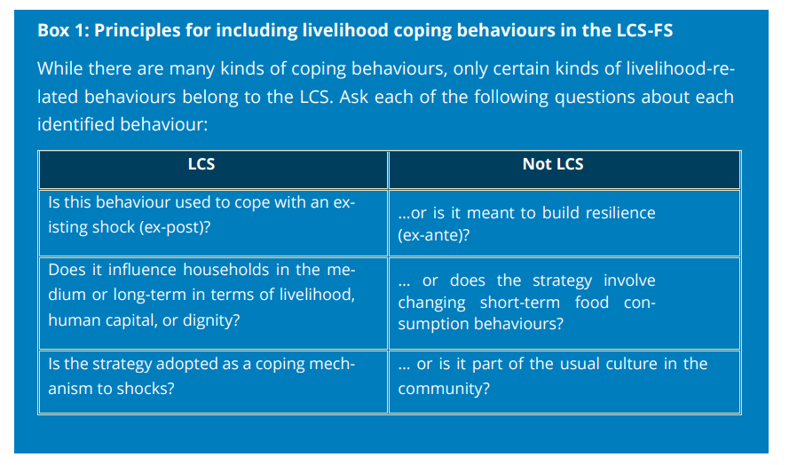
Developing new strategies

Slide 43
STEP 1: Desk review
For LCS-EN, please refer to the guidance note and list of strategies in the VAM Resource Center to explore the livelihood coping strategies for essential needs, as well as their explanations and relevance.
Refer to the proposed qualitative questionnaire for focus group discussions see the:
‘LCS-EN Qualitative tool’ here
Analyze existing LCS data from recent data collection activities, remove the irrelevant strategies
Review secondary data sources and anecdotal information on how people are coping
Conduct focus group discussions to validate the relevance of these strategies

Slide 44
Step 2: list of strategies
RESEARCH SCOPE
Ensure that all population groups of interest participate through focus group discussions. This will allow you to capture the different coping strategies applied by different populations.
Population groups of interest include:
Displaced residents refugee Migrants
The contextual parameters of interest are as follows:
rural urban camp etc.
It is essential to also ensure that all contextual settings present in your country office are covered.
RESEARCH QUESTION: What do people do when they don't have enough food to eat or money to buy food?
Questions to be asked during FGDs: How do households in your community cope with this specific shock (e.g., flood, drought, economic crisis, etc.)? How do households in your community cope to increase their households’ resources to access essential needs? How do households in your community cope to reduce the demand for essential goods and services? How do households in your community cope to distribute essential goods and services within their households?
Notes:
**Mohamed**

Slide 45
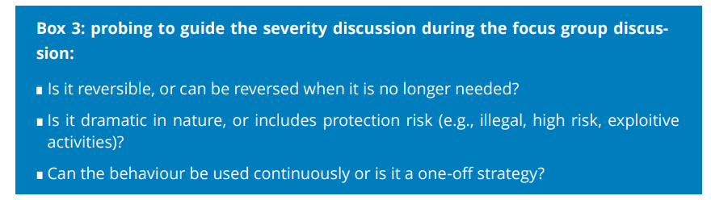
STEP 3: FGD (Adjusting The severity)
Split the FGD so that the list of coping strategies or behaviours is agreed upon first, then the severity is discussed.
Severity should be classified into 3 categories (stress, crisis and emergency). Agree on the least severe first, then the most severe, and the middle group will fall naturally.
The final determined severity is based on the expected medium or long-term impact on households foreseen by participants and the FGD should reach a consensus on this.
Newly formulated coping strategies must be communicated with the RAM-N for review and inclusion both in the standard Codebook and Survey Designer platform.
Global.ResearchAssessmentandTargeting@wfp.org
Notes:
**Mohamed**

Slide 46
Data quality checks
And Analysis

Slide 47
LCS-EN : EXPLORATION OF DATA
Run frequencies on each of the strategies in your module
2. If applicable, disaggregate the results by population groups (IDPs, refugees, etc.) and/or context setting (urban, rural, camps) to explore them separately
3. Closely examine the results of each answer option for each strategy
4. If you have more than the ten required strategies (4 stress, 3 crisis, and 4 emergency) then review the results to omit strategies that don’t apply to more than 50% of a given population group/strata.
*Important: if you have only 10 strategies and you have high proportions of not applicable against some strategies then ensure that you carry out a full review of your LCS-EN module by referring to the guidance note and related materials on the VAM Resource Centre.
Find the scripts for LCS-EN on GITHUB WFP

Slide 48
Quality check examples (1)
Track the results of each strategy and of the indicator per enumerator through cross-tabulation of LCS by enumerator.
If some enumerators tend to classify households differently than the average or tend to select the same answer options across most strategies, this could be due to a lack of understanding of the module, and they should be identified and re-trained.
The household assets section could be used to verify some of the answers to LCS. For example, if a household reports current ownership of productive assets, then a coping strategy related to selling those assets cannot be recorded as “exhausted”.
When the interviewee reports not having any school-aged children in their household, then coping strategies such as "withdrew children from school" or "moved children to a less expensive school" the response must be N/A.

Slide 49
Quality check examples (2)
Meanwhile, for some strategies, the N/A response option does not make sense; this is the case especially for the emergency coping strategies of begging and illegal activity.
The not applicable response is not an option for this question because it could be applicable to all households if they are truly in need. While households that apply this strategy might have concerns about responding to this question, it is necessary to ask in order to understand if they have reached a level of emergency and have employed such a strategy.
Likewise, it is not possible to ‘exhaust’ these strategies. The exhaustion of these coping strategies occur only in catastrophic/famine situations where there is near exhaustion of livelihoods in the community. There are usually always more illegal activities to engage in, or strangers to ask for money from.
Thus, if you see a high prevalence of ‘N/A’ or ‘no, exhausted’ responses, then the enumerators selecting these response should be identified and retrained.

Slide 50
LCS-EN : calculation
No matter how many strategies are included in your module, the indicator needs to be calculated ONLY based on 10 strategies (4 stress, 3 crisis, 3 emergency)
How to select the ten strategies to be used if you have more than the ten required strategies?
Omit strategies that don’t apply to more than 50% of a given population group/strata.
Among the strategies that are widely applied in the population, usually select those that are most applied
Notes:
Let’s talk about the calculation per se now….and let’s start by clarifying something very important…
…
So how do you choose within each level? …

Slide 51


LCS-EN: calculation
Build a dichotomous variable for each coping severity level, representing if a household adopted or exhausted any strategy with that level of severity.
Three dichotomous variables need to be created:
• stress_coping_EN
• crisis_copin_EN
• emergency_coping_EN
Then, a categorical variable is built, representing the severity level of the most severe strategy that a household adopted or exhausted. The categorical variable ranges from 1 to 4 and reflect one of four groups in which households are allocated:
• no use of stress, crisis, or emergency strategies
• use of stress strategies
• use of crisis strategies
• use of emergency strategies
Notes:
If a household responds with “No, because we already sold those assets or have engaged in this activity within the last 12 months and cannot continue to” to a strategy, that household is considered to have experienced that strategy. Conversely, if a household responds with “No because we did not need to” or “Not applicable (don’t have access to this strategy)”, then the household is considered to not have experienced that particular strategy.

Slide 52
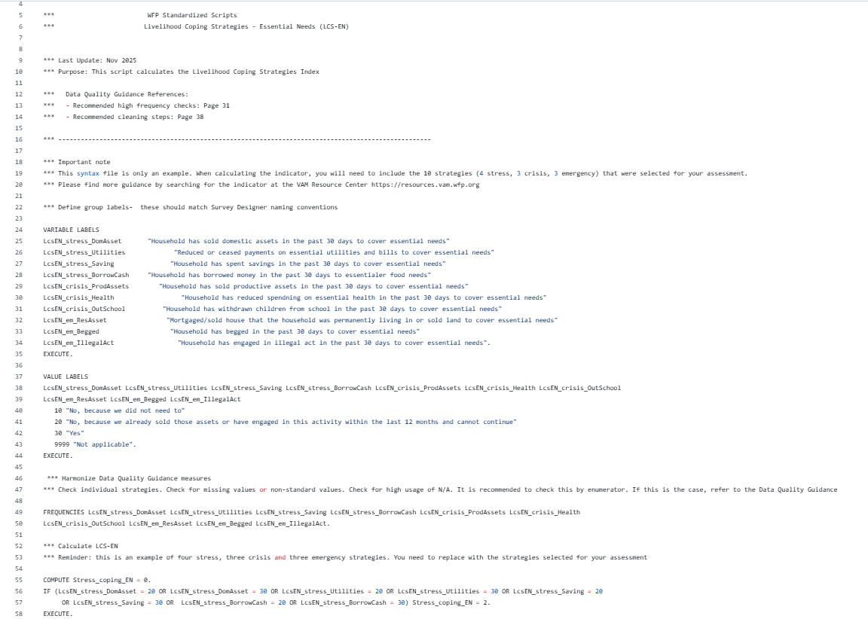
LCS-EN: GITHUB
Find the scripts for LCS-EN on GITHUB WFP

Slide 53
Reporting

Slide 54
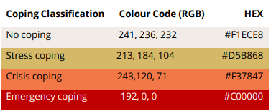
LCS-EN: REPORTING EXAMPLE
“Analysis results of the LCS-EN indicator have shown that 47 percent of interviewed households reported having relied on livelihood coping strategies in the previous month or having exhausted them within the last 12 months due to lack of resources to access essential needs.
Comparisons between households headed by females and males have shown a higher proportion of those headed by females relying on stress coping strategies. This may be explained by the limited work opportunities for women. “
Figure 1 - Proportion of households relying on livelihood coping strategies for essential needs
Reminder:
Please use the standard colours

Slide 55
LCS-EN: REPORTING EXAMPLE
Figure 2 - Proportion of households relying on each of the livelihood coping strategies for essential needs
“When looking at the analysis results by the individual coping strategies, it becomes apparent that borrowing money to cover essential needs (30%), spending of savings (16%), as well as the reduction of expenditures on essential health (15%), are the strategies most often applied by households.
In addition, a relatively high proportion of households (9%) resorted to selling their last female animal. Resorting to this strategy may come with negative long-term consequences on the livelihoods of the affected households as it may be difficult to reverse this strategy; female animals are the reproductive assets for livestock owners, which provide their households with milk and more animals for income generation.”

Slide 56
Available Resources

Slide 57
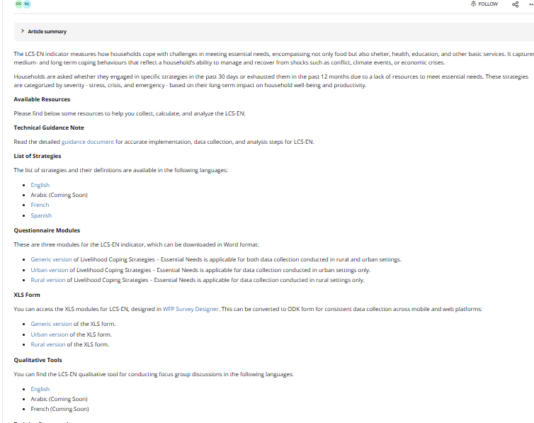
LCS-EN: VAM Resource Centre
For more information and guidance on LCS-EN go to VAM Resource Center

Slide 58
Thank You!

