Slide 1

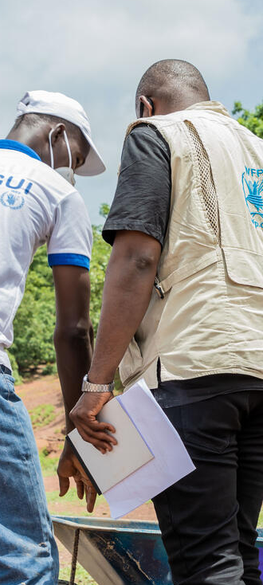

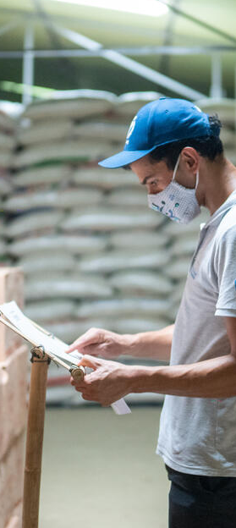
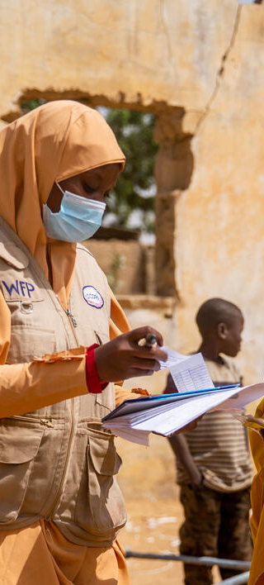
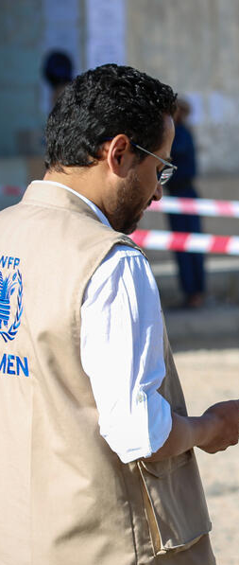
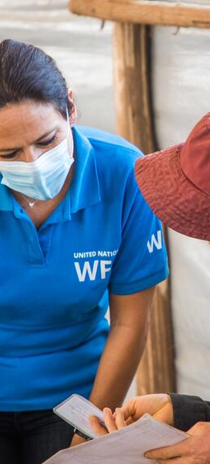

Strategic Roundtable on Looming Food Crises
Annual Partnership Consultation 2023
Dr. Arif Husain, Chief Economist

Slide 2
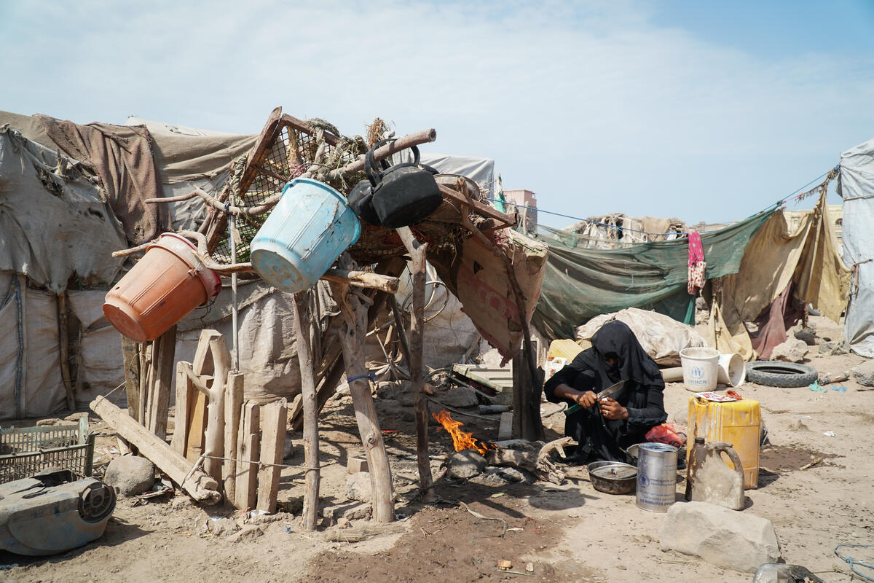
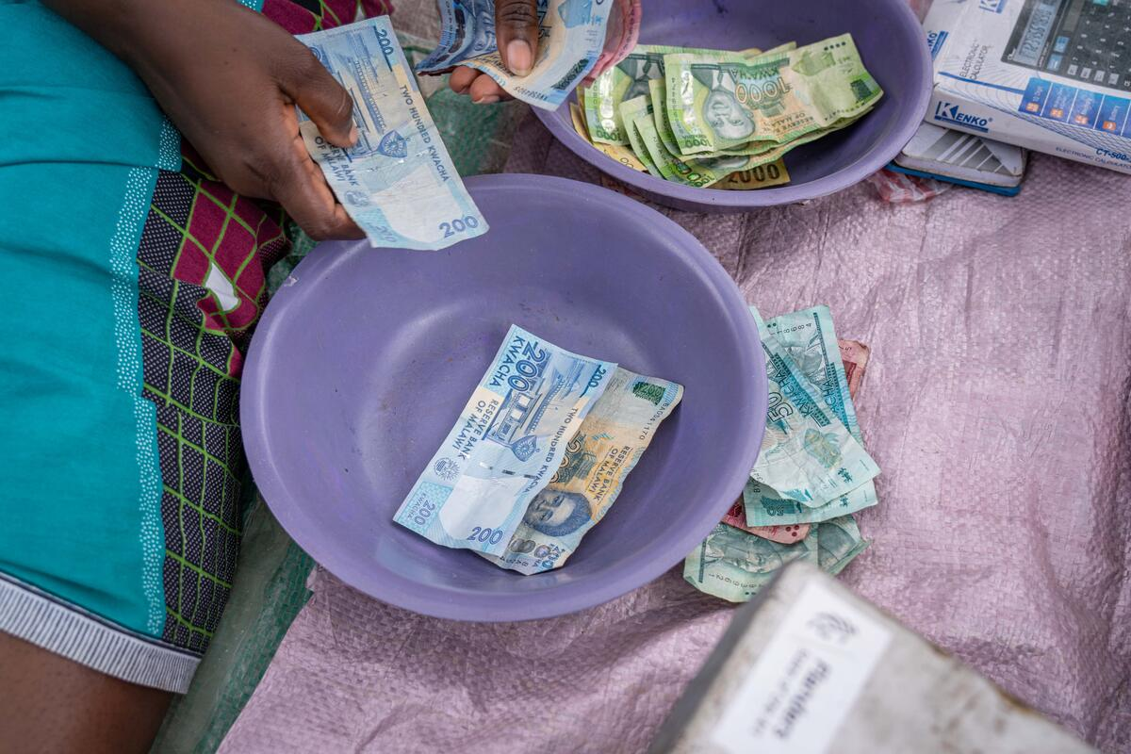
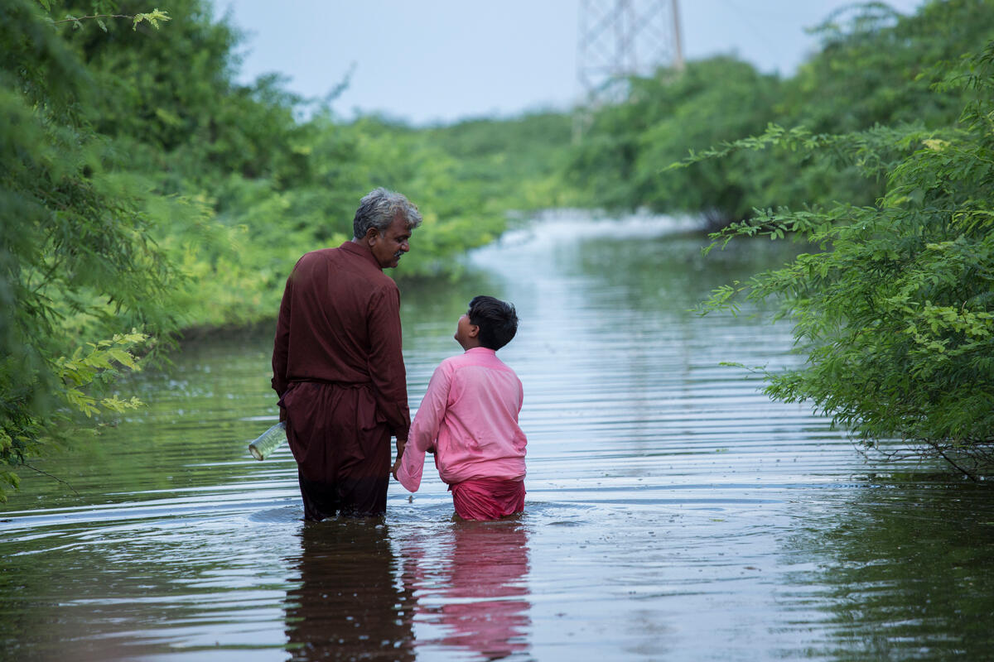
  CONFLICT & INSECURITY
  ECONOMIC
  SHOCKS
  CLIMATE
  CRISIS

Slide 3
  CONFLICT & INSECURITY
  ECONOMIC SHOCKS
  CLIMATE CRISIS
Global prices are still at crisis level
 | Today vs Pre-COVID (% change) | Today vs Pre-Ukraine (% change) | Today vs 2022/23-Peak (% change)
Indices
Food Price Index | +25% | -4% | -22%
Fertilizer Index | +98% | -31% | -47%
Natural Gas Price Index | +108% | -64% | -80%
Prices
Maize | +34% | -15% | -36%
Rice | +53% | +58% | 0%
Wheat | +39% | -29% | -48%
Currencies
DXY Dollar Index | +8% | +9% | -6%
Source: IMF , Trading Economics
Notes:
Data sources
Indices and prices from IMF Primary Commodity Price System (Excel Database: https://www.imf.org/en/Research/commodity-prices)
DXY from Trading Economics (https://tradingeconomics.com/dxy:cur), monthly averages of closing values
Accessed on 18 October 2023
Notes
Today = September 2023
Food Price Index, 2016 = 100, includes Cereal, Vegetable Oils, Meat, Seafood, Sugar, and other Food Price Indices
Fertilizer index, 2016 = 100 includes DAP, Potash and UREA
Natural Gas Price Index, 2016 = 100, includes European, Japanese, and American Natural Gas Price Indices
Maize: Maize (corn), U.S. No.2 Yellow, FOB Gulf of Mexico, US price, US$ per metric ton
Rice: Rice, 5 percent broken milled white rice, Thailand nominal price quote, US$ per metric ton
Wheat: Wheat, No.1 Hard Red Winter, ordinary protein, Kansas City, US$ per metric ton

Slide 4


  CONFLICT & INSECURITY
  ECONOMIC SHOCKS
  CLIMATE CRISIS
Despite decreasing global food prices, food remains very expensive in many countries
52 countries with food
inflation larger than 10%
Out of 166 countries
10 countries with food
inflation larger than 50%
4 countries with food
inflation larger than 100%
Sources: Trading Economics | Food Inflation
Notes:
Data sources
Data from https://tradingeconomics.com/country-list/food-inflation, accessed 20 October 2023, considered if no older than July 2023
Additional data, from the October 2023 RAM Prices & Currencies Brief, for Cuba, DRC, Myanmar, Sudan and Syria
Data saved in 20230922_Prices and currencies.xlsx (https://wfp.sharepoint.com/:x:/s/EconomicMarketAnalysis/ESLNkQReo1tPioIDbekjIiEBEKBFWEP2G76VbELmS9SH9A?e=VdzsCj)
Notes
Countries with 100%+ food inflation are Argentina, Lebanon, Syria, Venezuela
Countries with 50%+ food inflation are Argentina, Cuba, Egypt, Lebanon, Myanmar, Sierra Leone, Suriname, Syria, Turkey, Venezuela

Slide 5



  CONFLICT & INSECURITY
  ECONOMIC SHOCKS
  CLIMATE CRISIS
26 currencies lost 15% or more of their value over the past year
  The mean debt level of low-income countries reached 67 percent of GDP in 2022
  At the end of 2022, almost 60 percent of low-income countries were already in debt distress or at high risk of debt distress
52 countries with food
inflation larger than 10%
Out of 166 countries
10 countries with food
inflation larger than 50%
4 countries with food
inflation larger than 100%
Sources: Trading Economics | Food Inflation,
Notes:
Data sources
Currency data from https://tradingeconomics.com/currencies, accessed 20 October 2023.
Additional data, from WFP COs and websites, on parallel exchange rates Cuba, Ethiopia, Iran, Yemen
Data saved in 20230922_Prices and currencies.xlsx (https://wfp.sharepoint.com/:x:/s/EconomicMarketAnalysis/ESLNkQReo1tPioIDbekjIiEBEKBFWEP2G76VbELmS9SH9A?e=XGJrVu).
Mean debt level from Global Economic Prospects – June 2023 (https://openknowledge.worldbank.org/server/api/core/bitstreams/6e892b75-2594-4901-a036-46d0dec1e753/content)
LICs at high risk of or in debt distress: IMF Global Food Crisis Update: Recent Developments, Outlook, and IMF Engagement – April 2023 https://www.imf.org/en/Publications/IMF-Notes/Issues/2023/04/12/Global-Food-Crisis-Update-Recent-Developments-Outlook-and-IMF-Engagement-531948

Slide 6
  CONFLICT & INSECURITY
  ECONOMIC SHOCKS
  CLIMATE CRISIS
26 currencies lost 15% or more of their value over the past year
A higher cost of debt
  The mean debt level of low-income countries reached 67 percent of GDP in 2022
  At the end of 2022, almost 60 percent of low-income countries were already in debt distress or at high risk of debt distress
52 countries with food
inflation larger than 10%
Out of 166 countries
10 countries with food
inflation larger than 50%
4 countries with food
inflation larger than 100%
Sources: Trading Economics | Food Inflation,
Notes:
Data sources
https://tradingeconomics.com/united-states/interest-rate (accessed 20 October 2023)
https://tradingeconomics.com/euro-area/interest-rate (accessed 20 October 2023)
Notes
Current Interest rates as of September 2023
US Fed Funds Rate: 5.5%
Euro Area Interest Rate: 4.5%

Slide 7
  CONFLICT & INSECURITY
  ECONOMIC SHOCKS
  CLIMATE CRISIS
A higher cost of debt
Slow global growth in 2023 and 2024
26 currencies lost 15% or more of their value over the past year
  The mean debt level of low-income countries reached 67 percent of GDP in 2022
  At the end of 2022, almost 60 percent of low-income countries were already in debt distress or at high risk of debt distress
52 countries with food
inflation larger than 10%
Out of 166 countries
10 countries with food
inflation larger than 50%
4 countries with food
inflation larger than 100%
Sources: Trading Economics | Food Inflation,
Notes:
Data sources
World Bank Global Economic Prospects – June 2023

Slide 8
  CONFLICT & INSECURITY
  ECONOMIC SHOCKS
  CLIMATE CRISIS
A higher cost of debt
Slow global growth in 2023 and 2024
26 currencies lost 15% or more of their value over the past year
  The mean debt level of low-income countries reached 67 percent of GDP in 2022
  At the end of 2022, almost 60 percent of low-income countries were already in debt distress or at high risk of debt distress
52 countries with food
inflation larger than 10%
Out of 166 countries
10 countries with food
inflation larger than 50%
4 countries with food
inflation larger than 100%
Sources: Trading Economics | Food Inflation,
Notes:
Data sources
World Bank Global Economic Prospects – June 2023

Slide 9



  CONFLICT & INSECURITY
  ECONOMIC SHOCKS
  CLIMATE CRISIS
The economic effects of the food crisis
GDP growth has weakened
External balances have widened
Reserve coverage is approaching lowest level in over a decade
For the 45 countries strongly affected by the food crisis
Source: IMF
Notes:
Data sources
IMF, Fall 2023 Global Food Crisis Update—Recent Developments, Outlook, and IMF Engagement
Notes
GDP growth = Median real GDP growth
Foreign exchange reserves = Median reserve coverage in months of imports

Slide 10
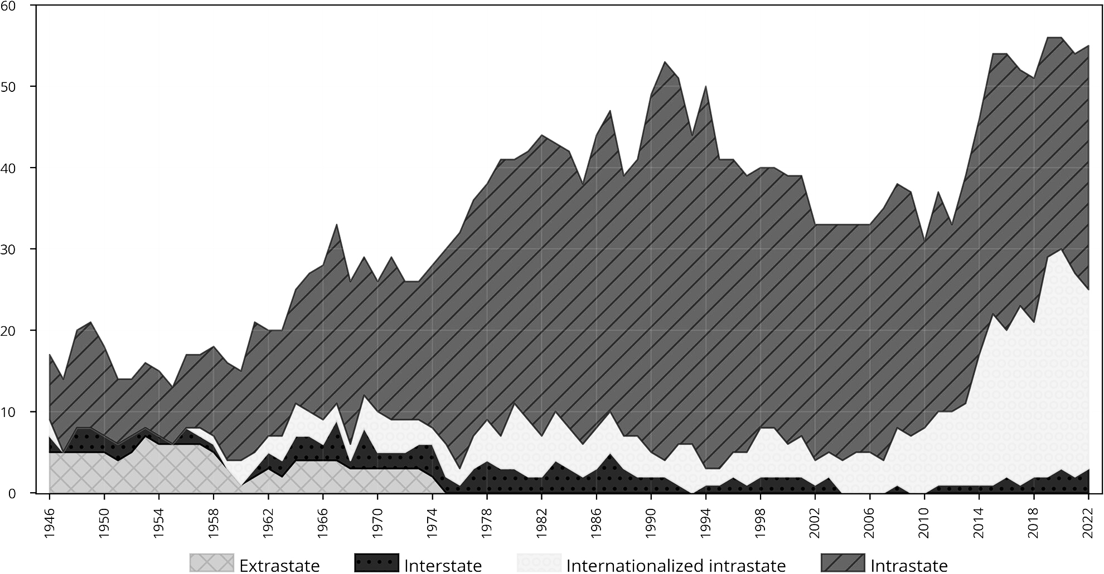

  CONFLICT & INSECURITY
  ECONOMIC SHOCKS
  CLIMATE CRISIS
State-based armed conflicts sharply increased between 2012 and 2022
55
conflicts
The number of armed conflicts sharply increases
33
conflicts
Source: Davies, S., Pettersson, T., & Öberg, M. (2023). Organized violence 1989–2022, and the return of conflict between states. Journal of Peace Research, 60(4), 691-708.

Slide 11

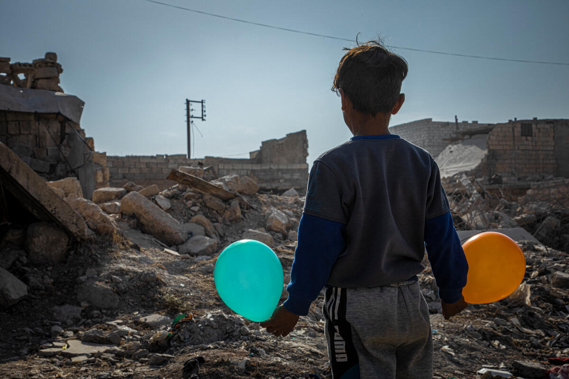
  CONFLICT & INSECURITY
  ECONOMIC SHOCKS
  CLIMATE CRISIS
The impacts of overlapping conflict
345M
people facing acute food insecurity in
79 countries
69%
or 239M people facing acute food insecurity live in fragile and conflict-affected situations
Source: GORP June 2023, World Bank

Slide 12
  CONFLICT & INSECURITY
  ECONOMIC SHOCKS
  CLIMATE CRISIS
Increasing frequency of climate shocks
1963 - 1982
1983 - 2002
2003 - 2022
v
An average of 70
climate-related disasters yearly
An average of 217
climate-related disasters yearly
An average of 336
climate-related disasters yearly
352
Climate disasters
in 2022
30
Climate disasters
in 1960
Notes:
Data sources
https://public.emdat.be/data
Notes
Considering meteorological, hydrological, climatological disasters

Slide 13








  CONFLICT & INSECURITY
  ECONOMIC SHOCKS
  CLIMATE CRISIS
352
Climate disasters in 2022
1963 - 1982
1983 - 2002
2003 - 2022
v
Droughts
159
289
318
Extreme temperature
30
188
383
Floods
519
1732
3368
Glacial lake outbursts
0
0
3
Landslides
99
304
351
Storms
572
1622
2071
Wildfires
18
210
216
Source: EM-DAT

Slide 14
  CONFLICT & INSECURITY
  ECONOMIC SHOCKS
  CLIMATE CRISIS
31.8 MILLION
WEATHER-RELATED DISPLACEMENTS IN 2022
352
Climate disasters in 2022
v
1963 - 1982
1983 - 2002
2003 - 2022
Droughts
159
289
318
2,200,000
Extreme temperature
30
188
383
12,000
Floods
519
1732
3368
19.2 MILLION
Glacial lake outbursts
0
0
3
NO DATA
Landslides
99
304
351
53,000
Storms
572
1622
2071
10.0 MILLION
Wildfires
18
210
216
366,000
Source: EM-DAT, IDMC
Notes:
Data sources
IDMC, Global Report on Internal Displacement 2023, https://www.internal-displacement.org/global-report/grid2023/
Notes
Disasters caused 32.6 million internal displacements in 2022. Besides the 31.8 million weather-related internal displacements mentioned on this slide, this figure includes 716,000 internal displacements by geophysical disasters (earthquakes, volcanic eruption and landslides).

Slide 15



  CONFLICT & INSECURITY
  ECONOMIC SHOCKS
  CLIMATE CRISIS
Forced displacement continues to rise
108 million people were forcibly displaced
in 2022
62.5
million
people were internally displaced due to conflict and violence in 2022
Source: UNHCR, IDMC
Notes:
Data sources
Forced displacement – UNHCR Refugee Statistics: https://www.unhcr.org/refugee-statistics/
IDPs due to conflict and violence – IDMC Global Report on internal displacement 2023: https://www.internal-displacement.org/global-report/grid2023/
Notes
108.4 million forcibly displaced at the end of 2022

Slide 16
  CONFLICT & INSECURITY
  ECONOMIC SHOCKS
  CLIMATE CRISIS
Forced displacement continues to rise
35.3 million refugees
108 million people were forcibly displaced
in 2022
5.4 million asylum-seekers
62.5 million internally displaced persons because of conflict and violence
5.2 million other people in need of international protection
Source: UNHCR, IDMC
Notes:
Data sources
Forced displacement – UNHCR Refugee Statistics: https://www.unhcr.org/refugee-statistics/
IDPs due to conflict and violence – IDMC Global Report on internal displacement 2023: https://www.internal-displacement.org/global-report/grid2023/
Notes
108.4 million forcibly displaced at the end of 2022

Slide 17


Global acute food insecurity numbers
349M
people in
79 countries
345M
people facing acute food insecurity
in 79 countries where WFP provides direct assistance and data is available
283M
people in
81 countries
272M
people in
79 countries
124M
people facing acute food insecurity in 51 countries
135M
in 55
countries
178M
Beneficiaries to be reached
113M
people in
53 countries
160M
Beneficiaries reached
128M
Beneficiaries reached
116M
Beneficiaries reached
91M
Beneficiaries reached
97M
Beneficiaries reached
87M
Beneficiaries reached
2017
2018
2019
2020
2021
2022
2023
COVID-19 Pandemic Declared
Conflict in Ukraine
Source: GRFC 2018, 2019, 2020, WFP GORP November 2020, November 2021, November 2022, June 2023, WFP Annual Performance Report for 2017, 2018, 2019, 2020, 2021,2022, WFP Dashboard

Slide 18
WFP faces the largest funding gap recorded in our 6-decade history
Funding Overview
10.1B USD
Required
10.5B
12.5B
13.7B
14.8B
21.4B
23.5B
7.2B
14.1B
6B USD
Received
8B
9.6B
8.4B
10B
Sources: WFP Annual Performance Report for 2017, 2018, 2019, 2020, 2021,2022, WFP Dashboard
Notes:
Data sources
Data for 2023 are from the ED dashboard, accessed 25 October 2023.
Notes
Required: Approved Requirements
Received: Received Contributions
For 2023, projected operational requirements and the global funding forecast instead of received contributions

Slide 19



In 2022, 30 of the world’s largest donor countries gave…
Costing
4,800 USD
per person
per year
47 times more
per person
per year
29.3B
USD TO INITIALLY HELP 6M REFUGEES REACHING DONOR COUNTRIES
22.3B
USD IN HUMANITARIAN
AID FOR
216M PEOPLE
Costing
100 USD
per person
per year
Source: OECD, UNHCR, UN OCHA
Notes:
Data sources
OECD for USD figures (https://www.oecd-ilibrary.org/development/development-co-operation-profiles_2dcf1367-en; https://www.oecd.org/dac/financing-sustainable-development/ODA-2022-summary.pdf)
UNHCR for the refugees and asylum seekers (https://popstats.unhcr.org/refugee-statistics/download/)
OCHA for the people targeted (https://humanitarianaction.info/overview/2022)
Notes
216M are people targeted through inter-agency plans in 2022
In-donor refugee support to Ukrainians: 18.4B USD [own estimate!]
In-donor refugee support to asylum seekers and refugees from elsewhere: 10.9B USD [own estimate!]
Humanitarian aid by all donors (including non-DAC): 46.9B USD in 2022 [according to the Global Humanitarian Assistance Report 2023]

Slide 20
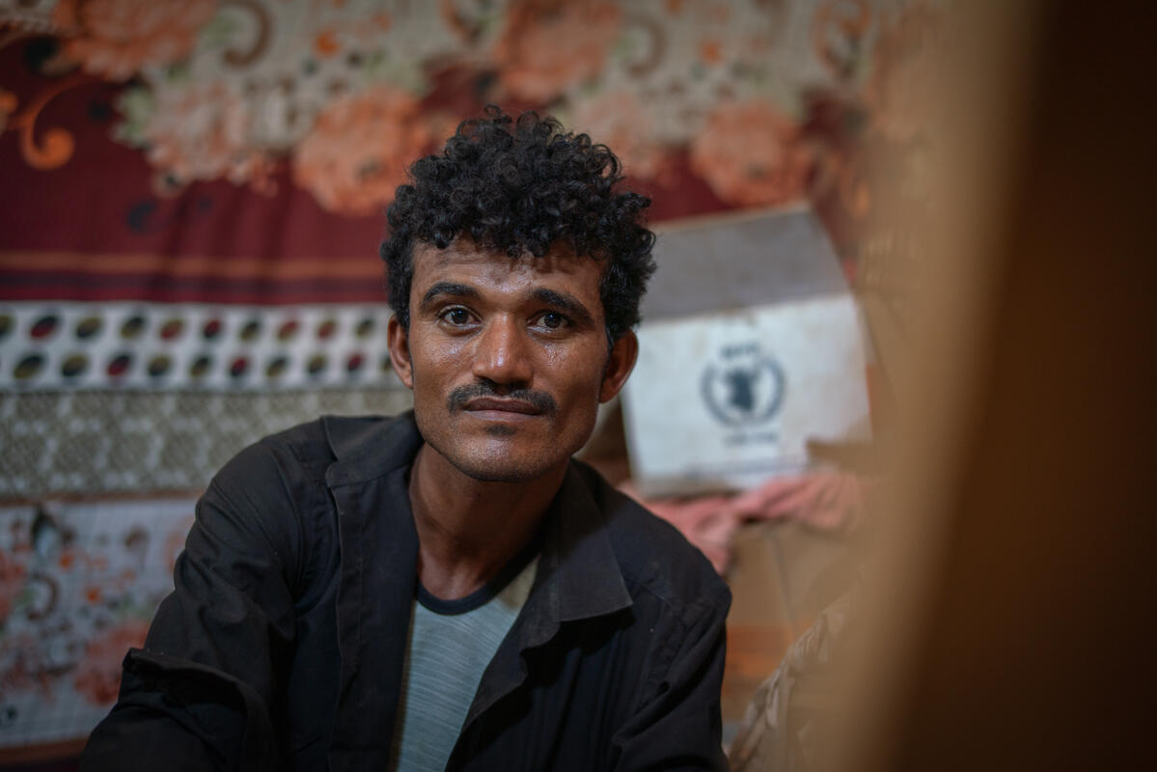


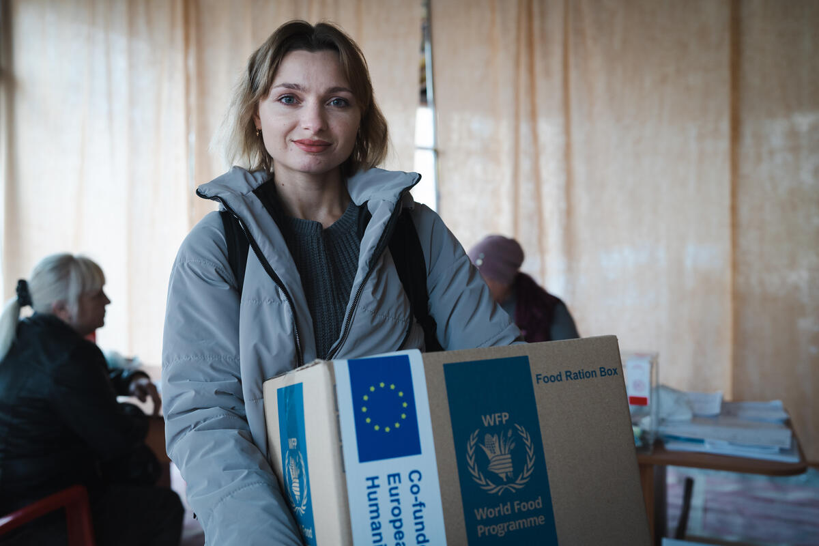


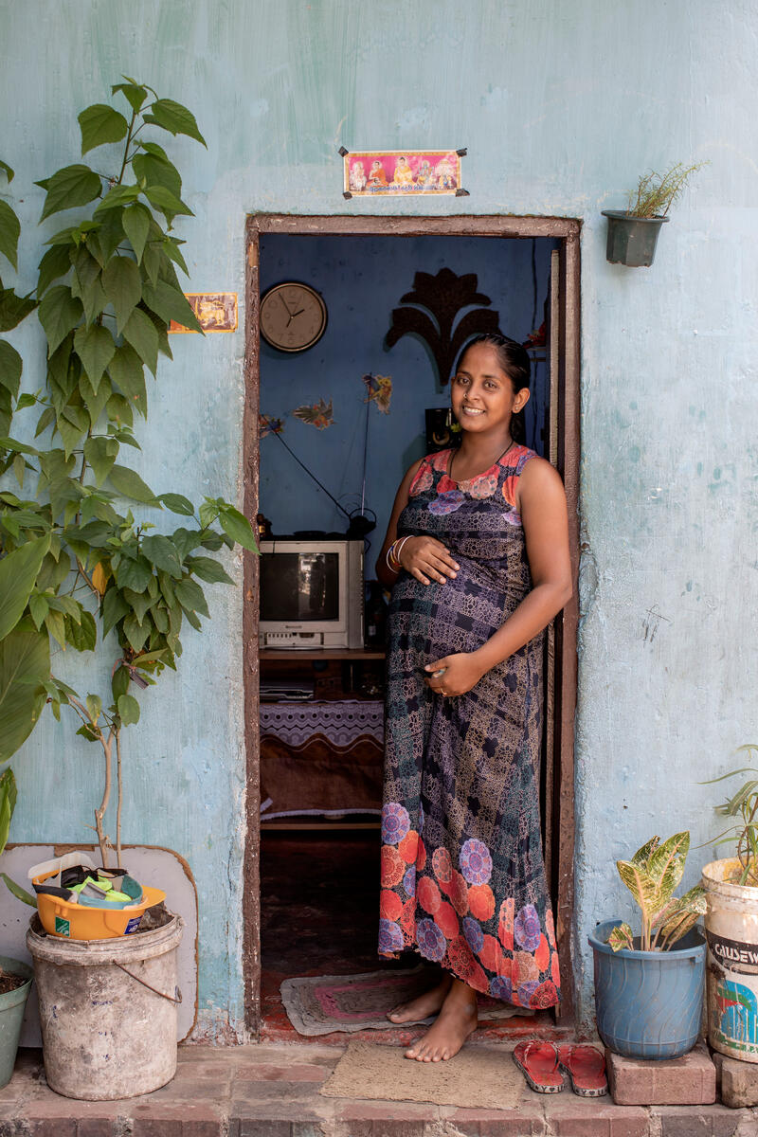

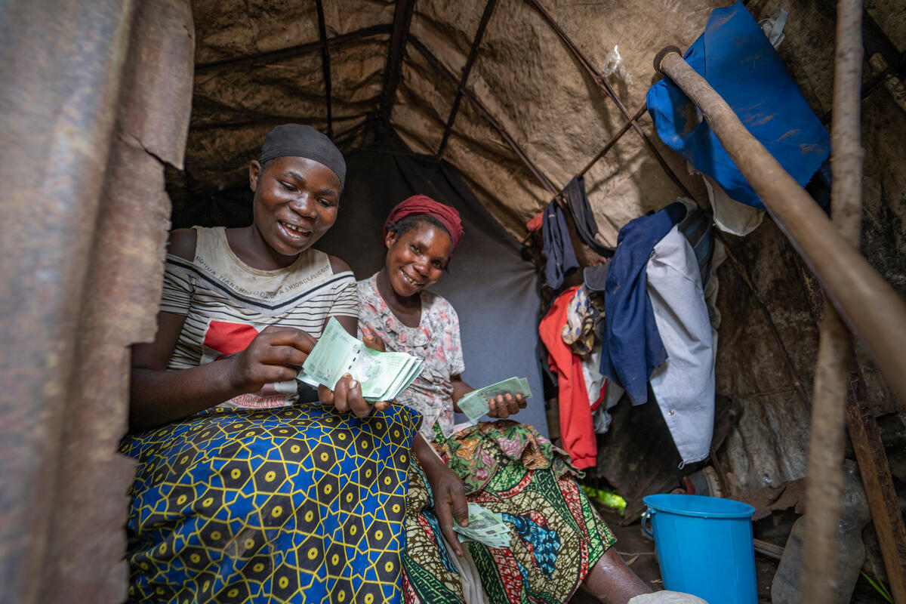

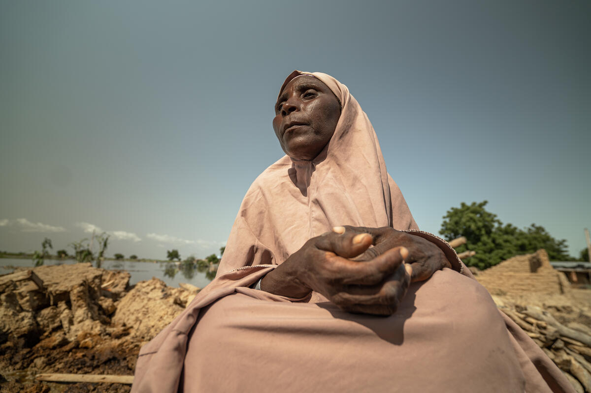

Each
1% cut
to WFP’s
assistance
could lead to
another
400,000
people
taking a
step towards
famine
Notes:
Data sources
https://docs.wfp.org/api/documents/WFP-0000152366/download/

Slide 21

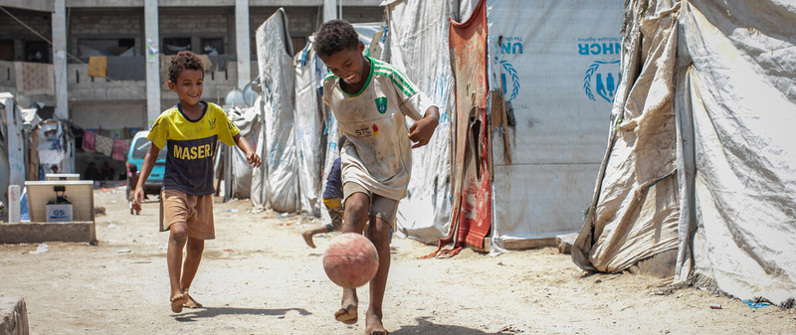

Thank you

