Slide 1


WFP/Badre Bahaji
Perceived Needs Indicators
Needs Assessments & Targeting Unit
2023 July

Slide 2

AUDIENCE
The audience of this PowerPoint can range from enumerators to RAM and Programme staff in various offices. It can also be used for the training of partners or service providers.
Slide sections have been inserted to assist in the selection of relevant material based on the audience.

Slide 3
Introduction

Slide 4
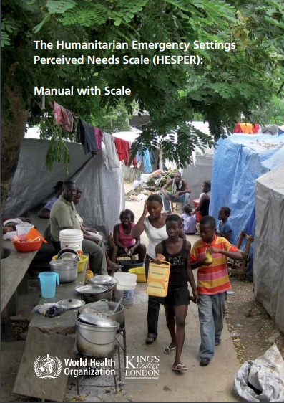
HESPER
The perceived needs indicators are largely based on the Humanitarian Emergency Settings Perceived Needs Scale (HESPER).
Part of the content of this presentation is taken from the HESPER guide.
World Health Organization & King’s College London (2011). The Humanitarian Emergency Settings Perceived Needs Scale (HESPER): Manual with Scale. Geneva: World Health Organization.

Slide 5
Perceived needs: training instructions 1
Discuss the objectives of the module and explain the role of these indicators. This gives the enumerators a clear understanding of the importance of the data they would be soon collecting.
Explain that the module is important to better understand people's vulnerabilities, priorities, and their need of assistance from their own perspective.

Slide 6
Perceived needs indicators
The perceived needs indicators show how a population perceives and prioritizes their unmet needs.
They are based on a series of questions asking households whether they perceive certain areas (e.g., food, shelter, education…) as being “a serious problem”.
Understanding self-identified needs is important to understanding the main concerns of a population and helps design responses that are more people-centred.

Slide 7
The PERCEIVED NEEDS Module

Slide 8
USE OF THE Perceived needs indicators
Normally used in Essential Needs/Multisectoral Assessments.
They highlight sector-specific gaps faced by the population, helping to design multisectoral responses.
They provide important information for multipurpose cash programmes, as they indicate the needs that households are likely to prioritize with the cash assistance.

Slide 9
Module Structure
The perceived needs module is divided into three parts:
  Questions related to respondents’ own problems
  Questions related to problems in the respondent’s community
  Questions asking to rank the first, second, and third most important problems faced overall

Slide 10
Respondents’ own problems: main question
Question | Answer options
Do you have a serious problem with…. | 0 No serious problem
 | 1 Serious problem
 | 8888 Don't know, not applicable, declines to answer
Read the whole question
Remember that the question refers to the person who is responding (not the household)
Remember that the question is subjective: we want to know what people feel their serious problems are, and not what you think their serious problems are
You should capture the person’s views, even if you disagree with them

Slide 11
Respondents’ own problems: Answer options
Question | Answer options
Do you have a serious problem with…. | 0 No serious problem
 | 1 Serious problem
 | 8888 Don't know, not applicable, declines to answer
1 “Serious Problem” should be entered only if the respondent perceived the problem as serious
If you are unsure, ask follow-up questions to probe or phrase the question in a different way. For example: “Am I understanding well that you are saying that […] is not a serious problem for you?”
If the respondent gets upset or looks very uncomfortable (some questions might be sensitive) answering a question, do not insist too much and consider passing on to the next question.

Slide 12
Respondents’ own problems: EXAMPLEs
Drinking water (question 1)
Interviewer: “Do you have a serious problem because you do not have enough water that is safe for drinking or cooking?”
Respondent: “We had problems for a long time and we had to find water wherever we could. In the last few days though aid workers have come and they have given us water to drink.”
Interviewer: “That’s good. So would you say that you have still got a serious problem with this, or is it okay now?”
Respondent: “It is a problem, but it is not a serious problem.”
Correct answer option:
0 “No serious problem”
Food (question 2)
Interviewer: “Do you have a serious problem with food? For example, because you do not have enough food, or good enough food, or because you are not able to cook food.”
Respondent: “We don’t have enough food at all.”
Interviewer: “Would you say that this is a serious problem?”
Respondent: “Yes, very serious.”
Correct answer option:
1 “Serious problem”

Slide 13
Problems in respondents’ community: main question
Question | Answer options
Is there a serious problem in your community because of | 0 No serious problem
 | 1 Serious problem
 | 8888 Don't know, not applicable, declines to answer
Read the whole question
Remember that the question refers to the community of the respondent this time
However, remember that the question remains subjective: we want to know what people feel the serious problems in their communities are
You should capture the person’s views, even if you disagree with them
Notes:
Answer options are the same

Slide 14
RATING of PROBLEMS
Enumerator: “I am now going to read out all the problem areas which you have told me that you have a serious problem with. I would like you to tell me which of these are your three most serious problems”:
Out of these problems, which one is the most serious?
Which is the second most serious?
Which is the third most serious?

Slide 15
Module Design

Slide 16

Module overview
WFP’s perceived needs module is based on a subset of questions of the original HESPER scale. WFP’s module includes three parts:
  14 questions related to respondents’ own problems
  5 questions related to problems in the respondent’s community
  3 questions asking to rank the first, second, and third most important problem faced
Important! It is not necessary to use the whole module.
It is ok to focus on the questions in the first and second part that are more relevant to the context. In addition to previous assessments, these can be identified through focus group discussions and key informant interviews.

Slide 17
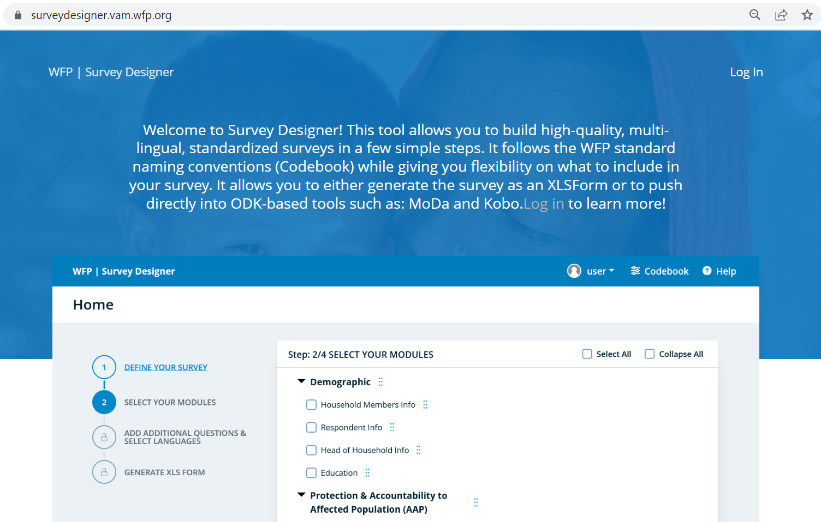
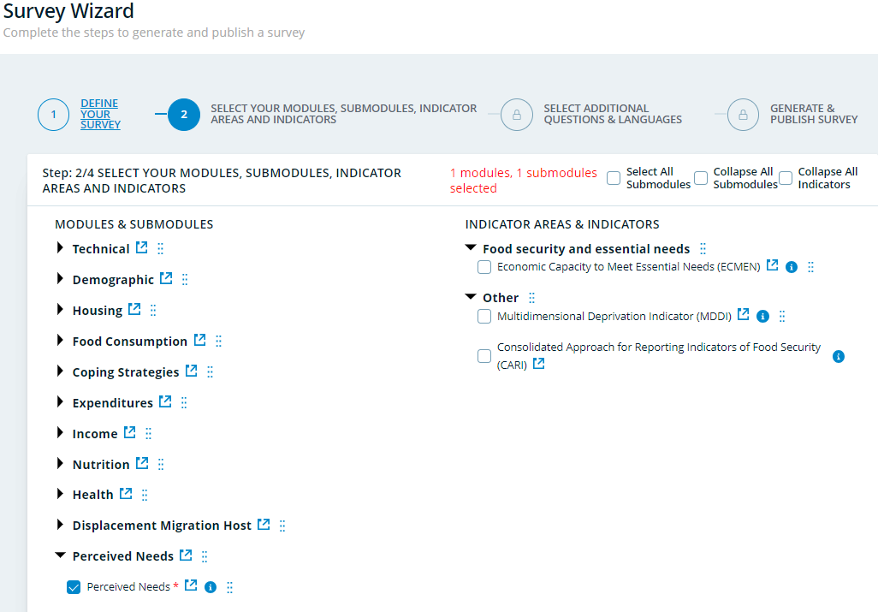
PERCEIVED NEEDS: Survey Designer
Perceived Needs (Survey Designer)
Notes:
The Survey Designer is WFP’s web-based tool that allows users to build tailored assessment, monitoring, and market-based questionnaires using standardized content in multiple languages.

Slide 18
Perceived needs: Module design
When designing your questionnaire including the Perceived Needs module, please refer to the Survey Designer as it offers the WFP’s standard modules in XLSform and Word formats.
If you rely on data collection tools and platforms that do not support XLSforms, you must replicate the standard module correctly, including skip patterns and validation constraints.
Notes:
An XLS Form is the Excel format of the content in a Survey questionnaire It contains all the questions and
the answer ( of each survey in chosen languages the skip logic and the rules that will inform the data
collection This allows transferring questions selected in the Survey Designer to online ODK tools for data
collection coded in a standardised way and also facilitates data analysis following the data collection exercise

Slide 19
Explanation of individual questionS

Slide 20
Perceived needs: training instructions 2
If your module does not include all the questions included in the standard module, make sure to adjust this section accordingly.
Some questions do not have a standard explanation as they are straightforward. However, you might provide additional clarifications based on the context.

Slide 21
Explanations
Question | Explanation
Water Do you have a serious problem because you do not have enough water that is safe for drinking or cooking? | This question includes any water that is used either for drinking or for cooking. For example, this may include drinking water from taps in the person’s home, water from shared taps, or bottled water. The question does not include water for washing (falls under hygiene).
Food Do you have a serious problem with food? For example, you do not have enough food, or good enough food, or you are not able to cook your food? | This question is about whether the person has enough food, and whether they have food that is appropriate and suitable to their needs. It also includes having suitable equipment and facilities to cook food, for example a stove, firewood, pots or pans.
Place to live Do you have a serious problem because you do not have a suitable place to live? | This question may include a temporary or permanent house, hut, tent, or any other kind of shelter.
Toilet Do you have a serious problem because you do not have easy and safe access to a clean toilet? | This question refers to the toilet (or toilets) that the person uses on a regular basis. If they have a toilet in their home, this may refer to that toilet. If the person uses shared toilets (for instance in a camp setting), this may refer to the shared toilets.

Slide 22
Explanations
Question | Explanation
Hygiene Do you have a serious problem because in your situation it is difficult to keep clean? For example, because you do not have enough soap, sanitary materials, water or a suitable place to wash?
Clothes Do you have a serious problem because you do not have enough, or good enough, clothes, shoes, bedding or blankets?
Income or livelihood Do you have a serious problem because you do not have enough income, money or resources to live? | This question may include a wide range of problems to do with the person’s livelihood, for example lack of income from employment, lack of access to farmland, lack of tools for farming, lack of boats or nets for fishing, or lack of access to other resources on which their livelihood depends.
Physical health Do you have a serious problem with your physical health? For example, because you have a physical illness, injury or disability | This question may include any kind of physical illnesses or injuries, including physical disabilities.

Slide 23
Explanations
Question | Explanation
Health care Do you have a serious problem because you are not able to get adequate health care for yourself? For example, treatment or medicines [ENUMERATOR: READ THE FOLLOWING ONLY FOR WOMEN] or health care during pregnancy or childbirth. | You should read out different questions for men and women. Any kind of health care is included, for example hospital treatment, access to a doctor or nurse, access to medications, and sexual health care (including access to contraceptives). The question for women also includes access to support and health care during pregnancy and childbirth.
Safety Do you have a serious problem because you or your family are not safe or protected where you live now? For example, because of conflict, violence or crime in your community, city or village? | This question may refer to any serious problem that the person has with safety or security. This could include if they do not feel safe because of crime, conflict, war, violence, the political situation, or any other kind of instability. The question asks about the person’s family, so it includes their children, husband or wife, or other family members.
Education Do you have a serious problem because your children are not in school, or are not getting a good enough education? | If the person has already told you at the beginning of the interview that they do not have any children, you do not need to ask this question and can give a rating of ‘not applicable’. If the person only has children who are not of school age [provide specific range based on country’s compulsory education age] (that is, they are either too old or too young to go to school), you should also rate the question as ‘not applicable’.
Care for family members Do you have a serious problem because in your situation it is difficult to care for family members who live with you? For example, young children in your family, or family members who are elderly, physically or mentally ill, or disabled

Slide 24
Explanations
Question | Explanation
Information Do you have a serious problem because you do not have enough information? For example, because you do not have enough information about the aid that is available; [ENUMERATOR: READ THE FOLLOWING ONLY FOR DISPLACED PEOPLE] or because you do not have enough information about what is happening in your home country or hometown? | You should read out different questions for people who have been displaced from home and people who have not been displaced from home
Assistance Do you have a serious problem because of inadequate aid? For example, because you do not have fair access to the aid that is available, or because aid agencies are working on their own without involvement from people in your community. | It is important to remember that you are assessing whether the person thinks that there is a serious problem in this area. You should rate the question as ‘no serious problem’ (0) if the person feels that aid is being, or has been, handed out fairly, and that aid agencies are involving the community in the aid process. You should also rate this question as ‘no serious problem’ (0) if the person does not have fair access to aid, or the community is not involved in the aid process, but the person does not see this as a serious problem.

Slide 25
Explanations
Question | Explanation
Justice Is there a serious problem in your community because of an inadequate system for law and justice, or because people do not know enough about their legal rights?
Gender Based Violence Is there a serious problem for women in your community because of physical or sexual violence towards them, either in the community or in their homes?
Alcohol or drug use Is there a serious problem in your community because people drink a lot of alcohol, or use harmful drugs? | This question may include harmful drugs that can be bought from pharmacies or other shops, as well as illegal drugs.

Slide 26
Explanations
Question | Explanation
Mental illness Is there a serious problem in your community because people have mental illnesses? | This question may refer to any mental illnesses or mental health problems that people in the community are experiencing. It is important to remember that you are not assessing whether these mental illnesses exist in the community, but rather whether the person feels there is a serious problem in the community because people have a mental illness (however the person defines this). For example, if the person thinks that many people in the community have a mental illness but does not think that this is a serious problem, you should rate the question as ‘no serious problem’ (0). However, if the person thinks that people in the community have a mental illness, and thinks that this is a serious problem, you should rate the question as ‘serious problem’ (1).
Care for people in your community who are on their own Is there a serious problem in your community because there is not enough care for people who are on their own? For example, care for unaccompanied children, widows or elderly people, or unaccompanied people who have a physical or mental illness, or disability?

Slide 27
exercises

Slide 28
Perceived needs: training instructions 3
If your module does not include all scenarios included in this section, make sure to adjust accordingly.
In this section, let trainees give their answer and discuss before providing the right answer to each scenario.

Slide 29
SCENARIO 1
Food
Interviewer: "Do you have a serious problem with food? For example, because you do not have enough food, or because you are not able to cook the food you have."
Respondent: "No"
What should the interviewer do next?
The interviewer should rate the question as ‘0’ (‘no serious problem’)

Slide 30
SCENARIO 2
Place to live
Interviewer: "Do you have a serious problem because you do not have a suitable place to live?"
Respondent: "I have a house. It is not great but it is okay"
What should the interviewer do next?
The interviewer should ask: “Would you say this is a serious problem?”
If the person answers “Yes”, the interviewer should rate the question as ‘1’ (‘serious problem’).
If the person answers “No”, the interviewer should rate the question as ‘0’ (‘no serious problem’).

Slide 31
SCENARIO 3
Toilets
Interviewer: "Do you have a serious problem because you do not have easy and safe access to a clean toilet?"
Respondent: "I can use the toilets in the camp, but I am scared of going there. It is very dark at night?"
What should the interviewer do next?
The interviewer should ask: “Is this a serious problem for you?”
If the person answers “Yes”, the interviewer should rate the question as ‘1’ (‘serious problem’).
If the person answers “No”, the interviewer should rate the question as ‘0’ (‘no serious problem’).

Slide 32
SCENARIO 4
Keeping Clean
Interviewer: "Do you have a serious problem because it is difficult to keep clean in your current situation. For example, you do not have enough soap, water, or a suitable place to wash?"
Respondent: "I don't want to talk about that. That is private."
What should the interviewer do next?
The interviewer should not pry. They should rate the question as ‘does not know / not applicable / declines to answer’.

Slide 33
SCENARIO 5
Clothing, shoes, bedding or blankets
Interviewer: "Do you have a serious problem because you do not have enough, or good enough, clothes, shoes, bedding or blankets?"
Respondent: "Could you tell me where I could find some? My clothes are very old."
What should the interviewer do next?
The interviewer should say something like: “I am sorry but unfortunately, I do not have any information about that, but I am happy to talk about this after the interview. Would it be okay to continue with the interview for now? Do you think it is a serious problem that your clothes are old?” ….

Slide 34
SCENARIO 6
Health care
Interviewer: "Do you have a serious problem because you are not able to get adequate health care for yourself? For example, this may include treatment, medicines, or health care during pregnancy or childbirth"
Respondent (female): Looks upset and cries a bit.
What should the interviewer do next?
The interviewer should pause for a minute, and then ask: “Are you okay to continue?”
If the person says “Yes”, the interviewer should ask: “Is this a serious problem?”
If the person answers, the enumerator should select the correct response accordingly

Slide 35
Data quality checks
And Analysis

Slide 36
EXPLORATION OF DATA and quality checks
Tabulate each of the questions in your module.
If applicable, disaggregate the results by population groups (IDPs, refugees, etc.) and/or context setting (urban, rural, camps) to explore them separately.
Track the results of each question per enumerator to detect data quality issues. If enumerators tend to classify households very differently than the average or tend to select the same answer options across most questions, then this could be due to a lack of understanding of the module, and they should be identified and re-trained.
Perform logical tests. For example, when the interviewee reports not having any school-aged children in their household composition section, then question on having serious problem with sending children to school should be “not applicable.”
Analysis scripts

Slide 37
Perceived needs: analysis
Perceived needs are analyzed in three main ways:
  For each aspect/question, report the share of households who indicated it is a “serious problem.”
  For each aspect/question, report the share of households who indicated it among their top three problems.
  Mean/median number of aspects indicated as “serious problems.”
https://github.com/WFP-VAM/RAMResourcesScripts/tree/dev/Indicators/Perceived-needs
Analysis scripts

Slide 38
Analysis EXAMPLE 1
“The analysis of perceived needs reveals that food is perceived as a serious problem by more than half of all households.
Housing and hygiene are also perceived as serious problems by a large share of the population (about 40 percent of households). This might indicate that households are in need of both food and non-food assistance “
Figure 1 - Share of households indicating various aspects as a serious problem (top 10 problems)

Slide 39
Analysis EXAMPLE 2
“Food, housing and hygiene appear as the aspects that households identify more often as their top problems.
This finding suggests that these could be the needs that households would prioritize through cash assistance, if provided“.
Figure 2 – Share of the population who rated various aspects as one of their three most serious problems (top 10 aspects)

Slide 40
Analysis EXAMPLE 3
“The analysis shows that, on average, women-headed household report a slightly higher number of serious problems than households headed by men.
This aligns with other findings of this report, which show greater vulnerability among women-headed households“.
Figure 3 – Average number of aspects indicated as serious problems by gender of head of household

Slide 41
Available Resources

Slide 42

Perceived needs: VAM Resource Centre
For more information and guidance go to
Perceived Needs (Resource Centre)

Slide 43
Thank You!

