Slide 1
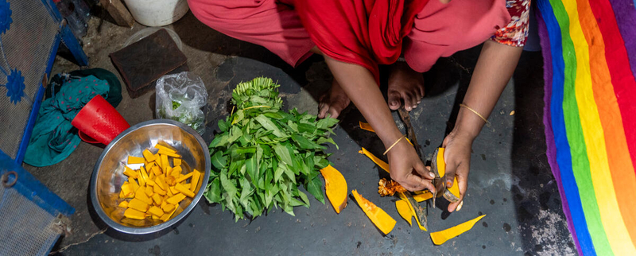
Household Dietary Diversity Score (HDDS)
Needs Assessments & Targeting Unit
2024 January

Slide 2

AUDIENCE
The audience of this PowerPoint can range from enumerators to RAM and Programme staff in various offices. It can also be used for the training of partners or service providers.
Slide sections have been inserted to assist in the selection of material.

Slide 3
Introduction

Slide 4
HDDS: training instructions 1
Discuss the objectives of the module, i.e., to gain information on the dietary diversity of households in the targeted population.
Explain the role of this indicator in food insecurity figures and the use of information, internally and externally. This gives the enumerators a clear understanding of the importance of the data they would be soon collecting.

Slide 5
HDDS: What is it?
The Household Dietary Diversity Score (HDDS) is an indicator that was developed by USAID’s Food and Nutrition Technical Assistance Project (FANTA).
It aims to reflect the economic ability of a household to access a variety of foods, as a proxy of household access to food.
It is based on the key concept of household dietary diversity, or the number of different food groups consumed over a given reference period.
It is measured based on the households’ self-reported consumption of 12 food groups in the previous 24 hours (yesterday).
This presentation was prepared based on the full FANTA guidelines found on the VAM Resource Centre.

Slide 6
HDDS: Why Dietary Diversity?
A more diversified diet is an important outcome in and of itself.
It is associated with improved outcomes in birth weights, child anthropometric status, and improved haemoglobin concentrations.
A more diversified diet is highly correlated with caloric and protein adequacy, percentage of protein from animal sources (i.e., high quality protein), and household income.
Studies have shown that an increase in dietary diversity is associated with socio-economic status & household food security (household energy availability).
While questions on dietary diversity can be asked at the household or individual level, this module specifically focuses on the household level.
Individual dietary diversity is usually captured through other indicators, such as the Minimum Dietary Diversity for Women (MDD-W).

Slide 7

HDDS: USEs OF this indicator
HDDS can be used in food security assessments to complement other food security indicators.
It is not a standalone measure of food insecurity and should be used alongside other measures, e.g., food consumption, coping strategies, anthropometric data, household income and expenditures.
The HDDS is one of the food security outcome indicators in the Integrated Food Security Phase Classification (IPC) acute food insecurity reference table.
Note that while other versions of indicators for dietary diversity exist (namely the Dietary Diversity Score or DDS, which is a country-level indicator used for WFP monitoring purposes only and calculated based on the FCS), the FANTA version is the one used by WFP assessments & IPC.

Slide 8
The Household Dietary Diversity Module

Slide 9
HDDS: training instructions 2
Note how the main question is worded. "Now I would like to ask you about the types of foods that you or anyone else* in your household ate yesterday during the day and at night.“
Normally, foods consumed outside the home are not counted, but this is a decision to be taken by the CO, and the training materials should be adjusted accordingly*.
Be sure the question includes a recall period of the last 24 hours*; this is the standard timeframe.
*Note that these are key differences with the FCS, and the methodologies should not be mixed up!
Notes:
According to the FANTA guidance: “The respondent should be instructed to include the food groups consumed by household members in the home, or prepared in the home for consumption by household members outside the home (e.g., at lunchtime in the field.) As a general rule, foods consumed outside the home that were not prepared in the home should not be included.
While this may result in an underestimation of the dietary diversity of individual family members (who may, for example, purchase food in the street), HDDS is designed to reflect household dietary diversity, on average, among all members. Including food purchased and consumed outside the household by individual members may lead to overestimating HDDS overall.
However, in situations where consumption outside the home of foods not prepared in the household is common, survey implementers [Country offices] may decide to include those foods. Such decisions should be clearly documented, so that subsequent surveys will use the same protocol and to ensure correct interpretation and comparison.”

Slide 10
HDDS MODULE: What to ask?
*Note that unlike the FCS, small quantities should be counted in the main groups (not as miscellaneous/condiments) and the methodologies should not be mixed up!
Module 1: Household Dietary Diversity Score This module will allow you to collect information needed to compute HDDS – 24hr recall
Now I would like to ask you about the types of foods that you or anyone else in your household ate yesterday during the day and at night. Note for enumerator: Read the list of foods. Place a 1 in the box if anyone in the household ate the food in question, place a zero in the box if no one in the household ate this food |  |  | Variable Name
Foods | Foods
1. | Cereals, grains: rice, pasta, bread, sorghum, millet, maize | |___| | HDDSStapCer
2. | Roots and tubers: potato, yam, cassava, white sweet potato, taro, plantain | |___| | HDDSStapRoot
3. | Pulses/legumes, nuts and seeds: beans, cowpeas, lentils, soy, pigeon pea, peanuts, other nuts | |___| | HDDSPulse
4. | Dairy products: milk, yogurt, cheese, other dairy products | |___| | HDDSDairy
5. | Meat, poultry, offal: goat, beef, chicken, pork | |___| | HDDSPrMeat
6. | Fish and seafood: fish and other seafood (including canned tuna) | |___| | HDDSPrFish
7. | Eggs | |___| | HDDSPrEgg
8. | Vegetables and leaves: spinach, onion, tomatoes, carrots, peppers, green beans, lettuce, etc. | |___| | HDDSVeg
9. | Fruits: banana, apple, lemon, mango, papaya, apricot, peach, etc. | |___| | HDDSFruit
10. | Oils and fats: vegetable oil, palm oil, ghee, butter, margarine, other fats or oils | |___| | HDDSFat
11. | Sugar and sweets: sugar, honey, jam, candy, chocolate, biscuits/cookies, pastries, cakes, ice cream, and other sweets (including sugary drinks) | |___| | HDDSSugar
12. | Miscellaneous/ Condiments and spices: tea, coffee, cocoa powder, salt, garlic, spices, yeast, tomato paste | |___| | HDDSCond
Notes:
“In this questionnaire food consumed by only one member of the household and not by the others is still recorded. For example if a child was given a piece of fruit to eat as a snack, this is recorded as ‘yes’ for fruit even if no other members of the household ate fruit.” (FAO, 2010).

Slide 11
What are the differences between HDDS & FCS?

Slide 12

HDDS vs. FCS
HDDS | FCS
Recall period of previous 24H | Recall period of last 7 days
12 food groups (including ‘miscellaneous’) But similarly, food items are adapted to local context | 8 food groups + condiments But similarly, food items are adapted to local context
Refers to the household as a whole, among all members (anyone) | Refers to at least half of household (50% or more)
Normally includes only foods consumed or prepared at home, and does not include foods prepared outside the home. | Includes foods consumed by the household, whether inside or outside the home.
Values the consumption of ‘miscellaneous’ or ‘condiments’ in the scoring. | Does not value the consumption of ‘condiments’ in the scoring.
Any quantity consumed should be counted. Does not distinguish small quantities. | Indicates to be careful about small quantities, which should be counted as condiments.
see next slide
Decisions should be documented for following surveys to follow the same protocol in future for comparison.
see next slide
Notes:
Guidelines for measuring household and individual dietary diversity (fao.org) "If meals/snacks are purchased and consumed outside the home on a regular basis by one or more family members, administering the questionnaire at the individual level is more appropriate as it is not possible to capture accurately meals/snacks purchased and eaten outside the home at household level.“
While for FCS, the question refers to the majority of the household, meaning 50% or more, HDDS concerns the consumption of anyone in the household. The suggestion is to limit consumption to in the home only, because it is possible that the respondent may not know what all household members consumed outside of the home, if the meal was not eaten together (or by the majority of the HH).

Slide 13
HDDS vs. FCS (cont.)
HDDS | FCS
12 food groups (including ‘misc.’) Cereals and grains Roots and tubers Pulses/legumes/nuts Milk and other dairy products Meat Fish/shellfish Eggs Vegetables and leaves Fruits Oil, fat, butter Sugar or sweet Condiments (Miscellaneous) | 8 food groups + condiments Cereals, grains, roots and tubers Pulses/legumes, nuts and seeds Milk and other dairy products Meat, fish and eggs Vegetables and leaves Fruits Oil, fat, butter Sugar or sweets Condiments
While the food groups are different, the food items should be the same, just categorised differently.
In both cases, the food items should be contextualised to the country context.

Slide 14
Module Design

Slide 15

HDDS vs. FCS: what’s the added value?
While it may seem that HDDS and FCS/FCS-N are quite similar, due to the key differences in the methodology, it means that they are measuring slightly different things.
Given that HDDS counts the consumption of food items by anyone in the household, and in any quantity, it means that how foods are counted is different.
For example, 2 members of a 5-person household drink tea with a splash of milk and a spoonful of sugar at home.
  In HDDS, this would be counted in dairy, sugar and miscellaneous/condiments.
  In FCS, this would not be counted.
As the majority of the household did not consume tea, it should not be counted in FCS.
Notes:
So how do you choose within each level? …

Slide 16
Foods consumed outside the home
The HDDS guidance indicates that foods consumed outside the home that were not prepared in the home should not be included.
While this may result in an underestimation of the dietary diversity of individual family members (who may, for example, purchase food on the street), HDDS is designed to reflect household dietary diversity, on average, among all members.
Including food purchased and consumed outside the household by individual members may lead to overestimating HDDS overall.
However, in situations where consumption outside the home of foods not prepared in the household is common, especially by the majority of the household, COs may decide to include those foods.
Includes foods | Normally does not include foods
-Prepared in the home and consumed in the home or outside the home; or -Purchased or gathered outside and consumed in the home | -Purchased outside the home and consumed outside Because respondents may not know exactly which foods were purchased & consumed outside the home by every household member, and we want to avoid that the respondent guesses what was consumed, overestimating consumption.
Decisions should be documented for following surveys to follow the same protocol in future for comparison.

Slide 17

HDDs: data quality checks
Inconsistencies between FCS and HDDS. If a household reports having consumed an FCS food group all 7 days (e.g. oil, or sugar/sweets), then the corresponding food group in HDDS (oil) must be counted as 1/yes.
However, it should be noted that small quantities consumed by anyone in the household are counted in HDDS, so it is not possible to apply the reverse logic; meaning that HDDS can have a value of 1, while the corresponding food group in FCS can still be 0.

Slide 18
HDDS Module design
When designing your questionnaire, including the HDDS module, please refer to the Survey Designer as it offers the WFP’s standard modules in XLSform and word formats.
The food items should be contextualized to reflect the most common local food items. However, the 12 food groups (including condiments/misc.) must remain as proposed.
If you have to rely on data collection tools and platforms that do not support XLSforms then you must replicate the standard module correctly, including the visibility and validation constraints.

Slide 19

HDDS Module design – a forbidden merger
Note that, in the past, a merged version of the FCS/FCS-N and HDDS modules have emerged.
However, due to the significant differences between the methodologies for FCS and HDDS (i.e., in the recall period, who is included, and how to deal with small quantities), it goes against guidance to merge the modules for assessments.
Thus, if collecting HDDS, namely for IPC but also for FS assessments in general, HDDS must be collected according to the validated methodology, which means that this should be collected as a separate module.
This is true for both face-to-face and remote methodologies. Even if merging the modules appears to save time, it can create confusion and goes against the tested and validated form of HDDS.
Notes:
Regardless, time-savings are negated by the fact that this is not the accurate way to collect the module.

Slide 20
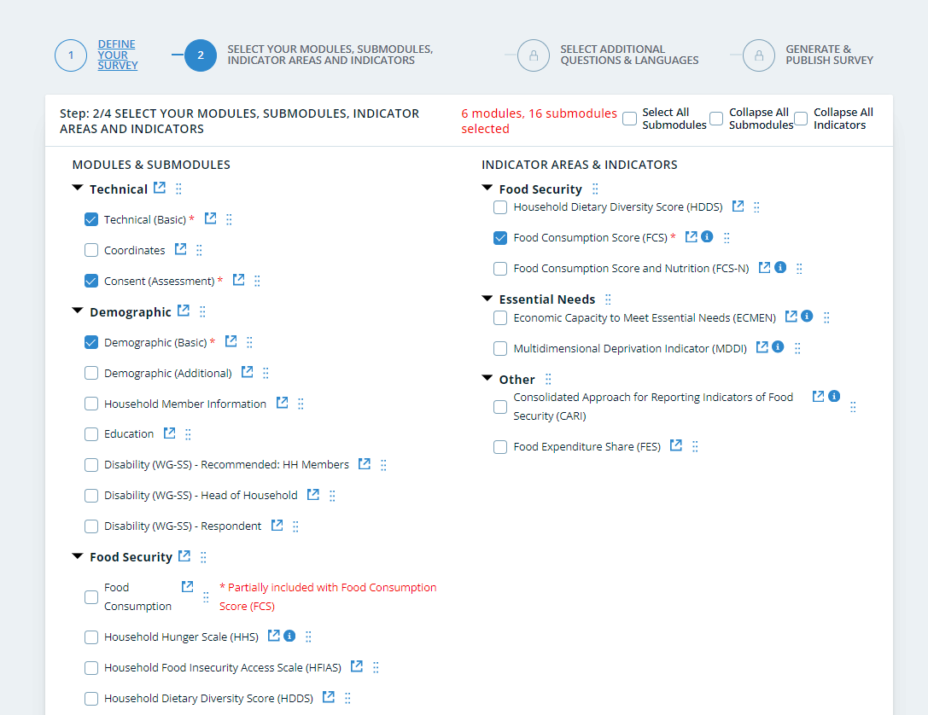
HDDS: Survey Designer
HDDS Codebook (Survey Designer)

Slide 21
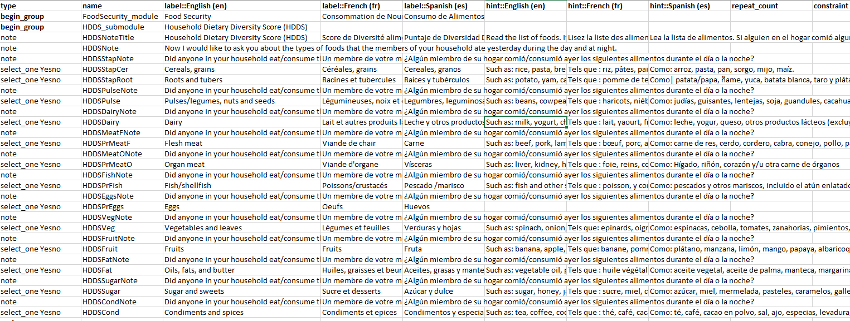
HDDS: Survey Designer
Food items must adjusted to the local context
Find the latest standard HDDS module in XLSform on
Survey Designer

Slide 22
How to calculate HDDS?

Slide 23
HDDS: CALCULATION example 1
The HDDS variable is calculated for each household.
HDDS (0-12) | Total number of food groups consumed by household members. Values for food groups from 1-12 will be either 0 or 1. Add up all the variables: HDDSStapCer+ HDDSStapRoot+ HDDSPulse+ HDDSDairy+ HDDSPrMeat+ HDDSPrFish+ HDDSPrEgg+ HDDSVeg+ HDDSFruit+ HDDSFat+ HDDSSugar+ HDDSCond
Recode HDDS (lowest thru 2=1) (3 thru 4=2) (5 thru highest = 3) into HDDSCat_IPC.
Value labels HDDSCat_IPC
1 '0 - 2 food groups (phase 4 to 5)’
2 '3 - 4 food groups (phase 3)’
3 ‘5-12 food groups (phase 1 to 2)’
Notes:
See here: https://www.ipcinfo.org/ipc/technical/manual_en

Slide 24
Analysis

Slide 25
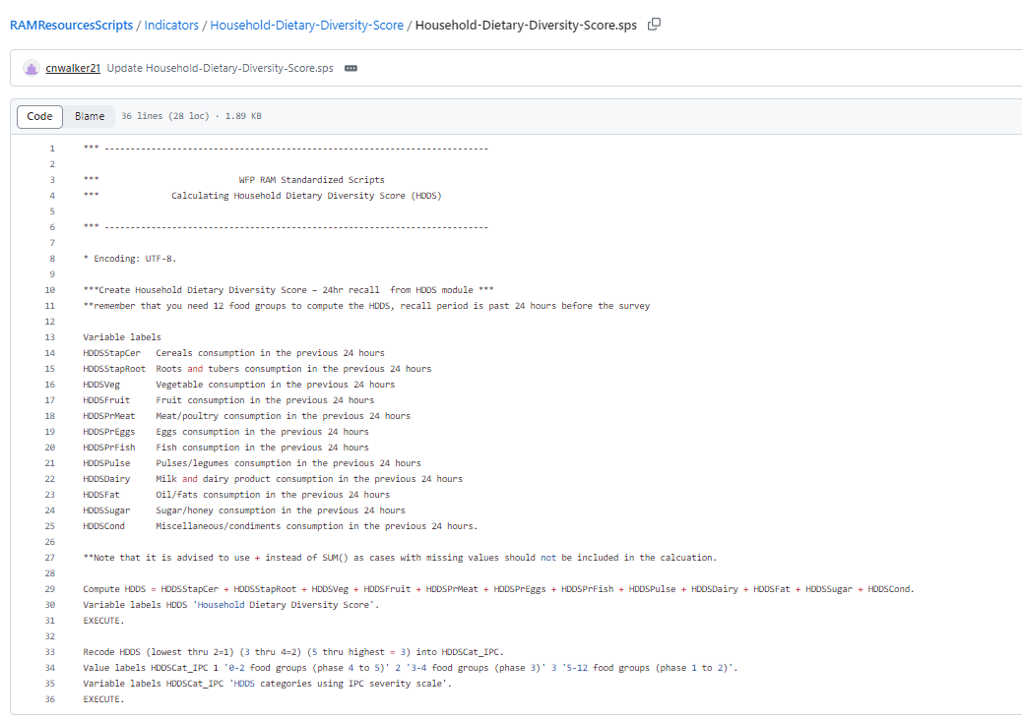
HDDS: GITHUB
Find the SPSS, STATA and R scripts on
GitHub WFP RAM

Slide 26
Reporting

Slide 27
HDDS: REPORTING EXAMPLE
“Analysis results of the household dietary diversity score in a country indicate that households in District 3 are worse off compared to the other districts, where 37% of households have low dietary diversity scores.
Meanwhile, Districts 1 and 4 have the highest household dietary diversity scores in the country, where 30% and 24% of households have high dietary diversity, respectively.“
Notes:
When monitoring beneficiaries of WFP programme activities, it is expected that the proportion of households with poor and borderline consumption decreases and the proportion of households with acceptable consumption increases following the receipt of food assistance.

Slide 28
Available Resources

Slide 29
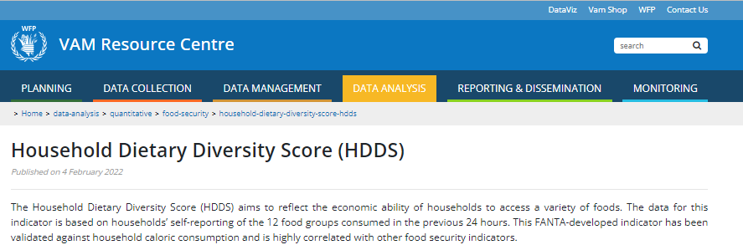
HDDS: VAM Resource Centre
For more information and guidance go to
HDDS (Resource Centre)

Slide 30
Thank You!

