Slide 1
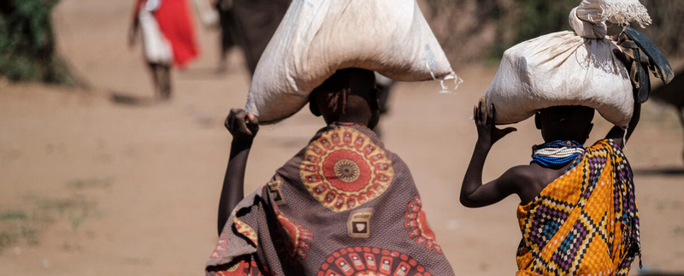
© WFP/Kabir Dhanji
Household Hunger Scale (HHS)
Needs Assessments & Targeting Unit
2024 April

Slide 2

AUDIENCE
The audience of this PowerPoint can range from enumerators to RAM and Programme staff in various offices. It can also be used for the training of partners or service providers.
Slide sections have been inserted to assist in the selection of material.

Slide 3
Introduction

Slide 4
HHS: training instructions 1
Discuss the objectives of the module, i.e., to gain information on the food-related behaviors and experiences associated with difficulty in accessing food in the targeted population, to measure household access to food.
Explain the role of this indicator in food insecurity figures and the use of information, internally and externally. This gives the enumerators a clear understanding of the importance of the data they would be soon collecting.

Slide 5
HHS: What is it?
The Household Hunger Scale (HHS) is an indicator that was developed by USAID’s Food and Nutrition Technical Assistance Project (FANTA).
It is a subset of questions from the full Household Food Insecurity Access Scale (HFIAS), which is not commonly applied in WFP Food Security assessments.
This presentation was prepared based on the full FANTA guidelines found on the VAM Resource Centre.
Note, however, that WFP only collects HHS, rarely HFIAS

Slide 6
HHS: What is it?
The Household Hunger Scale (HHS) is a household food deprivation scale.
It is based on “experiential” or “perception-based” data collection.
It relies on self-reported information by the households.
It assesses whether households have experienced problems of food access in the preceding 30 days.
It is used to classify the severity of food insecurity for that period.
It assesses food consumption strategies adopted by households facing a lack of access to food.

Slide 7

HHS: USEs OF this indicator
Note that HHS is recommended for acute food security settings and is less useful in measuring chronic food insecurity.
HHS is most appropriate to use in areas of acute food insecurity and is recommended in situations of shocks.
It can be used to:
  Monitor the prevalence of hunger over time across countries or regions.
  Assess the food security situation in a country or region.
  Monitor and evaluate the impact of policies and programmes.
  Provide early warning information for food and nutrition monitoring.
It is not a standalone measure of food insecurity and should be used alongside other measures, e.g., food consumption, coping strategies, dietary diversity, anthropometric data, household income and expenditures.
The HHS is one of the food security outcome indicators in the Integrated Food Security Phase Classification (IPC) acute food insecurity reference table.

Slide 8
HHS: training instructions 2
Note how the main question is worded for the 3 questions: “In the past 30 days, did you or any household member…“
If yes, ask about the frequency, “How often did this happen in the past 30 days…”:
The response options are
  1 = Rarely (1–2 times),
  2 = Sometimes (3–10 times), or
  3 = Often (more than 10 times)

Slide 9
HHS MODULE: What to ask? (1)
1
Variable name | Question | Response option | Code
HHSNoFood | In the past 30 days, was there ever no food to eat of any kind in your house because of lack of resources to get food? | 0 = No (skip to HHSBedHung) 1 = Yes | |___|
HHSNoFood_FR | How often did this happen in the past? | 1 = Rarely (1–2 times) 2 = Sometimes (3–10 times) 3 = Often (more than 10 times) | |___|
HHSBedHung | In the past 30 days, did you or any household member go to sleep at night hungry because there was not enough food? | 0 = No (skip to HHSNotEat) 1 = Yes | |___|
HHSBedHung_FR | How often did this happen in the past? | 1 = Rarely (1–2 times) 2 = Sometimes (3–10 times) 3 = Often (more than 10 times) | |___|
HHSNotEat | In the 30 days, did you or any household member go a whole day and night without eating anything at all because there was not enough food? | 0 = No (Skip to the next section) 1 = Yes | |___|
HHSNotEat_FR | How often did this happen in the past? | 1 = Rarely (1–2 times) 2 = Sometimes (3–10 times) 3 = Often (more than 10 times) | |___|
2
3
Notes:
The individual questions are explained in further detail on the following slides.

Slide 10
HHS MODULE: What to ask? (2)
For each of the 3 main questions, if the respondent says “yes” the household experienced them, then the enumerator asks, “How often did this happen in the past 30 days?
The respondent will then likely reply with “a couple of times,” “a few times,” “frequently/often,” which should be coded as below.
The enumerator should then clarify the number of times that it happened, asking was that 1-2 times? 3-10 times, or more than 10 times in the past 30 days?
Be careful to select the right frequency according to the number of times!
HHSNoFood_FR | How often did this happen in the past? | 1 = Rarely (1–2 times) 2 = Sometimes (3–10 times) 3 = Often (more than 10 times) | |___|
Notes:
The individual questions are explained in further detail on the following slides.

Slide 11
HHS module design
HHS question | Intended Meaning of the Question
Q1: No food of any kind in the house | This question asks about a situation in which there is no food to eat of any kind in the house because food was not available to household members through usual means (e.g., through purchase or barter, gifts, own production, from storage).
Q2: Go to sleep hungry because there was not enough food | This question asks whether the respondent or other household members felt hungry at bedtime because they did not have enough food to eat during the day and evening.
Q3: Go a whole day and night without eating | This question asks whether any household member did not eat from the time they awoke in the morning to the time they awoke the following morning because there was not enough food. A person who chooses not to eat for a whole day for reasons other than lack of food (for example, if fasting or on a diet) should not respond affirmatively to Q3.

Slide 12

HHS: CONDITION 1 PROBING example
Probing questions should be applied during interviews to better understand the conditions experienced.
For example, if a household reported having no food to eat of any kind in the house, then probe:
“Are you sure that there was absolutely no food in the house, including in storage/stocks?”
“And you had no other means to get food (purchase, barter, gifts, production, storage)?”

Slide 13
HHS module design
HHS question | Intended Meaning of the Question
Q1: No food of any kind in the house | This question asks about a situation in which there is no food to eat of any kind in the house because food was not available to household members through usual means (e.g., through purchase or barter, gifts, own production, from storage).
Q2: Go to sleep hungry because there was not enough food | This question asks whether the respondent or any other household members felt hungry at bedtime because they did not have enough food to eat during the day and evening.
Q3: Go a whole day and night without eating | This question asks whether any household member did not eat from the time they awoke in the morning to the time they awoke the following morning because there was not enough food. A person who chooses not to eat for a whole day for reasons other than lack of food (for example, if fasting or on a diet) should not respond affirmatively to Q3.
To be “hungry” is to have a compelling need or desire for food, to have a painful sensation, or to be in a state of weakness caused by the need for food. A hungry person is not necessarily one who has not eaten at all; food eaten may not have been enough to fill the belly/feel full/satisfied.

Slide 14
HHS: Condition 2 PROBING example
Probing questions should be applied during interviews to better understand the conditions experienced.
For example, if a household reported going to sleep hungry because there was not enough food, then probe:
“Why did they go to bed hungry?”
The response must be due to lack of resources.

Slide 15
HHS module design
HHS question | Intended Meaning of the Question
Q1: No food of any kind in the house | This question asks about a situation in which there is no food to eat of any kind in the house because food was not available to household members through usual means (e.g., through purchase or barter, gifts, own production, from storage).
Q2: Go to sleep hungry because there was not enough food | This question asks whether the respondent or other household members felt hungry at bedtime because they did not have enough food to eat during the day and evening.
Q3: Go a whole day and night without eating | This question asks whether any household member did not eat from the time they awoke in the morning to the time they awoke the following morning because there was not enough food. A person who chooses not to eat for a whole day for reasons other than lack of food (for example, if fasting or on a diet) should not respond affirmatively to Q3.

Slide 16
HHS: Condition 3 PROBING example
Probing questions should be applied during interviews to verify that the responses are correct and understand the conditions experienced.
For example, if a household reported going a whole day and night without eating, then probe:
“Why did this person go a whole day/night without eating?”
… must be due to lack of resources
… and not due to fasting, lack of time, or other reasons.
Where possible, use observation to probe and question responses that seem unlikely, where relevant

Slide 17
HHS: Clarification
If the respondent says “no” but adds that it only happened a few times:
Then correct answer is “1” yes.
Be careful to probe between the frequencies – rarely, sometimes, and often.
If the respondent describes a frequency that translates to 3-10 times
then “2” sometimes should be selected.
The respondent should be allowed to answer in their own words and the enumerator should select the most appropriate answer option.
However, if the respondent has difficulty replying, then the enumerator can list the response options again.

Slide 18
HHS MODULE: What to ask?
Need that pre-coded responses should be read only 1x
Variable name | Question | Response option | Code
HHSNoFood | In the past 30 days, was there ever no food to eat of any kind in your house because of lack of resources to get food? | 0 = No (skip to HHSBedHung) 1 = Yes | |___|
HHSNoFood_FR | How often did this happen in the past 30 days? | 1 = Rarely (1–2 times) 2 = Sometimes (3–10 times) 3 = Often (more than 10 times) | |___|
HHSBedHung | In the past 30 days, did you or any household member go to sleep at night hungry because there was not enough food? | 0 = No (skip to HHSNotEat) 1 = Yes | |___|
HHSBedHung_FR | How often did this happen in the past 30 days? | 1 = Rarely (1–2 times) 2 = Sometimes (3–10 times) 3 = Often (more than 10 times) | |___|
HHSNotEat | In the past 30 days, did you or any household member go a whole day and night without eating anything at all because there was not enough food? | 0 = No (Skip to the next section) 1 = Yes | |___|
HHSNotEat_FR | How often did this happen in the past 30 days? | 1 = Rarely (1–2 times) 2 = Sometimes (3–10 times) 3 = Often (more than 10 times) | |___|

Slide 19
The Household Food Insecurity Access Scale (HFIAS) Module

Slide 20
HFIAS: What is it?
The Household Food Insecurity Access Scale (HFIAS) consists of nine occurrence questions and nine frequency of occurrence questions, asking whether or not a specific condition associated with the experience of food insecurity ever occurred during the previous 30 days.
These questions were designed to represent varying levels of food insecurity, reflecting 3 domains perceived as central to the experience of food insecurity cross-culturally:
  Anxiety about household food supply;
  Insufficient quality, which includes variety, preferences, and social acceptability;
  Insufficient food supply and intake and the physical consequences.
  For more information, see here the FANTA guidelines found on the VAM Resource Centre.

Slide 21
HFIAS & HHS: What are they?
HFIAS Occurrence Questions In the past 30 days, …. | If yes, how often did this happen in the past 30 days?: 1= rarely (1-2 times) Sometimes (3-10 times) Often (more than 10 times)
1. … did you worry that your household would not have enough food?
2. ….were you or any household member not able to eat the kinds of foods you preferred because of a lack of resources?
3. ….did you or any household member have to eat a limited variety of foods due to a lack of resources?
4. …did you or any household member have to eat some foods that you really did not want to eat because of a lack of resources to obtain other types of food?
5. …., did you or any household member have to eat a smaller meal than you felt you needed because there was not enough food?
6. …, did you or any household member have to eat fewer meals in a day because there was not enough food?
7. …, was there ever no food to eat of any kind in your household because of lack of resources to get food?
8. …, did you or any household member go to sleep at night hungry because there was not enough food?
9. …., did you or any household member go a whole day and night without eating anything because there was not enough food?
HFIAS - NOT typically used in WFP assessments
HHS - sometimes used in WFP assessments
HHS

Slide 22
HFIAS & HHS: What are they?
You were worried that your household would not have enough food to eat?
You (or any other HH member) went to sleep at night hungry because there was not enough food?
You (or another HH member) went a whole day and night without eating anything because there was not enough food?
You (or another HH member) were not able to eat the kinds of foods you preferred due to lack of resources?
You (or any other HH member) had to eat a limited variety of foods due to lack of resources?
You (or any other HH member) had to eat some foods that you really did not want to eat because of a lack of resources?
You (or any HH member) had to eat a smaller meal than you felt you needed because there was not enough food?
There was no food to eat of any kind in your house because of lack of resources to get food?
You (or any other HH member) had to eat fewer meals in a day because there was not enough food?
HHS
Notes:
While the full set of 9 HFIAS occurrence questions were found to be not comparable across countries
The last 3 occurrence questions (Q7, Q8, & Q9) were comparable across countries
They appear to be interpreted the same way and have the same meaning across countries.

Slide 23
Module Design

Slide 24
HHS module design
When designing your questionnaire, including the HHS module, please refer to the Survey Designer as it offers the WFP’s standard modules in XLSForm and word formats.
It is very important that the full module for HHS includes the 3 main questions & 3 frequency of occurrence questions; It is not possible to pick & choose which of these questions to ask.
However, the choice of whether to use a 4-week or 30-day recall period, depends on the context (a culture may contextualise time differently and prefer either to think in weeks or in days). Note that no other time periods should be used.
If you must rely on data collection tools and platforms that do not support XLSForms then you must replicate the standard module correctly, including the visibility and validation constraints.

Slide 25
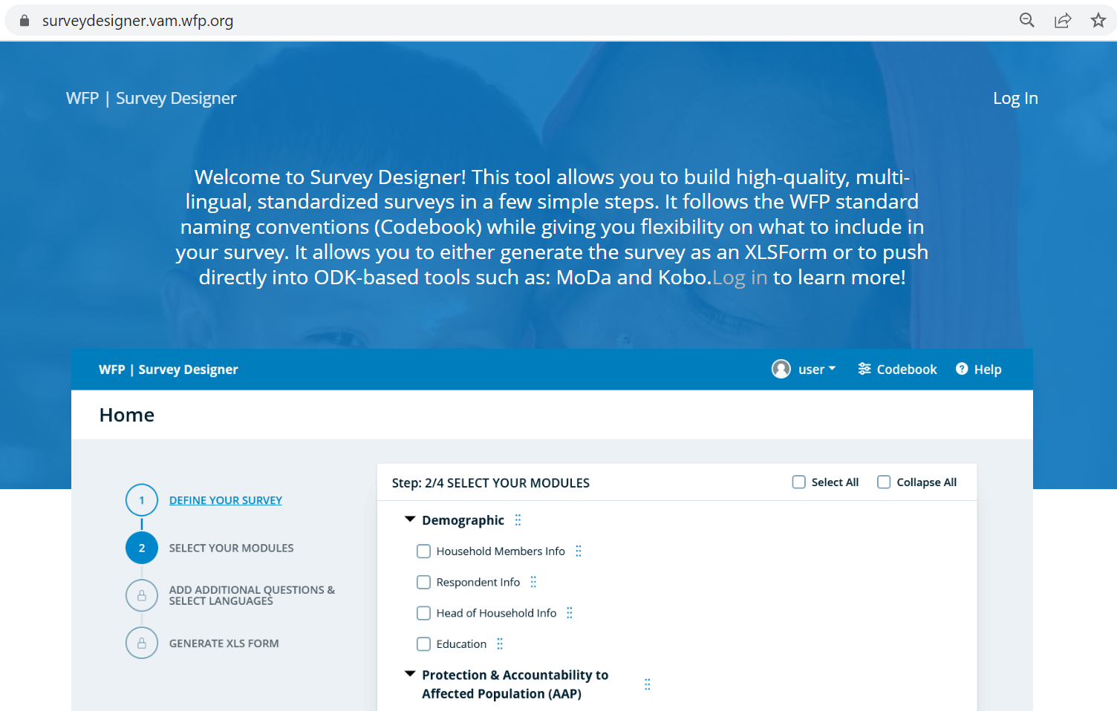
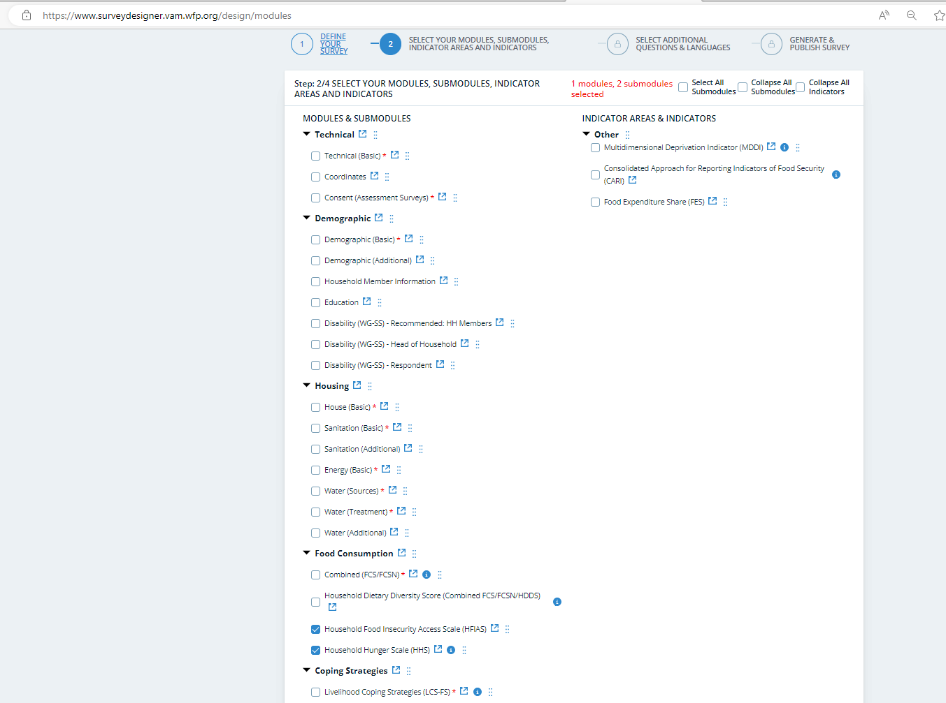
HHS: Survey Designer
HHS Codebook (Survey Designer)

Slide 26
HHS: Survey Designer
Find the latest standard HHS module in XLSform on
Survey Designer

Slide 27
How to calculate HHS?

Slide 28
HHS: CALCULATION
Step 1. Recode responses from 3 (“rarely,” “sometimes,” and “often”) into 2 frequency categories (“rarely or sometimes,” and “often”).
Create a new variable for each frequency of occurrence question - HHSQ1 HHSQ2 HHSQ3.
Step 2. RECODE HHSNoFood_FR HHSBedHung_FR HHSNotEat_FR (1=1) (2=1) (3=2) (ELSE=0) INTO HHSQ1 HHSQ2 HHSQ3. Now all HH should have a value of 0, 1 or 2
Step 3. The values of the new variables are then summed for each household to calculate HHS score. COMPUTE HHS=HHSQ1 + HHSQ2 + HHSQ3. Each HH should have an HHS score between 0 & 6.
These scores are used to generate the HHS indicators.

Slide 29
HHS: CALCULATION(s)
This is the standard version that should be used in all cases, except for IPC reporting.
Household Hunger Score | Household Hunger Categories (Standard)
0-1 | Little to no hunger in the household
2-3 | Moderate hunger in the household
4-6 | Severe hunger in the household
Household Hunger Score | Household Hunger Categories (IPC)
0 | No hunger in the household
1 | Little hunger in the household
2-3 | Moderate hunger in the household
4 | Severe hunger in the household
5+ | Very severe hunger in the household
Note that the IPC uses 4 categories
(0, 1, 2-3, 4, 5+)
Notes:
To tabulate the categorical HHS indicator, two different cutoff values (> 1 and > 3) are applied to the HHS scores that were generated in the previous step.

Slide 30
HHS: Median
Because the HHS score is generally not normally distributed, reporting or using the mean HHS score for analysis is not recommended. Instead, it is recommended to take the median.
FREQUENCIES VARIABLES=HHS
/STATISTICS=MEAN MEDIAN MINIMUM MAXIMUM
/ORDER=ANALYSIS.
**To tabulate the categorical HHS indicator, two different cutoff values (> 1 and > 3) are applied to the HHS scores that were generated in Step 3 above**
RECODE HHS (0 thru 1=1) (2 thru 3=2) (4 thru Highest=3) INTO HHSCat.
variable labels HHSCat 'Household Hunger Score Categories'.
EXECUTE.
***define labels
Value labels HHSCat
1 ‘No or little hunger in the household’
2 ‘Moderate hunger in the household’
3 ‘Severe hunger in the household’.

Slide 31
Analysis

Slide 32
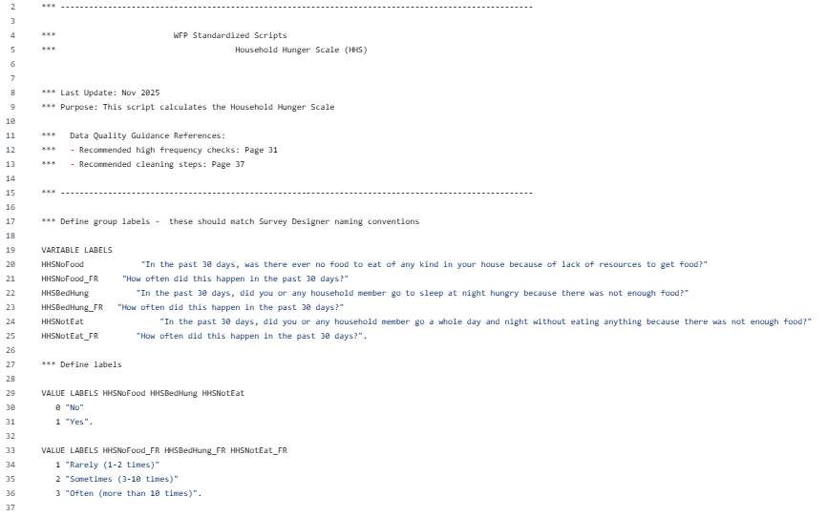
HHS: GITHUB
Find the SPSS, STATA and R scripts on
GitHub WFP

Slide 33
Reporting

Slide 34
HHS: REPORTING EXAMPLE
The proportion of households reporting severe hunger in the baseline reduced by 10%, from 15% at baseline to 5% at the endline.
Households experiencing little to no hunger increased from 54% at the baseline compared to 73% at the endline.

Slide 35
Available Resources

Slide 36
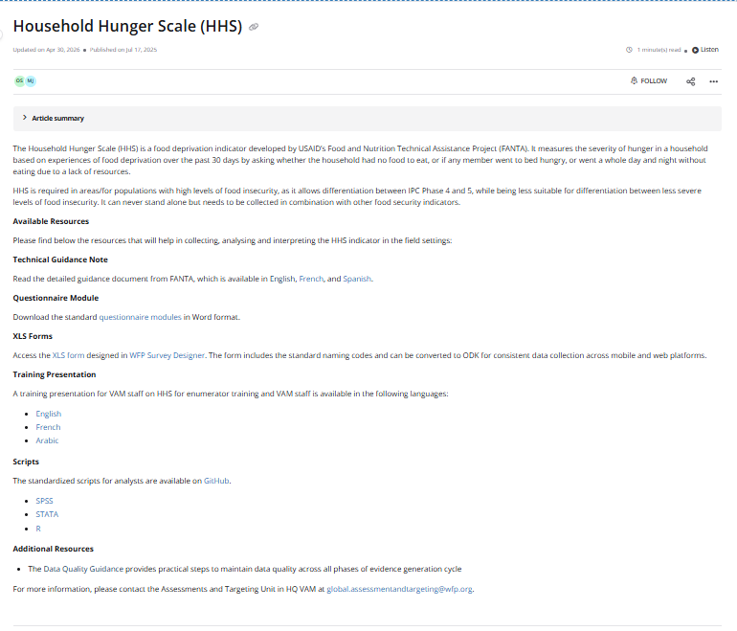
HHS: VAM Resource Centre
For more information and guidance go to HHS (Resource Centre)

Slide 37
Thank You!

