Slide 1
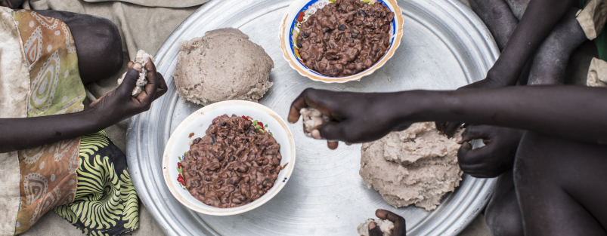

Food Consumption Score (FCS) &
Food Consumption Score Nutritional Analysis (FCS-N)
Needs Assessments & Targeting Unit
2024 April

Slide 2

AUDIENCE
The audience of this PowerPoint can range from enumerators to RAM and Programme staff in various offices. It can also be used for the training of partners or service providers.
Slide sections have been inserted to assist in the selection of material.

Slide 3
Introduction

Slide 4
FCS/FCS-N: training instructions 1
Discuss the objectives of the module, i.e., to gain information on the food consumption of households in the targeted population.
Explain the role of this indicator in food insecurity figures and the use of information, internally and externally.
This gives the enumerators a clear understanding of the importance of the data they would be soon collecting.

Slide 5
FCS: What is it?
The Food Consumption Score (FCS) is a composite score based on households’ dietary diversity, food consumption frequency & the relative nutritional value of the food consumed.
  Dietary diversity: number of different food groups consumed over a reference period.
  Food consumption frequency: number of days (in the past 7 days) that a specific food groups were eaten at the household level.
  Nutritional value: weighting of food groups value in terms of caloric density, macro and micronutrient content.
The FCS is highly correlated with other food security proxy indicators, including the Household Dietary Diversity Score, reduced Coping Strategies Index, and Vitamin A, Protein-rich and Hem Iron intake.

Slide 6
FCS-N: What is it?
The Food Consumption Score for Nutrition Quality Analysis (FCS-N) was designed to improve the understanding of households’ dietary intake of key nutrient-rich foods, focusing on:
  Protein
  Vitamin-A
  Hem Iron
The FCS-N asks about an additional 7 subgroups beyond the 8 standard food groups in the FCS. The FCS-N is recommended for nutrition-sensitive interventions as it can feed into decision-making on nutrition-sensitive programming.

Slide 7
FCS/FCS-N: Definitions
Some other definitions to consider….
Food group is defined as a grouping of food items that have similar caloric and nutrient content.
Food items fall under food groups and cannot be further split into separate foods. Generic terms such as ‘rice’ or ‘tomatoes’ are generally considered to be food items for this analysis.
Condiment, in this context, refer to a food that is generally eaten in very small quantities, often just for flavour. Examples include spices, a ‘pinch’ of fish powder, a ‘splash’ of milk in tea or coffee, etc.
Subgroup, any disaggregated food group, beyond the 8 aggregate food groups plus condiments, such as 'fish' as a subgroup of ‘meat, fish and eggs.’

Slide 8

FCS & FCS-N: USEs OF the(se) indicator(s)
The FCS can be used in a range of ways, including for programme activity monitoring, determining the food security situation at a point in time, and to inform population-level targeting.
The FCS indicator plays a part in classifying households according to their level of food security, through Consolidated Approach for Reporting on food Insecurity (CARI).
This FCS is one of the food security outcome indicators in the Integrated Food Security Phase Classification (IPC) acute food insecurity reference table.

Slide 9
The FCS and FCS-N Module(s)

Slide 10
FCS/FCS-N: training instructions 2
This section briefly introduces the format of the standard module. Note that the examples and food groups are explained in further detail in the next section.
Nevertheless, please ensure that the examples of food items on the standard module presented in the next slide are contextualized based on the country context. If certain food items are not consumed, e.g. insects, ensure that they are removed.
Note that the FCS-N follows the same format as the FCS but has 7 subgroups of the 8 main food groups of the FCS.

Slide 11
Fcs MODULE
How many days over the last 7 days, did most members of your household (50% +) eat the following food items, inside or outside the home? Note for enumerator: Determine whether the consumption of food items (e.g., fish, milk) was only in small quantities and should be recorded as a condiment. | Foods | Number of days eaten in past 7 days. Write 0 if not consumed in the last 7 days | Variable names | How was this food acquired? Write the main source of food for the past 7 days. If 0 days, do not specify the main source.
1. | Cereals, grains, roots and tubers: rice, pasta, bread, sorghum, millet, maize, potato, yam, cassava, white sweet potato, taro, plantain | |___| | FCSStap | |___|
2. | Pulses/legumes, nuts and seeds: beans, cowpeas, lentils, soy, pigeon pea, peanuts, other nuts | |___| | FCSPulse | |___|
3. | Dairy: milk, yoghurt, cheese, and other dairy products (Exclude margarine/butter or small amounts of milk for tea/coffee) | |___| | FCSDairy | |___|
4. | Meat, fish and eggs: goat, beef, chicken, pork, fish and other seafood (including canned tuna), escargot, insects, eggs (Exclude meat and fish consumed in small quantities) | |___| | FCSPr | |___|
5. | Vegetables and leaves: spinach, onion, tomatoes, carrots, peppers, green beans, lettuce, etc | |___| | FCSVeg | |___|
6. | Fruits: banana, apple, lemon, mango, papaya, apricot, peach, etc (exclude packaged fruit juice) | |___| | FCSFruit | |___|
7. | Oils and fats: vegetable oil, palm oil, ghee, butter, margarine, other fats or oils | |___| | FCSFat | |___|
8. | Sugar and sweets: sugar, honey, jam, candy, chocolate, biscuits/cookies, pastries, cakes, ice cream, and other sweets (including sugary drinks) | |___| | FCSSugar | |___|
9. | Condiments and spices: tea, coffee, cocoa powder, salt, garlic, spices, yeast, tomato paste; small quantities of other foods, especially meat or fish and small amounts of milk in tea or coffee. | |___| | FCSCond | |___|
Code book list name: SRf |  | Food acquisition codes (Sources of food, SRf) 100 = Own production (crops, animal husbandry) 200 = Fishing/hunting 300 = Gathering 400 = Loan/borrow 500 = Purchase with cash 600 = Purchase on credit 700 = Begging or scavenging for food 800 = Exchange labour or items for food (barter) 900 = Gift (food) from family, friends, or neighbours 1000 = Food assistance (in-kind or value voucher) from WFP, civil society, NGOs, government, etc.
The main question
There are 8 main food groups, plus condiments
Each food group has examples of food items
There are 10 sources of food.
The follow-up question

Slide 12
Fcs-N MODULE
1. | Cereals, grains, roots and tubers: rice, pasta, bread, sorghum, millet, maize, potato, yam, cassava, white sweet potato, taro, plantain | |___| | FCSStap
2. | Pulses/legumes, nuts and seeds: beans, cowpeas, lentils, soy, pigeon pea, peanuts, and/or other nuts | |___| | FCSPulse
3. | Dairy: milk, yoghurt, cheese, and other dairy products (Exclude margarine/butter or small amounts of milk for tea/coffee) | |___| | FCSDairy
4. | Meat, fish and eggs: goat, beef, chicken, pork, fish and other seafood (including canned tuna), escargot, insects, eggs (Exclude meat and fish consumed in small quantities) | |___| | FCSPr
If 0, skip to question 5
4.1 | Flesh meat: beef, pork, lamb, goat, rabbit, chicken, duck, other birds, insects | |___| | FCSNPrMeatF
4.2 | Organ meat: liver, kidney, heart and/or other organ meats |  | FCSNPrMeatO
4.3 | Fish/shellfish: fish and other seafood, including canned tuna (fish in large quantities and not as a condiment) | |___| | FCSNPrFish
4.4 | Eggs | |___| | FCSNPrEgg
5. | Vegetables and leaves: spinach, onion, tomatoes, carrots, peppers, green beans, lettuce, etc. | |___| | FCSVeg
If 0, skip to question 6
5.1 | Orange vegetables (vegetables rich in Vitamin A): carrot, red pepper, pumpkin, orange sweet potatoes | |___| | FCSNVegOrg
5.2 | Green leafy vegetables: spinach, broccoli, amaranth and/or other dark green leaves, cassava leaves | |___| | FCSNVegGre
6. | Fruits: banana, apple, lemon, mango, papaya, apricot, peach, etc | |___| | FCSFruit
If 0, skip to question 7
6.1 | Orange fruits (Fruits rich in Vitamin A): mango, papaya, apricot, and peach (Exclude oranges) | |___| | FCSNFruitOrg
7. | Oils and fats: vegetable oil, palm oil, ghee, butter, margarine, other fats or oils | |___| | FCSFat
8. | Sugar and sweets: sugar, honey, jam, candy, chocolate, biscuits/cookies, pastries, cakes, ice cream, and other sweets (including sugary drinks) | |___| | FCSSugar
9. | Condiments and spices: tea, coffee, cocoa powder, salt, garlic, spices, yeast, tomato paste; small quantities of other foods, especially meat or fish and small amounts of milk in tea or coffee. | |___| | FCSCond
Meat, fish & eggs subgroups:
Flesh meat
Organ meat
Fish
Eggs
Vegetables subgroups:
Orange vegetables
Green leafy vegetables
Fruit subgroup:
Orange fruits

Slide 13
Food Consumption Score
Nutrition Quality Analysis (FCS-N)

Slide 14
Fcs-N
MODULE
Note that the FCS-N module follows the same structure and format as FCS, but has 7 subgroups (linked to meat, fruit & veg)
How many days over the last 7 days, did most members of your household (50% +) eat the following food items, inside or outside the home? Note for enumerator: Determine whether the consumption of food items (e.g., fish, milk) was only in small quantities and should be recorded as a condiment. | Foods | Number of days eaten in past 7 days If 0 days, do not specify the main source. | Variable names | How was this food acquired? Write the main source of food for the past 7 days
4. | Meat, fish and eggs: goat, beef, chicken, pork, fish and other seafood (including canned tuna), escargot, eggs (meat and fish consumed in large quantities and not as a condiment) | |___| | FCSPr | |___|
If 0, skip to question 5
4.1 | Flesh meat: beef, pork, lamb, goat, rabbit, chicken, duck, other birds | |___| | FCSNPrMeatF | |___|
4.2 | Organ meat: liver, kidney, heart and/or other organ meats | |___| | FCSNPrMeatO | |___|
4.3 | Fish/shellfish: fish, including canned tuna, and/or other seafood (fish in large quantities and not as a condiment) | |___| | FCSNPrFish | |___|
4.4 | Eggs | |___| | FCSNPrEggs | |___|

Slide 15
Fcs-N MODULE (Cont.)
How many days over the last 7 days, did most members of your household (50% +) eat the following food items, inside or outside the home? Note for enumerator: Determine whether the consumption of food items (e.g., fish, milk) was only in small quantities and should be recorded as a condiment. | Foods | Number of days eaten in past 7 days If 0 days, do not specify the main source. | Variable names | How was this food acquired? Write the main source of food for the past 7 days
5. | Vegetables and leaves: spinach, onion, tomatoes, carrots, peppers, green beans, lettuce, etc. | |___| | FCSVeg | |___|
If 0, skip to question 6
5.1 | Orange vegetables (vegetables rich in Vitamin A): carrot, red pepper, pumpkin, orange sweet potatoes | |___| | FCSNVegOrg | |___|
5.2 | Green leafy vegetables: spinach, broccoli, amaranth and/or other dark green leaves, cassava leaves | |___| | FCSNVegGre | |___|
6. | Fruits: banana, apple, lemon, mango, papaya, apricot, peach, etc | |___| | FCSFruit | |___|
If 0, skip to question 7
6.1 | Orange fruits (Fruits rich in Vitamin A): mango, papaya, apricot, and peach [Exclude oranges] | |___| | FCSNFruiOrg | |___|

Slide 16
FCS-N: lookouts
IMPORTANT: The FCS-N must still ask about the main groups as a separate question (in addition to the subgroups)!
EXAMPLE:
A household indicates that in the last 7 days…
…most members of the household consumed flesh meat items for lunch, on 5 different days.
…they also had eggs on three of the mornings of these days when they consumed flesh meat items.
…& on a different day, they had fish for dinner.
4. | Meat, fish and eggs: goat, beef, chicken, pork, fish and other seafood (including canned tuna), escargot, insects, eggs (Exclude meat and fish consumed in small quantities) | |__6_| | FCSPr
If 0, skip to question 5
4.1 | Flesh meat: beef, pork, lamb, goat, rabbit, chicken, duck, other birds | |__5_| | FCSNPrMeatF
4.2 | Organ meat: liver, kidney, heart and/or other organ meats | |__0_| | FCSNPrMeatO
4.3 | Fish/shellfish: fish, including canned tuna, and/or other seafood (fish in large quantities and not as a condiment) | |_1__| | FCSNPrFish
4.4 | Eggs | |_3__| | FCSNPrEgg
Notes:
IMPORTANT: The FCS-N must still ask about the main groups as a separate question (in addition to the subgroups)! Under no circumstances should subgroups be summed up or the max value of the subgroups be taken.

Slide 17
FCS/FCS-N: training instructions 3
The aim is to capture the number of days when the household consumed each of the food groups. Not the number of times per food group/item.
Note how the main question is worded (on the next slide). The question is referring to the number of days where the household consumed each of the food groups (not the number of times!).
Foods consumed inside and outside the home are accounted for but must be consumed by more than half of the household (+50%).
Be sure the question includes a recall period of 7 days and not “last week”. We always ask about the same period beginning from today and counting backwards (i.e., “the last 7 days” not “the past week,” or “last week”). Interviewees could get confused if the timeframe is not specific.

Slide 18
Fcs/FCS-N MODULE(S): MAIN QUESTION
How many days over the last 7 days, did most members of your household (50% +) eat the following food items, inside or outside the home?
Food consumed outside of the household should only be counted if 50% or more (half or more) of the household consumed it.
The FCS module asks respondents how many days, in the last 7 days, did most members of their households (+50%) consume each of the food items/groups, inside or outside their home.
The module has been adapted to help enumerators quantify “most members in a household” and to capture the eating habits of households in urban settings, where consumption outside household is more frequent than rural areas.

Slide 19
Fcs/FCS-N MODULE(S): MAIN QUESTION (continued)
How many days over the last 7 days, did most members of your household (50% +) eat the following food items, inside or outside the home?
The recall period of the consumption of different food groups is the last/previous 7 days or a week from the interview date. For example, if today is Wednesday, we would be asking about the period from Wednesday last week until yesterday.

Slide 20
Fcs/FCS-N MODULE(S): Secondary QUESTION
The food source column of the food consumption module is used to record the main method by which the household obtained each recorded food item/group.
How was this food acquired?
Write the main source of food for the past 7 days.
If not eaten, do not specify the main source.
In situations where a household states that a particular food group was sourced equally from two or more main sources, the enumerator must probe to determine which source provided the highest share of the foods belonging to that food group.

Slide 21
Fcs/FCS-N MODULE(S): food sources
While less emphasis tends to be placed on the component related to sources of food, it has great importance in explaining the food security situation of households and their level of vulnerability.
Food acquisition codes (Sources of food, SRf) 100 = Own production (crops, animal husbandry) 200 = Fishing/hunting 300 = Gathering 400 = Loan/borrow 500 = Purchase with cash 600 = Purchase on credit 700 = Begging or scavenging for food 800 = Exchange labour or items for food (barter) 900 = Gift (food) from family, friends, or neighbours 1000 = Food assistance (in-kind or value voucher) from WFP, civil society, NGOs, government, etc.
For example, a household which mainly relies on humanitarian food assistance, borrowing, and gifts, can typically be considered more vulnerable than a household that is able to obtain food through cash purchases.
That said, cash purchases include any cash from any source, so could be from food assistance in cash or begging. The analyst will thus need to later cross check household income sources to understand purchasing behaviour in cash.

Slide 22
Food Groups

Slide 23
Fcs/FCS-N MODULES: training instructions 4
A list of relevant food items contextualised based on local dishes and common ingredients should be introduced during the training.
Discuss which food items comprise the most commonly eaten dishes and how they should be registered, i.e., a soup/stew/or curry could consist of some chunks of beef (meat), beans (pulses), a tomato base (vegetables) and spices (condiments) and be served with bread or rice (cereals).
In addition, it can be helpful to use contextual knowledge to guide respondents – e.g., in some cultures, there are particular days of the week where certain food items are consumed, like meat or fruit on Fridays.
Notes:
Before the training, it is suggested that the trainer update the list of examples in the PPT, as well as in the questionnaire itself. Ensure harmonization in the food items between modules: FCS, FCS-N, HDDS, MDDW, as relevant.

Slide 24

Food group 1: Staple Foods
Staple foods (cereals, grains, roots and tubers) are eaten regularly—even daily—` and supply a major proportion of a person's energy and nutritional needs.
Specific staples vary from place to place but are typically inexpensive and readily available.
Standard module example items:
Rice, pasta, bread, sorghum, millet, maize, potato, yam, cassava, white sweet potato, taro and plantain.
Note that processed products like pasta should be counted under cereals
Excludes orange flesh sweet potatoes (vegetable), & soybeans (pulses/legumes)
Notes:
Some of the leading food staple items around the world are cassava, maize, plantains, potatoes, rice, sorghum, soybeans, white sweet potatoes, wheat, and yams.

Slide 25
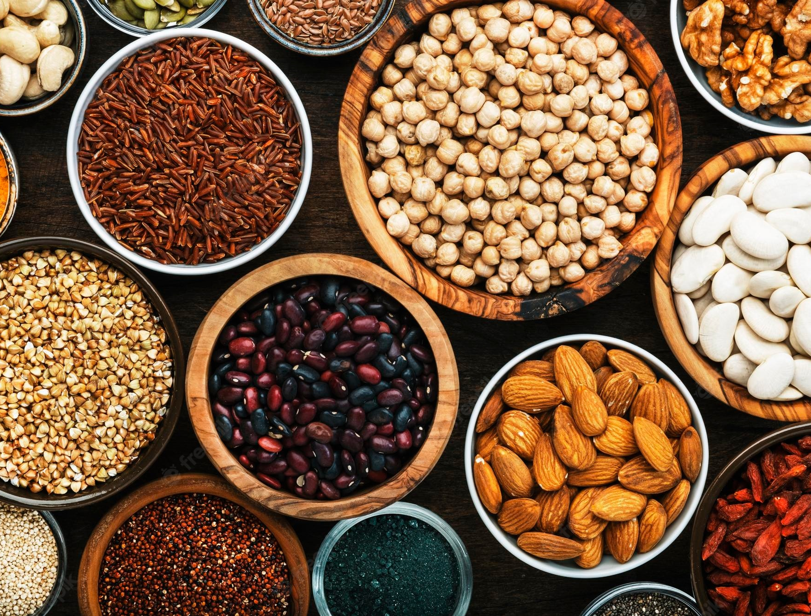
Food group 2: Pulses/Legumes, nuts & Seeds
Pulses, also known as legumes, are the edible seeds of leguminous plants cultivated for food. They are relatively sustainable and inexpensive, rich in protein and fiber.
Dried beans, lentils, peas and nuts are the most known and consumed examples of pulses. Seeds should also be counted here if eaten in sufficient quantities.
Standard module example items:
beans, cowpeas, peanuts, lentils, soy, pigeon pea and/or other nuts
Excludes small quantities (common case for nuts, seeds and sometimes pulses)! Excludes green beans and fresh peas (vegetables).
Oils extracted from nuts and seeds are not included (oils & fats)

Slide 26
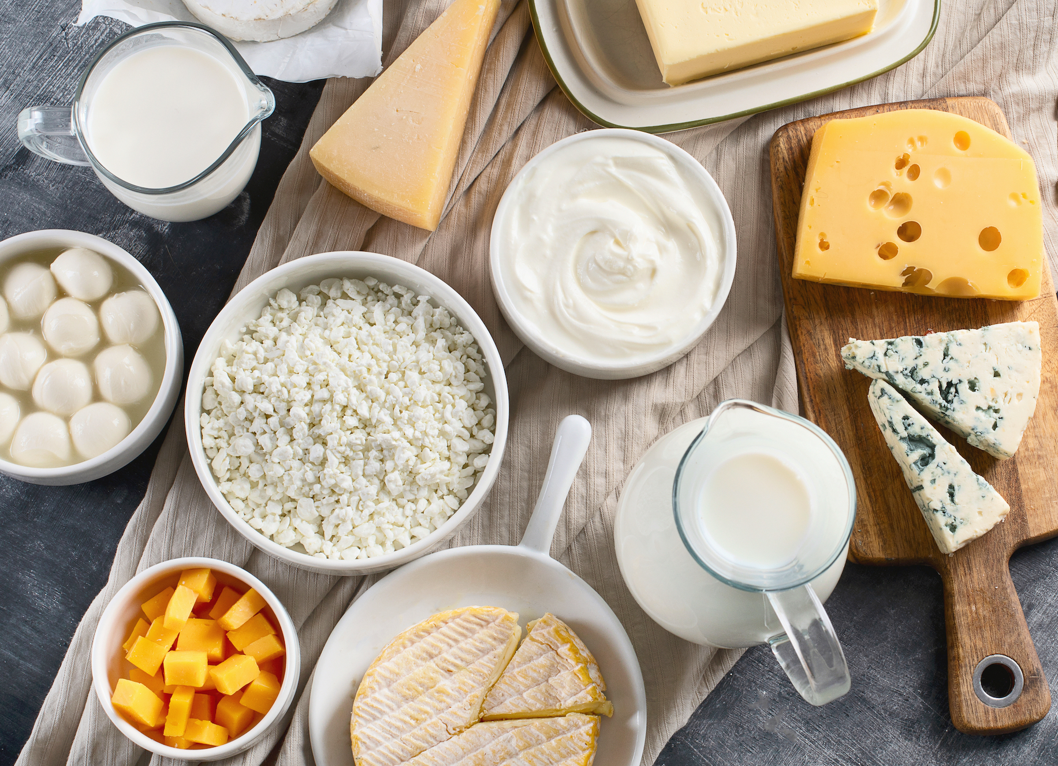
Food group 3: dairy
Codex Alimentarius defines a milk product as a “product obtained by any processing of milk, which may contain food additives, and other ingredients functionally necessary for the processing”.
Standard module example items:
Milk, yoghurt, cheese, and other dairy products
Excludes margarine, butter, and sour cream (fats), ice cream and condensed milk (sweets), and small amounts of milk in tea and coffee (condiments)
Notes:
https://www.fao.org/dairy-production-products/products/en/

Slide 27
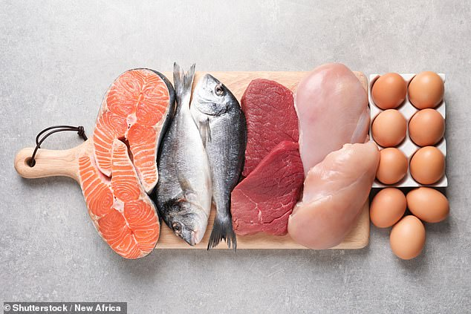
Food group 4: meat, fish, eggs
Poultry, meat and eggs are among the animal-source foods most widely eaten at the global level, across greatly diverse cultures, traditions and religions.
Fresh or canned meats and fish are included.
Standard module example items:
goat, beef, chicken, pork, escargot, insects,
fish, shellfish, and other seafood (including canned tuna)
Eggs from poultry
Meat, fish and eggs consumed in small quantities, as a condiment, (e.g., fish powder) are not counted
Notes:
https://www.fao.org/poultry-production-products/products-processing/en/

Slide 28

Fcs-N subgroupS: Flesh meat, Organ meat, fish, eggs
If the household indicates that they have consumed meats, fish and eggs in the FCS, they will be asked about the frequency of consumption of these subgroups in the FCS-N.
Note that in the FCS-N module the protein group ‘meat, fish and eggs’ is broken down into 4 subgroups:
Flesh Meat: goat, beef, chicken, pork
Organ meat: Liver, kidney, heart, gizzard, blood-based foods like blood pudding and/or other organ meats
Fish: fish, shellfish, and other seafood (including canned tuna)
Eggs: from all poultry
Does not include escargot or fish eggs as the nutritional qualities are insufficient/unknown
Notes:
https://www.fao.org/poultry-production-products/products-processing/en/

Slide 29
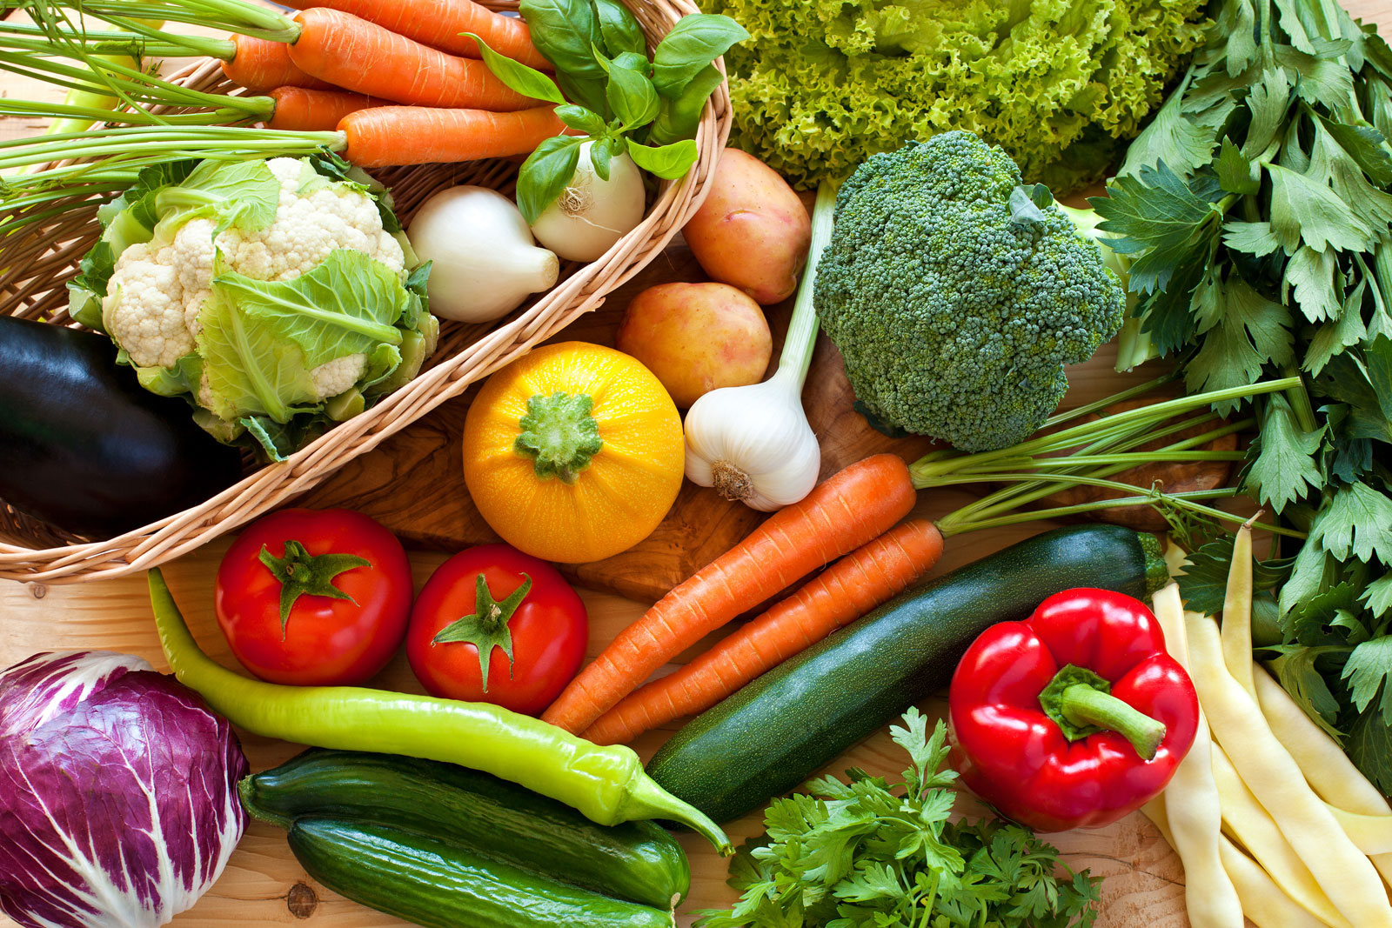
Food group 5: Vegetables & leaves
Vegetables are considered edible parts of plants (e.g., seedbearing structures, flowers, buds, leaves, stems, shoots and roots), cultivated or harvested from the wild. They can be consumed raw, cooked and minimally processed form.
Standard module example items:
Spinach, onion*, tomatoes, carrots, peppers, green beans, lettuce, etc.
Includes tinned or frozen vegetables but does not include pickled vegetables.
*Onions and garlic used to flavour dishes should be counted as condiments.
Parsley can be consumed as an herb (condiment) or as a vegetable (e.g. Tabbouleh)

Slide 30
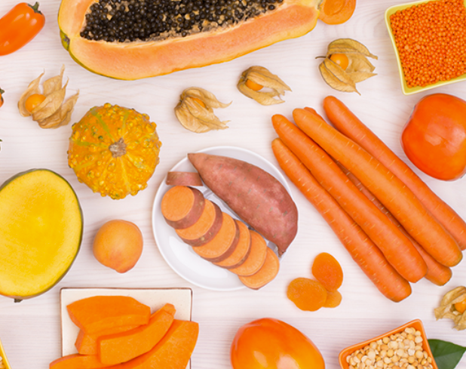
Fcs-N subgroup: orange (vitamin-A-rich) vegetables
If the household indicates that they have consumed vegetables in the FCS, they will be asked about the frequency of consumption of this subgroup in the FCS-N.
Note that in the FCS-N module, the vegetables group has a subgroup, focusing on vitamin-A-rich vegetables.
This includes any vegetables that are orange-colored on the inside.
Standard module example items:
carrot, red pepper, pumpkin, orange sweet potatoes
Does not include white sweet potatoes (roots/tubers).
Notes:
https://www.fao.org/poultry-production-products/products-processing/en/

Slide 31
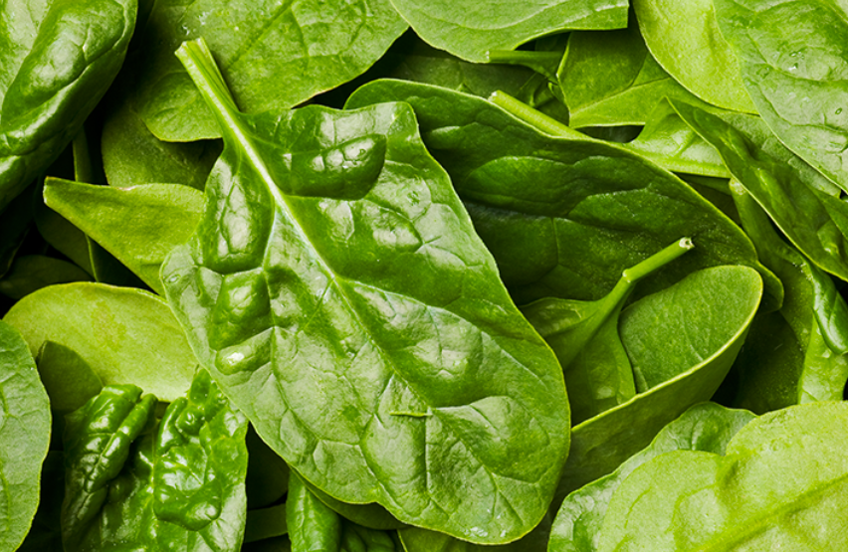
Fcs-N subgroup: Dark green Leafy vegetables
If the household indicates that they have consumed vegetables in FCS, they will be asked about the frequency of consumption of this subgroup in the FCS-N.
Note that in the FCS-N module, the vegetables group has a subgroup, focusing on dark green leafy vegetables.
Only very light-colored leaves, like iceberg lettuce and cabbage are not included in this sub-category.
Standard module example items:
spinach, broccoli, amaranth and/or other dark green leaves, cassava leaves
Parsley should be included only if consumed in sufficient quantities
Notes:
https://www.fao.org/poultry-production-products/products-processing/en/

Slide 32
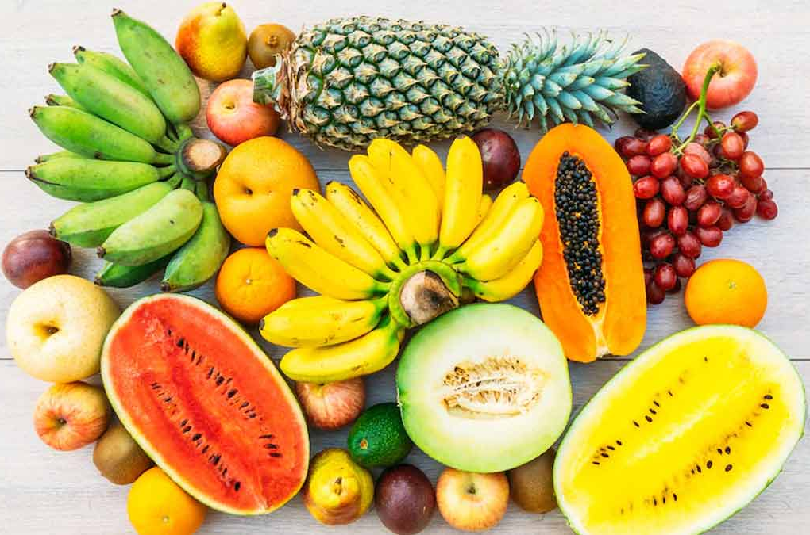
Fcs Food group 6: fruits
Fruits are considered edible parts of plants (e.g., seedbearing structures, flowers, buds, leaves, stems, shoots and roots), either cultivated or harvested from the wild.
They can be consumed in their raw state or a minimally processed form.
Standard module example items:
Bananas, apples, mango, papaya, apricot, peach, etc.
Fruit that has been dried should be counted as a fruit.
However, boxed/packaged fruit juice should be considered under sugars as they do not have the same nutritional value as in whole fresh form

Slide 33
Fcs-N subgroup: Orange (Vitamin-A rich) Fruits
If the household indicates that they have consumed fruits in FCS, they will be asked about the frequency of consumption of this subgroup in the FCS-N.
Note that in the FCS-N module, the fruits group has a subgroup, focusing on vitamin-A-rich fruits.
This includes any fruits that are dark yellow or orange on the inside (except oranges themselves!).
Standard module example items:
mango, papaya, apricot, and peach
Do not count oranges, tangerines, or other orange citrus fruits. Mango and papaya must be ripe (orange on the inside).
Notes:
https://www.fao.org/poultry-production-products/products-processing/en/

Slide 34

Fcs Food group 7: OILs and fats
Butter is considered a solid saturated fat, and oil is considered a liquid unsaturated fat.
Oil is generally healthier compared to fats/butter, but both are counted in the FCS module.
Standard module example items:
Vegetable oil, palm oil, ghee, butter, margarine, and other fats/oils.
Deeply fried snacks, (e.g., potato chips, doughnuts, samosas) should be counted as oils & fats. Further, deeply fried foods (e.g., fried fish, chicken or vegetables or potatoes) should be counted as (fish, chicken, vegetables, roots and tubers, respectively), but also the oil for frying should be counted here. Meanwhile, any quantity (even small amounts) consumed by the majority of the household should be counted – e.g. a dash of oil in a dish.

Slide 35
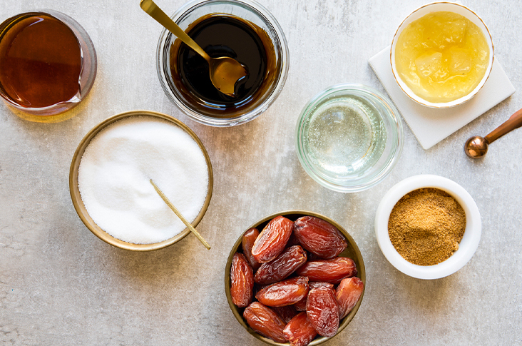
Fcs Food group 8: Sugar & sweets
Note that honey, dates, and other sweets should be counted as well
Sugar and sweets are soluble carbohydrates and are high in glucose.
All types of sweeteners and desserts are counted in this FCS food group.
Standard module example items:
sugar, honey, jam, candy, chocolate, biscuits/cookies, pastries, cakes, ice cream, and other sweets
Includes very sugary drinks (e.g. soda and sugary tea). Like oil/fat, any amount of sugar and sweets consumed by the majority of the household should be counted.

Slide 36
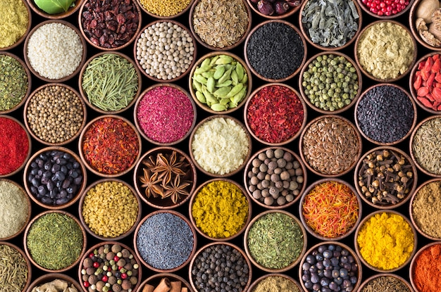
Fcs Food group 9: condiments & spices
Condiments are supplemental ingredients (such as a sauce or powder) that are added to enhance the flavour, improve taste, or complement the dish, but cannot be considered a standalone dish.
The condiments food group is mainly included to help capture foods consumed in very small quantities and avoid inclusion under nutritious food groups.
Standard module example items:
tea, coffee, cocoa powder, salt, garlic, spices, yeast, tomato paste
Condiments such as small amounts of meat or fish and milk are used to adjust the taste of foods or drinks

Slide 37

question:
can you think of other examples of food items for OUR context?

Slide 38
Food sources

Slide 39
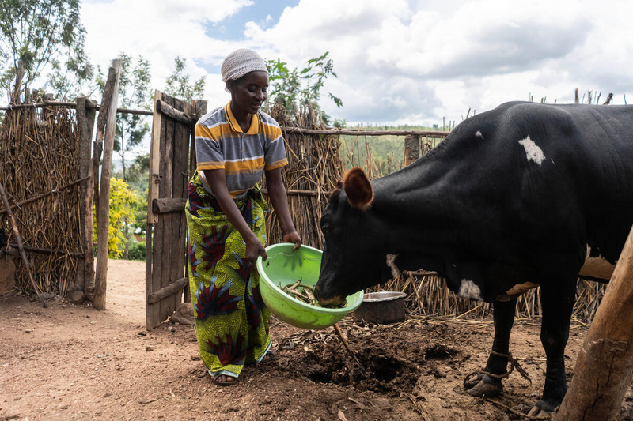
FCS: food sources – Own Production
All food groups could be produced and sourced using own production, though some are more obvious and frequent than others.
Includes all agricultural crops, fruit trees, vegetable gardens, animal husbandry, aquaculture, apiculture (honey), etc.
Depending on the scale and diversity of production and setting (urban/rural) this could indicate some level of self-reliance/ self-sufficiency.
Or could indicate a lack of resilience if heavily dependent on own production for many food groups and lack the cash to purchase other foods.
© WFP/Arete/Fredrik Lerneryd

Slide 40

FCS: food sources – Fishing & Hunting
Only applicable to protein sources like meat and fish
Depending on the context/setting (coastal/urban/rural), this could indicate contextual habits/preferences and a level of self-reliance (a choice)
Or could indicate a level of despair, searching for protein sources (meat or fish) that is available in the wild (usually free or with minimal cost).
Verify that the source indicated makes sense, noting that this only applies to protein sources.
© WFP/Arete/Siegfried Modola

Slide 41

FCS: food sources – Gathering
This includes gathering (or foraging) of wild berries, fruits, vegetables, and leaves for household consumption.
Depending on the context/setting (urban/rural), this could indicate some level of self-reliance (a choice)
Or could indicate a level of despair, searching for food that is available in the wild (usually free).
Verify that the source indicated makes sense, noting that this mostly applies to vegetables and fruits.
© WFP/Gabriela Vivacqua

Slide 42
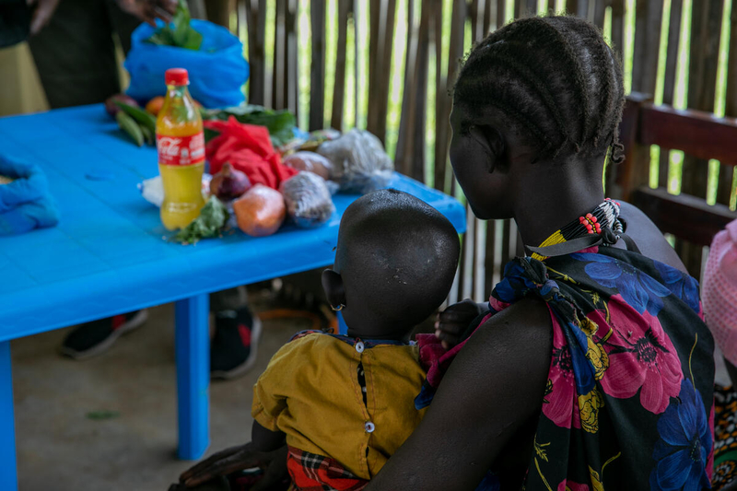
FCS: food sources – Loan/Borrow
Borrowing food as a loan from neighbours, family, friends, etc.
Loan/borrow comes with the intention and expectation that it will be repaid either in food or cash later.
This is contrary to gifts, which do not come with the expectation of being returned.
Note that this should not be confused with purchases made on credit or loans from shops.
Take care to not mix up loans/ borrowing from family/ friends/ neighbours with purchases on credit (at formal shops/ markets)
© WFP/Eulalia Berlanga

Slide 43
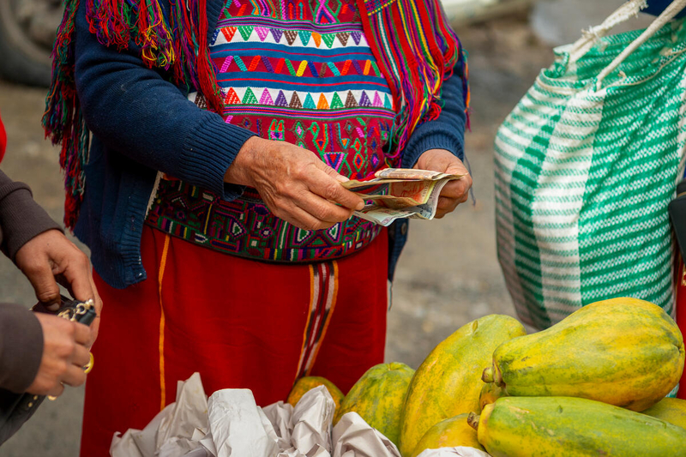
FCS: food sources – Purchase with Cash
Purchases at formal or informal markets using cash.
Note that cash could be earned from regular income sources such as livelihoods activities but could also be received through cash assistance or begging.
Thus, while this option typically indicates self-reliance, it needs to be cross-referenced with the income sources of the household.
Ensure that cash purchases, regardless of the source (income, begging or food assistance) are captured here.
© WFP/Giulio d’Adamo

Slide 44
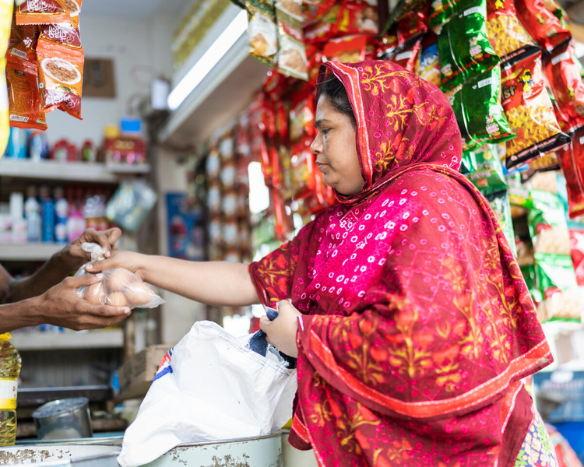
FCS: food sources – Purchase on Credit
Households mostly obtained this food through purchases at formal or informal markets using credit or a loan.
This does not include loans/borrowing from friends/neighbours.
Depending on the context, this could indicate some level of vulnerability (shortage of cash to make the purchase immediately), or it can be considered normal practice.
Take care to not mix up purchases on credit with loans/ borrowing from family/ friends/ neighbours
© WFP/Sayed Asif Mahmud

Slide 45
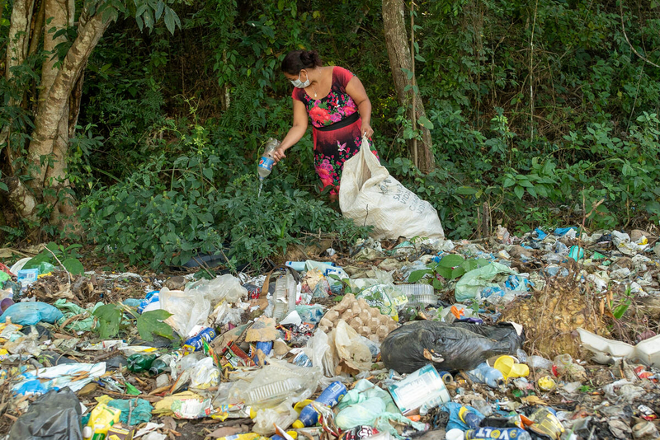
FCS: food sources – Begging or Scavenging
This includes strategies such as begging/ asking strangers for food, relying on leftover food from restaurants or shops or resorting to theft, scavenging for food or ‘dumpster diving’.
If a household uses money received through begging to buy food, main source should be cash purchases, not begging.
This usually indicates severe food gaps and desperation.
© WFP/Arete/Gerardo Aguilar
Ensure that there is some consistency in the data reported – if begging for food is indicated here, then it would also be likely be reported as an income source, and as a livelihood coping strategy.

Slide 46

FCS: food sources – Trade/Barter
This includes exchanging labour for food, or as payment for work, or in exchange for other goods or services that they traded.
Depending on the local context, it could indicate a level of despair, while in some contexts it is considered normal consumer behaviour.
It could also be possible that they have received other food items as gifts or food assistance that do not suit their preferences, so they trade them for other more preferred food items.
© WFP/Mohammad Hasib Hazinyar

Slide 47
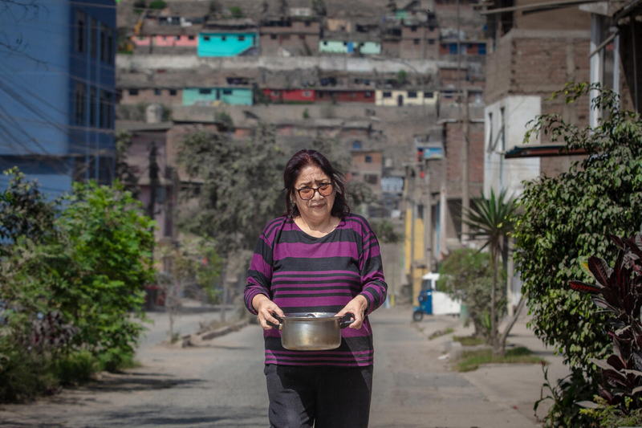
FCS: food sources – Gift
Households mostly obtained this food as a gift from family, friends, or neighbours, etc.
As it is a gift, it is not expected to be repaid.
Depending on the context and frequency of this option, it could indicate a strong reliance on outside sources to meet basic food needs and that the household is considered vulnerable in the community.
© WFP/Semire Comunicaciones
Formal food assistance from any organisation should not be counted here.

Slide 48

FCS: food sources – food Assistance
Households mostly obtained this food in the form of assistance (in-kind or value vouchers) from humanitarian organisations (including WFP), civil society, NGOs, or the government.
This category captures food assistance in the form of in-kind food or value vouchers only.
Food assistance in the form of cash, regardless of the source, should be counted under cash purchases.
If a large-scale cash distribution has recently taken place, the enumerator should be particularly observant to clarify the type of assistance and only count in-kind/value vouchers here.
© WFP/Eloge Mbaihondoum

Slide 49
HOW TO ASK?

Slide 50
Fcs/FCS-N MODULE(S): how to ask
“In the past 7 days, how many days did most members of your household consume this food group (give examples for each food group) inside or outside the home?”
IMPORTANT: When asking the question, you ask how many days NOT how many times, as household members may consume the same food group for example 3 times on the same day, and this will be considered as 1-day consumption from the same group.
The aim is to capture the number of days when the household consumed each of the food groups. Not the number of times per food group/item.
Notes:
E.g., If a household consumed eggs at breakfast and meat at lunch on the same day, this is considered as one day of animal protein consumption (meat, egg, fish). Similarly, if a household consumed bread every day in the past 7 days this is considered a 7 day of cereals consumption regardless if they consumed rice or any other cereal products or not

Slide 51
Fcs/FCS-N MODULE(S): how to ask
“Over the past 7 days, how many days did most of your household members consume this food group (give examples for each food group) inside or outside the home?”
IMPORTANT: You must ask about the number of days that a food item was consumed in the past week/7 days. Sometimes households or respondents may get confused and answer about their purchases.
For example, a household bought tinned tuna in the past 7 days but didn't consume any of it in the past 7 days. This information must not be captured under the FCS module (but should be captured in the household expenditure module).
That said, there should be some consistency between the modules – if a household reports buying perishable goods like meat and dairy, fruits or vegetables in the last 7 days (in the expenditure module) then it is likely that those should also be captured here in the FCS.

Slide 52
Fcs/FCS-N MODULE(S): how to ask
“In the past or over the past 7 days, how many days did most of your household members (50% or more) consume this food group (give examples for each food group) inside or outside the home?”
IMPORTANT: To help in quantifying most of a household, consider 50% of the household members or more.

Slide 53
Fcs/FCS-N MODULE(S): how to ask
“In the past or over the past 7 days, how many days did most of your household members consume this food group (give examples for each food group) inside or outside the home?”
IMPORTANT: Consumption of food outside or inside the home is both accounted for, as long as the foods are consumed by 50%+ of household members, and of sufficient quantities.

Slide 54
Fcs/FCS-N: training instructions 5
It is important to stress that the enumerators are the first point of control for data quality checks. They should check for the inconsistencies during data collection (see examples that follow).
It is also vital that the enumerators stress quantities consumed, particularly for protein-rich foods such as milk, eggs, meats and fish, as they could have been consumed in small quantities, as condiments.
Small quantities must not be considered in the main food groups. The following table will guide you on how to determine if the food consumed is insufficient or small.

Slide 55
Small quantities - cut-offs for condiments
No. | Food group | What doesn’t count = daily consumption Register as condiments | What counts = daily consumption Register under main food groups
1. ​ | Cereals, grains, roots and tubers | breadcrumbs sprinkled over a dish | One bowl of rice per person One plate of pasta per person One piece of bread per person ½ injera per person
2. ​ | Pulses, legumes, nuts | A sprinkle of nuts or seeds over a dish 1 tablespoon of peanut butter, used to flavour a dish Any quantity of nut milk (almond milk, soy milk) | One small bowl of nuts (e.g., as a snack) per person 1 tablespoon of peanut butter per person 1 tablespoon of hummus per person 1 tablespoon of seeds per person
3. ​ | Milk and other dairy products | A splash of milk/spoon or powdered milk added to tea or coffee​ Grated cheese sprinkled over a meal A spoonful of yogurt, used to flavour a dish Very liquid or watered-down yogurt | 1/2 cup of milk per person (fresh or powdered) A small piece of cheese (like a box of matches) per person​ 1 tablespoon of soft cheese per person One small cup of yogurt per person
4. ​ | Meat, fish and eggs | Less than 1/2 egg per person, e.g. one egg on top of a shared dish Eggs used in baking One small piece of meat (like a box of matches) for more than one person​ Fish powder spread over meals​ Fish sauce/paste used in a dish A piece of meat or fish to add flavour to a soup​ or dish Bone broth Dried fish | 1/2 egg (duck or chicken) per person 2 quail eggs per person Half- or whole-sized fish per person Handful of small fish (e.g., sardines, shrimp) 1 small piece of organ meat (size of matchbox) per person 1 small piece of meat (size of matchbox) per person Half a can of tuna per person A handful of insects (e.g., termites, crickets, or caterpillars) per person
Notes:
E.g., If a household reported consuming fish on a particular day in the last 7 days, then enumerators must probe to understand the quantities consumed. First by asking whether it was consumed by the majority of the household and if yes, then was it the main ingredient of the meal or used as a condiment? And can it be a stand-alone dish for the household? Or is it used to adjust the flavour of the meal? If used to adjust the flavour then it can only be reported under condiments.

Slide 56
Small quantities - cut-offs for condiments
No. | Food group | What doesn’t count = Register as condiments | What counts = Register as condiments
5. ​ | Vegetables and leaves | Garlic cloves used to flavour a dish One or two tomatoes, used to flavour a dish Two onions or less, used to flavour a dish Tomato paste, tomato sauce or ketchup used to flavour a dish Any amount of cucumber, cauliflower and/or carrot consumed only as pickle ​ Leaves: a few leaves for all | Half of a vegetable per person (e.g., cucumber, bell pepper) A dish made primarily from tomatoes (or any other vegetable) 1 medium onion per person Leaves: handful serving per person
6. ​ | Fruits | Fruits used to flavour refreshments (e.g., a lemon slice added to a drink) One small piece of fruit, split between 2 or more people ​​ - with the exception of larger fruits, where half would suffice Less than 3 fresh dates per person ​ Coconut water | One full piece of smaller fruit per person (e.g., mandarin, sugar banana, passionfruit) ½ a piece of bigger fruits (e.g., apple, pear, orange, banana) per person 1 slice of pineapple per person 3 fresh dates per person A handful of berries per person (fresh or frozen) Half a cup of dried fruit per person ¼ avocado per person
7. ​ | Oil, fat, butter |  | Any amount of oil should be counted (including a dash of oil in a shared dish) 1 tablespoon of butter per person A handful of potato chips per person
8. ​ | Sugar or sweets |  | Any amount of candy, cookies/biscuits or chocolate (even one small piece) Any amount of dried dates A cup/box of fruit juice per person Sugary tea (with one tablespoon or more) per person

Slide 57
question:
What are “NoRMAL” consumption habits in this context?
What do households normally eat and how often?
Does it differ by area?
by population group?
Notes:
During the enumerator training, discuss "normal” consumption habits by area and population group (e.g., religion, etc…) to enable enumerators to probe respondents properly regarding food consumption and spending.

Slide 58

PROBING examples
Probing should be used during interviews to better understand and confirm when unusual household food consumption information is reported.
In case the household responds with a low (or high) consumption for the context, enumerators should probe to confirm.
E.g., in contexts where cereals (rice, bread, etc.) are usually consumed daily, use probing:
"Why was the consumption of staples less than 4 days?"
“What did the household eat instead on the other 3 days?”
If, for example, the household ate pulses/legumes (e.g., lentils), instead, this can be understood and accepted.

Slide 59

PROBING examples
We need to be especially careful about protein consumption (meat, fish and eggs), taking care to not include small quantities and only including foods consumed by the majority of the household.
“Are you sure that the household did not eat any eggs in the past 7 days?"
“In the case of meat/fish/eggs, how much was consumed per person/day?”
If less than a matchbox size (or ½ egg) per person per day was consumed, then it should not be included.

Slide 60

FCS/FCS-N: data quality checks
Inconsistences between the main food groups and the subgroups for the FCS-N. While constraints will likely be set in the questionnaire, the enumerator should also use logic to ensure that subgroup consumption e.g., orange fruits, make sense considering how many days the household reported consumption of the main FCS group (i.e., fruits).
Inconsistencies between FCS and HDDS. Inconsistencies between FCS and HDDS. If a household reports having consumed an FCS food group all 7 days (e.g. oil, or sugar/sweets), then the corresponding food group in HDDS (oil) must be counted as 1/yes. However, it should be noted that small quantities consumed by anyone in the household are counted in HDDS, so it is not possible to apply the reverse logic; meaning that HDDS can have a value of 1, while the corresponding food group in FCS can still be 0.
Inconsistencies between food sources and the location: Check that the FCS sources are local, using knowledge of the local context and triangulating with the other relevant data points gathered in the same interview. For example, high reporting of own production or fishing/hunting in deserts, urban or landlocked areas. Also, certain food sources only make sense for some food groups, e.g., hunting/fishing only applies to ‘meat, fish and eggs.’
Inconsistencies between the FCS and food expenditures. The respondent reports not having spent any money on perishable food products (e.g., dairy products, meat, fruit and veg) in the past 7 days in the Expenditure module but reports frequent dairy consumption with cash purchases being the main source in the consumption module, or vice versa – reports no food consumption, with large expenditures.
Notes:
Let’s talk about the calculation per se now….and let’s start by clarifying something very important…
…
So how do you choose within each level? …

Slide 61

Enumerator’s notes
Enumerators and field supervisors should take note of any irregular consumption patterns that may stand out during the pilot or actual data collection phases to raise during the daily debriefing and discuss how to handle these cases.
Any qualitative information that would explain the quantitative data, or that would trigger adjustments, such as for the food items in the FCS module, should be highlighted and discussed.

Slide 62
FCS-N: lookouts
EXAMPLE:
In the last 7 days, most members of the household consumed flesh meat items for lunch, on 5 different days.
The household indicated that they also had eggs on three of the mornings of these days when they consumed flesh meat items.
On a different day, they had fish for dinner.
IMPORTANT: The FCS-N must still ask about the main groups (in addition to the subgroups)
4. | Meat, fish and eggs: goat, beef, chicken, pork, fish and other seafood (including canned tuna), escargot, insects, eggs (Exclude meat and fish consumed in small quantities) | |__6_| | FCSPr
If 0, skip to question 5
4.1 | Flesh meat: beef, pork, lamb, goat, rabbit, chicken, duck, other birds | |__5_| | FCSNPrMeatF
4.2 | Organ meat: liver, kidney, heart and/or other organ meats | |__1_| | FCSNPrMeatO
4.3 | Fish/shellfish: fish, including canned tuna, and/or other seafood (fish in large quantities and not as a condiment) | |_0__| | FCSNPrFish
4.4 | Eggs | |_3__| | FCSNPrEgg

Slide 63
FCS-N: lookouts
IMPORTANT: The FCS-N must still ask about the main groups (in addition to the subgroups)
The frequency value for the main food group ‘meat, fish and eggs’ is 6 and must not be aggregated to 9 (5+1+3).
The main group cannot exceed 7 days.
& It is not possible that the subgroups consumption to exceed (be higher than) the main group.
In addition, we cannot take the maximum (5) as this would not be correct either.
Because guess what! For the FCS calculation, we only use the number of days when the main food groups were consumed.
4. | Meat, fish and eggs: goat, beef, chicken, pork, fish and other seafood (including canned tuna), escargot, insects, eggs (Exclude meat and fish consumed in small quantities) | |__6_| | FCSPr
If 0, skip to question 5
4.1 | Flesh meat: beef, pork, lamb, goat, rabbit, chicken, duck, other birds | |__5_| | FCSNPrMeatF
4.2 | Organ meat: liver, kidney, heart and/or other organ meats | |__1_| | FCSNPrMeatO
4.3 | Fish/shellfish: fish, including canned tuna, and/or other seafood (fish in large quantities and not as a condiment) | |_0__| | FCSNPrFish
4.4 | Eggs | |_3__| | FCSNPrEgg

Slide 64
Fcs/FCS-N: training instructions 6
The following section on how the food groups come together and how the FCS is calculated is recommended for analysts only.
While in some enumerator trainings, the analysts decide to train the enumerators on this calculation, it is not recommended as they are not ultimately responsible for the calculation, but rather the collection.
It is instead recommended to focus on how to pose the questions and probe during the enumerator training and to save these slides for the analysts.

Slide 65
How do the food groups come together?

Slide 66
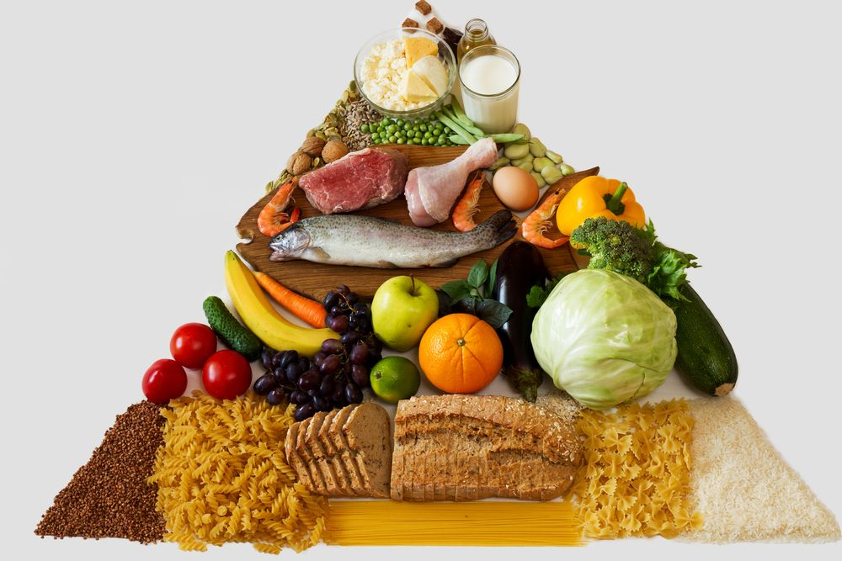
Food group weights
Sugar & sweets: 0.5
Oils, fat, butter: 0.5
Milk & dairy: 4.0
Pulses, legumes & nuts: 3.0
Meat, fish & eggs: 4.0
Fruits: 1.0
Vegetables & leaves: 1.0
Staple foods: 2.0

Slide 67
Food Groups (definitive) | Food Items (examples) | Weight | Justification
Meat, Fish & Eggs | Beef, goat, poultry, pork, fish & eggs | 4 | Highest quality protein, easily absorbable micronutrients (no phytates), energy dense, fat.
Dairy | Milk, yoghurt, cheese & other dairy products | 4 | Highest quality protein, source of micronutrients, vitamin A, and energy.
Pulses/ Legumes | Beans, cowpeas, lentils, soy, pigeon pea, peanuts, and/or other nuts | 3 | Energy dense, high amounts of protein but of poorer quality than animal sources, micronutrients not readily available (due to presence of phytates), low fat.
Staples | Cereals, grains, roots & tubers (e.g., Rice, pasta, bread, sorghum, millet, maize, potato, yam, cassava, white sweet potato, taro, plantain | 2 | Energy dense and usually consumed in larger quantities. Protein content lower and poorer quality (poorly digested/ poorly absorbed/ not containing balanced amino acids) than pulses or animal source proteins, and micronutrients not easily absorbable (due to presence of phytates).
Vegetables | Vegetables & leaves | 1 | Low energy, low protein, no (or low) fat, source of micronutrients.
Fruits | Fruits | 1 | Low energy, low protein, no fat, source of micronutrients, high in sugar.
Oil | Oil, fat, and butter | 0.5 | Energy-dense but with low nutritional value (no or lower amounts of other nutrients).
Sugar | Sugar, honey, jam, candy, chocolate, biscuits/cookies, etc. | 0.5 | Energy dense but with low nutritional value (no or lower amounts of other nutrients).
Condiments | Spices, tea, coffee, salt, fish powder, small amounts of milk for tea. | 0 | These foods are, by definition, eaten in very small quantities and not considered to add significant nutritional value to the overall household diet and are not considered in the analysis.

Slide 68
Module Design

Slide 69
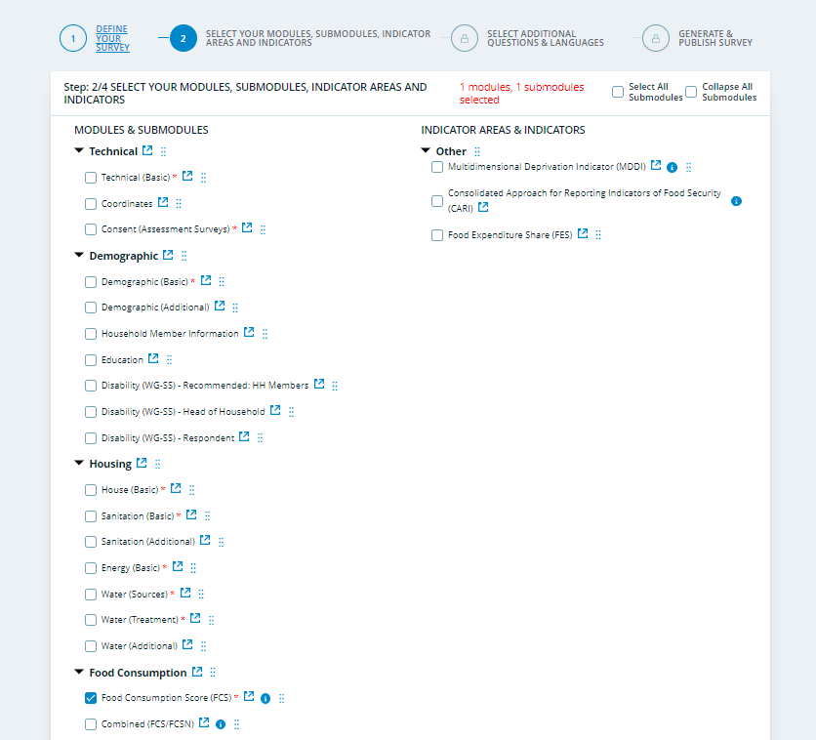
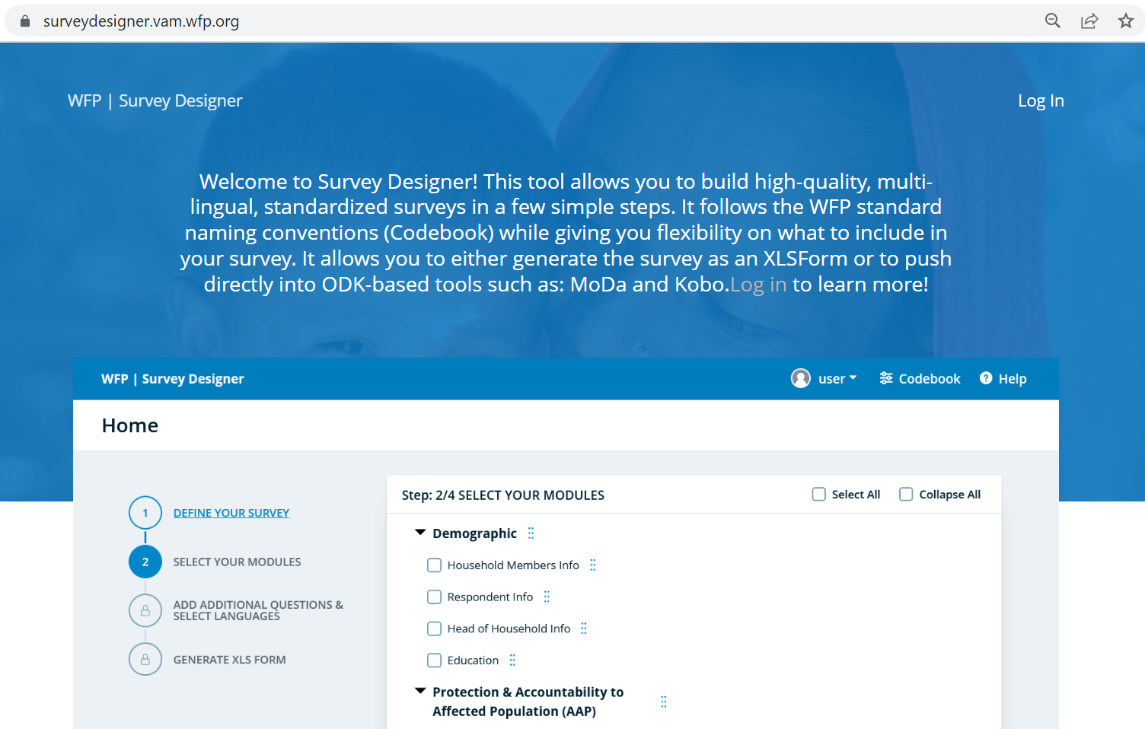
FCS: Survey Designer
FCS Codebook (Survey Designer)

Slide 70
FCS-N: Survey Designer
FCS-N Codebook (Survey Designer)

Slide 71
FCS/FCS-N Module(s) design
When designing your questionnaire, including the FCS/FCS-N module(s), please refer to the Survey Designer as it offers the WFP’s standard modules in XLSform and Word formats.
The examples of food items must be contextualized to reflect the most common local food items. However, the 8 food groups (and 7 subgroups for the FCS-N) must remain as indicated in the standard FCS module.
If you have to rely on data collection tools and platforms that do not support XLSforms then you must replicate the standard module correctly, including the visibility and validation constraints.
Notes:
If this opportunity is missed during the data cleaning phase, data analysts must ensure data quality through the triangulation of responses. Refer to the data quality assurance guidance note for more information.

Slide 72
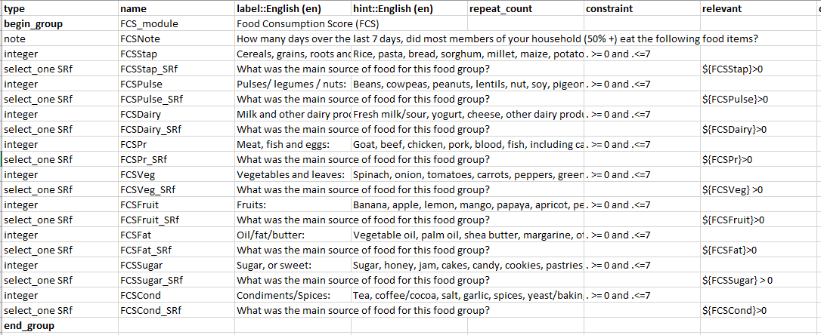
FCS: Survey Designer
Food items that must adjusted for local context
Find the latest standard FCS module in XLSform on
Survey Designer

Slide 73
Quality assurance

Slide 74

FCS data quality checks: Erroneous values
An FCS module in a dataset contains values that are wrong by either exceeding the number of days in a week (>7) or being negative.
Suggested ways to deal with this:
During the tool design phase: It is recommended to code the XLS form to only allow values between 0-7 to avoid typos or erroneous values.
During the data collection: If, for whatever reason, there are still households with erroneous data, this should be captured during the daily data quality checks. The analyst should immediately flag issues to the field teams to correct the issue both in terms of providing the correct number (e.g., in case of typos) and paying more attention to not replicating the same mistake in the future.
During the data analysis: In case of values greater than 7 (days of consumption) recode to 7 days maximum. However, be wary of 8s – for the FCS module, and all modules – as the ‘8’ is located just above the ‘0’ on a telephone (and tablet) keypad, 8s are frequently mistaken for 0s so be careful in recoding data to first check for 8s, which may be recoded to 0 rather than 7. Check also for 99 or 999 meaning not applicable and should be recoded as 0s.

Slide 75
FCS data quality checks: Missing values
Households have data missing in this FCS module.
Suggested ways to deal with this:
During the tool design: The questions in the FCS module should be programmed as mandatory, so that it is not possible to skip any of the module, leaving data gaps.
During the data collection: If the quality checks show that some enumerators still have missing values, this must immediately be flagged to the enumerators concerned. It should be considered to fix the coded restrictions to ensure this mistake is not repeated.
During the data analysis: if missing values are not too widespread, do not replace them but drop such cases from your analysis.

Slide 76
FCS data quality checks: Abnormal consumption
Households reported food consumption that does not look logical for the context.
Examples of red flags:
Entire module is filled with zeros (no food consumption in the past 7 days), in areas that are not in catastrophic/famine conditions.
Entire module is filled with sevens (ate every food group every day in the past 7 days).
Low oil and sugar consumption in contexts where these groups are normally eaten daily.
Staples are only consumed few days a week.
Suggested ways to deal with this:
During the tool design: Add a warning to the XLS form so a popup message appears to give an option to verify the validity some answers, e.g., by asking “Why were cereals consumed less than 4 days over the past 7 days? What did the household eat instead?”.
Notes:
ffffffff

Slide 77
FCS data quality checks: Abnormal consumption
Suggested ways to deal with this (continued):
During the data collection: The analyst should always conduct thorough data quality checks on the FCS and checking for outliers. Check common factors – is the data coming from the same enumerator?, or from the same area?. If a few enumerators report data that is very different from the rest of the team, it is recommended to follow up and ensure that data is accurately reflecting the situation.
Sometimes, outliers can be explained, e.g., if one team is surveying a deserted pastoralist population who has a diet that differs significantly from the rest of the population. The main thing is that it is important for the analyst to get an idea of whether all enumerators are collecting the data correctly so that the data is accurately capturing the situation.

Slide 78
FCS data quality checks: Abnormal consumption
Run frequencies on the FCS variables and compare the mean FCS and the mean number of days of consumption of the different food items/groups.
DESCRIPTIVES VARIABLES=FCSStap FCSPulse FCSDairy FCSPr FCSVeg FCSFruit FCSFat FCSSugar FCSCond
/STATISTICS=MEAN STDDEV MIN MAX.
Descriptive Statistics
 | N | Minimum | Maximum | Mean | Std. Deviation
FCSStap | 1236 | 0 | 7 | 6.75 | 1.018
FCSPulse | 1236 | 0 | 7 | 5.46 | 1.824
FCSDairy | 1236 | 0 | 7 | 3.48 | 2.909
FCSPr | 1236 | 0 | 7 | 2.02 | 2.090
FCSVeg | 1236 | 0 | 7 | 4.11 | 2.552
FCSFruit | 1236 | 0 | 7 | 1.45 | 1.944
FCSFat | 1236 | 0 | 7 | 6.13 | 1.893
FCSSugar | 1236 | 0 | 7 | 6.53 | 1.562
FCSCond | 1236 | 0 | 7 | 5.86 | 2.145
Valid N (listwise) | 1236

Slide 79
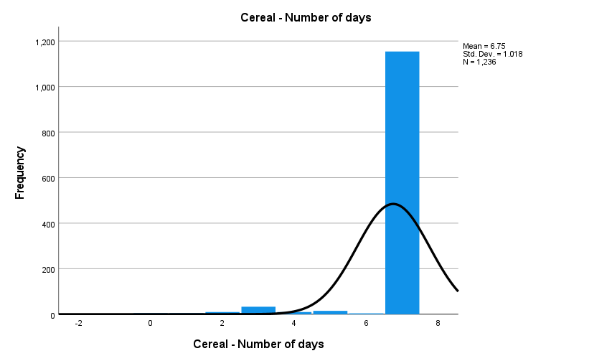
FCS data quality checks: Abnormal consumption
Calculate the spread of variance by graphing the distribution of the FCS variables.
FREQUENCIES VARIABLES=FCSStap
/HISTOGRAM NORMAL
/ORDER=ANALYSIS.
Repeat this step for all food groups
Cereals - Number of days
 |  | Frequency | Percent | Valid Percent | Cumulative Percent
Valid | 0 | 5 | 0.4 | 0.4 | 0.4
 | 1 | 5 | 0.4 | 0.4 | 0.8
 | 2 | 10 | 0.8 | 0.8 | 1.6
 | 3 | 33 | 2.7 | 2.7 | 4.3
 | 4 | 10 | 0.8 | 0.8 | 5.1
 | 5 | 15 | 1.2 | 1.2 | 6.3
 | 6 | 4 | 0.3 | 0.3 | 6.6
 | 7 | 1154 | 93.2 | 93.4 | 100.0
 | Total | 1236 | 99.8 | 100.0
Missing | System | 2 | 0.2
Total |  | 1238 | 100.0
Low consumption of cereals, 4 days or less should be flagged during quality checks

Slide 80
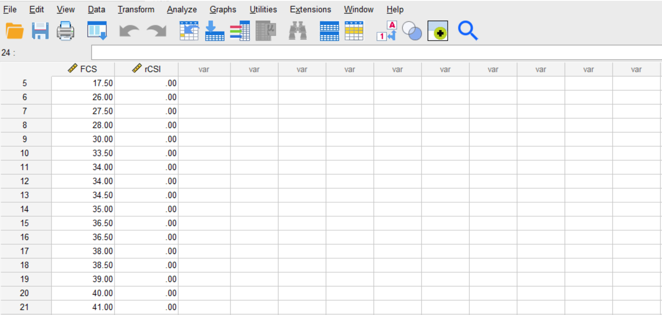
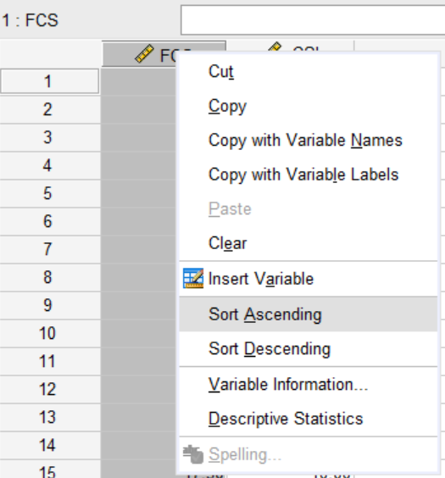
FCS: examine & triangulate the data
Investigate with other highly correlated indicators such as rCSI.
e.g., HHs with low FCS and low rCSI
Cases of poor food consumption with no coping strategies (rCSI) should be flagged
Again, make a judgement call on the data quality after investigating such red flags.

Slide 81
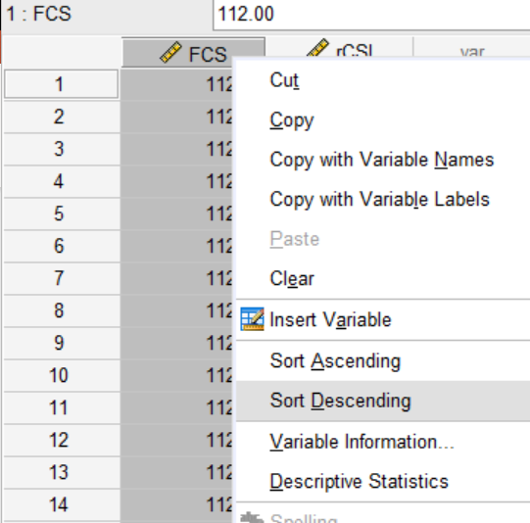
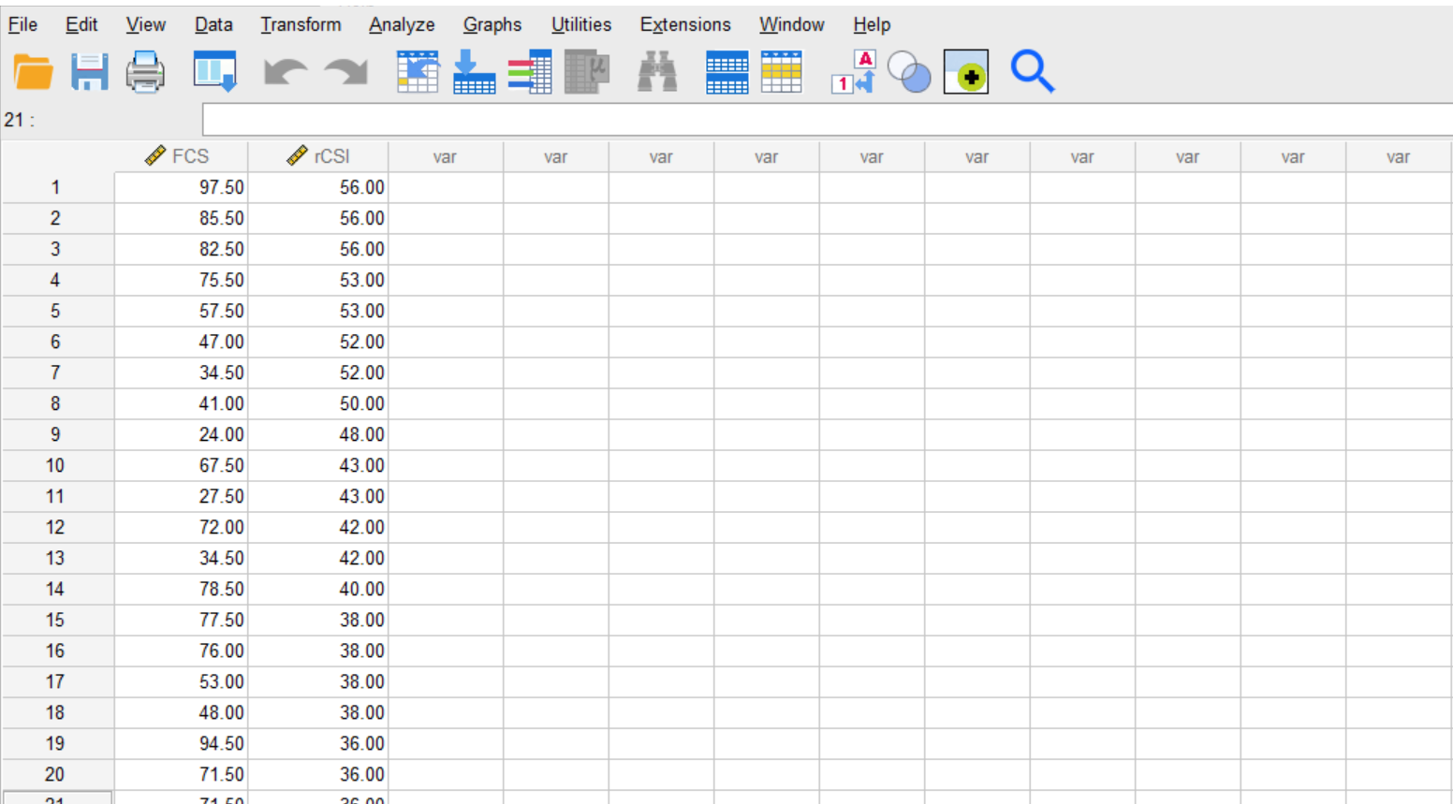
FCS: examine & triangulate the data
Investigate FCS with other highly correlated indicators such as rCSI.
e.g., households with high FCS and high rCSI
Similarly, cases of acceptable food consumption with high coping strategies (rCSI) should be investigated
Need to understand why households with acceptable FCS have such high rCSI.

Slide 82
FCS-N data quality checks: Erroneous subgroups
The number of days of consumption of food subgroups cannot exceed the main food group. For example, it is not possible for a household to report that they ate ‘green leafy vegetables’ 5 days per week if they only consumed ‘vegetables’ 3 days per week. On the other hand, they could have consumed green leafy veg 4 days and vegetables 6 days, since they could have eaten other vegetables.
Suggested ways to deal with this:
During the tool design: It is recommended to code the XLS form to only allow values that are less than the maximum of the value of the main group. Furthermore, it is recommended to include an exhaustive list of all examples possible in the context for all main groups and subgroups to ensure all relevant food items and local dishes are captured.
During the data collection: If, for whatever reason, there are households with data in the subgroups that exceeds the maximum values of the main groups, the analyst must immediately flag this to the enumerator(s) of concern to ensure the mistake is not repeated.
During the data analysis: In cases where the days of consumption of the subgroup is higher of than the main group, analyst must decide based on a contextual discussion whether the main group or the subgroup should be set as the maximum.

Slide 83
FCS data quality checks: Illogical food source
Some households reported food sources that do not look logical for the context. For example, high reporting of own production or fishing/hunting in deserts, urban or landlocked areas. Further, there are certain food sources that only make sense for some food groups, e.g., hunting/fishing only applies to ‘meat, fish and eggs.’
Suggested ways to deal with this:
During the tool design phase: It is recommended to code the XLS form to only allow the hunting/fishing option of food sources for the protein food group.
During the data collection: Check the FCS sources thoroughly for illogical answers by using knowledge of the local context and triangulating with the other relevant data points gathered in the same interview.
Afterwards, check the flagged issues for common factors – is the data coming from the same enumerator, or from the same area and follow up with them immediately. Once the data collection has finished, it is difficult to clean this type of data.

Slide 84
Analysis

Slide 85
FCS: CALCULATION
Step 1. Calculate the average number of the days of consumption of each food group to help understand the general food consumption patterns at national level, by region or population group (e.g., male vs. female-headed households) etc.

Slide 86
FCS: CALCULATION (Cont.)
Step 2. Multiply the value obtained for each food group by its weight and sum the weighted food group scores, thus creating the score for FCS, which is used to group households into the food consumption groups (FCGs).
Food groups | Frequency of consumption | Weights | Frequency x weight
Cereals, grains, roots, and tubers | 7 | 2 | 14
Legumes/pulses, nuts and seeds | 2 | 3 | 6
Milk and other dairy products | 3 | 4 | 12
Meat, fish, and eggs | 2 | 4 | 8
Vegetables and leaves | 2 | 1 | 2
Fruits | 1 | 1 | 1
Oil/fat/butter | 7 | 0.5 | 3.5
Sugar or sweets | 7 | 0.5 | 3.5
Condiments | 7 | 0 | 0
Sum of score |  |  | 50
COMPUTE FCS = FCSStap*2 + FCSPulse*3 + FCSDairy* + FCSPr*4 + FCSVeg*1 + FCSFruit*1 + FCSFat*0.5 + FCSSugar*0.5.

Slide 87
FCS: CALCULATION (cont.)
Step 3. Compute the mean FCS, which can be used to understand the development in food consumption over time or between different population groups.
Step 4. Create the three Food Consumption Groups (FCGs), using the titles ‘poor,’ ‘borderline,’ and ‘acceptable,’ based on the recommended standard cut-offs
Categories | Thresholds | Adjusted thresholds*
Poor food consumption | 0-21 | 0-28
Borderline food consumption | 21.5-35 | 28.5-42
Acceptable food consumption | 35.5 - 112 | 42-112
*Used in contexts where the consumption of oil and sugar is high. Consult with your CO RAM/VAM Officer and/or Regional RAM/VAM Officer on applicable thresholds in your country or region.

Slide 88
FCS-N: CALCULATION example
Step 1. Aggregate the individual food groups into nutrient rich food groups:
Vitamin A-rich foods (6 groups): dairy + organ meat + eggs + orange vegetables + green leafy vegetables + orange fruits.
Protein-rich foods (6 groups): pulses + dairy + flesh meat + organ meat + fish + eggs.
Hem iron-rich foods (3 groups): flesh meat + organ meat + fish.
Notes:
As the purpose of the analysis is to assess nutrient inadequacy by looking at the frequencies of consumption of food groups rich in the nutrients of interest, we first need to create the nutrient rich food groups. This is done simply summing up the consumption frequency of the food subgroups belonging to each nutrient rich food group, following the FCS module (Annex I). See the example Table 5 for vitamin A-rich foods, which should be repeated for protein-rich foods and hem iron-rich foods.

Slide 89
FCS-N: CALCULATION example (Cont.)
Step 2. Sum up the frequency of consumption of the aggregated nutrient-rich food groups
Step 3. Build the category of frequency for each of the 3 groups:
= 0 times (never consumed)
= 1-6 times (sometimes consumed)
= 7 or more times (consumed at least 7 times)
Example: Vitamin A-rich food subgroups | Frequency of consumption
Dairy | 2
Organ meat | 0
Eggs | 1
Orange vegetables | 1
Green leafy vegetables | 3
Orange fruits | 2
Sum of score | 9
Notes:
As the purpose of the analysis is to assess nutrient inadequacy by looking at the frequencies of consumption of food groups rich in the nutrients of interest, we first need to create the nutrient rich food groups. This is done simply summing up the consumption frequency of the food subgroups belonging to each nutrient rich food group, following the FCS module (Annex I). See the example Table 5 for vitamin A-rich foods, which should be repeated for protein-rich foods and hem iron-rich foods.

Slide 90
Scripts

Slide 91
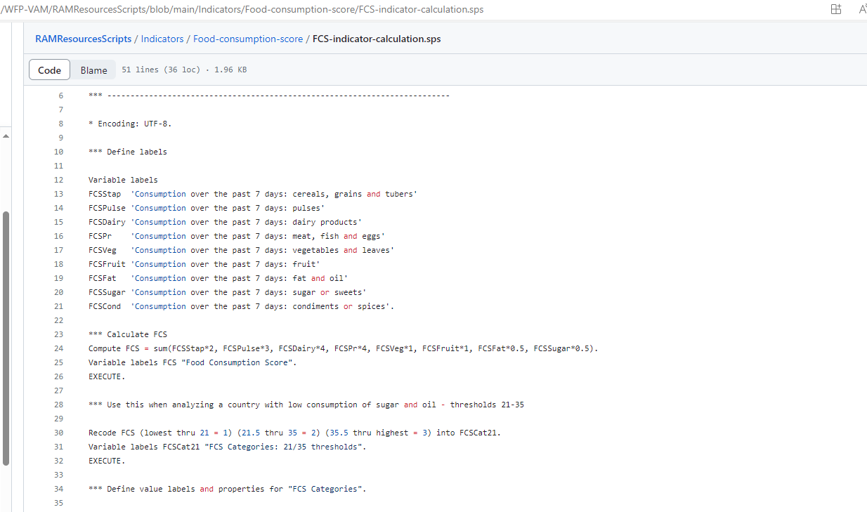
FCS: GITHUB
Find the SPSS, STATA and R scripts on
GitHub WFP RAM

Slide 92
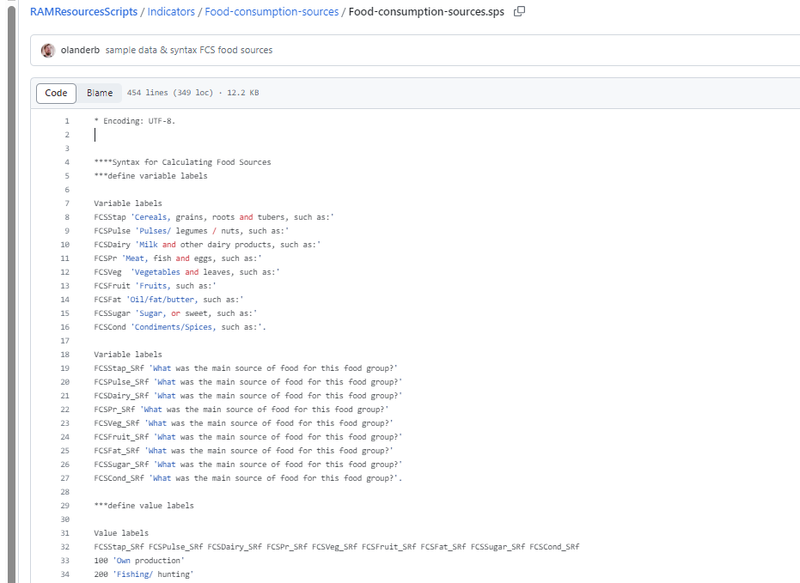
FCS Food sources: GITHUB
Find the SPSS, STATA and R scripts on
GitHub WFP RAM

Slide 93
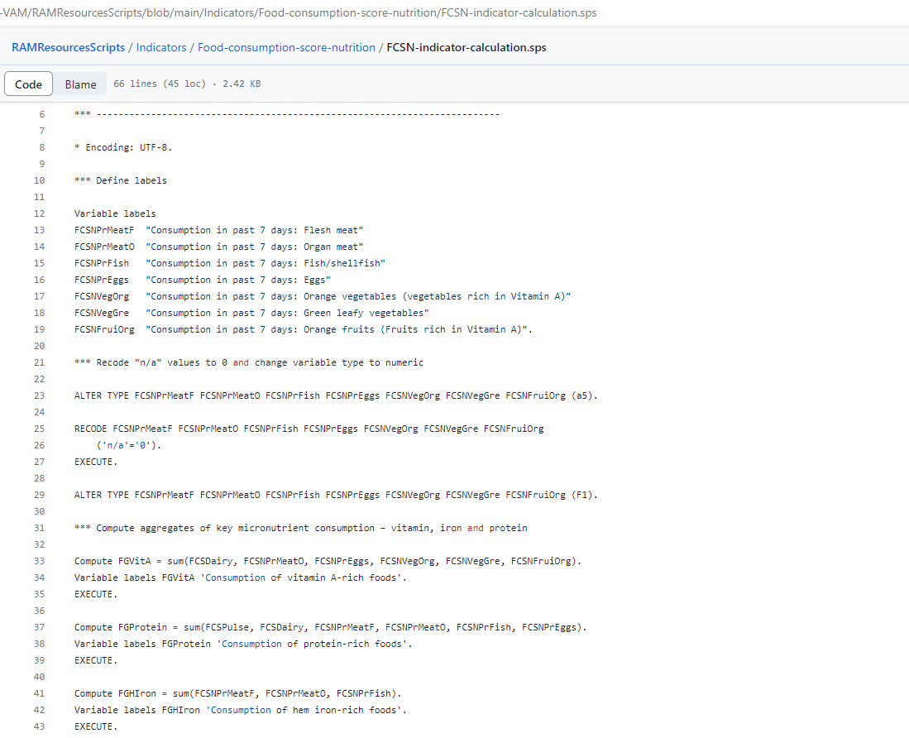
FCS-N: GITHUB
Find the SPSS, STATA and R scripts on
GitHub WFP RAM

Slide 94
Reporting

Slide 95
FCS: REPORTING EXAMPLE (1)
“Looking at the average days of consumption by food group, the consumption of all food groups increased marginally after assistance.
Notably, households increased consumption of pulses, oil and dairy.”

Slide 96
FCS: REPORTING EXAMPLE (2)
“Analysis results of the FCS indicate that one in three households have inadequate food consumption levels.
A higher proportion of male-headed households have inadequate food consumption, an 8-percentage point difference compared to female-headed households (39% and 31%, respectively). “

Slide 97
FCS: food sources
“Analysis results of the main sources of food indicate that 68% of households acquired their food through cash purchases, followed by gifts from family and friends, purchases on credit and assistance.
While in this case, there are many cash purchases, it should be noted that much of the cash was likely to have come from remittances, as 36% of the population are relying on remittances as the main income source (followed by non-agricultural wage labour at 23% and salaried work at 21%. “

Slide 98
Food consumption score
Nutritional quality analysis
“When looking at the number of days that food groups were consumed by households with acceptable vs. inadequate food consumption levels, it is apparent that households with acceptable food consumption tend to eat more flesh meat, eggs, dairy, pulses, dark green leafy vegetables, and orange vegetables. Meanwhile, there are no differences between average consumption of organ meat, fish, and orange (vitamin-A rich) fruits.
Nevertheless, consumption levels of Hem-iron-rich foods shows a concerning situation for most households, both with inadequate and adequate food consumption levels.”

Slide 99
Available Resources

Slide 100
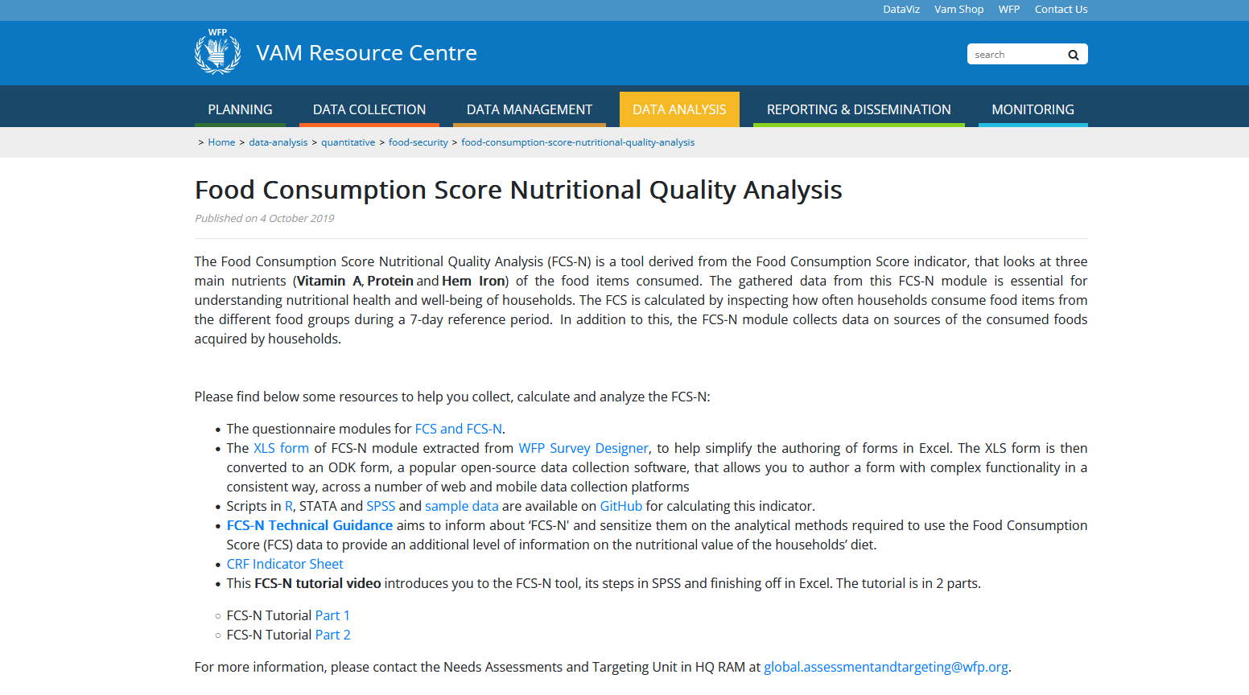
FCS: VAM Resource Centre
For more information and guidance go to
FCS (Resource Centre)

Slide 101
FCS-N: VAM Resource Centre
For more information and guidance go to
FCS-N (Resource Centre)

Slide 102
Thank You!

