Slide 1
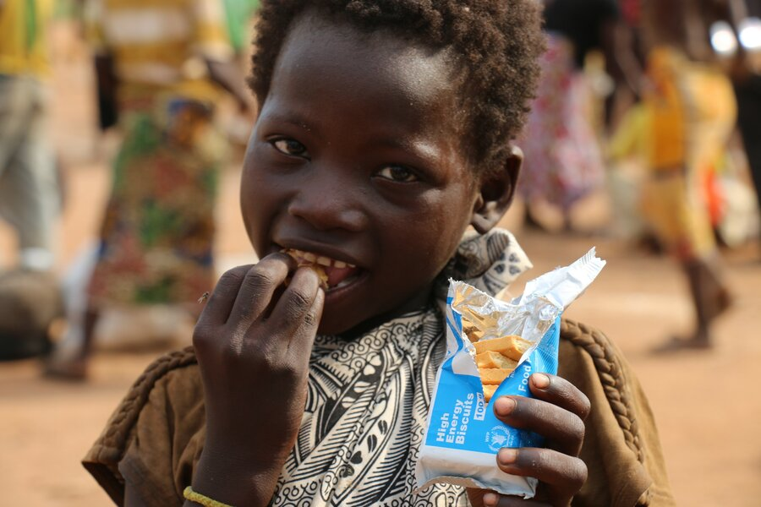

WFP/Badre Bahaji
Food Expenditure Share (FES) Needs Assessments & Targeting Unit
2024 September

Slide 2

AUDIENCE
The audience of this PowerPoint can range from enumerators to RAM and Programme staff in various offices. It can also be used for the training of partners or service providers.
Slide sections have been inserted to assist in the selection of relevant material based on the audience.

Slide 3
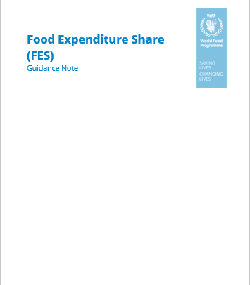
Guidance Note for FES
Please refer to the guidance note in the VAM Resource Center to explore the Food Expenditure Share, as well as its explanation and relevance.

Slide 4
Introduction

Slide 5
FES: training instructions 1
Discuss the Objectives of the Module:
Gain information on the Food Expenditure Share (FES) of the targeted population.
Assess households' economic vulnerability and their capacity to access food.
Understand households' ability to cope with recent shocks and their potential to withstand future shocks.
Importance of the Data:
Emphasize the critical importance of accurate data collection.
Highlight how the data will be used to improve food security interventions and policies.
Ensure enumerators understand the impact of their work on the well-being of the population they are surveying.

Slide 6
Definition
FES is a household-level indicator that reflects economic vulnerability and, consequently, food insecurity.
Measures the proportion of a household's total consumption expenditures that is dedicated to food.
Captures the household’s ability to maintain food consumption in the face of shocks.

Slide 7
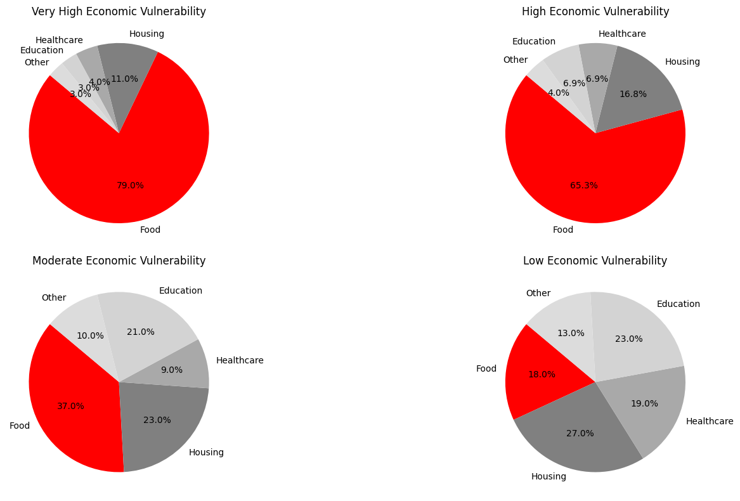
Why is fes important?
A higher percentage of food expenditures out of total household expenditures often indicates financial strain and economic vulnerability, limiting the household's ability to allocate resources to other essential needs such as health, housing, education, and transportation.

Slide 8
What is the Fes used for?
Assessment
One of the indicators used to estimate the CARI in food security assessments.
Programme Design and Reporting
Inform food security interventions and guide program design and targeting.
Report to stakeholders and donors.

Slide 9
SOURCES OF DATA

Slide 10
Which sources of data are needed?
Household economic capacity: you will always need a household survey with an expenditure module.
Find the latest version of the expenditure module
Survey Designer

Slide 11
Which sources of data are needed? (WFP modules)
Expenditure module
Food expenditures (in the previous 7 days)
Non-food expenditures (in the previous 30 days)
Non-food expenditures (in the previous 6 months)
Find the latest standard modules in XLSform on
Survey Designer

Slide 12
The EXPENDITURE MODULE

Slide 13
FES: training instructions 2
This section presents the structure, logic and main elements of the standard expenditure module.
If your expenditure module is different from the standard version, for example because recall periods are different or because food and non-food categories/items are customized to the context, please make sure to adapt these slides.

Slide 14
Overview of the expenditure module
Group | Recall period | Sources of consumption | Preferred respondent/informant
Food | Previous 7 days | Purchases (cash & credit) In-kind assistance and gifts Own-production | HH member normally in charge of preparing and purchasing food
Non-Food | Previous 30 days | Purchases (cash & credit) In-kind assistance and gifts | HH head, or HH member more familiar with non-food expenditures
Non-food | Previous 6 months | Purchases (cash & credit) In-kind assistance and gifts | HH head, or HH member more familiar with non-food expenditures

Slide 15
An important clarification
Even though, for simplicity, we call it the “expenditure module,” we are actually asking about two things:
For purchased items (cash and credit), we ask what the HH purchased and how much it spent on these purchases.
For non-purchased items (own production or in-kind assistance and gifts), we ask what the HH consumed and how much its value would be if purchased.
This is because our objective is quantifying the monetary value of what households consume to understand their vulnerability.
For purchased items, we ask about what households spent (and not the value of what they consumed) only because that is much easier to recall. But ultimately, that serves as a proxy of the value of what households consume.

Slide 16

Discussion question:
What would happen if we only asked about purchases?
For example, think about households that rely on their own production, or aid and donations.
Notes:
If we only asked about the value of purchases, households who access consumption through different channels (own production, assistance/gifts) would appear systematically more vulnerable than households relying on purchases, even when that is not the case. Imagine a farming household that self-produces most of its food. If we only ask about purchases, it would appear as unable to access any food.

Slide 17
Expenditure module
Food expenditures – 7 days (or 30 days)
Non-food expenditures
30 days
6 months

Slide 18
Food submodule: overview
 | Item name | Example¹ Note: Before asking yes/no questions related to a certain item name, the enumerator should read: now I will ask you about your consumption and expenditures of [item name]. This includes items such as…[Example] | Variable Name | Did your household purchase any [item] for household consumption in the last 7 days, using cash² or on credit? 1=Yes -> 0=No -> next question (_GiftAidYN) | Considering both purchases made in cash and on credit, how much did your household spend on [item] in the last 7 days? (curr.) | In the last 7 days, did your household consume any [item] that came from in-kind gifts or in-kind assistance³? 1=Yes -> 0=No -> next question (_OwnYN) | What would be the value of the consumed [item] that came from in-kind gifts or assistance if you were to buy that at the market? (curr.) | In the last 7 days, did your household consume any [item] that you produced, gathered/hunted/fished⁴, or received in exchange of labor? 1=Yes -> 0=No -> next item | What would be the value of the consumed [item] that you produced, gathered/hunted/fished, or received in exchange of labor if you were to buy that at the market? (curr.)
 | Food groups (7 days⁵) |  | _7D | _CashCredYN | _CashCred | _GiftAidYN | _GiftAid | _OwnYN | _Own
1 | Cereals | maize, rice, sorghum, wheat, etc. in the form of raw cereals, flour, bread, pasta and similar products | HHExpFCer | |__| | |__| | |__| | |__| | |__| | |__|
Notes:
^{[1]} The examples below should be replaced with items commonly consumed in the survey area(s)
^{[2]} Includes also value vouchers
^{[3]} This caterogy includes the following sources: In-kind assistance from international and local NGOs, UN Agencies, government; gifts from family and friends; borrowing from family and friends; begging
^{[4]} The use of the words “gathered, hunted, or fished” depends on each specific food group
^{[5]} The standard recall period for the food expenditure module is 7 days, with the alternative to choose a 30 days (_1M) recall period. This alternative is recommended if the objective of the module is monitoring programmes distributing value voucher if a) value vouchers should or are normally redeemed at once; b) the survey is purposedly fielded after redemption of the vouchers

Slide 19
Food submodule: flow
Before starting: ensure that the sub-module is being administered to (or at least it is informed by) the HH member who is most knowledgeable about food consumption in the household
Before asking questions about a food group: read the list of examples of food items that belong to that group (e.g. clarify that “cereals” include maize, rice, pasta…) → important to refresh the memory of respondent, especially since the food groups here are different to that of the Food Consumption Score!
For each food group, you ask three yes/no questions. ‘Yes’ answers lead to follow-up questions about the value of the consumed goods and services.

Slide 20
Food submodule: cash and credit
Question | Clarifications
Did your household purchase any […] for household consumption in the last 7 days, using cash or on credit? | Here we want to know if something has been purchased, independently from whether it was actually consumed. For household consumption: it means that we do not consider purchases made for giving gifts or for feeding animals (i.e., fodder). Cash: includes also value vouchers; the source of cash does not matter (e.g. no different treatment of purchases made with cash assistance) Credit: when the household purchases something now but repays it later
Considering both purchases made in cash and on credit, how much did your household spend on [item] in the last 7 days? | Here we want to know what was actually spent on the purchase, independently from the quantity consumed. For purchases made on credit, report the money that the household will need to pay back in the future → do not report zero!

Slide 21
Food submodule: in-kind assistance and gifts
Question | Clarifications
In the last 7 days, did your household consume any […] that came from in-kind gifts or in-kind assistance? | Here we want to know if household consumed something from in-kind assistance of in-kind gifts, not if the household received it! In-kind assistance and gifts include assistance from NGOs, UN agencies, government; religious authorities; gifts and borrowing from family and friends; food received through begging. Remember that we only care about in-kind assistance and in-kind gifts, not if the HH consumed something from cash received as assistance/gifts.
What would be the value of the consumed […] that came from in-kind gifts or assistance if you were to buy that at the market? | Here respondent needs to provide an estimate of what it would cost to purchase what they consumed if they needed to buy it. If a specific item does not exist in the local market, estimate based on value of comparable items.

Slide 22
Food submodule: own production
Question | Clarifications
In the last 7 days, did your household consume any […] that you produced, gathered/hunted/fished, or received in exchange of labor? | Here we want to know if household consumed something from own production, not if the household produced it or harvested it! Own production: includes food produced in household farm or garden, gathered and hunted from open fields, forests, rivers, lake, sea etc; but also food received in exchange of labor (e.g. as part of remuneration from agricultural wage work) The use of the words “gathered, hunted, or fished” depends on the food group It does not matter when the food was produced, it only matters when it was consumed. For example, if in the last 7 days household consumed some food out of stocks from previous production, that needs to be counted.
What would be the value of the consumed [item] that you produced, gathered/hunted/fished, or received in exchange of labor if you were to buy that at the market? | Here respondent needs to provide an estimate of what it would cost to purchase what they consumed if they needed to buy it → do not report the value they would get if they needed to sell!

Slide 23

Food submodule: consumption groups
Food group | Examples of items
Cereals | Maize, rice, sorghum, wheat, etc. in the form of raw cereals, flour, bread, pasta and similar products
Tubers | Potatoes, sweet potatoes, cassava, plantains, yams
Pulses, nuts and seeds | Beans, peas, lentils, nuts in shell or shelled
Vegetables | Dark green leafy vegetables, orange vegetables, other vegetables
Fruits | Fresh, frozen, and dried fruit
Meat | Fresh, chilled, frozen meat and poultry; dried and salted meat
Fish | Fresh and frozen fish and other seafood
Food group | Examples of items
Oil/Fat/Butter | Vegetable oil, butter, margarine
Milk/Dairy products | Milk, cheese, yogurt, powdered milk
Eggs | Eggs
Sugar, candy and desserts | Raw sugar, honey, jams, chocolate, ice cream and similar products
Condiment | Salt, spices, bouillon cubes, fish powder
Non-alcoholic beverages (including bottled water) | Coffee, tea, herbal infusion; bottled water; soft drinks; packaged juices
Snacks and meals prepared outside the home | Ready-made meals and snacks prepared outside the home, no matter if consumed inside or outside the home
Note that there are slight differences between the food submodule and Food Consumption Score (FCS) module with regards to how foods are categorized, e.g. sweet potatoes
Notes:
The examples below should be replaced with items commonly consumed in the survey area(s).

Slide 24
Discussion question:
Are there important local foods that are not included in the list of the examples?
Let’s include them (and remove those that are not relevant)!

Slide 25
Expenditure module
Food expenditures – 7 days (or 30 days)
Non-food expenditures
30 days
6 months

Slide 26
Non-food submodule (30 days): overview
 | Item name | Example Note: Before asking yes/no questions related to a certain item name, the enumerator should read: now I will ask you about your consumption and expenditures of [item name]. This includes items such as…[Example] | Variable Name | In the last 30 days, did your household purchase any [item], using cash or credit? 1=Yes -> 0=No -> next question (Assistance) | Considering both purchases made in cash and on credit, how much did your household spend on [item] in the last 30 days? (curr.) | In the last 30 days, did your household use any [item] that came from in-kind gifts or in-kind assistance? 1=Yes -> 0=No -> next question | What would be the value of [item] that came from in-kind gifts or in-kind assistance if you were to pay for it? (curr.)
 | Non-food items (30 days) |  | _1M | _CashCredYN | _CashCred | _GiftAidYN | _GiftAid
 | Personal care
1 | Hygiene items and services | Soap, toothbrush, toothpaste, toilet paper, razors, menstrual hygiene products, diapers, detergents, insecticides, cosmetics; hairdressers/barber, beauty salon | HHExpNFHyg | |__| | |__| | |__| | |__|
 | Transport
2 | Transport-related goods and services | Public transportation (bus, rail, boat etc.), taxi, rental of vehicles, maintenance of vehicles used for transportation (including lubricant, tires, spare parts, repairs fees etc.) DO NOT INCLUDE PURCHASE OF VEHICLES; EXCLUDE FUEL | HHExpNFTransp | |__| | |__| | |__| | |__|
Notes:
The examples of goods and services should be replaced with items commonly consumed in the survey area(s).

Slide 27
Non-food submodule (6 months): overview
 | Item name | Example Note: Before asking yes/no questions related to a certain item name, the enumerator should read: now I will ask you about your consumption and expenditures of [item name]. This includes items such as…[Example] | Variable name | In the last 6 months, did your household purchase any or pay for [item], using cash or credit? 1=Yes -> 0=No -> next question | Considering both purchases made in cash and on credit, how much did your household spend on [item] in the last 6 months? (curr.) | In the last 6 months, did your household use or benefit from any [item] that came from in-kind gifts or in-kind assistance? 1=Yes -> 0=No -> next item | What would be the value of [item] that came from in-kind gifts or in-kind assistance if you were to pay for it? (curr.)
 | Non- food items (6 months) |  | _6M | _CashCredYN | _CashCred | _GiftAidYN | _GiftAid
 | Health
1 | Health services | Outpatient and hospital services, doctor fees, traditional healing | HHExpNFMedServ
2 | Medicines & Health products | Medicines, other medical products and equipment like glasses, syringes, crutches etc. | HHExpNFMedGood
 | Clothing
3 | Clothing and footwear | Clothes, shoes, and repair, tailor and laundry services DO NOT INCLUDE SCHOOL UNIFORMS | HHExpNFCloth
.
Notes:
The examples below should be replaced with items commonly consumed in the survey area(s).
The expenditure module can be complemented by questions on agricultural land (HHExpNFAgriLandRent), agricultural workforce (HHExpNFAgriWorkf), farming inputs (HHExpNFFarmInp) and livestock inputs (HHExpNFLvstInp) or other items used as intermediate goods for income generating activities

Slide 28
Non-food submodules: flow
Before starting: ensure that the sub-module is being administered to the household member who is most knowledgeable about non-food expenditures (default assumption is that this member is the head of household)
Before asking questions about a non-food group: read the list of examples of items that belong to that group (e.g. “hygiene products” includes soap, toothpaste, toilet paper etc); also tell the respondent what they should exclude → important to refresh the memory of respondent!
For each category group, you will ask two yes/no questions. ‘Yes’ answers lead to follow-up questions

Slide 29
Non-food: cash and credit
Question | Clarifications
In the last 30 days/6 months, did your household purchase any/pay for […], using cash or credit? | Here we want to know if something is purchased, independently from whether it is actually consumed Cash: includes also value vouchers; the source of cash does not matter (e.g. no different treatment of purchases made with cash assistance) Credit: when the household purchases something now but repays later
Considering both purchases made in cash and on credit, how much did your household spent on […] in the last 30 days/6 months? | Here we want to know what was actually spent for the purchase, independently from the quantity consumed For purchases made in credit, report the money that the household will need to pay back in the future → do not report zero!

Slide 30
Non-food: in-kind assistance and gifts
Question | Clarifications
In the last 30 days/6 months, did your household use any/benefit from […] that came from in-kind gifts or in-kind assistance? | Here we want to know if household consumed something from in-kind assistance of in-kind gifts, not if the household received it! In-kind assistance and gifts include NGOs, UN agencies, government; religious authorities; gifts from family and friends; borrowing from family and friends; begging Remember that we only care about in-kind assistance and gifts, not if the household consumed something thanks to cash received as assistance/gifts
What would be the value of […] that came from in-kind gifts or in-kind assistance if you were to pay for it? | Here respondent needs to provide an estimate of what it would cost to purchase what they consumed if they needed to buy it If a specific item does not exist in the local market, estimate based on value of comparable items

Slide 31
Non-Food submodule (30 days): groups
Group | Examples of items
Hygiene items and services | Soap, toothbrush, toothpaste, toilet paper, menstrual hygiene products, diapers, razors, detergents, insecticides, cosmetics; hairdressers/barber, beauty salon
Transport-related goods and services | Public transportation (bus, rail, boat etc.), taxi, rental of vehicles, maintenance of vehicles used for transportation (including lubricant, tires, spare parts, repairs fees etc.) DO NOT INCLUDE PURCHASE OF VEHICLES; EXCLUDE FUEL
Fuel | Gasoline, diesel and any other fuel used for vehicles DO NOT REPORT ON FUEL USED FOR VEHICLES USED EXCLUSIVELY FOR PRODUCTIVE/BUSINESS PURPOSES; DO NOT REPORT ON FUEL USED FOR PURPOSES OTHER THAN TRANSPORTATION
Water supply for domestic use | Water for domestic supply EXCLUDE BOTTLED DRINKING WATER
Electricity | Electricity DO NOT REPORT ELECTRICTY USED FOR BUSINESS/PRODUCTIVE PURPOSES ONLY

Slide 32
Non-Food submodule (30 days): groups
Food group | Examples of items
Other sources of energy for cooking, heating, lighting etc. | Gas, kerosene, other liquid fuels; wood, charcoal, candles, other solid fuels DO NOT INCLUDE ELECTRICITY; DO NOT INCLUDE FUEL FOR TRANSPORTATION
Services related to dwelling | Waste collection, sewage collection, maintenance charge in collective buildings, security services, wages paid to help like maids and gardeners
Communication-related goods and services | Mobile top-up, internet, landline charges, postal services. DO NOT INCLUDE PURCHASE OF DEVICES LIKE PHONES, RADIOS, COMPUTERS, TVs…
Goods and services related recreation, sport and culture | Entertainment, sports, lottery, gambling, newspapers, magazines, books, toys, hobbies, hotels DO NOT INCLUDE EXPENDITURES FOR LARGE/SPECIAL CEREMONIES LIKE WEDDINGS AND FUNERALS
Alcohol, Tobacco

Slide 33
Non-Food submodule (6 months): groups
Group | Examples of items
Health services | Outpatient and hospital services, doctor fees, traditional healing
Medicines & Health products | Medicines, other medical products and equipment like glasses, syringes, crutches etc.
Clothing and footwear | Clothing and shoes, including purchase, repair, tailor and laundry services DO NOT INCLUDE SCHOOL UNIFORMS
Education services | Tuitions fees, Exam fees, Other fees
Food group | Examples of items
Education goods | Other education costs including uniforms, books, canteen, transport and other education material
Rent | Rent paid for housing DO NOT INCLUDE RENT PAID FOR A FIELD (agriculture = business)
Household non-durable furniture and utensils | Textiles (like bed sheets, blankets, pillows, curtains, carpets) and utensils (like bowls, plates, silverware, cookpots, brooms, brushes, umbrellas, torches, lamps, lightbulbs, etc.) DO NOT INCLUDE DURABLE FURNITURE, EQUIPMENT AND APPLIANCES LIKE BEDS, TABLES, CHAIRS, FRIDGE, TV, PHONES, FANS, STOVES, GAS COOKER…
Household routine maintenance | Goods and services for household routine maintenance (like repairs to dwelling, repairs to appliances and furniture etc.).

Slide 34
Considerations for administering the module
Tips for successful implementation

Slide 35
Non-Food groups: general considerations
Do not forget that we are not asking only about goods, but also services; if respondents seem to be reporting only goods, probe regarding services.
For non-food groups, it is important to make sure that respondents do not report twice the same expenditure under different groups (e.g. “fuel” under “transport-related goods and services” or under “other sources of energy for cooking, heating, lighting etc.”
As indicated in the questionnaire, it is very important that large expenditures are not included (e.g. purchase of vehicles, phones, large furniture, appliances…)
Make sure respondents are not reporting on expenditures made for business inputs and investments (this includes rent paid on agricultural fields, even if used for own production).

Slide 36
Reminder!
For both food and non-food items, we start by asking, in the last [XX] days, did your household purchase any item on cash or credit?
If yes, we ask the value.
Then we ask about use of items (products and services) that came from in-kind gifts or in-kind assistance.
It is only here, that we would endeavour to estimate the value of items that were ‘used’ but not purchased -> only when received as in-kind gifts or assistance.

Slide 37
Additional clarification
Source | What counts | What doesn’t count
Purchases (cash and credit) | If a household purchased food within 7 days, the cost of the good should be counted. | If a household purchased food more than 7 days ago, but they are still using it, we do not count it! (We only care about valuing purchases within the time period mentioned by category).
In-kind assistance or gifts | If a household is consuming food that they received as part of a food basket (in-kind assistance) no matter of when they received it (within or beyond the last 7 days, then an estimated value needs to be provided. | If a household received food as part of a food basket (in-kind assistance) within the last 7 days, but has not started to consume it yet, then we do not count it.
Own production (only for food*) | If a household consumed food within the last 7 days, that they produced (at some point in time), then an estimated value needs to be provided (no matter when they produced it). | If a household produced food within the last 7 days, but have not yet consumed it, then this would not be taken into account.
Remember for purchases, we do not care whether they are consuming it, but whether they purchased it, in the relevant time period
Remember for in-kind assistance, we do not care when they received it, but whether they are consuming it in the relevant time period
Remember for own production, we do not care when they produced it, but whether they are consuming it in the relevant time period

Slide 38
General considerations
Pay special attention to the different recall periods of sub-modules (7 days, 30 days, 6 months)
Ensure that respondents understand that they are supposed to report on behalf of the entire household.
No matter who did the purchasing, all household expenditures should be reported.
Pay extra attention to zeros when entering values (e.g. careful of not writing 1,000 instead of 10,000!), and 8’s instead of zeros
Make sure that values are reported in right currency for the context.
Probe!

Slide 39
Probing: when to probe?
Household declares that does not spend/consume anything on very common consumption categories (e.g., cereals, tubers, hygiene items, clothing…)
Expenditures/Consumption that look excessively low or high, especially in comparison to…
Household size
Reported income (when collected)
Type of livelihood
Food consumption (e.g. households do not report consuming meat in the FCS module but report expenditures on meat)
Status of the dwelling

Slide 40
Probing: how to probe?
If reported expenditures/values of consumption is too high or low:
Make sure the respondent understood the reference period (e.g. switching between submodules with different recall periods)
Make sure the respondent understood what it is included in the food group → Read again the examples in each group if necessary
Make sure the respondent is reporting using the required currency – if cannot report in the requested currency, help make conversions
Ask the respondent about the exact items purchased/consumed: then ask about quantities and prices to understand if the estimate made by the respondent is realistic

Slide 41
Difficulties in recalling
Respondents might struggle to recall what they spent/consumed because:
They can’t remember which items they consumed among those that are part of a certain group (e.g. cannot remember about all the products that are part of “cereals” or “hygiene items”)
They can’t remember how much they spent or how much they consumed of these products

Slide 42
Strategies to help with recall
Break down the category: for the most important items that form part of a group (e.g. ask about their purchases of rice, maize, pasta, bread, flour within the group “cereals”)
Break down the recall period: e.g. for the 30 days recall, ask about last 7 days only – then ask about 2 weeks ago and so on
If the two strategies above do not work, try to get an estimate of what they would “typically” consume/spend in a certain period – then figure out if the last 7days/30 days are somehow different than the usual situation and adjust accordingly.
Regardless, we cannot accept responses for ‘I don’t know’. So we should never see 0s across the board or responses like 88, 99, or 999. In all instances, do your best to work with the household to provide best guess estimates of expenditures.

Slide 43
Design of the EXPENDITURE MODULE

Slide 44
EXPENDITURE: Module design
When designing your questionnaire, including the expenditure module, please refer to the Survey Designer as it offers the WFP’s standard modules in XLSform and Word formats.
Your module might include more/different disaggregation of expenditure categories, but it should include the standard questions.
If you rely on data collection tools and platforms that do not support XLSforms, you must replicate the standard module correctly, including skip patterns and validation constraints.

Slide 45
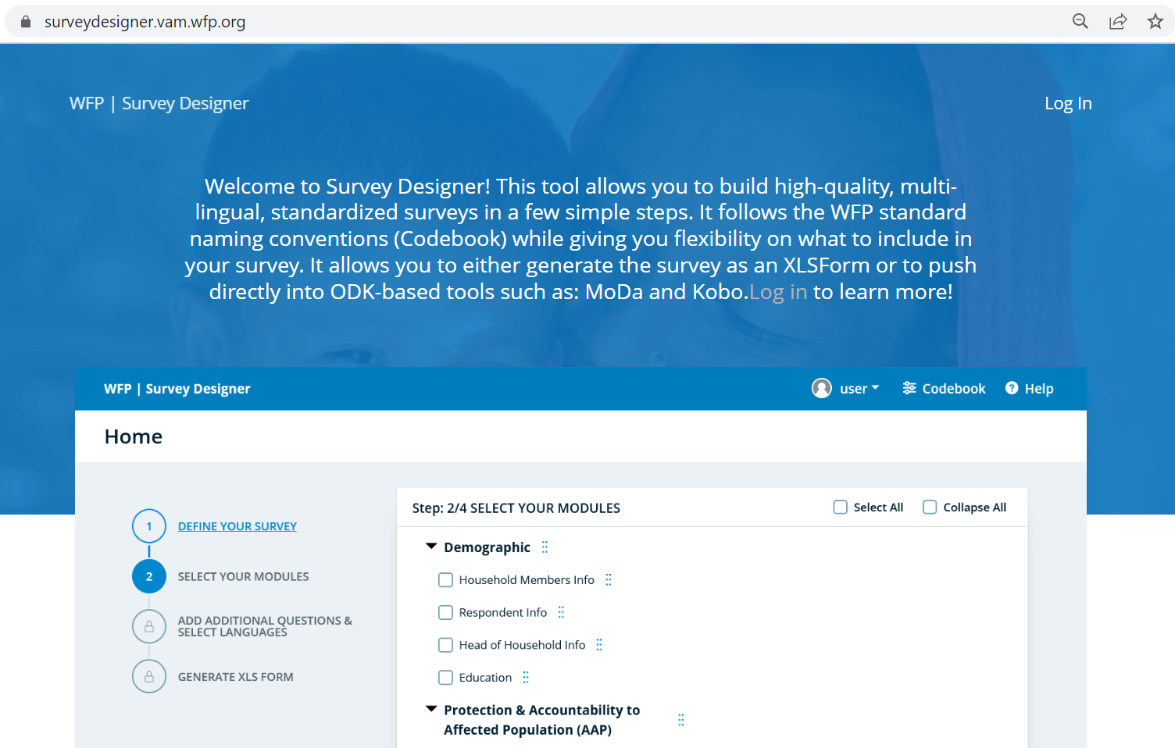
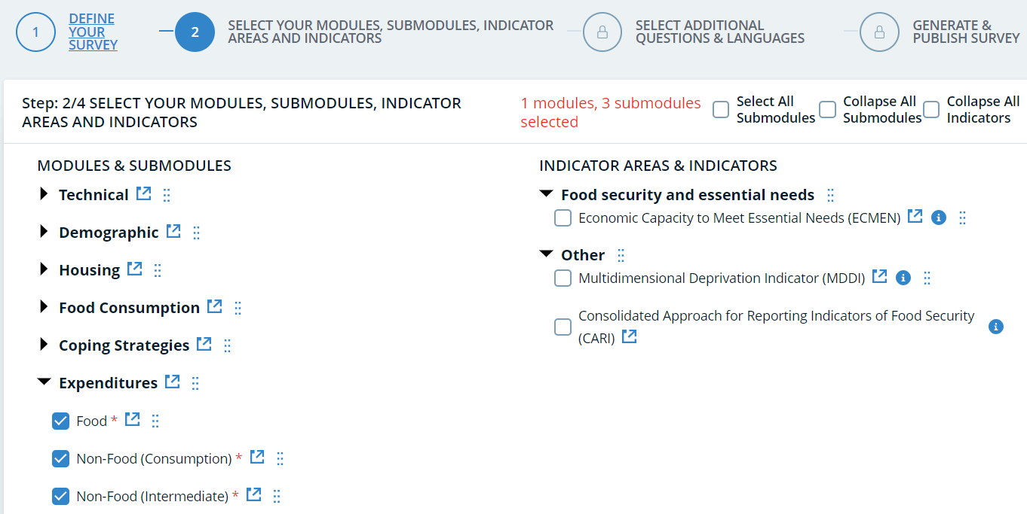
Expenditure: Survey Designer
Expenditure Module (Survey Designer)
After selecting the three parts of the expenditure module, you will be able to move to the next step in which you choose the appropriate recall period for the food sub-module (either seven days or 30 days) for your context.

Slide 46
Food expenditures: 7 vs. 30-day recall period
 | 7 days recall | 30 days recall
Advantages | More accurate recall (average food estimates closer to the “real” mean) Faster administration and less burden for respondent | For individual households, food consumption expenditures resemble more their “typical” monthly consumption
Disadvantages | Less precision as there are higher chances that households report a value of food consumption expenditures that is different from their usual one | Recall is more difficult, tendency to underreport consumption expenditures
When to use it | By default | If households tend to purchase/receive most of their food in a specific week of the month but consume it evenly throughout the month In contexts where households have very regular monthly expenditures patterns (e.g. where salaried employment is the main livelihood) and households are more comfortable reporting their monthly rather than weekly expenditures
Notes:
For the food expenditure sub-module, there are two options: a 7-day or 30-day recall period.

Slide 47
Expenditures CATEGORIES
It is always a good practice to customize the examples of items within expenditure categories (e.g. the most common cereal products withing the category “cereals”)
In general, it is not recommended to modify the expenditure categories. Some exceptions:
Further disaggregate a category if an item or sub-category is very important in a given context (e.g. if firewood is much more important than all other fuels, it might be easier to capture it separately).
Do not ask about categories that are obviously irrelevant in a given context (e.g. asking about expenditures on electricity in a place where no one has access to it).
If expenditure categories are modified:
Make sure they do not overlap (and it is clear what needs to be reported under each category)
They do not leave items without a category where to be reported
They do not include items that should not be captured as regular consumption (investments, inputs, irregular large expenditures, transfers of money)

Slide 48
Improving data quality through xls progRAMMING
Expenditure data quality can be improved through:
Constraints | Warning messages
For each item, depending on the local currency, set constraints for values that are obviously unrealistic, e.g.: Spending 10,000 USD for cereals in last 7 days Spending 0.1 USD for electricity in last 30 days | When food or non-food total consumption expenditures (i.e. cash + assistance/gifts + own-production) is zero, have a warning message asking the enumerator to verify The same could be applied to very common consumption categories or groups of them In certain circumstances, these warning might also be triggered by logical checks with other sections of the questionnaire (e.g. household reporting consumption of a food category in the previous 7 days in the FCS module, but zero consumption expenditures on it during the previous 30 days)
Under no circumstances should the food expenditure submodule be linked through skip patterns to other modules such as the Food Consumption Score (i.e. the fact that the majority of HH members did not consume a food category in the previous 7 days does not imply that they had no consumption expenditures on that category in the previous 7 days!)

Slide 49
Data quality checks and cleaning

Slide 50
Data Quality checks
At minimum, it is recommended to track the following
By enumerator:
Share of interviews with total food or non-food consumption expenditures of 0. Observing a household with 0 food or NF consumption expenditures is very unlikely. Hence enumerators with consistent shares of these observations might be skipping the module.
Average/Median per capita food and non-food consumption expenditures. Enumerators reporting much higher/lower values than the rest might be not implementing the module correctly, and should be addressed and retrained. If possible, it is also recommended to monitor the per capita average/median value of each single variable in the module and possibly other intermediate aggregates (e.g. total value of food from own production)
General
Occurrence of values that do not make economic sense. If spotted, investigate the extent to which these values occur, and the potential reasons (e.g., misunderstanding with currencies or anomalies with a specific enumerator).

Slide 51
DATA CLEANING
It is recommended cleaning the data through these stages:
Preliminary check regarding the usability of the expenditure data: checking the share of observations presenting either zero food or non-food total expenditures. If the share of these problematic observations is very high (e.g., higher than 15 percent), it might be needed to identify an appropriate solution to use the expenditure data.
Cleaning variable by variable: the objective is identifying implausible values for each question of the expenditure module and (potentially) correct it. This stage is in turn divided into two steps:
Manual cleaning: through visualizations and tables, identify implausibly low or high values and judge whether an obvious mistake occurred. If so, and if the “true value” of these data points can be logically deducted, correct the values using a syntax file.
Statistical/Automatic cleaning: identify any remaining anomalously low/high values (expressed in per capita terms) based on statistical rules and automatically replace them.
Cleaning aggregates: the objective is addressing cases where the whole expenditure module appear to be invalid. Cleaning is performed on two aggregates: 1) total food and 2) total non-food consumption expenditures, to identify and correct implausibly low/high values. Anomalously low/high values (expressed in per capita terms) are identified based on statistical rules and automatically replaced. If the value of an aggregate is replaced for an observation, all the expenditures variables for that observations should be reconciled to march the new value of the aggregate.

Slide 52

Find more in the wfp Data Quality guidance
For details and resources on data quality checks and cleaning related to the consumption expenditure module, refer to the Data Quality Guidance note

Slide 53
COMPUTATION

Slide 54
Overview of steps
1. Calculate Monthly Food Expenditures.
2. Calculate Monthly Non-Food Expenditures.
3. Calculate Monthly Total Expenditures.
4. Compute the FES indicator by calculating the percentage of monthly food expenditures out of total expenditures and assign the household into an FES classification.

Slide 55
FES MODULE: Calculating Monthly food expenditures
Variable Name: HHExpF_1M
Determine the household's monthly food expenditures by summing:
The monetary value of food expenditures made via cash or credit.
The value of consumed food items obtained from household own production.
The value of consumed food items obtained through in-kind assistance and gifts.
If food expenditures were collected using the standard seven-day recall period, adjust by dividing by seven and multiplying by 30 to report in monthly terms.
Total Food Expenditures in the last 7 days
7
30
HHExpF_1M

Slide 56
Overview of steps
1. Calculate Monthly Food Expenditures.
2. Calculate Monthly Non-Food Expenditures.
3. Calculate Monthly Total Expenditures.
4. Compute the FES indicator by calculating the percentage of monthly food expenditures out of total expenditures and assign the household into an FES classification.

Slide 57
Aggregating consumption expenditures: Items of consumption
In the computation of the monthly expenditures, we should include only items that:
Represent actual household consumption → E.g. Do not include business/livelihood inputs!
Reflect regular/recurrent consumption → Do not include expenses for celebrations or large assets!
Be careful with rent:
Expenditures on rent to be included in economic capacity only if included in the MEB
If in doubt on how to aggregate consumption expenditures
FES guidance note

Slide 58
FES MODULE: Calculating Monthly Non-Food Expenditures
Important Note: Exclude expenses on celebrations, festivals, donations, large one-off household expenses (e.g., a house or a vehicle), as well as expenditures for livelihood inputs (e.g., agricultural inputs, hired labor) from the non-food consumption expenditure aggregate. This ensures alignment with the FES's objective of reflecting regular household consumption capacity.
Variable Name: HHEXPNF_1M
Determine the household's monthly non-food expenditures by summing:
The aggregation of the value of non-food expenditures made in cash or credit and through in-kind assistance and gifts within the previous 30 days.
The aggregation of the value of non-food expenditures made in cash or credit and through in-kind assistance and gifts within the previous 6 months, divided by 6.
Total Non-Food Expenditures in the last 30 days
Total Non-Food Expenditures in the last 6 months
6
HHEXPNF_1M

Slide 59
Overview of steps
1. Calculate Monthly Food Expenditures.
2. Calculate Monthly Non-Food Expenditures.
3. Calculate Monthly Total Expenditures.
4. Compute the FES indicator by calculating the percentage of monthly food expenditures out of total expenditures and assign the household into an FES classification.

Slide 60
FES MODULE: Calculating Household Total Monthly Expenditures
Variable Name: HHEXP
Determine the household's monthly total expenditure by summing:
Monthly food expenditures.
Monthly non-food expenditures.
HHEXPF_1M
(Food)
HHEXPNF_1M
(Non-Food)
HHEXP_1M
(Total)

Slide 61
Overview of steps
1. Calculate Monthly Food Expenditures.
2. Calculate Monthly Non-Food Expenditures.
3. Calculate Monthly Total Expenditures.
4. Compute the FES indicator by calculating the percentage of monthly food expenditures out of total expenditures and assign the household into an FES classification.

Slide 62
FES MODULE: Calculating FES and assigning into an FES classification (1)
Variable Name: FES
Compute the FES by dividing its monthly food expenditures by its total monthly expenditures.
HHEXPF_1M
(Food)
HHEXP_1M
(Total)
FES

Slide 63
FES MODULE: Calculating FES and assigning into an FES classification (2)
The At this stage, each household’s FES should fall within the range of 0 and 100%.
After calculating the food expenditure share (FES) for each household, it's important to assign them into FES categories based on their FES score.
0 <= FES < 50%
LOW FES
50% <= FES < 65%
MEDIUM FES
65% <= FES < 75%
HIGH FES
75% =< FES
VERY HIGH FES

Slide 64
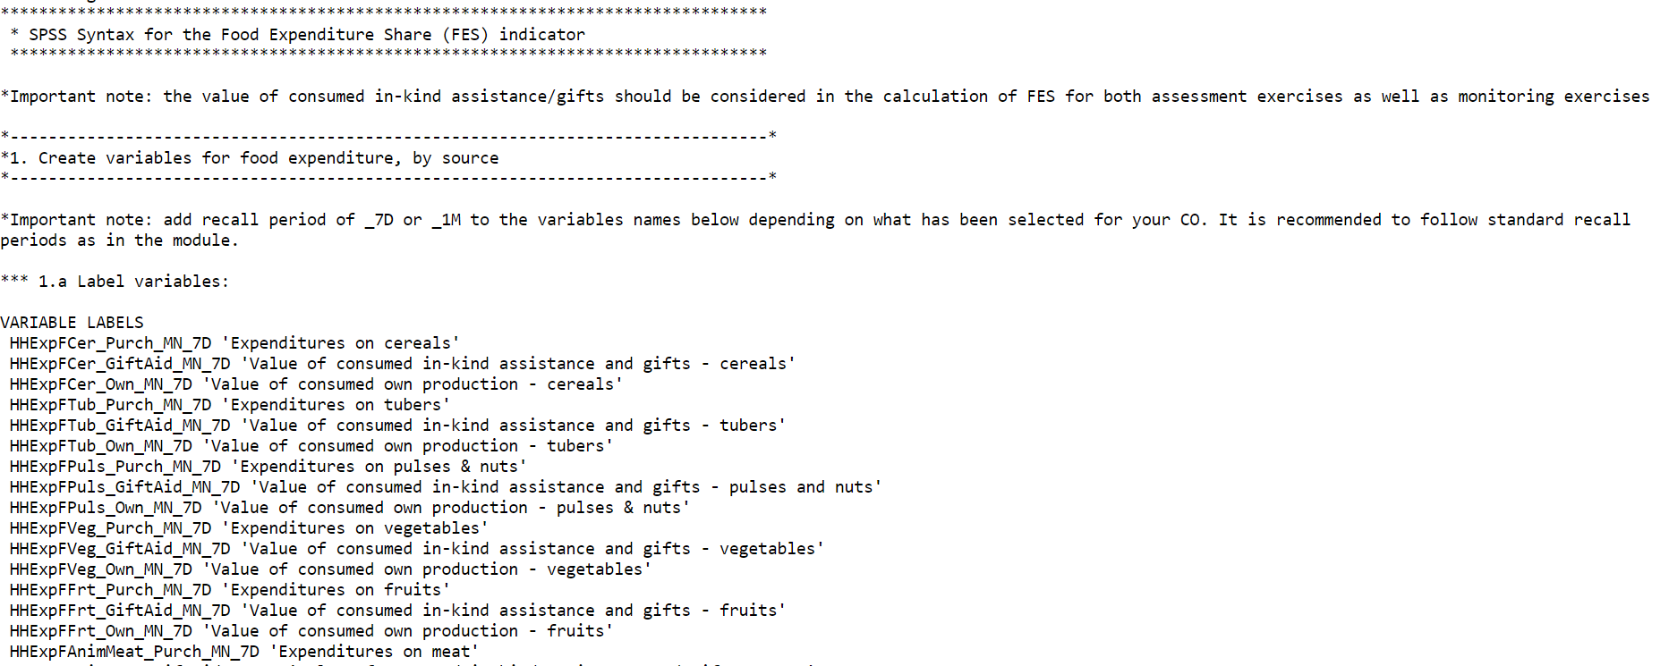
FES: GITHUB
Find the SPSS, STATA and R scripts on
GitHub WFP RAM

Slide 65
Reporting

Slide 66
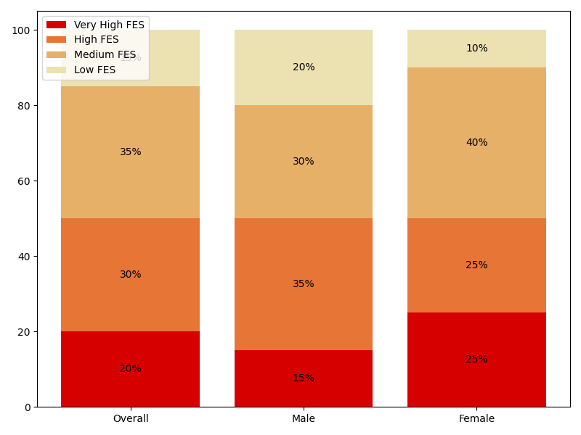
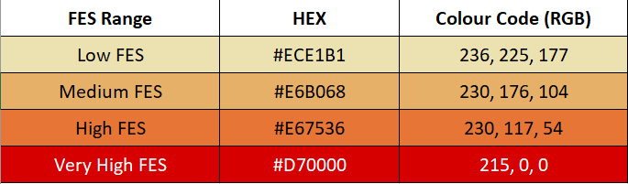
FES: REPORTING EXAMPLE
“Half of the households (50 percent) fall into the medium and high FES categories, indicating a substantial portion of income is allocated to food.
Male-Headed Households: These households tend to have a more balanced distribution across FES categories, with a slight leaning towards high expenditure.Female-Headed Households: There is a higher proportion of female-headed households in the medium and very high FES categories, suggesting that these households might be more vulnerable to food insecurity, as they spend a larger portion of their income on food.
Figure 1 - Proportion of households within each FES classification
Reminder:
Please use the standard colours

Slide 67
Available Resources

Slide 68
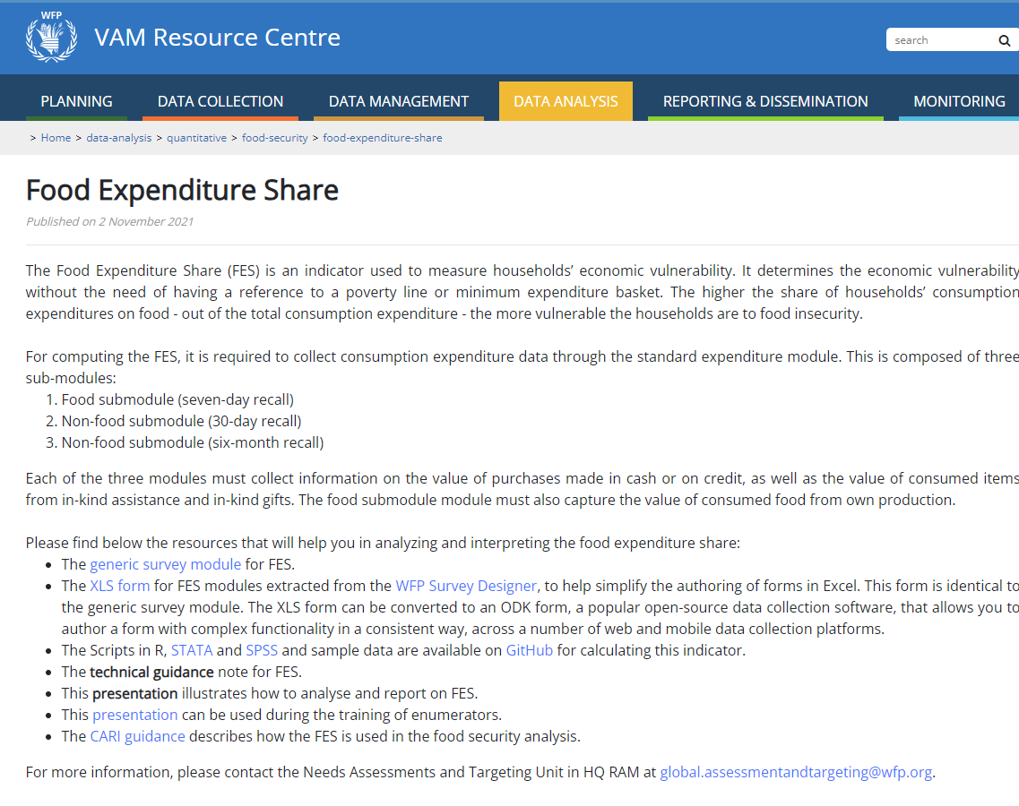
FES: VAM Resource Centre
For more information and guidance go to
FES (Resource Centre)

Slide 69
Thank You!

