Slide 1
DATA
VISUALIZATION
GUIDELINES
For VAM and Monitoring Officers
March 2025
Notes:
-

Slide 2
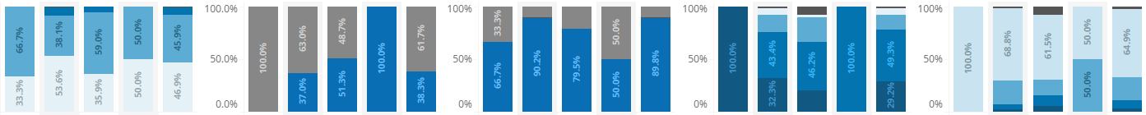
Introduction
The Data Visualization Guidelines are designed to support VAM and Monitoring Officers in building clear and effective charts, dashboards and infographics.
The initiative stems from the feedback received that identified data visualizations as one of the primary capacity gap where Country Offices need additional support or training, including the 2024 VAM and Monitoring Capacities Annual Survey.
These guidelines recommends best practices to effectively communicate WFP work on food security to WFP staff, partners and the public. They provide appropriate tools for both data visualizations novice and experts alike, offering tips and resources to create coherent, visually appealing data visualizations with consistent colour palettes, chart elements and types to align with data visualization best practices.
For further guidance and examples, consult the Resource Centre.

Slide 3
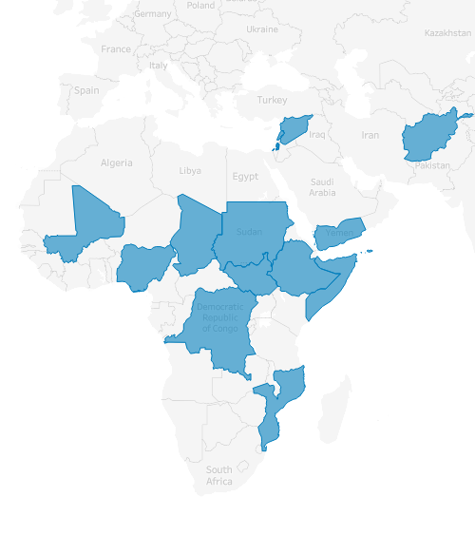
Table of Contents
Colour palette
Chart elements
Selecting the right chart: chart types
Best practices
Common errors
Tools and resources
Annex: colour codes

Slide 4
Colour Palette

Slide 5

General considerations on colours
The suggested colour palette optimize the WFP palette for data visualization purposes (i.e. ensuring all elements have enough contrast to be visible and accessible when used together). For other visual aspects, such as fonts and logo usage, please refer to the Visual Identity Guide.
Some food security indicators, such as the CARI and IPC, have specific palettes to ensure they can be distinct from other charts in a report or dashboards. For IPC colours, please refer to the IPC Technical Manual.
The commonly used “traffic light” palette is no longer recommended for food security indicators for accessibility reasons.
As a rule of thumb, pick a minimum number of colours to create consistency and avoid a cluttered look. Two palettes are suggested as primary and accent colours. More colours could be added where necessary, for example to distinguish between different data categories.
Notes:
Why we are moving away from the traffic light in data visualization: https://www.linkedin.com/pulse/end-traffic-light-dashboards-kat-greenbrook/

Slide 6
Primary colour palette: Blue
Primary Colour
ABC
HEX #007DBC
RGB 0, 125, 188
WFP blue is our main brand colour, and it should dominate all WFP data visualizations. Additional colours can be used alongside the primary palette as necessary (e.g. categorical data).
Use gradients of the WFP blue for a single metric. This is effective when representing data that follows a sequence or has a progression. Examples for three and four items are provided – additional examples can be generated using this tool.
This palette can be combined with the accent colour palette (red) to create contrast and enhance clarity.
FCS example (3 categories)
ABC
ABC
ABC
Acceptable
Borderline
Poor
HEX #B4CFED
RGB 180, 207, 237
HEX #007DBC
RGB 0, 125, 188
HEX #002F5A
RGB 0, 47, 90
LCS example (4 categories)
ABC
ABC
ABC
ABC
No coping
Stress coping
Crisis coping
Emergency coping
HEX # B4CFED
RGB 180, 207, 237
HEX # 73A5D4
RGB 115, 165, 212
HEX #007DBC
RGB 0, 125, 188
HEX #002F5A
RGB 0, 47, 90

Slide 7
Accent colour palette: Red
Primary Colour
ABC
HEX #E3002B
RGB 0, 125, 188
The secondary palette choice is used to highlight emergency-related data, with red reserved for very severe, emergency situations.
It should be used sparingly as an accent colour to draw attention to critical information.
When necessary, red can be combined with the primary palette and the categorical palette to create contrast and enhanced clarity.
FCS example (3 categories)
ABC
ABC
ABC
Acceptable
Borderline
Poor
HEX #ECE1B1
RGB 180, 207, 237
HEX #E67536
RGB 230, 117, 54
HEX #E3002B
RGB 0, 125, 188
LCS example (4 categories)
ABC
ABC
ABC
ABC
No coping
Stress coping
Crisis coping
Emergency coping
HEX # ECE1B1
RGB 180, 207, 237
HEX # E6B068
RGB 230, 176, 104
HEX #E67536
RGB 230, 117, 54
HEX #E3002B
RGB 0, 125, 188

Slide 8
Additional colours for categorical data
For other types of data, a few additional colours could be used to distinguish different groups such as regions, activities, or gender.
To maintain clarity, limit categorical palettes to a maximum of 7 colours with good contrast.
The data visualization palette is a reduced version of the WFP palette.
ABC
ABC
ABC
HEX #007DBC
RGB 0, 125, 188
HEX #008EB2
RGB 0, 142, 178
HEX #002F5A
RGB 0, 47, 90
ABC
ABC
ABC
ABC
HEX #E3002B
RGB 227, 0, 43
HEX #810054
RGB 129, 0, 84
HEX #ECE1B1
RGB 236, 225, 177
HEX #E67536
RGB 230, 117, 54

Slide 9
CARI colour palette
Population
ABC
HEX #FFD7D7
RGB 255, 215, 215
ABC
HEX #FF6E6E
RGB 255, 110, 110
ABC
HEX #E3002B
RGB 227, 0, 43
ABC
HEX #820000
RGB 130, 0, 0
Food secure
Marginally food insecure
Moderately food insecure
Severely food insecure
Area
ABC
HEX #FFFFD4
RGB 255, 255, 212
ABC
HEX #EAE297
RGB 243, 226, 151
ABC
HEX #D7C55A
RGB 215, 197, 90
ABC
HEX #C7A600
RGB 199, 166, 0
More than 75% of the population in the area are food secure
More than 25% of the population in the area are is marginally food secure, moderately or severely food insecure
More than 25% of the population in the area are either moderately or severely food insecure
More than 25% of the population in the area are severely food insecure

Slide 10
Chart Elements

Slide 11
Chart elements
Figure number
Depending on relevance, WFP charts may include the following visual elements:
Figure number
Figure title
Figure subtitle
Legend
X-axis title
X-axis labels
Y-axis title
Y-axis labels
Data labels
Data source
Notes
Figure 1
Household Food Consumption Score Classification by State | 2024
Figure title
Relative Proportion of Households per FCS Classification by State
Figure subtitle (optional)
100
Y-axis labels
75
68%
62%
62%
66%
68%
78%
73%
81%
87%
82%
Y-axis title
Percent
50
25
31%
31%
29%
28%
28%
Data labels
22%
21%
17%
17%
13%
6%
7%
6%
3%
0
0.1%
4%
2%
0.3%
3%
1%
X-axis labels
Fayhedge
Vertgate
Lochby
Springbeech
Clearelf
Rockcoast
Oldhaven
Shademeadow
Newmeadow
Dellmere
X-axis title
ADMIN1Name
Legend
Acceptable
Borderline
Poor
Notes (optional)
Notes: the numbers may not sum up due to rounding
Data source
Source: WFP VAM Unit

Slide 12
FOR ALL CHARTS WITH AXES (E.G. BAR CHARTS)
FOR ALL CHARTS WITHOUT AXES (E.G. MAPS)
Make sure that the chart has a clear and descriptive title, e.g., “Most used livelihood coping strategies by region”.
Make sure that a figure number is included to easily reference each chart, e.g., “Figure 1,” “Figure 2.”
Ensure X-axis and Y-axis have informative titles and readable labels for clarity.
Include a legend to distinguish different data sets or categories.
Cite the data source and add disclaimers if there are specific conditions or exceptions related to the data that viewers should be aware of.
Make sure that elements are sorted best (top) to worse (bottom) and the sorting is consistent throughout the report.
Use a clear, descriptive title and include a figure number for easy reference.
Use data labels to directly annotate data points with their values.
Include a legend to distinguish data sets, especially in maps.
Cite the data source and add disclaimers if there are specific conditions or exceptions related to the data that viewers should be aware of.
For maps, especially ones including territories with disputed borders, a disclaimer is recommended:
  “The designations employed and the presentation of material in the maps do not imply the expression of any opinion whatsoever on the part of WFP concerning the legal or constitutional status of any country, territory or sea area, or concerning the delimitation of frontiers.”
In both cases, ensure all text elements use Open Sans as font at an appropriate size (e.g. 8-12pt for body). Use Bold/Extrabold styles for figure titles and numbers.
If applicable, a concise subtitle is added to provide additional context.

Slide 13
Selecting the right chart
Chart types
Notes:
https://data.europa.eu/apps/data-visualisation-guide/

Slide 14
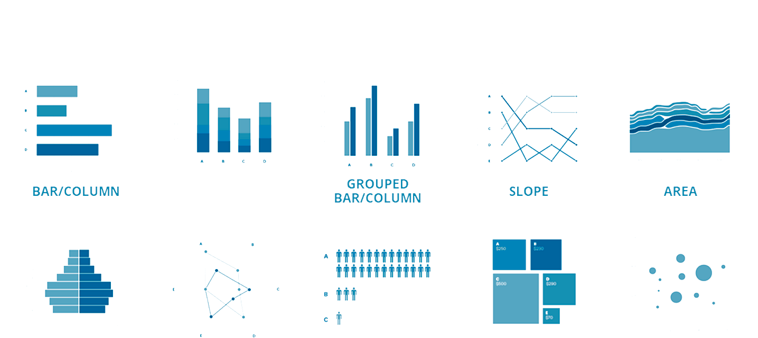
Comparison
Charts that shows similarities, differences, trends and patterns between two or more variables in a dataset
BAR/COLUMN
STACKED BAR/COLUMN
GROUPED BAR/COLUMN
SLOPE
AREA
FLAGPOLE
RADAR
PICTOGRAM
TREEMAP
BUBBLE
Source: datavizproject.com

Slide 15
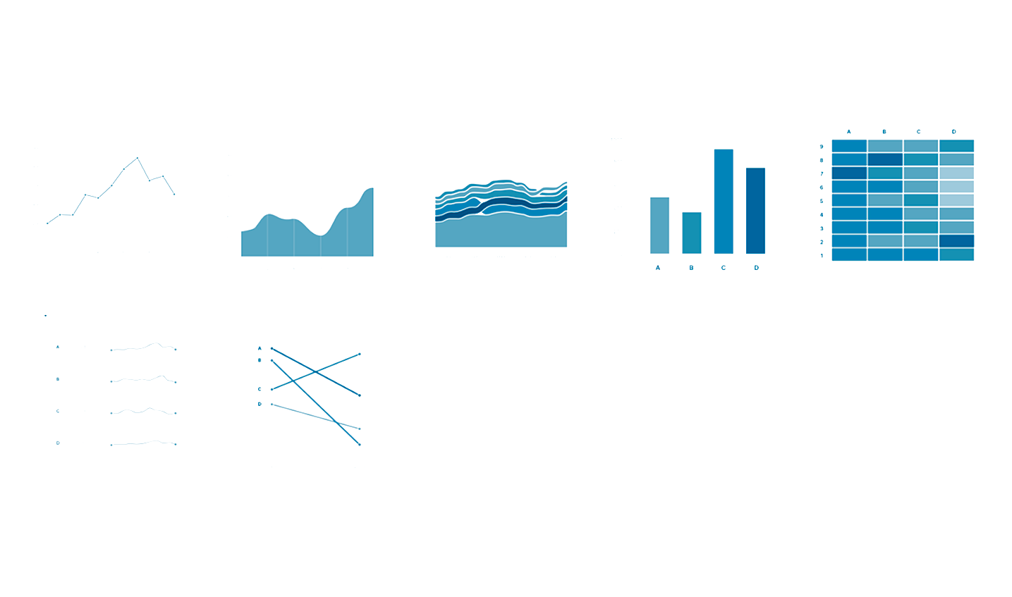
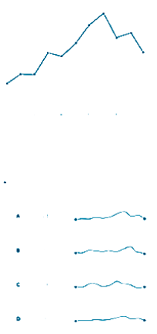
Change over time
Charts that track how data points evolve over a period, thereby revealing trends, cycles, and patterns.
LINE
AREA
STACKED AREA
BAR CHART
HEAT MAP
SPARKLINE
SLOPE
Source: datavizproject.com

Slide 16
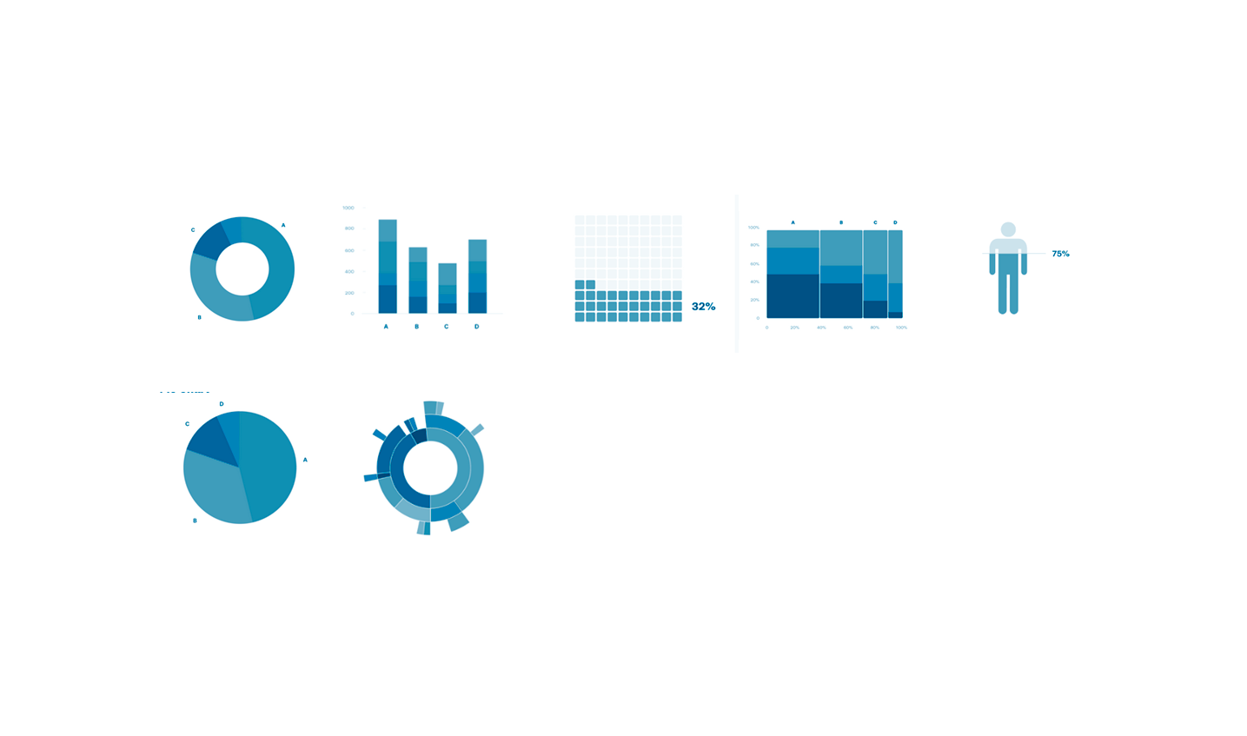
Part-of-a-whole
Charts that represent the relative size of parts in a dataset and how each part contributes to the overall sum
DONUT
100% STACKED BARS
WAFFLE
MOSAIC
PICTORIAL FRACTION
PIE
SUNBURST
Source: datavizproject.com

Slide 17

Distribution
Distribution charts visualize the spread and skewness of data points in a dataset, providing insights into the variability and underlying patterns of the data.
HISTOGRAM
BOXPLOT
WORD CLOUD
CLOROPLETH MAP
Distribution in a body of text
Geographical distribution
PARALLEL SETS
POPULATION PYRAMID
CLUSTER ANALYSIS
Source: datavizproject.com

Slide 18

Correlation
“Correlation” charts display the relationship between two or more variables, helping to identify patterns, trends, and potential causality in the data.
SCATTERPLOT
BUBBLE CHART
HEATMAP
VENN DIAGRAM
Source: datavizproject.com

Slide 19

Geographical
“Geographical” charts visually represent data based on geographical areas or locations, enabling spatial patterns and regional comparisons to be easily observed.
CHOROPLETH
BUBBLE MAP
FLOW MAP
GRAPHS ON A MAP
DOT DENSITY
Source: datavizproject.com

Slide 20
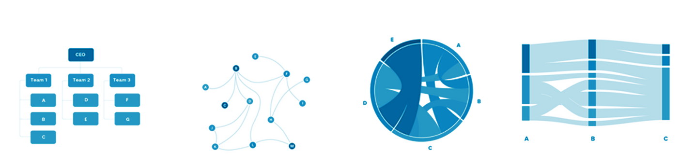
Flows and networks
Flows and networks charts describe flows and networks.
TREE DIAGRAM
NETWORK
CHORD
SANKEY
For panel data only
Source: datavizproject.com

Slide 21
Best Practices
Notes:
https://www.atlassian.com/data/charts/how-to-choose-colours-data-visualization

Slide 22
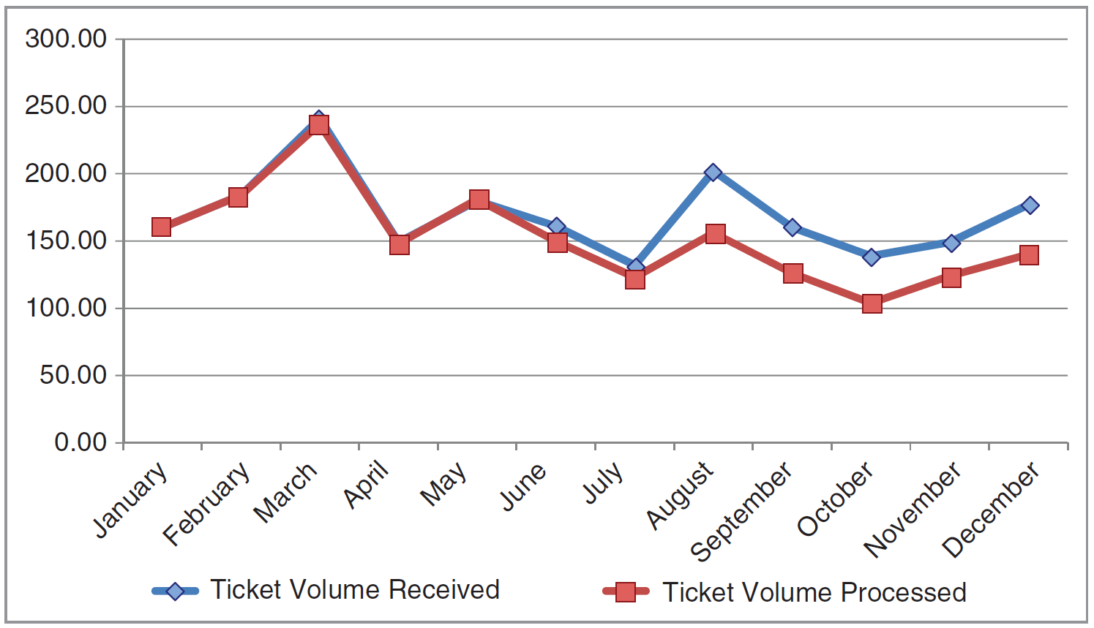
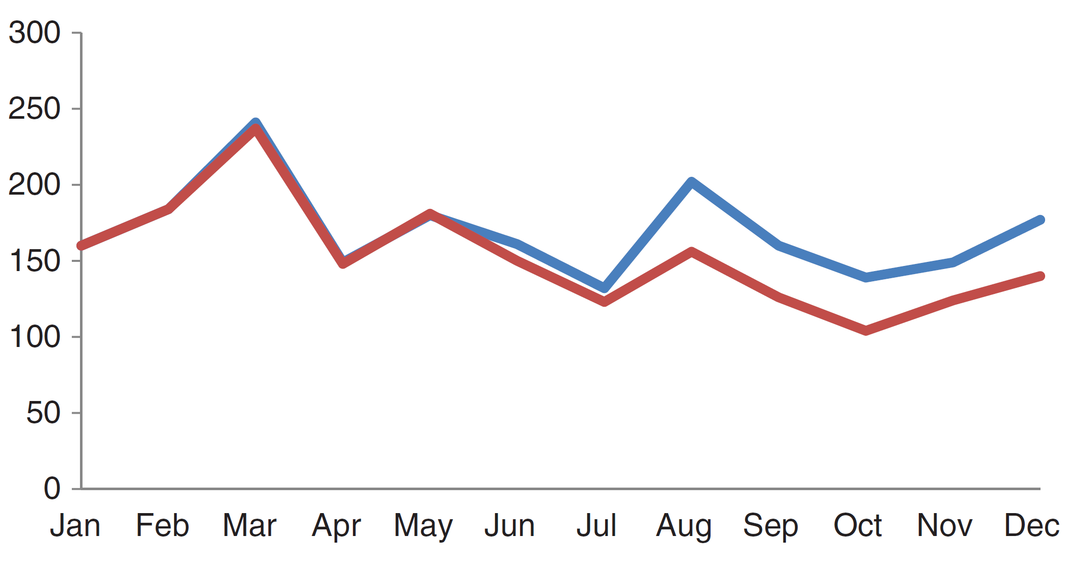
Simplify and declutter
BEFORE
Simplifying the display of data by removing extra elements to improve clarity and effectiveness.
Minimize use of colours: Use colour sparingly and purposefully. Stick to a consistent colour scheme throughout your visualization.
Use data intentionally: Only select the most important data series to avoid overwhelming the viewer.
Simplify text elements: Keep labels, titles, and annotations concise. Avoid jargon and complex language.
Remove Chartjunk: Chartjunk refers to all unnecessary or confusing visual elements in a chart or graph: minimize gridlines, borders and marks; align the text so it is readable. This will make your work stand out!
Sugar Prices
Wheat Prices
AFTER
Commodity prices fluctuated significantly in 2024
Sugar
usd/kg
Wheat
2024

Slide 23
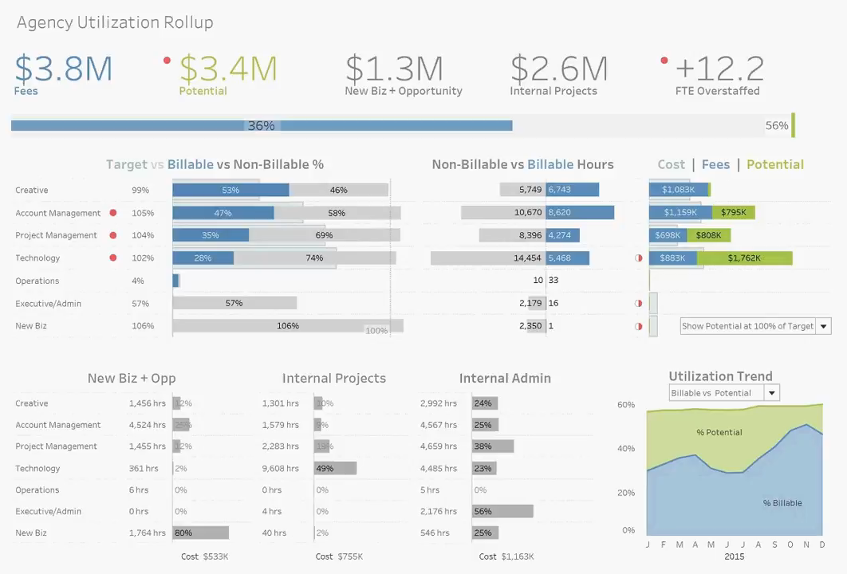
Pay attention to layout
Paying attention to the layout in data visualization is crucial as it guides the viewer’s eye movement and focus. Research indicates that viewers typically start at the first line and then proceed in a left-to-right pattern (or right-to-left in countries where that is the writing norm). Larger elements also tend to attract attention before smaller ones.
Therefore, the most important figures or charts should be strategically placed at these high-attention areas (see animation) to ensure they are noticed and understood effectively.
This careful arrangement of visual elements can significantly enhance the viewer’s comprehension and interpretation of the data.

Slide 24
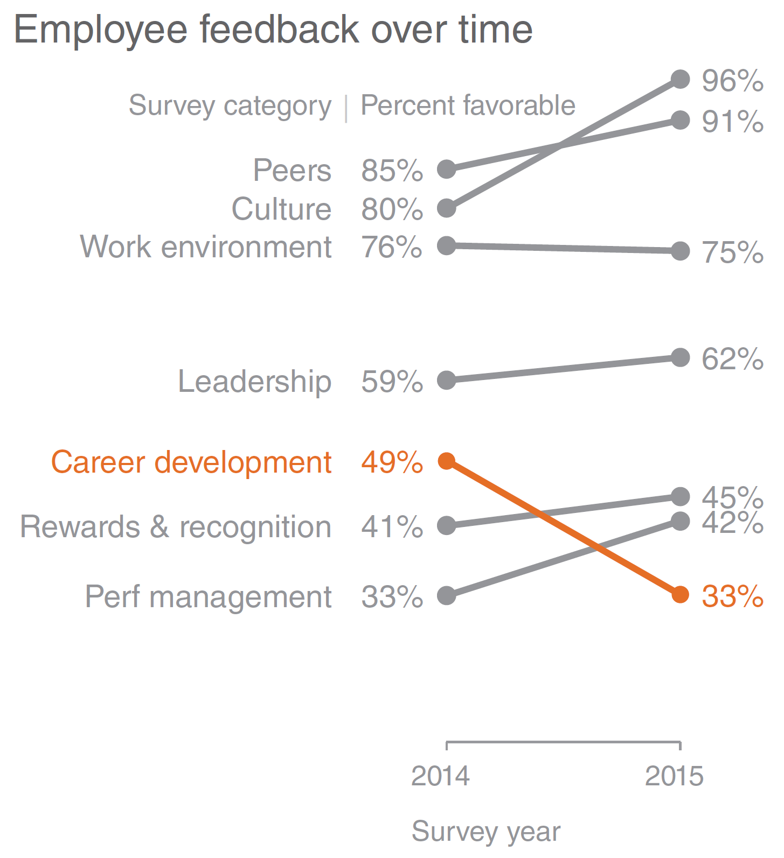
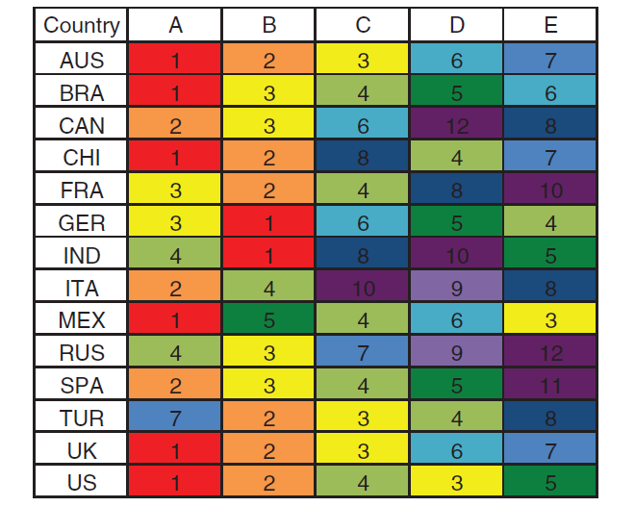
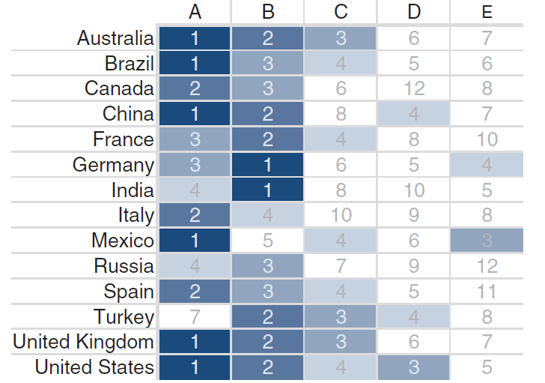
Use colour wisely
Using colours with intent is a fundamental best practice in data visualization, aimed at enhancing clarity and avoiding misinterpretation.
Avoid colour overload by selecting a restrained and purposeful colour palette that maintains coherence across the visualization.
Use greyscale elements and an accent colour to highlight key information, ensuring clarity without overwhelming the audience
Source:

Slide 25
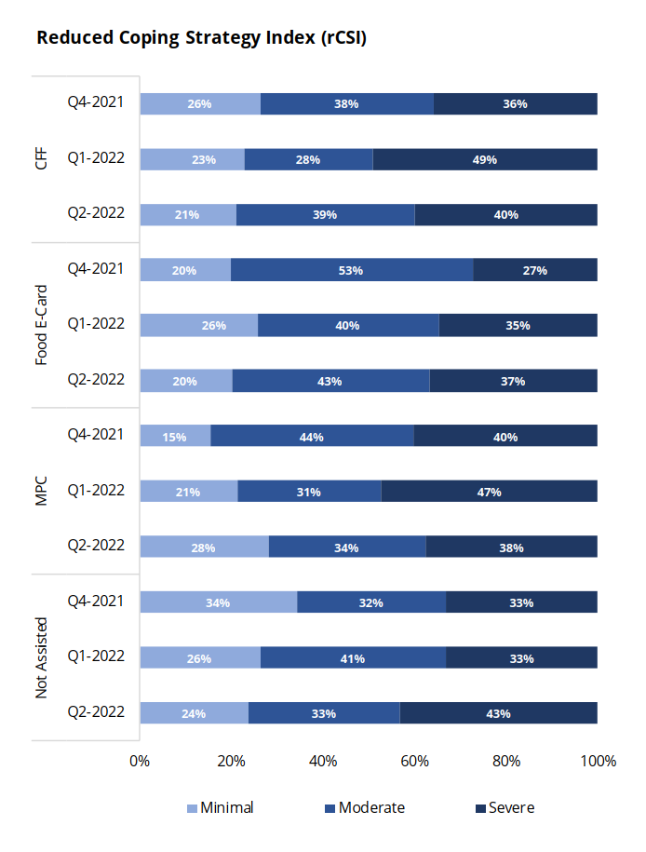
Avoid repetition fatigue
Do not overuse the same visual elements or formats, as it can lead to viewer disinterest or desensitization.
Variety in presentation keeps the viewer engaged and ensures that each piece of data is given its due attention and impact.
Source: WFP

Slide 26

Consider cultural sensitivities
When creating data visualizations, it’s important to be mindful of colour associations across different cultures. For example, white is associated with purity and innocence in Western cultures, but it is a colour associated to mourning and death in many East Asia countries.
It is also advisable to steer clear of colour palettes that could unintentionally convey partisanship, for example if they are strongly associated with a national political party, or bias, such as using pink for women and blue for men.
Instead, opt for neutral colours or a diverse palette that doesn’t reinforce such clichés. This approach ensures your visualizations are inclusive, respectful, and can be accurately interpreted by a global audience.
JeongMee Yoon’s “The Pink & Blue Project”

Slide 27
Common Errors

Slide 28
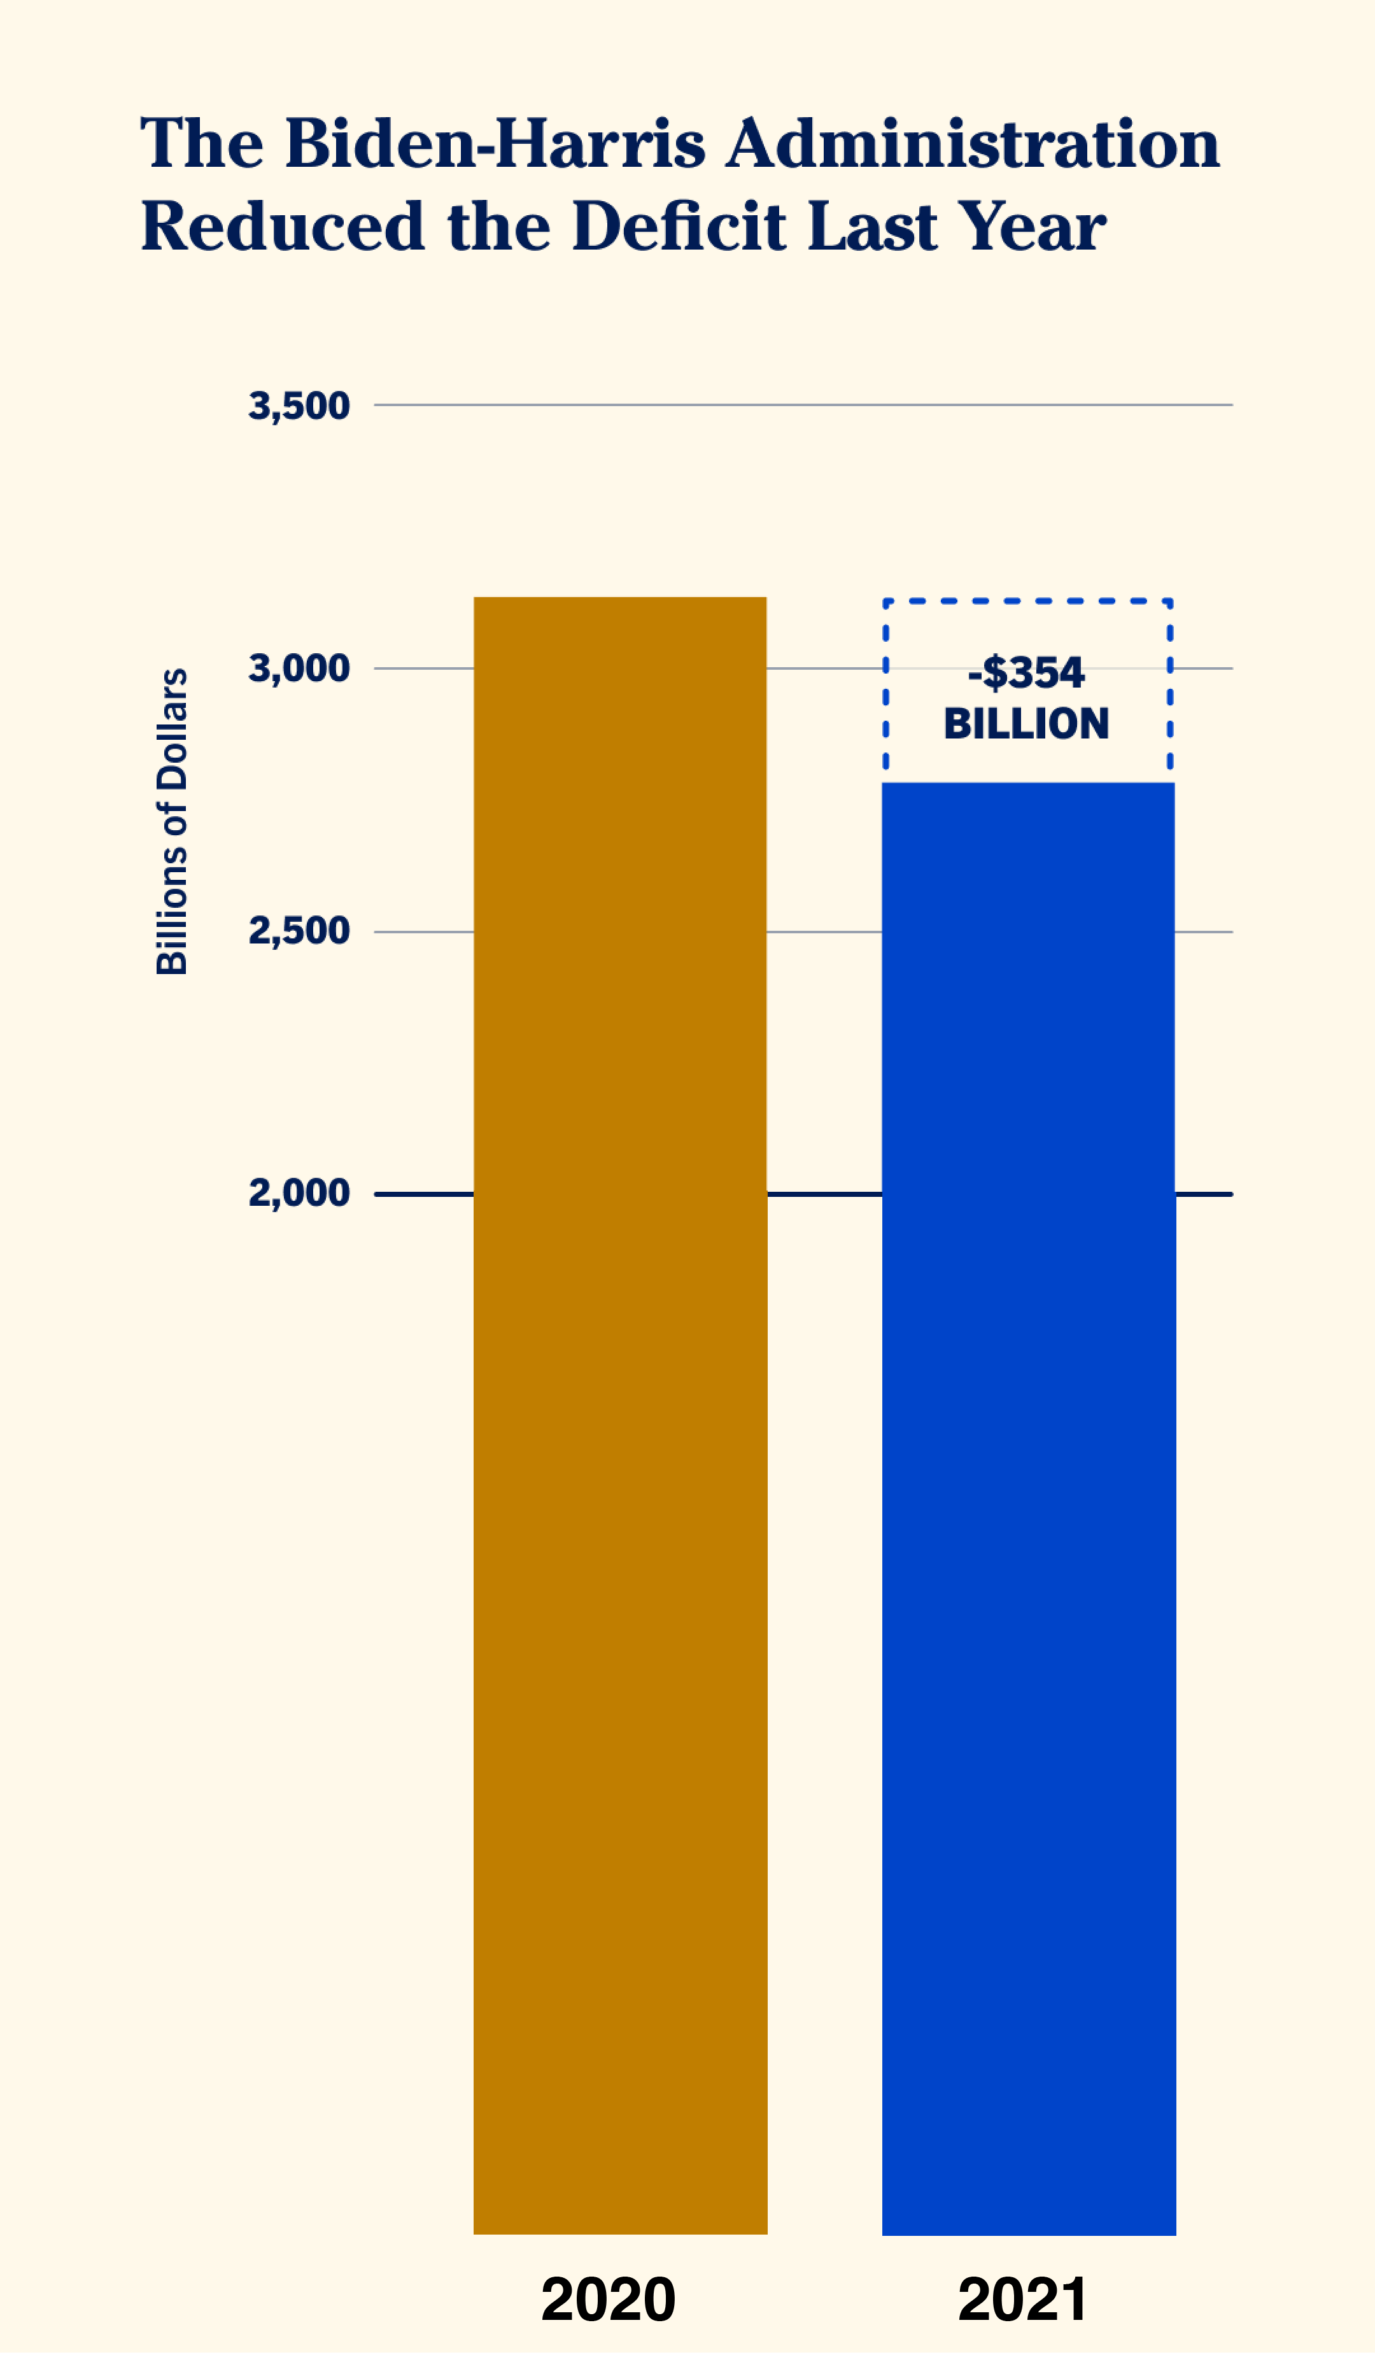
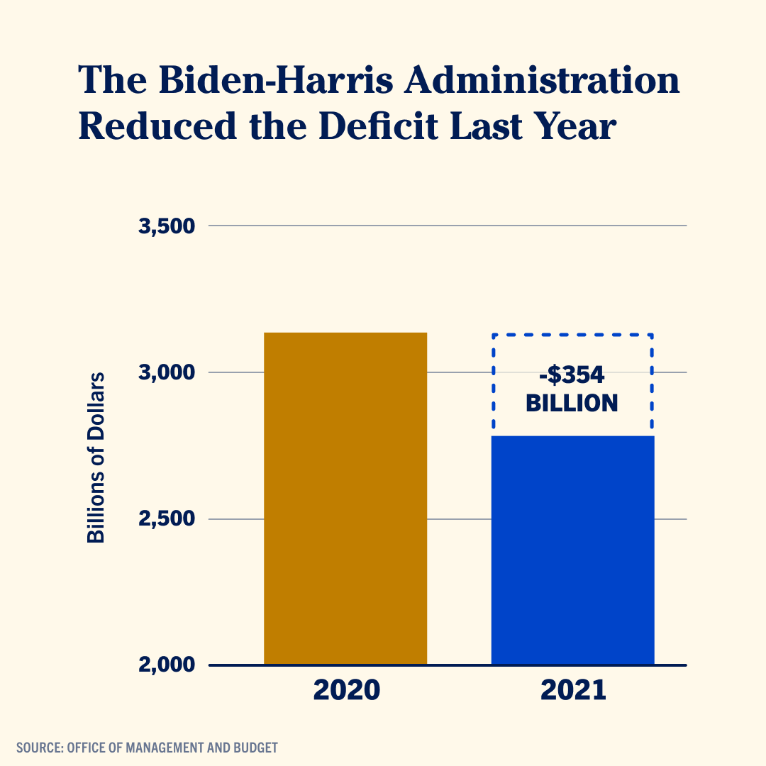
Cutting the y-axis
This error occurs when the y-axis in a bar chart does not start at zero, which can lead to a misrepresentation of the data. By cutting the y-axis, differences between values can appear exaggerated, potentially leading to incorrect conclusions.
In the example, on Figure A, where the y-axis starts at 2000, does not accurately represent a reduction of only $354 billion. Figure B shows a corrected version, which provides a more truthful visual representation of the data.
FIGURE A
FIGURE B
Source: European Union Data Visualization Guide

Slide 29
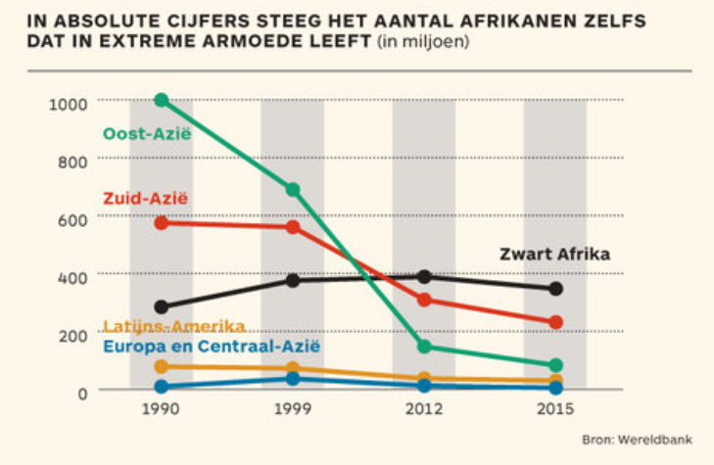
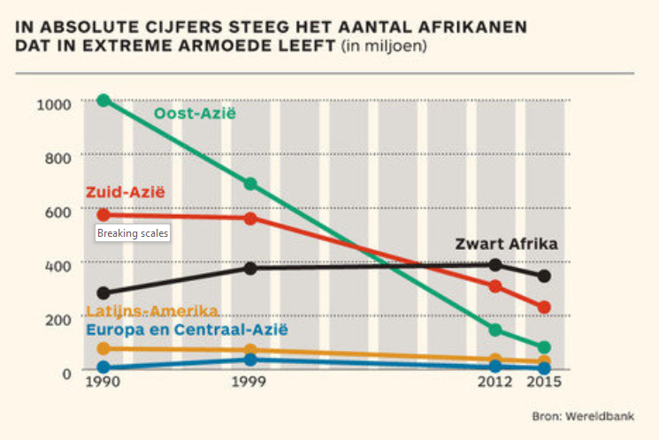
Breaking scales
Breaking scale refers to the practice of not using consistent intervals or units on the axes of a graph or chart. This can distort the representation of the data and make it difficult for viewers to accurately interpret trends and patterns.
In the example in Figure A, the years on the x-axis are equally distributed, although 13 years have passed in the period 1999-2012 and only 3 years have passed between 2012-2015. Figure B shows the correct scale for this graph.
FIGURE A: ORIGINAL
FIGURE B: CORRECTED
Source: European Union Data Visualization Guide

Slide 30
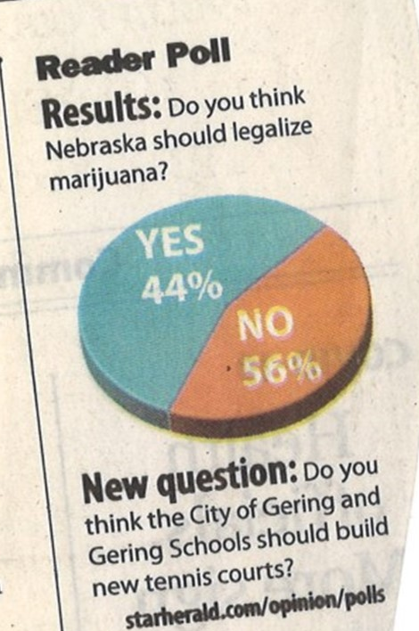
Respecting proportion
This error involves not maintaining consistency in the visual representation of data values. For instance, in a pie chart, each slice should accurately represent its proportion of the whole. Any inconsistency can lead to misinterpretation of the data.
FIGURE A
Source: European Union Data Visualization Guide

Slide 31
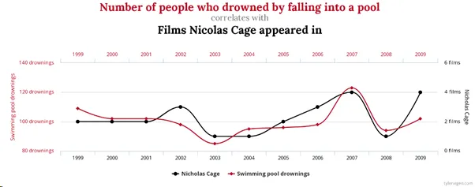
Forcing a relationship
This error involves implying a correlation or causal relationship between variables where none exists. It often results from inappropriate use of trend lines or other visual elements that suggest connections between data sets that are not supported by the actual data.
The example in Figure A shows a relationship between the number of movies actor Nicolas Cage appeared in the number of people who drowned in a pool, clearly a spurious correlation.
FIGURE A
Source: https://www.tylervigen.com/
Notes:
https://www.sciencedirect.com/science/article/pii/S2590291120300711

Slide 32
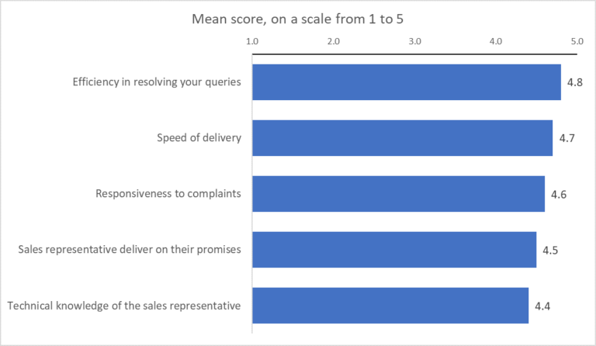
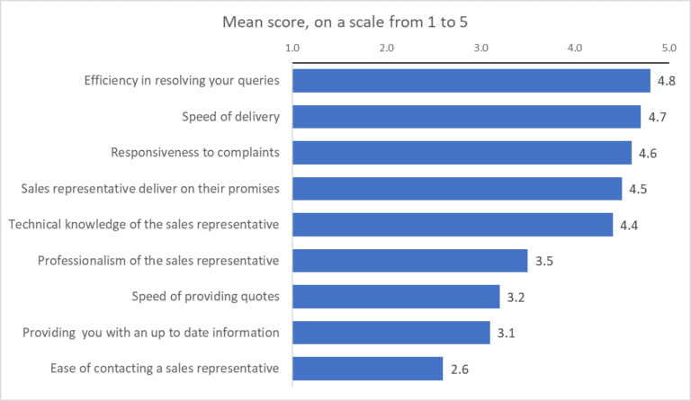
Cherry picking
Cherry picking involves selectively presenting only specific data points that support a particular conclusion, while ignoring others that may contradict it. This practice undermines the integrity of data visualization by offering a skewed perspective of the data.
FIGURE A
FIGURE B
Source: European Union Data Visualization Guide

Slide 33
Tools and resources

Slide 34
Tools and resources
Several tools can help refine and test your data visualizations:
Colour selection and accessibility: DataViz Palette Generator, Adobe colour, and Coolors help build accessible and effective colour palettes.
Complex, static graphs: RawGraphs.io is great for complex visualizations and runs entirely in your browser without sending data externally. Adobe Illustrator is also powerful to create complex, static graphs.
Interactive dashboards: Tableau is the corporate tool for creating interactive and static dashboards, which can be both internally and externally published on WFP Analytics
DATA PRIVACY REMINDER
Do not upload sensitive information to external tools unless they are WFP approved or process data locally.
Please refer to the Data Classification Guidance and Data Privacy Framework for more information.

Slide 35
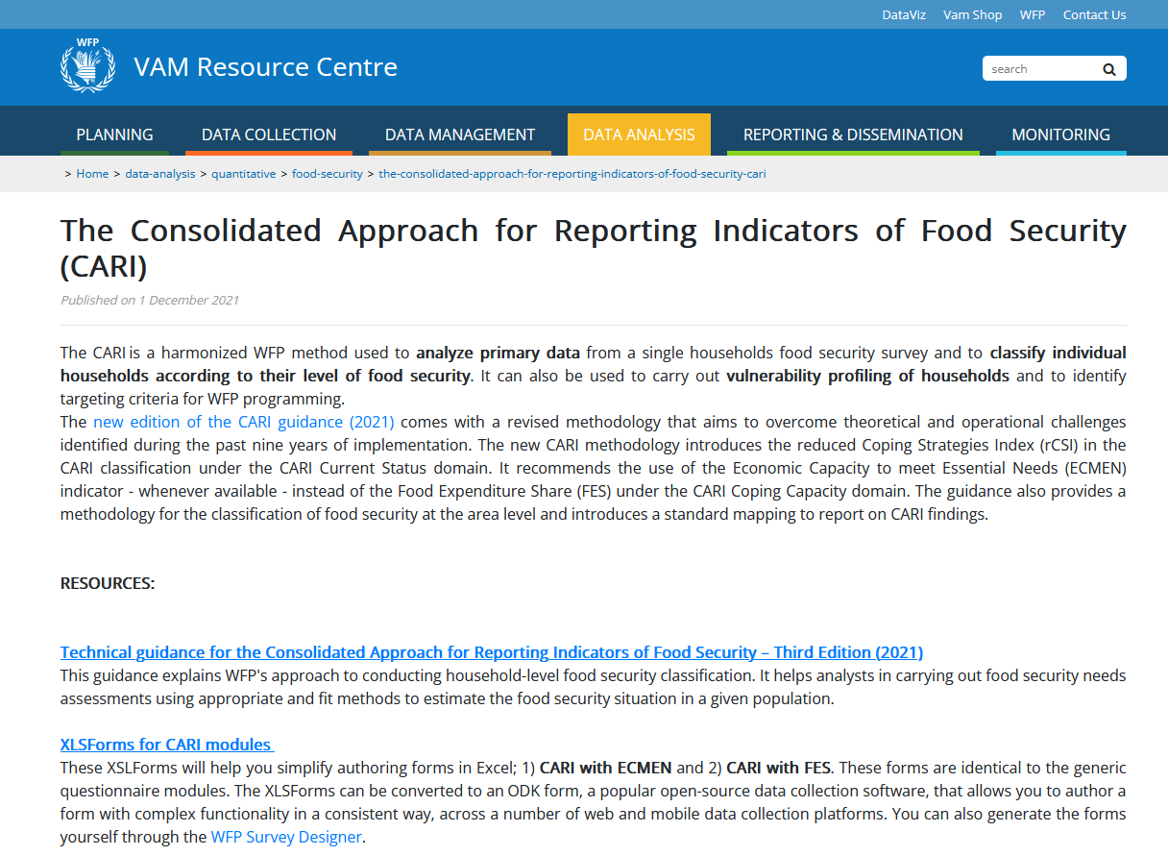
Indicator guidance
Check out the Resource Centre for guidance on specific indicators, including scripts to calculate them and guidelines for data visualizations.
For the full breakdown of all corporate indicators, consult the Indicator Compendium.

Slide 36
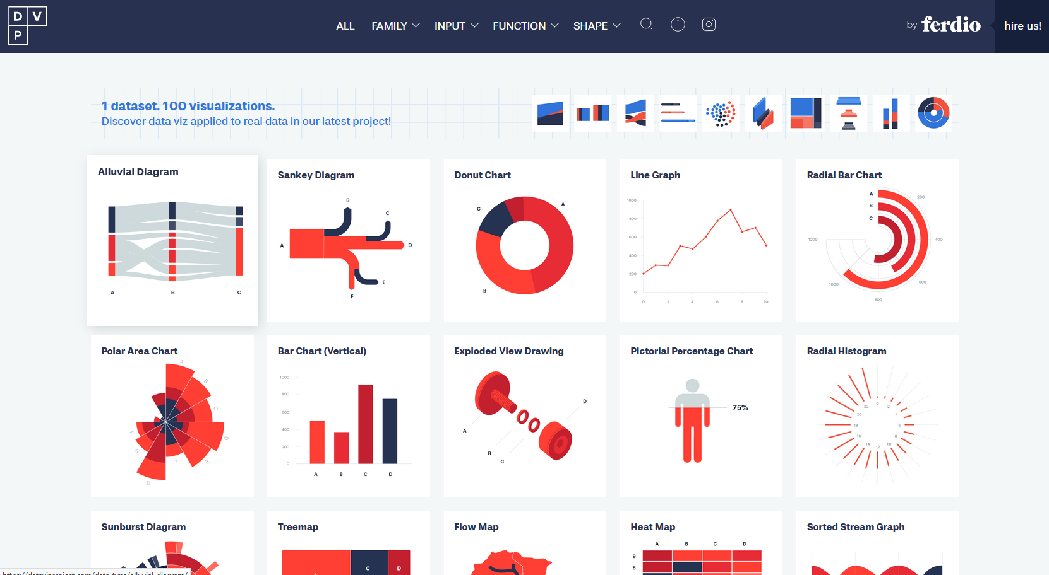
Data visualization references and books
The Data Viz Project (datavizproject.com/) is a great reference website for finding relevant data visualization, divided by their function and required inputs to make them.

Slide 37
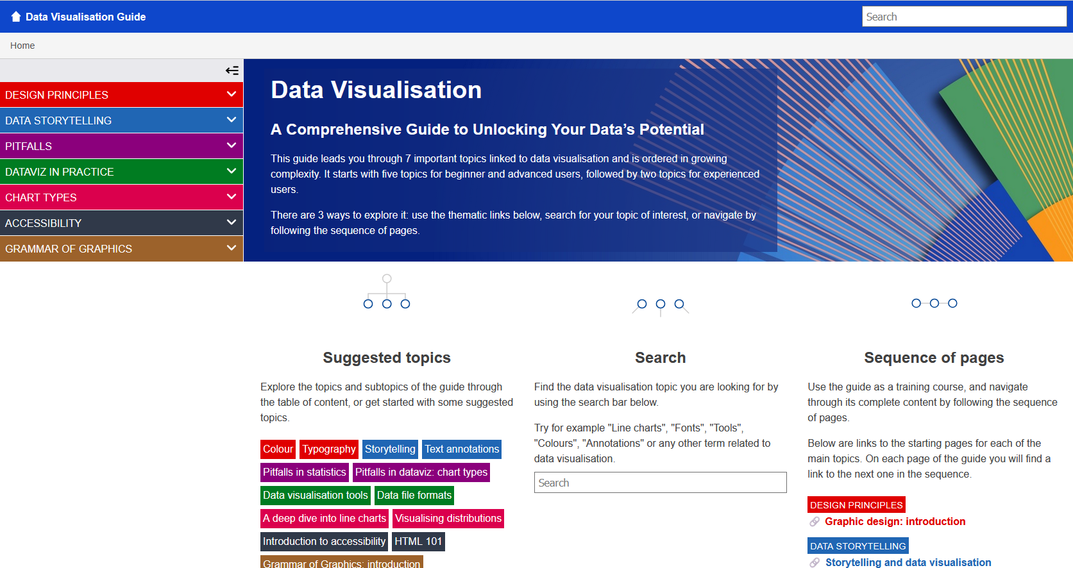
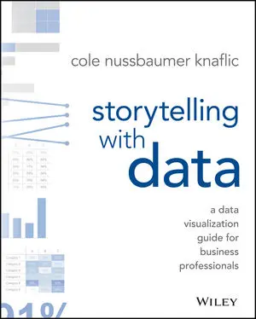
Data visualization books
The European Union Data Team has produced an excellent
Data Visualization Guide (data.europa.eu/apps/data-visualisation-guide/) covering in depth all the important topics for building great data visualizations. Many of the examples of common pitfalls used in this document have been taken from this manual.
Storytelling with Data: A Data Visualization Guide for Business Professionals by Cole Nussbaumer Knaflic is another terrific resource to learn how to tell stories with data visualizations. The book is available through the WFP Library.

Slide 38

WFP photos, icons and templates
The WFP Multimedia Hub (multimedia.wfp.org/) contains:
Photos from WFP operations
Icons
PowerPoint, report and publication templates
Further guidance on WFP visual identity, tone and language
The Humanitarian icon package can be found on the OCHA website: https://brand.unocha.org/d/xEPytAUjC3sH/icons

Slide 39
Annex

Slide 40
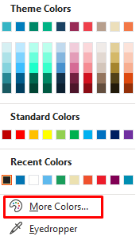
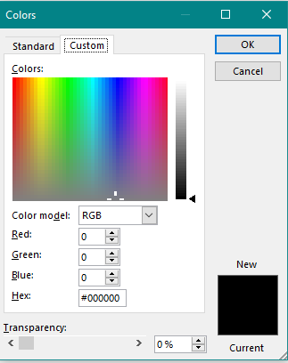
Colour codes
Colour codes, specifically HEX and RGB, are numerical representations of colours that are used in digital design and data visualization.
HEX codes are six-digit hexadecimal (base 16) numbers. The first two digits represent the red component, the next two green, and the last two blue (#RRGGBB). The values range from 00 (lowest intensity) to FF (highest intensity).
RGB codes represent the same colours but in decimal (base 10). They are expressed as rgb(red, green, blue), where each colour is an integer between 0 (lowest intensity) and 255 (highest intensity).
In tools like PowerPoint and Excel, the colour coders are found under “More colour” options.

Slide 41

Tools and resources

