Slide 1

Thematic analysis
Recap session

Slide 2
Introduction
There are many different theoretical approaches to qualitative data analysis. The choice of approach should always depend on the research question and design.
It is useful to start defining a theoretical approach to the data analysis when planning the research, as this will influence the focus area for the researchers during data collection.
As you advance your skills, you can advance the application of theory.

Slide 3


Question 1: What is inductive reasoning?

Slide 4
Inductive reasoning
Inductive reasoning is called a bottom-up approach because it moves from the researcher’s specific observations to broader generalizations and theories.
Inductive reasoning is more open-ended and exploratory than a deductive approach, especially at the beginning.
Most qualitative research is based on the inductive approach.

Slide 5
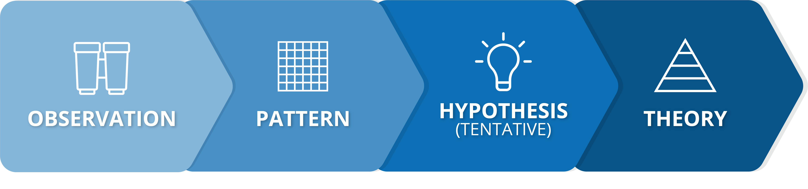
Inductive reasoning

Slide 6

Question 2: What is the difference between semantic and latent analysis?

Slide 7
Semantic and latent analysis
We can also distinguish between two levels of analysis: semantic and latent levels.
  A semantic approach examines only what participants say and the explicit content of the data.
  A latent approach goes beyond semantic content of the data to begin identifying and examining underlying assumptions and context.
Ask yourself: Am I interested in people’s stated opinions (semantic) or in what their statements reveal about their assumptions and social context (latent)?

Slide 8

Question 3: What is the difference between descriptive and interpretative analysis?

Slide 9
Descriptive and interpretative analysis
It is also possible to distinguish between descriptive and interpretative types of analysis:
  Descriptive analysis focusses on describing events, perceptions, and experiences. It includes a relative low level of interpretation. Examples include thematic and discourse analysis.
  Interpretative analysis aims to create more comprehensive interpretation of data to contribute to wider theories on the topic. Example includes grounded theory.

Slide 10

Thematic analysis

Slide 11
Thematic analysis
It is a type of descriptive analysis in which the researcher closely examines the data to identify common themes, topics, ideas, and patterns. These themes are then described, organised and analysed.
Thematic analysis is a good approach when you are trying to find out more about people’s views, opinions, knowledge, experiences, or values.
It is particularly useful when examining perspectives of different participants, highlighting similarities and differences, and generating unanticipated insights.

Slide 12
Types of research questions for thematic analysis
How do beneficiaries perceive WFP programmes?
What are women’s experiences of food distribution within the household?
What are host populations ideas and opinions about how to accommodate recent influx of Internally Displaced Persons (IDPs)?

Slide 13
Advantages to thematic analysis
It provides a lot of flexibility in data description and interpretation.
It allows the researcher to approach larger data sets more easily by sorting them into broad themes.
It can provide a detailed and complex account of data.
It is an easy and accessible form of analysis for researcher new to qualitative data analysis, as it does not require detailed theoretical knowledge.

Slide 14
Limitations of thematic analysis
It is often very subjective, relying on the researcher’s judgement. Therefore, it is prone to bias and risk missing nuances in the data.
The flexibility of the approach can lead to inconsistency and lack of coherency when developing the themes from the data.
There is insufficient literature outlining a pragmatic process for a trustworthy thematic analysis, compared to other methods. This may cause novice researcher to feel unsure about how to do the analysis thoroughly and systematically.

Slide 15

Question 4: What are the common steps in the data analysis process?

Slide 16
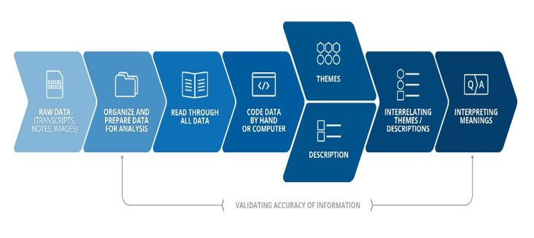
Common steps in the analysis process

Slide 17
Identifying themes and making descriptions
One of the first steps after coding is to create detailed descriptions of information about people, events, or settings, by writing out a narrative for each of the categories identified, using the coded information.
The descriptions, or summaries, can include perspectives from one individual or from multiple different perspectives.
The descriptions should also include relevant quotes and be supported by specific evidence.

Slide 18
Advice for describing categories
Identify where this category fits within your coding system or analysis framework. This will help you to see how it relates to the rest of your analysis.
Read through all the text coded for this category. As you read, write a summary list of all important points.
Go through all notes or memos related to the category.
Reflect on how prominent the category is in the data: Is it an issue raised often? By which type of respondents? In which situations is the category absent?
Define the boundaries of the category: What does it include: What does it not include?
Confirm the distinctiveness of the category: Is it different from other categories? Could it be incorporated within other categories?

Slide 19
Ways of presenting the interconnectedness of themes
A narrative discussion of a chronology of events
A detailed discussion of certain themes and sub-themes
A debate of multiple perspectives from respondents, including quotes
A process outlining a theory (grounded theory)
A detailed description of one respondent (case study)
A presentation of visuals to show key findings

Slide 20
Comparison
Comparison is a component or tool in descriptive and interpretative analysis.
Comparison naturally follows from description of categories. Once categories are described, they have to be compared with other categories, in other to contextualise the finding.
You can compare:
  Across situations
  Across demographically defined sub-groups
  Across time and contexts

Slide 21
Interpreting findings
In this step the researcher critically discuss what those results mean and what have been learned.
The researcher can reflect on the lessons learned and how the findings can be used (evaluations and programme adjustments). This step could also include a comparison of findings with information from literature or theories. It can be discussed how findings confirm past information or diverge from it.
This is also the time for identifying additional questions to ask, or other topics to be explored qualitatively.
The level of interpretation depends on the analysis approach and the intentions with the research. A higher abstraction of interpretation is required for a grounded theory analysis, compared with a thematic analysis.

Slide 22
Interpretation in a thematic analysis can include the following components:
Explain findings within the framework of the research questions and the sub-questions.
Critically reflect on the reliability and relevance of the findings.
Identify further areas or topics for research.
Comparing findings to previous research or stated assumptions.

Slide 23

Thank you! Questions?

