Slide 1


Reporting qualitative findings
Qualitative Research Blended Course
2023 September

Slide 2
Overview
Characteristics of qualitative reporting
What to include in a qualitative report?
How to make recommendations?
Use of qualitative findings in WFP
Examples of Qualitative Reports
Q&A

Slide 3
Characteristics of qualitative reporting

Slide 4
Scope
Why share the report?
  To raise awareness
  To collaborate
  To make decisions
  To knowledge share
Who is the audience?
  Donors, managers, colleagues, respondents, community leaders, CPs
Through which venue?
  Web, meetings, emails, webinars

Slide 5
Format
Books
Chapters
Narrative report
Summary reports
PowerPoint Presentations
Blogs
Graphs, images, videos

Slide 6
Add-ons
Images (remember consent)
Quotes
Graphs
Tables
Word clouds, bubble clouds, icons

Slide 7
Story-telling tips
Build your story by triangulating your qualitative research information with existing secondary information available
Coordinate with other stakeholders to get a comprehensive picture
“So what”?

Slide 8
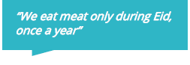

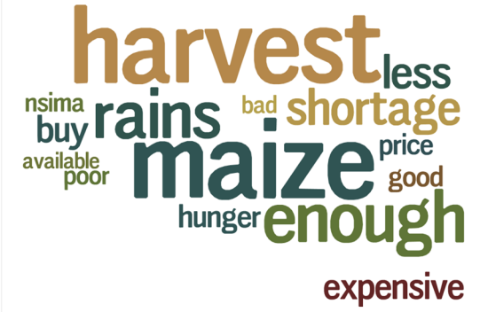
Text Data visualization
Emphasizing the story with data visualization
Households are not able to meet their food needs
Thanks to WFP’s school feeding program, children are able to go to school.
There were many factors affecting agriculture this year

Slide 9
What to include in a qualitative report?

Slide 10
Front page
Project title
Country Office/ Field Office
Date
Names of people involved in the research

Slide 11
Introduction
Abstract = short summary of the research (optional)
Context/background → justification for the research and the topic
Contact details

Slide 12
Research topic
Research topic
Sub-questions/themes

Slide 13
Methodology
Sampling outline
  Respondent profiles, exclusion/inclusion criteria, number of respondents, location
Data collection methods
  FGDs, Key Informant Interviews (KIIs), observations, debriefings, desk review
Data analysis approach
  Descriptive, inductive, thematic analysis

Slide 14
Results
Summary of findings per theme (if thematic analysis)
Examples of link between codes – categories – themes

Slide 15
Discussion
A discussion/interpretation of findings
What does the findings means? How should they be understood?
How do findings relate to initial themes?
Credibility of results
Assumptions
Lessons learned in terms of methods and approaches

Slide 16
Recommendations
SMART recommendations on key findings
(Specific, Measurable, Accountable, Realistic, Time-bound)
Next steps

Slide 17
How to make recommendations?

Slide 18




Writing recommendations based on qualitative findings
Research Results
Experience and Judgement of the Research Team
Recommendations are suggested actions that can improve current or prospective programme implementation.
Share actions with decision-makers and relevant colleagues.
Aligned with the research objectives.
Notes:
Recommendations are suggested actions that can improve current or prospective programme implementation.
They are formulated by combining the research results and the experience and judgement of the research team, and should be aligned with the research objectives.
Identify & share actions with decision-makers and relevant colleagues.

Slide 19
Advice for writing recommendations
Make 6-8 recommendations.
Prioritize recommendations, from high to low priority. This can help decision-makers decide which recommendations to start with.
Clearly link recommendations to specific findings. This makes it easier for the audience to see why you suggest the activity or change.
Be concise and concrete. It must be clear exactly what is recommended – and why.
Be realistic about what can be improved. Consider timeline, budget, and resources available.
Recommendations should be coherent and non-contradictory.

Slide 20
Recommendations should be SMART
Specific - it must be clear exactly what is being recommended.
Measurable - it should be possible to tell whether the recommendation has been implemented or not.
Accountable - the person or entity responsible for implementing the recommendation should be identified.
Realistic - recommendations need to fall within the range of the possible. This does not mean that they cannot be “outside the box” but they should bear resources and other constraints in mind.
Time-bound - the timetable for implementing the recommendation should be given.

Slide 21
Exercise – Reflect on and improve the following recommendation:
Prioritize vulnerable people during distributions.
CP staff should ensure that elderly and disabled people receive their food assistance first during monthly general food distributions.

Slide 22
Exercise – Reflect on and improve the following recommendations:
In collaboration with UNHCR, establish a feedback mechanism.
In collaboration with UNHCR, WFP Protection focal point should establish a hotline accessible to the IDP and host community in the west region of Bangladesh, by the beginning of Q3.

Slide 23
Exercise – Reflect on and improve the following recommendations:
Promote daily exchange with beneficiaries on WFP activities and procedures.
Communicate with beneficiaries on a weekly basis through WFP's Facebook page, responding to comments and questions around targeting and implementation of the cash-based assistance programme.

Slide 24
Use of qualitative findings in WFP

Slide 25
Informing operational changes
Sufficiency of quantities received, or CBT values (Palestine)
Changing certain commodities in the food ration (Palestine)
Evaluate the markets in terms of their compliance with the contract terms (keeping the lowest prices, storage conditions, correct labelling etc) (Turkey)
Revise the vulnerability criteria for targeting (Egypt and Syria)
Assess markets and reasons behind food price changes (Syria)
Design and inform the CSP (Jordan and Tunisia)

Slide 26
Examples of Qualitative Reports
Targeting validation of cash program for Sudan Crisis in Egypt:
WFP Jordan Country Strategic Plan (2023-2027): Beneficiary Consultations:
What are some key reporting elements used in these reports? Which elements do you think are most helpful in conveying the message?

Slide 27
Q & A

