Slide 1
Coding in qualitative data analysis
Second Cohort of the Blended Course
on Qualitative Research
Regional Bureau for the Middle East,
Northern Africa and Eastern Europe, Cairo (RBC)
El Gouna,EGYPT
September ,2023

Slide 2
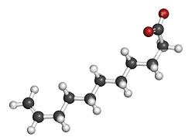
Overview
What is coding in qualitative data analysis?
Code naming
Quality assurance of coding

Slide 3
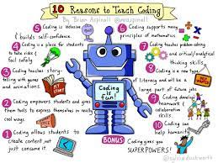
What is Coding ?

Slide 4

What is coding in qualitative data analysis?
The coding process is a way to manage, locate, identify, and sort qualitative data.
A code helps order the data so that you can keep track of your topics and easily find information
Codes can be used to serve many purposes: they can be descriptive, topical, or analytical.
..

Slide 5

Coding example
A code in qualitative analysis is a word or short phrase( that assigns a summative or essence-capturing attribute to a portion of the data.
  What is the passage about?
For example, in a section of an interview transcript in which the informant explains his experiences with receiving cash transfers, he mentions that he often feels insecure when withdrawing money from the ATM, fearing he may lose his card. The analyst may choose to code the section ‘cash withdrawal’, or ‘loss of card’.
Coding is the process of labeling and organizing your qualitative data to identify different themes and the relationships between them.

Slide 6
Codes – categories - themes
Codes that are similar, are often grouped together under a category. The category summarizes the type of codes.
  For example, codes of ‘cash withdrawal’ and ‘loss of card’ could be grouped under a category called ‘Perceptions of threats or insecurities’.
In a similar way, several categories can be grouped under a common theme.
  For example, the category of ‘Perceptions of threats or insecurities’ can be part of a broader theme such as ‘Perceptions about cash assistance’.

Slide 7
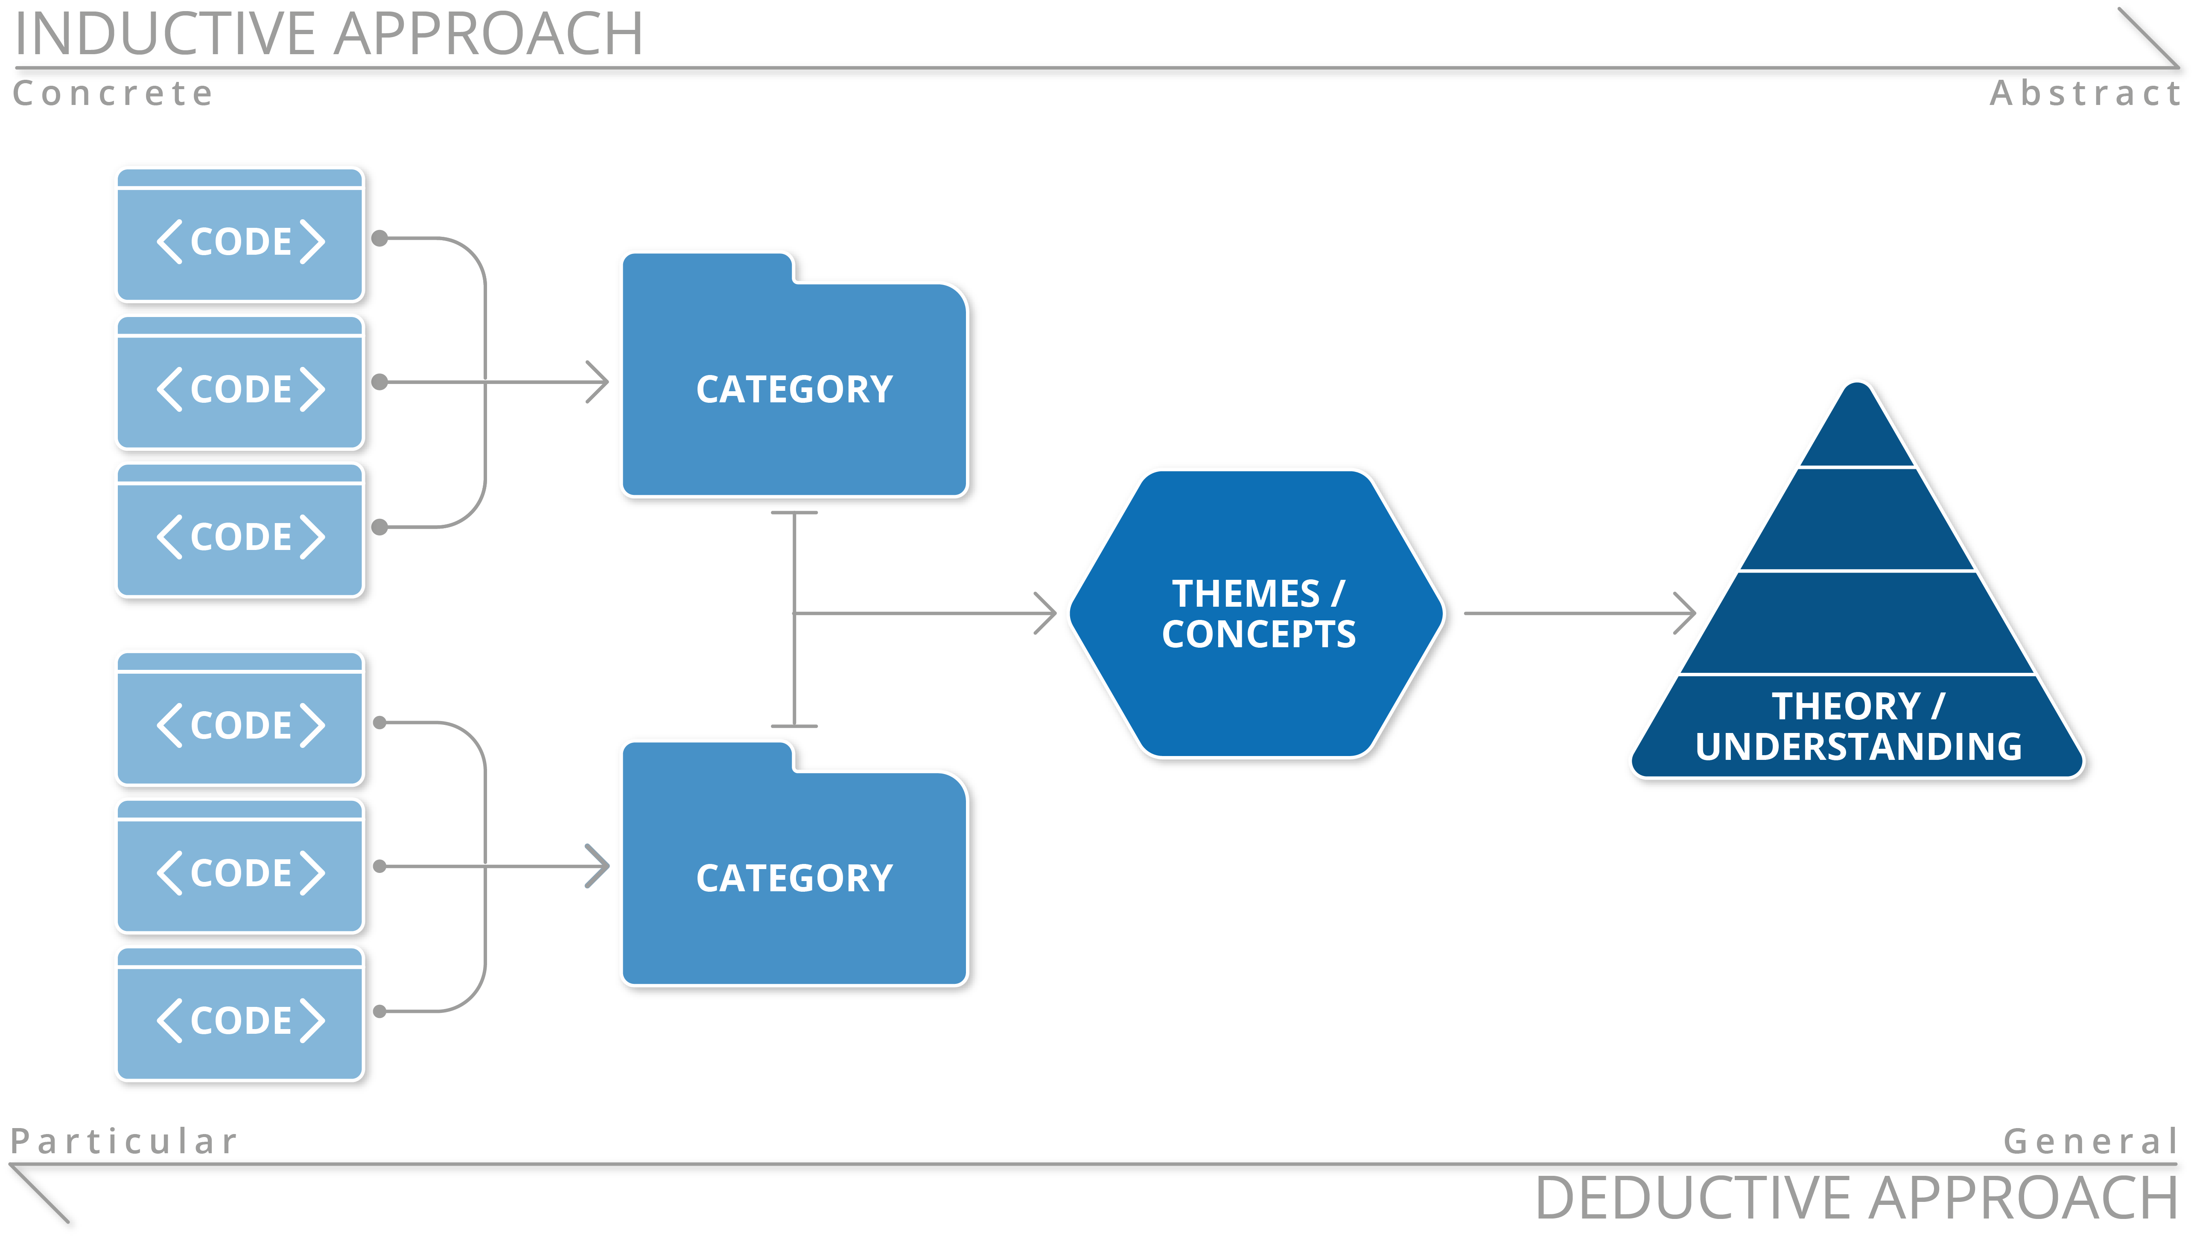

Slide 8

Coding cycles and saturation
Coding is a cyclical process: codes are created, grouped, challenged, and recreated, repeatedly.
All data sources can be coded, and the coding process is very similar.
Coding saturation is the point when NO new code and categories are identified in all data sources. Each of the categories must be fully developed and described, including their variations and contrasts to other categories.

Slide 9

Coding Methods

Slide 10

Coding manually
Data can be coded manually by using Word or paper, by highlighting text or photo sections in certain colours and adding comments to the margins.
Coding manually tends to be more intuitive and is great for researchers new to qualitative analysis because it creates a good understanding of the data and analysis flow.

Slide 11
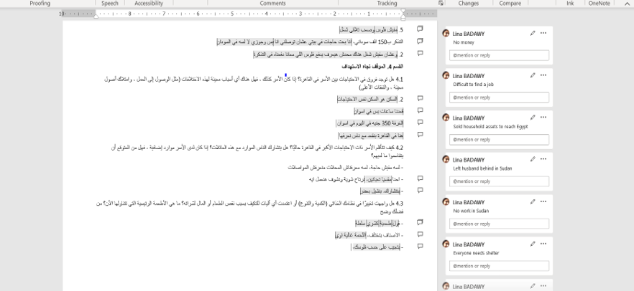

Slide 12
Coding using a software
The choice of whether to code manually or to use a software depends on the amount of data, resources available to purchase the software, and the preference and experience of the research team in terms of coding.
MAXQDA or Atlas.ti or Tutorial​
Nvivo Tutorial​
Great for larger amounts of data
Easy re-coding and coding tracking
Texts, images, and videos
Can be comprehensive to learn esp. for more advance analysis tools
Not a substitute for analysis

Slide 13
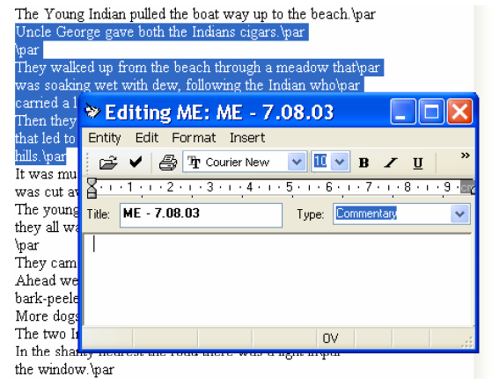
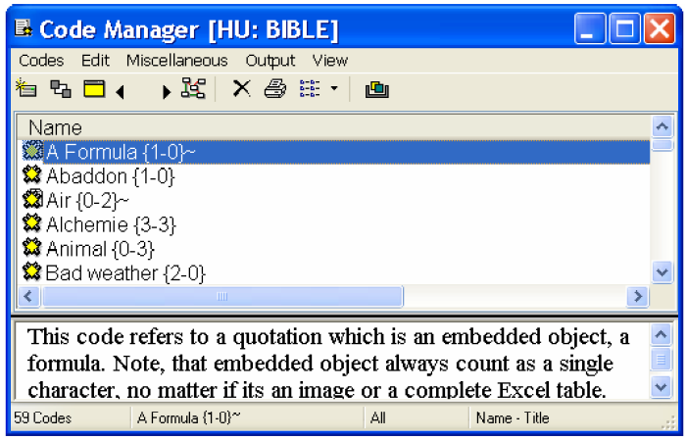
Software: ATLAS.ti
http://www.atlasti.com/ -- free trial available

Slide 14
Code naming

Slide 15

Types of codes
Respondent type codes highlight diversity of data amongst the sampled population, such as between men and women.
Analytical codes identify more interpretative and analytical concepts.
Topical codes categorise topics or issues.
Descriptive codes describe actions, events, or expériences.

Slide 16
Naming codes
Codes should be as specific and precise as possible.
  For example, instead of using ‘attitude’ and ‘behaviour’ as codes, use specific traits like ‘dislike’ and ‘carelessness’.
Code names should be neither too broad nor too narrow.
  For example, in a passage addressing gender roles in the household, ‘roles’ may be too broad as a code, but ‘baking’ may be too narrow. An alternative to both could be ‘food preparation’.
The code name will start influencing the researcher’s thinking, process, and perceptions of what the data is about. This will affect future code names, because the associations created from the code naming inspire new codes.
  It is therefore important to be conscious and critical of the coding and to rename codes if needed through the process.

Slide 17
Codebook
Code | Cash withdrawal
Code group | Activity
Definition | Any reference to beneficiaries withdrawing cash assistance from an ATM
When to use | Use specifically when there is talk about how cash assistance has been accessed/withdrawn using card/ ATM.
When not to use | Avoid using if respondent is discussing different means of accessing cash assistance, or if the respondents discuss using the card to access money in general.
Example | ‘I always withdraw money on market days because that’s when I travel into town where the ATM is’
A codebook is a record of codes and their definitions. It is essential for ensuring consistency in the application of codes, especially when working as a team.

Slide 18
Quality assurance of coding

Slide 19
Coding credibility
Even though coding is prone to researcher bias, there are some ways of adding credibility to the process:
The researcher can make his/her perspectives and questions explicit in the presentation of codes and make sure the codes are applied consistently. This will help the reader understand how and why the data was interpreted in this way.
The most effective way of establishing credibility is to provide a strong and clear argument for the conclusions reached.

Slide 20

Coding reliability
Have multiple coders develop the codebook and code the data sets.
For team coding, engage in discussions about the code names and groups to define clear definitions.
Having a second person review a sample of the data, to see if they arrive at the same conclusion.
Review a sample of the data at a later stage to see if the codes have remained consistent.

Slide 21
Tips for the coding process

Slide 22

Tips for the coding process (I)
Make sure you have read all the data at least once.
Make sure your records (eg. transcripts) are double line spaced with wide margins. This allows you to write key words, additional codes, or reflections in the margins as you read through it.
Always keep a clean copy of the data sources. Make the copy before you start coding
Sequentially number the lines, paragraphs, pages, or other units in your sources.

Slide 23
Tips for the coding process (II)
Get familiar with the process: Start with a small project/ data sample, and do simple descriptions and analysis based on these small samples, before moving on to something bigger.
Challenge the codes: Be critical of the code names and corresponding passages. What are your assumptions? What might you have missed?
  Do a trial run to see if the codes created are sufficient in answering the research question.

Slide 24
Tips for the coding process (III)
Park certain data and ideas: Some data may not be immediately relevant or interesting.
  Create a code name or group for this type of data, so that you can return to it later.
Alternate between tasks: Take a break from coding and do some reading and reflecting on another piece of data.
  A break can provide surprisingly new perspectives.
Focus on the purpose: Always keep in mind the research question and the purpose of the coding. What are you trying to find out? Which coding approach have you committed to? What extent of coding is expected?

Slide 25
شكرًا لك
متشکرم

