Slide 1


Lessons learned from data collection
RBC Qualitative Research training
2023 September

Slide 2
Session outline
Before data collection
01
Throughout data collection
02
After data collection
03
Notes:
Categories of file naming
Misleading categories, mistakes in identifying the main criteria of the speakers, specially when we code Speaker 1, 2 ..without mirroring into digrame

Slide 3
Before Data collection

Slide 4
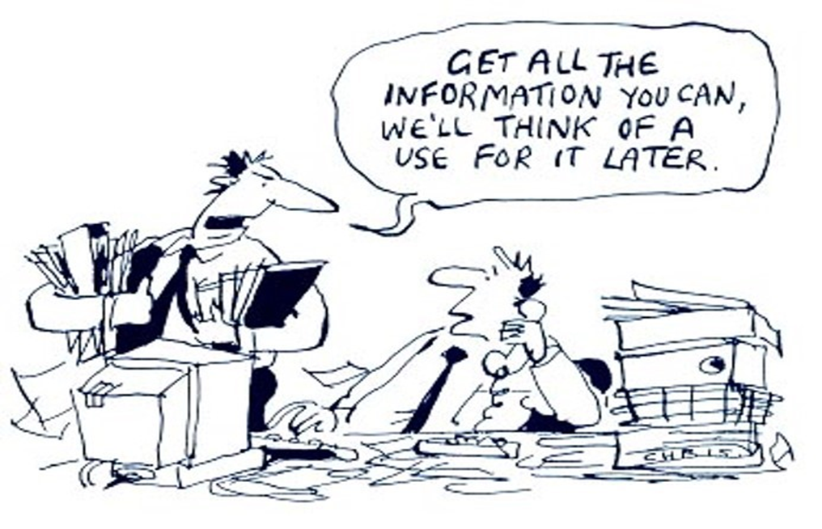
Sampling and reaching the saturation level
The type of the study “some studies “may reach saturation faster- when to decide on the saturation level?
The heterogeneity of the population (Composition of the groups)
Groups of special interest that require intensive study
Multiple samples within one study
Types of data collection methods used
Budget and resources available

Slide 5
Innovative Data Collection Methods

Slide 6
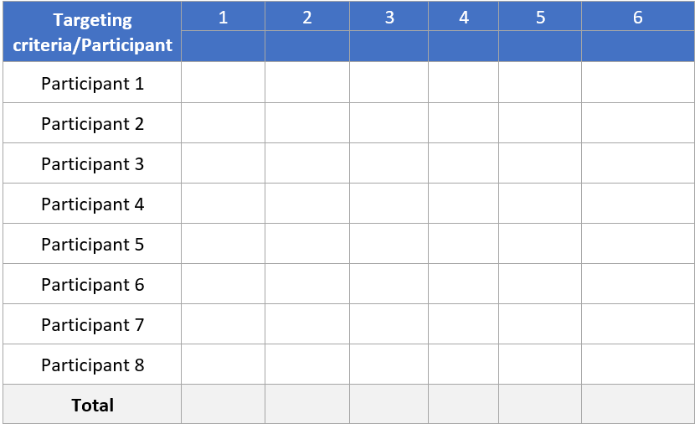
An example of free listing (Egypt):
Asking participants to list criteria they believe is associated with being more vulnerable, then display all collected criteria and ask them to rank the top 5 criteria from their point of view (5 for most vulnerable and 1 for least vulnerable).
Free listing
Asking participants to list all different kinds of XXX they can think of. It reveals the most salient (top of mind) items for the domain.
Helps quantify each item’s frequency and rank
Elderly
No shelter
PLW
Notes:
Capturing family wisdom includes recording not only what is said, but how it is said. Listen for those well-spoken statements that illustrate an important view. Try to record sentences or phrases are that are especially enlightening or eloquently express a point of view.
Use initials of the speaker before or after the quotation (remembering to protect confidentiality when writing reports).
It is difficult to capture the entire quote, so aim to get as much as you can, recording especially the key phrases. Use three periods (…) to indicate missing words

Slide 7
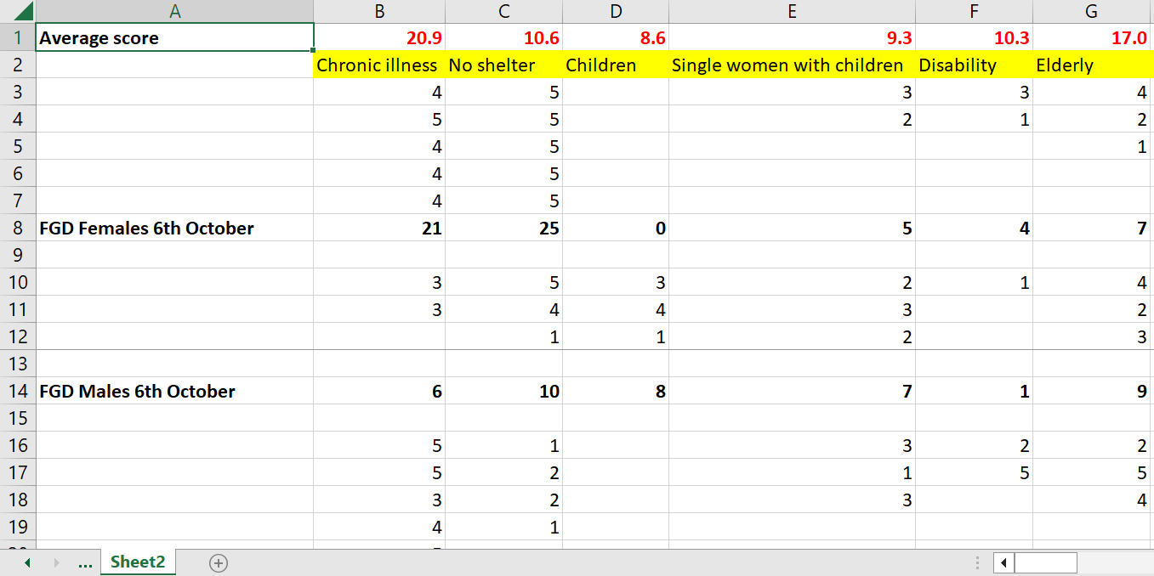
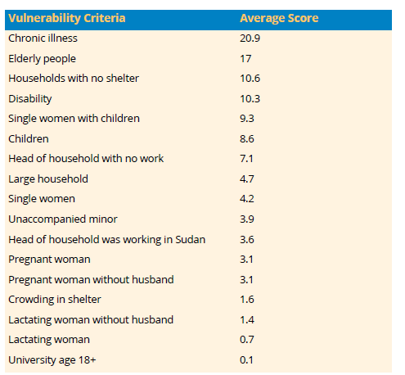
Free listing analysis
Final Output
Manual analysis
Anthropac (free basic app): http://www.analytictech.com/anthropac/anthropac.htm

Slide 8
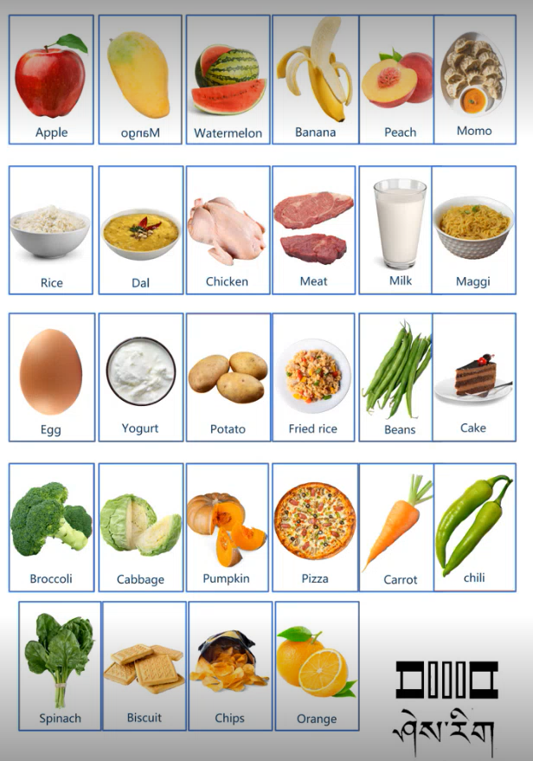
Pile sorting
Asking participants to sort cards into categories based on similar characteristics or qualities
Reveals how participants perceive and categorize items
An example of pile sorting (Bhutan):
Asking students from class 1-12 to
Define food groups
Frequency of consumption (Often, Sometimes, Rarely, Never)
Healthy vs unhealthy
Tasty vs Not tasty
Elderly
No shelter
PLW
Notes:
Capturing family wisdom includes recording not only what is said, but how it is said. Listen for those well-spoken statements that illustrate an important view. Try to record sentences or phrases are that are especially enlightening or eloquently express a point of view.
Use initials of the speaker before or after the quotation (remembering to protect confidentiality when writing reports).
It is difficult to capture the entire quote, so aim to get as much as you can, recording especially the key phrases. Use three periods (…) to indicate missing words

Slide 9
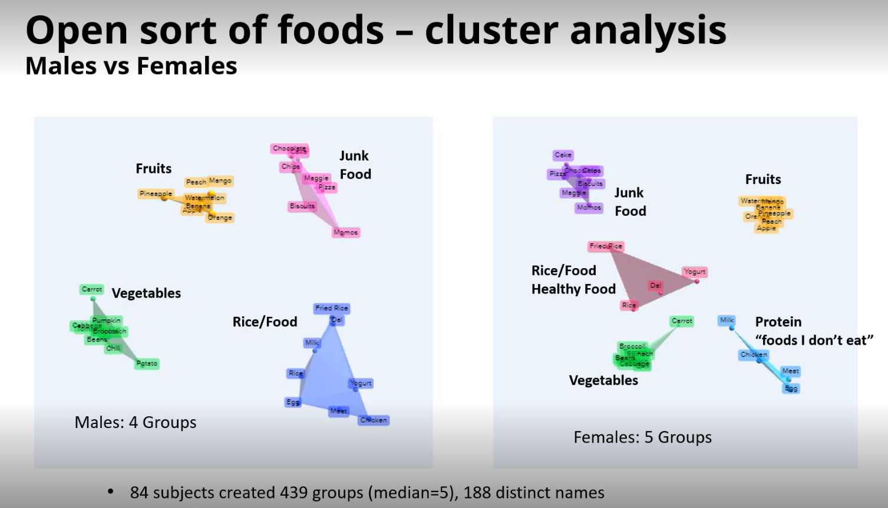
Pile sorting analysis
Optimal Workshop (Paid app): https://www.optimalworkshop.com/
Anthropac (Free basic app): http://www.analytictech.com/anthropac/anthropac.htm
Females identified 5 food groups vs only 4 groups identified by males – which then revealed many females in Bhutan are vegetarian.

Slide 10
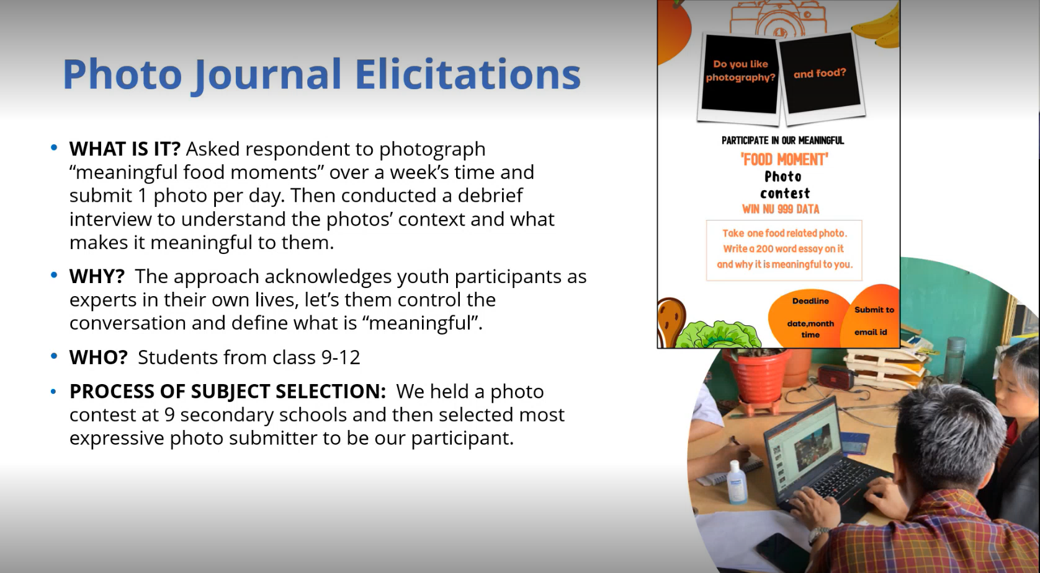

Slide 11
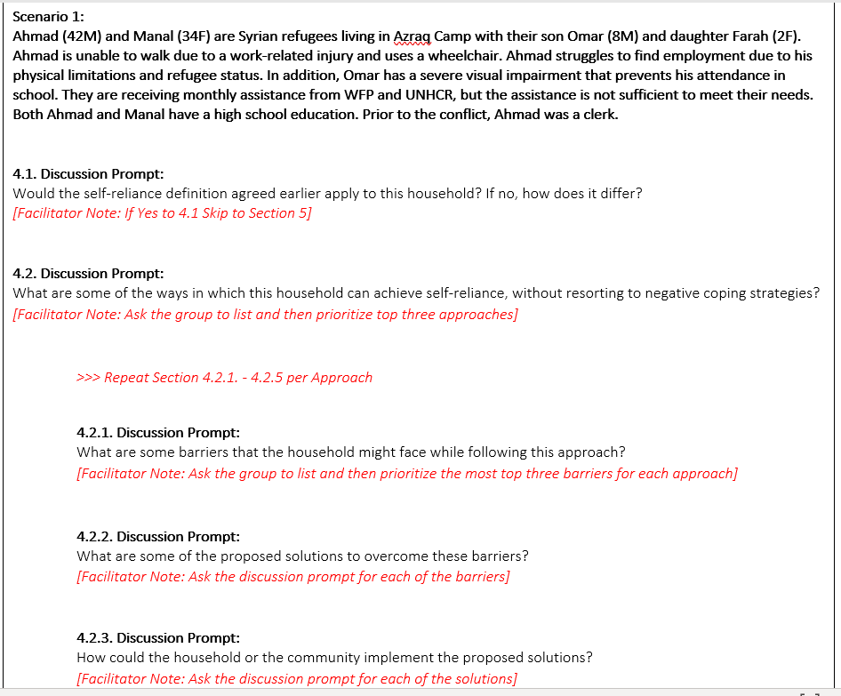
Focus Group Discussions (Projective Techniques)
Using some scenarios to probe and unpack the discussions (instead of asking direct questions about them).
Example from Jordan:
Beneficiary consultations were conducted to understand how they want to be assisted when they are no longer receiving GFA – to facilitate their transition and graduation from the GFA programme to more resilience building assistance.

Slide 12
Note taking

Slide 13

How to prepare for note taking?
Have a good understanding of the aim of the exercise and the main theme of the conversation – that is, the types of issues that are likely to arise.
Do not rely on a tape to capture the discussion, tone or importance of issues raised.
Writing up your data in detail can take some time but is a vital part of the qualitative research process. Time in your working day should therefore be allocated to this activity.
Effective note taking relies on note taker expertise in listening, observation and writing
Notes:
Before the FGD (or interview, if appropriate)
Prior to the FGD, it is the facilitator’s responsibility to ensure that the note-taker is well briefed and understands the following:
The gist (main theme) of the conversation – that is, the types of issues that are likely to arise. If a note-taker is warmed-up to the issues, they are more likely to ‘hear’ them
You cannot assume that a tape recording will be clear. Do not rely on a tape to capture the discussion, tone or importance of issues raised

Slide 14
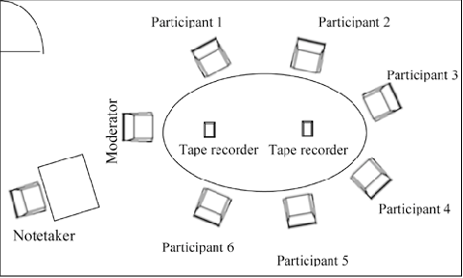
Types of notes
It’s a good idea to have a diagram of the set-up with participants numbered so that you can keep track of who is speaking, in your notes.
Ensure that both what is said and what is observed are recorded in the notes.

Slide 15
Types of notes
Memos
Are short notes (about two lines long) that capture the essence of what you learned from an activity. This can be helpful in identifying the main codes for a piece of data analysis
An example of a memo:
“This interview shows how listener's interest changed regarding the content and preferences related to listening. New codes like conflict and constituent assembly and listening pattern emerged which needs more research now.
Learning from the memo:
It was decided that more questions will be asked about the new codes. They are interesting areas for the research .
Narrative
As much as possible
Quotes
Includes recording not only what is said, but how it is said
Listen for those well-spoken statements that illustrate an important view.
Try to record sentences or phrases that are especially enlightening or express a point of view well.
Notes:
Capturing family wisdom includes recording not only what is said, but how it is said. Listen for those well-spoken statements that illustrate an important view. Try to record sentences or phrases are that are especially enlightening or eloquently express a point of view.
Use initials of the speaker before or after the quotation (remembering to protect confidentiality when writing reports).
It is difficult to capture the entire quote, so aim to get as much as you can, recording especially the key phrases. Use three periods (…) to indicate missing words

Slide 16
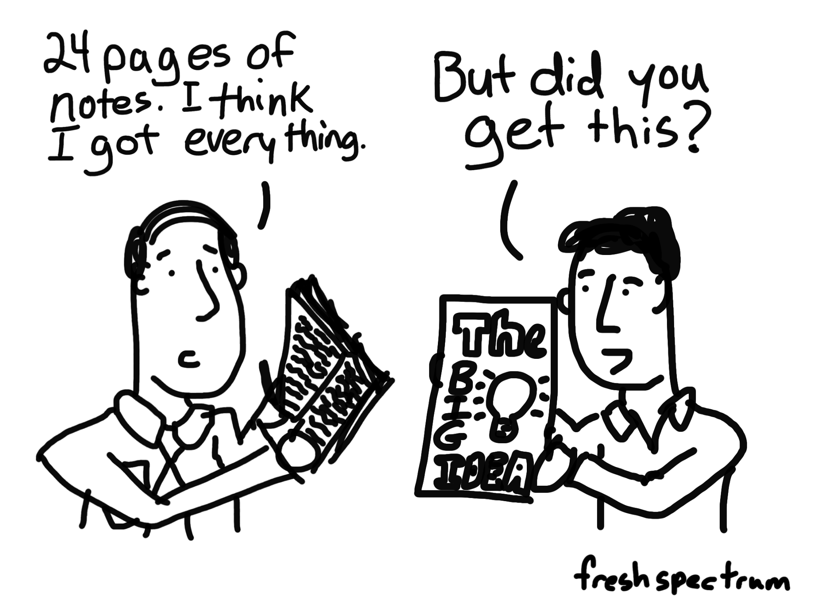
Note taking

Slide 17
Throughout the data collection

Slide 18

During the data collection
One moderator, keeps the discussion flow
The note-taker is not to be part of the discussion and should not interrupt it! The only reason to do this would be if the feel they have missed an important point.

Slide 19
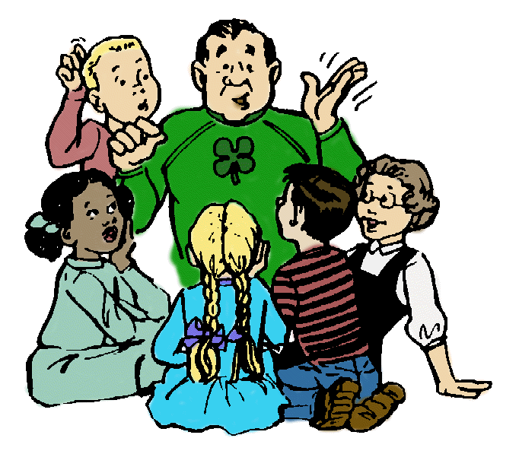
During the data collection : Moderator
Remember that Good Probing is Not Leading
It is important to avoid asking questions that are leading, meaning that they reflect your opinions or assumptions about a topic.
Pauses
- Allow participants to think
- Allow comments from additional participants
- Min 5 seconds
Body language
- Eye contact
- Slow down sign
- -

Slide 20
Difficult Situations
1. What do I do if interviewee is not interested to talk about the interview topic?
2. What do I do if interviewee does not respond to a question?
3. What do I do if interviewee begins to talk about topics that are not relevant to the research?
4. What do I do if interviewee starts side conversation with someone else ?
Notes:
Focus groups, ideally, allow researchers to collect the opinions and ideas of a variety of people. If
someone is doing a lot of the talking, however, this may prevent others from contributing their
thoughts, and limits the usefulness of the focus group. It is important to notice when this is
happening and do what you can to try to make sure that other people have the opportunity to say
things, even if they seem reluctant at first or insist that what is being said by others reflects what
they would have said. It is important to have people say things in their own words as much as
possible. If someone is dominating the conversation, you might want to respectfully acknowledge
their contribution, and thank them, saying something like, “I really appreciate your comments.”
Then make direct eye contact with other people and ask something like, “I’m very interested in
Hearing how other people are feeling about this issue” or “It’s very interesting to get a variety of
In this kind of situation, it is helpful to try to understand why people aren’t responding.
Are people feeling uncomfortable about talking?
Are people tired of talking about the topic and/or do they have no more to say about a
topic?
Do you think you might have asked a politically sensitive question (i.e., something that
people are afraid to answer honestly because it might make other people angry)?
Are people feeling uncomfortable about talking?
Sometimes the conversation will start to stray away from the topics of the focus group. When this
happens, you might take advantage of a pause and say, “Thank you for that interesting idea.
Perhaps we can discuss it in a separate session. For the purposes of exploring further the specific
topics that are the focus of this discussion, with your consent, I would like to move on to another
item.” Another strategy is to orient the group to the time you have remaining for your discussion.
You do not want the duration of the focus group to extend beyond the amount of time you
communicated to participants. You may want to mention this when discussion strays from the
intended focus, and then refocus the discussion accordingly or use this as an opportunity to indicate

Slide 21
Difficult Situations
5. What happens if interviewee skips ahead, providing information relevant to, or even completely answering, a question that I haven’t gotten to yet?
6. What do I do if I ask a question and the interview respondent says that they do not feel comfortable answering it?
7. What do I do if interviewee wants to leave in the middle of interview?
Notes:
Focus groups, ideally, allow researchers to collect the opinions and ideas of a variety of people. If
someone is doing a lot of the talking, however, this may prevent others from contributing their
thoughts, and limits the usefulness of the focus group. It is important to notice when this is
happening and do what you can to try to make sure that other people have the opportunity to say
things, even if they seem reluctant at first or insist that what is being said by others reflects what
they would have said. It is important to have people say things in their own words as much as
possible. If someone is dominating the conversation, you might want to respectfully acknowledge
their contribution, and thank them, saying something like, “I really appreciate your comments.”
Then make direct eye contact with other people and ask something like, “I’m very interested in
Hearing how other people are feeling about this issue” or “It’s very interesting to get a variety of
In this kind of situation, it is helpful to try to understand why people aren’t responding.
Are people feeling uncomfortable about talking?
Are people tired of talking about the topic and/or do they have no more to say about a
topic?
Do you think you might have asked a politically sensitive question (i.e., something that
people are afraid to answer honestly because it might make other people angry)?
Are people feeling uncomfortable about talking?
Sometimes the conversation will start to stray away from the topics of the focus group. When this
happens, you might take advantage of a pause and say, “Thank you for that interesting idea.
Perhaps we can discuss it in a separate session. For the purposes of exploring further the specific
topics that are the focus of this discussion, with your consent, I would like to move on to another
item.” Another strategy is to orient the group to the time you have remaining for your discussion.
You do not want the duration of the focus group to extend beyond the amount of time you
communicated to participants. You may want to mention this when discussion strays from the
intended focus, and then refocus the discussion accordingly or use this as an opportunity to indicate

Slide 22
Good Communicator
Speaking - 125-150 words per minute
Listening -125 -250 words per minute
  (audio books are 150-160)
Reading - 250 -300 words per minute
Thinking - 1 000 to 3 000 words per minute
Notes:
Considering the speed at which people process information:
Speaking - 125-150 words per minute
Listening -125 -250 words per minute
(audio books are 150-160)
Reading - 250 -300 words per minute
Thinking - 1 000 to 3 000 words per minute
Consider what other information your audiences are processing while your providing audio or visual inforamtion?

Slide 23
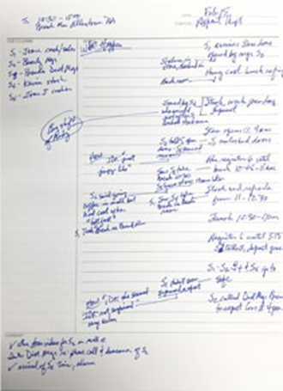
How to take notes?
During the field visit:
Don’t forget to take photos for the participants set-up to remind you with the speakers in the analysis phase.
Gather any materials developed during participatory activities
Try to attach the observations to the narrative
Agree with the moderator on how you are going to ask to slowdown the discussion if you need more time to take notes
Notes:
Some time by summarizing what the participants have said

Slide 24
Improving listening by reflections
Are there parts of conversation you miss because you:
(Unconsciously) make assumptions about the speaker as a result of their appearance, accent, educational and professional background?
Are making assumptions based on the speaker’s gender, age, ethnic, cultural, or religious background?
Notes:
When you are conducting research, carrying out needs assessments, and getting to know and work better with different stakeholders, listening skills are among the most important of all the
skills you need. They are often taken for granted, but in fact take time, effort and practice todevelop. Becoming more aware of yourself as a listener and an observer is the first step towards
strengthening your ability in these areas.

Slide 25
Improving listening by reflections
Are you too opinionated and therefore not open to hearing what is being said?
Do you disagree with the speaker because his or her beliefs and opinions differ from your own?
Do you think or assume that the speaker is wrong?
Are you making assumptions about the benefits of formal education, literacy or professional status?
Are too tired or too distracted to listen carefully and actively?
Notes:
When you are conducting research, carrying out needs assessments, and getting to know and work better with different stakeholders, listening skills are among the most important of all the
skills you need. They are often taken for granted, but in fact take time, effort and practice to develop. Becoming more aware of yourself as a listener and an observer is the first step towards
strengthening your ability in these areas.

Slide 26
Immediately after the FGD:
Type your field notes as soon as possible (a template for field notes may be useful)-Expanding short notes to long notes
Prepare memos based on an initial analysis by the data collector.
Listen to the audio tape of your interview, FDGs etc. (if made fully) to take detailed notes or to carry out transcription
Quotations can then be later used to illustrate key findings in your M&E report.
Carry out a debriefing session and take notes about it

Slide 27

Debriefing session
Go through the discussion guide and highlight key points and findings from each question.
Discuss the following:
What were the most important themes or ideas discussed?
What are the major points that need to be included in the final report?
What were the “memorable” quotes that captured the essence of the findings?

Slide 28

Debriefing session
More questions to debriefing:
Were there any unexpected participant findings?
Are there findings from this group that need to be incorporated in following groups?
What were common themes or findings based on any previous groups held?
How did this group differ from any previous groups, in relation to key findings?
Should we do anything differently for the next focus group?

Slide 29
Debriefing sessions are of high importance
Daily discussion session during data collection between field team and researchers is a MUST
To avoid loosing information (not everything is captured)
The first layer of analysis process
If teams are dispersed across different locations- phone or SKYPE can be used
Notes:
A daily team debrief is a MUST and should involve all the facilitators and notetakers. This is typically done at the end of the day, so ensure it is scheduled after everyone is back from the field. If teams are dispersed across different locations, the daily debrief may take place over the phone or on Skype. The daily debrief focuses on sharing general impressions about the process of data collection and the content learned during the day. The team shares experiences and insights; talks about challenges, including potentially inadequate questions that are not producing the required information, or are duplicative, or are left blank; and discusses the occurrence of data saturation, etc. During the debrief, the team should jointly identify solutions to improve the process and participation in general and discuss

Slide 30
Notes to be delivered for analysis purposes
Key points , main themes for each question (with rich narrative)
Quotes
Big ideas, hunches, or thoughts
Other notes

Slide 31
After the data collection

Slide 32
After Data collection Lesson learned
Data filing, organizing the files and the notes
Structuring the files to the analysis
Find common understanding to the coding process
Read the all the transcripts before starting the coding
Highly recommended to not count on one person on coding to end-up with subjective codes
Agree on the analysis methodology
Arrange for in-between meeting during the analysis to review & discuss

Slide 33
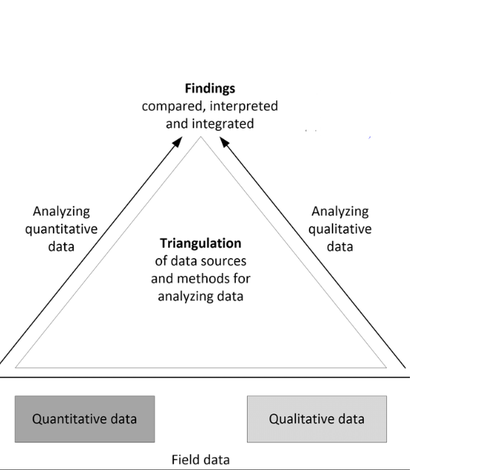
Data triangulation
Notes:
Triangulation is used to verify various pieces of information by relating them through space (comparison with other sources) or time (comparison with other years) to provide a full picture for analysis. Triangulation of qualitative data collected from different sources, and qualitative and quantitative data collected through mixed methods research helps validate and interpret findings to arrive at the main conclusions of a research question.
Enables holistic and longitudinal analysis

Slide 34
Types of data triangulation
1) Cross checking for accuracy and consistency
2) Enriching and deepening understanding
Notes:
There are two main types of triangulation that are useful in monitoring and should occur simultaneously within the same analytical exercise: cross-checking for accuracy and consistency, and enriching and deepening understanding.
Transform qualitative coded data into quantitative data – a process known as quantizing – and triangulate it with quantitative data.
Example 1. Accuracy
• Three informants each say that the market is about 10 km away: they validate each other’s information, and the monitoring team can be fairly sure that the market is indeed 10 km away.
• One informant says that the road is dangerous, another says it is fine, and a third has no opinion: triangulation shows that there is insufficient information on this issue, so probing is needed – for example, by investigating the characteristics of the person who says that the road is dangerous, asking a fourth person’s view, conducting an additional key informant interview with a local trader or sending the team's driver to explore the road while the interviews are being completed.
Example 2. Depth
• First point of view
In a focus group discussion, the monitoring team learns that the nearest market is held on Wednesday, and is a 10-km trek over a steep hill.
• Second point of view
In a subsequent focus group discussion with male farmers, the team learns that the market is an excellent outlet for selling livestock, but is less lucrative for agricultural produce.
• Third point of view
In a focus group discussion with women only, the team learns that not only is the road difficult, but many women are exposed to physical abuse on the way to the market and refrain from travelling there.
• Fourth point of view
In a key informant interview with an intermediary/trader who works at the market, it emerges that the quality of the produce from the studied village is not great, which partially explains the difficulty in selling it.
• Fifth point of view
In a household interview, a female household head reports that she is from a small minority group that forbids travel and work on Wednesdays, which restricts the use of the market for those sharing her ethnic origin.
In this case, no single point of view contradicts another, and each contributes useful additional insight, which increases understanding of the dynamics and intricacies of vulnerable groups. When comparing and contrasting these five points of view on local market dynamics during the first evening, the team decides to add an additional focus group and some key informant interviews to solidify the story. Team members also plan to visit the market as they leave the region to add direct observation to the insights.
Did all of the beneficiaries receive their full entitlement?
What was the quality of the entitlement? How was it delivered? Was it sold, shared or exchanged and why?

Slide 35
3 ways to triangulate qualitative data
Triangulate qualitative data with qualitative data overtime and from differ resources
Triangulate qualitative data with quantitative data.
Transform qualitative coded data into quantitative data – a process known as quantizing – and triangulate it with quantitative data.

Slide 36
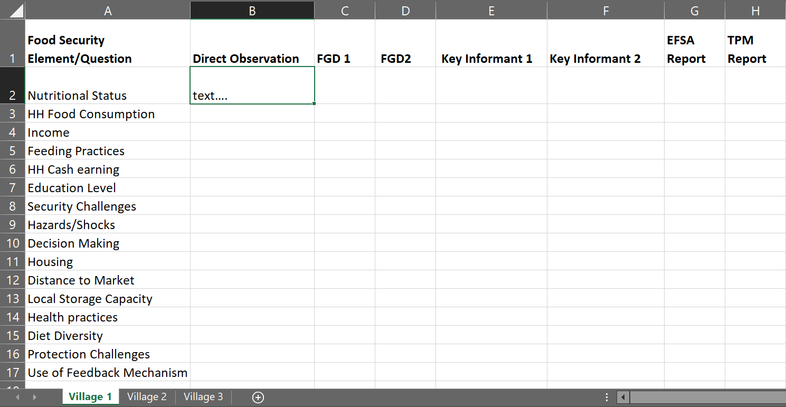
Qualitative data with qualitative data
Notes:
As shown in the example above, the column titles across the top of a triangulation matrix are the methods or sources chosen for data collection, while the row titles are the themes or specific questions addressed. Key insights are recorded in each cell permitting rapid visual comparisons, discussion and analysis. Each village or site should have its own sheet in a multi-page worksheet.

Slide 37
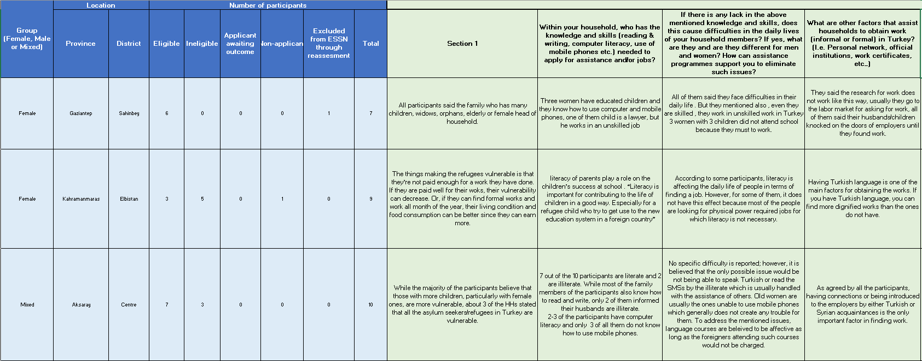
Qualitative data with qualitative data
Notes:
Example of Turkey FGD excel consolidated report

Slide 38
Qualitative data with quantitative data
CVME Round 2 (Quantitative)
29% of female HH and 12% of male HH cannot read or write
FGDs (Qualitative)
Lack of literacy skills leads to women’s limited access to information on institutional services, leaving them mainly with family and other social networks as their primary source of information on available opportunities
Participants reported that their children have better language skills, which they often depend on for their daily needs and social interactions.
Notes:
CVME Round 2 show high level of illiteracy among female headed compared with male headed households. Of the female headed households interviewed for the CVME, 29 percent of female heads can neither read nor write compared to 12 percent for male headed households. 62 percent of households surveyed had not been educated beyond primary school.
lack of literacy skills leads to women’s limited access to information on institutional services, leaving them mainly with family and other social networks as their primary source of information on available opportunities
sensitization and awareness activities conducted by WFP and TRC as well as access to language training for refugees are assisting in this regard and literacy training should be continued with a clear focus on support to female headed households.
participants reported that their children have better language skills, which they often depend on for their daily needs and social interactions

Slide 39
Thank you for your attention

