Slide 1


Qualitative Data Analysis-
Fundamentals
November 2023

Slide 2
Qualitative analysis approaches

Slide 3
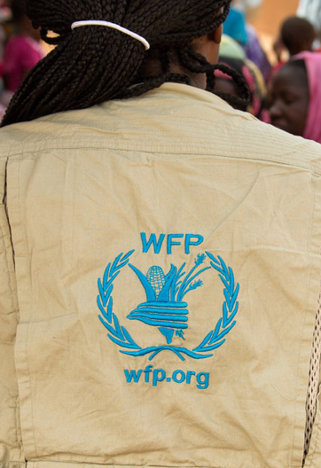
What is qualitative data analysis?
  Turns non-numeric data (transcripts, notes, recordings, photographs, etc) into findings
  Identify patterns in data that help to answer research question
Do’s
Don’ts
Insights are based only on frequency of responses, percentages of people who agree, consensus among respondents
Lists of quotes or words without description of relevance/importance

Slide 4
Analysis method is usually linked to your research approach
Focus of this guide
THEMATIC ANALYSIS
IDENTIFY COMMON THEMES, TOPICS, PATTERNS, AND IDEAS
What are women’s experiences of Intra-household food distribution? And how do these experiences compare to men's?
DISCOURSE ANALYSIS
LOOK AT SOCIAL UNDERSTANDINGS AND CULTURAL DYNAMICS BY FOCUSING ON HOW PEOPLE TALK ABOUT ISSUES
How do IDPs express their identities and sense of belonging with their home region?
GROUNDED THEORY
IDENTIFYING CATEGORIES AND CONCEPTS IN DATA TO CONSTRUCT A THEORY
IDENTIFYING CATEGORIES AND CONCEPTS IN DATA TO CONSTRUCT A THEORY
What broader social structures can explain differences in men and women’s experiences of shock?

Slide 5
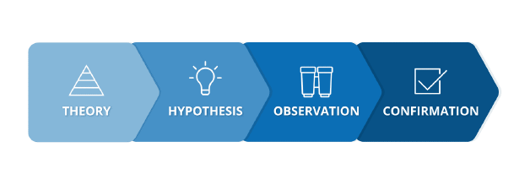
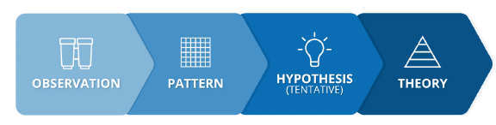
Deductive vs inductive research approach
Deductive approach
Top-down approach
Theory testing
A priori codes
Good for reports where you need to cover particular ideas
Hybrid approach
A set of a priori codes* reflecting your understanding of the topic and your research questions
Emergent codes added as you code the data and find other factors/topics/codes that you had not considered
Inductive approach
Bottom-up approach
Theory building
Emergent codes
Good for when you are doing more discovery in your analysis
*categories or themes established before data analysis begins, often based on existing theories, literature, or research questions.

Slide 6
Example of Hybrid Analysis Method
Predefined codes (deductive):
Women’s decision-making food distribution
Men’s decision-making food distribution
Women meal preparation
Breastfeeding women’s diet
Prior to reading transcripts
What are women’s experiences of Intra-household food distribution? And how do these experiences compare to men's?
After reading transcripts
Inductive codes:
Women eat less protein
Men eat more diversified diet

Slide 7
Steps of qualitative analysis

Slide 8
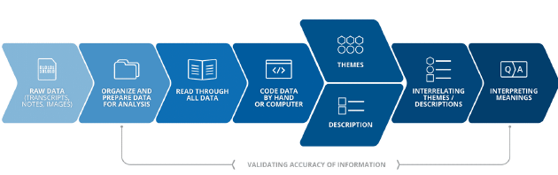
Stages of qualitative analysis
Notes:
The process moves from organization and reduction of data through coding towards interpretation which is really where the work of analysis emerges

Slide 9
Pre-coding step 1: Organize and prepare raw data
TRANSCRIBING AND TRANSLATING DATA
TYPING UP FIELD NOTES INTO MS WORD
SORTING AND LABELING DATA
Tips to keep organized
Make sure all notes are recorded digitally
Keep a written record of context/purpose for photos, videos and notes

Slide 10
Organize and store your data in a secure central location
Do’s
Don’ts
Upload anonymized transcripts and audio files into secure location:
  Create SharePoint folder accessible only by research team
  Use data library and restrict access to the team
Organize data files in systemized way:
  By date
  By location
  By category of respondent
Name files in a consistent way:
  Gambella FGD_Aug_1_2023_Women
  Gambella FGD_Aug_3_2023_Men
Store files on a personal laptop
Keep files on an audio recorder
Keep photographs in your personal phone or camera
Put files in a folder without naming them

Slide 11
Pre-coding step 2: Read through the Data
Tips on active reading of data:
Be immersed in the data to the extent that you are familiar with the depth and breadth of the content
“Repeated reading” of the data
Reading in an active way – searching for meaning, patterns and relationships within the text
Read through all data
Build understanding of people, events, ideas in data
Develop framework for further analysis
Record any ideas and understandings generated

Slide 12
Coding

Slide 13

What is coding in qualitative data analysis?
The coding process is a way to purposefully manage, locate, identify, and sort qualitative data. It is about accessing evidence and facilitating analysis
  It reduces long and complex narratives in key points.
There are many different approaches to coding
A code helps sort and order the data so that you can keep track of your topics and easily find information

Slide 14

Coding example
What is a code?
For example, in a section of an interview transcript in which the informant explains his experiences with receiving cash transfers, he mentions that he often feels insecure when withdrawing money from the ATM, fearing he may lose his card. The analyst may choose to code the section ‘ fear of cash withdrawal’, or ‘fear of card loss’.
A code is a label or tag that you give to a piece of text.
For thematic analysis: codes represent "what passages of data are about
Inductive: codes are a snapshot of the text
Deductive: codes reflect on existing questions
“I sometimes get worried about drawing cash from the ATM, I fear that maybe I will lose the card – maybe it will get stuck in the machine or stolen. “

Slide 15
Types of codes
Examples
Respondent type codes/ attribute codes: highlight diversity of data amongst the sampled population, such as between men and women
Analytical codes identify more interpretative and analytical concepts
Topical codes categorise topics or issues
Descriptive codes describe actions, events, or experiences
In Vivo coding using participants words to capture intent and meaning
Female under 36; interviews; Rome…
more men than women have access
coping strategies; social cohesion, etc.
Insufficient food quantity; men make financial decisions
“feeling over the moon”

Slide 16




Tips on creating codes
For thematic analysis: descriptive codes represent "what passages of data are about, they are a snapshot of the text
Codes should be as specific and precise as possible
Code names should be neither too broad nor too narrow
Be careful about previous associations: The code name will start influencing the researcher’s thinking, process, and perceptions of what the data is about. This will affect future code names.
Why? When codes are specific and precise, grouping and analysis of data can be done without needing to go back to the text itself
Examples :
“coping mechanism,” “traditional foods”
“women selling bodies for food”, “traditional foods are no longer affordable”
“loans,” “villagers can give loan of 0.50 USD to each other each month ”
“ monthly loans in smaller amounts”

Slide 17
Example of descriptive (inductive) code
Field notes about food assistance distribution:
“Yes, we have the disabled and the elderly. We no longer see this type of group being assisted adequately by the UNHCR. But they get food assistance. If they are unable to get to the distribution centers to collect the food themselves, they send their kins or people they trust to collect for them food.”
Codes:
INADEQUATE FOOD ASSISTANCE VULNERABLE PEOPLE
FOOD COLLECTION VUNLERABLE PEOPLE VIA SURROGATE
DIFFICULTIES ACCCESS TO FOOD ASSISTANCE VULNERABLE PEOPLE

Slide 18
Categories

Slide 19
categories
What is a category?
Codes clustered together according to similarity, regularity or patterns
There can be two or more levels of categories if needed (sub- categories)
Why create categories?
To arrange things in a systematic order, to make something part of a system or classification
To organize and group similarly coded data into categories or “families”

Slide 20
Codes – categories - themes
Loss of card, fear of cash withdrawal, fear of theft
Distance from ATM, time of collection, lack of ATMs
Codes that are similar, are often grouped together under a category. The category summarizes the type of codes.
  For example, codes of ‘theft of cash’ and ‘loss of card’ could be grouped under a category called ‘Perceptions of threats’
In a similar way, several categories can be grouped under a common theme.
  For example, the category of ‘Perceptions of threats’ and ‘Complaints about access’ can be part of a broader theme such as ‘Perceptions about the challenges of receiving cash assistance’
CODE
Perceptions of threats
Complaints about access
CATEGORY
THEME
Perceptions about challenges of access and threat in receiving cash assistance

Slide 21
Example of categorizing
Code: USE OF COMPLAINT MECHANISM
Code: KNOWLEDGE THROUGH INFORMATION MEETINGS
Code: USE OF INTERPERSONAL NEWS CHANNELS
Code: KNOWLEDGE THROUGH ANNOUNCEMENTS
Category:
information and feedback channels

Slide 22
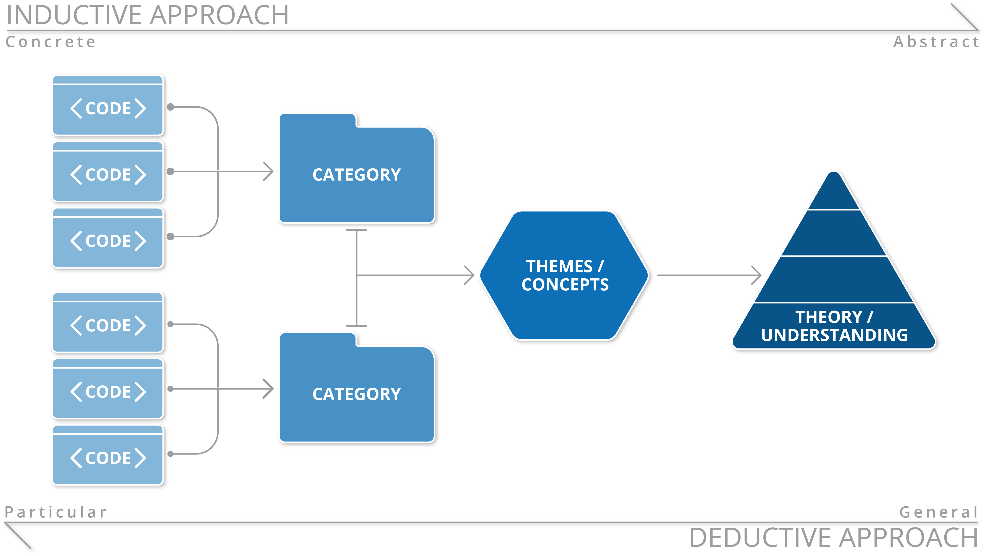
Reducing data
Identifying patterns
Notes:
Coding chart
This shows you how the chain works from codes to themes

Slide 23

CODING PROCESS: RECODING AND RECLASSIFYING
Coding is a cyclical process: codes are created, grouped, challenged, and recreated, repeatedly
Codes can and categories can be relabeled, dropped altogether in the second or third round
All data sources can be coded, and the coding process is very similar
Rarely will anyone get coding right the first time because qualitative enquiry demands attention to language, deep reflections, meanings etc.

Slide 24
Who codes?
Ways to increase reliability of codes
  Individuals or teams
  Ideally, coders have participated in the fieldwork
  Somebody who has a deep understanding of the program, evaluation questions, and evaluation themes
Have multiple coders develop the codebook and code the datasets
For team coding, engage in discussions about the code names and groups to define clear definitions
Having a second person review a sample of the data, to see if they arrive at the same conclusion
Review a sample of the data at a later stage to see if the codes have remained consistent

Slide 25
Amounts of data that gets coded
  There are various opinions ranging from coding all or most parts to coding those that are most needed
  Code in the beginning as much as you can
  The more experience in data analysis you have the more confident you feel selecting the relevant text
  Keep in mind practicalities

Slide 26
Options for coding data
Data can be coded manually by using Word or paper, by highlighting text or photo sections in certain colours and adding comments to the margins.
Coding manually tends to be more intuitive and is great for researchers new to qualitative analysis because it creates a good understanding of the data and analysis flow.
MAXQDA, NVivo or Atlas.ti
Great for larger amounts of data
Easy re-coding and coding tracking
Texts, images, and videos
Can be comprehensive to learn esp. for more advance analysis tools
Not a substitute for analysis
Manual coding
Coding with Software

Slide 27
Codebook
Code | Cash withdrawal
Definition | Any reference to beneficiaries withdrawing cash assistance from an ATM
When to use | Use specifically when there is talk about how cash assistance has been accessed/withdrawn using card/ ATM
When not to use | Avoid using if respondent is discussing different means of accessing cash assistance, or if the respondents discuss using the card to access money in general
Example | ‘I always withdraw money on market days because that’s when I travel into town where the ATM is’
A codebook is a record of codes and their definitions. It is essential for ensuring consistency in the application of codes, especially when working as a team

Slide 28
Coding credibility
Even though coding is prone to researcher bias, there are some ways of adding credibility to the process:
The researcher can make his/her perspectives and questions explicit in the presentation of codes and make sure the codes are applied consistently. This will help the reader understand how and why the data was interpreted in this way
The most effective way of establishing credibility is to provide a strong and clear argument for the conclusions reached

Slide 29
Thematic analysis

Slide 30
Thematic analysis
What is it?
Researcher closely examines the data to identify common themes, topics, ideas, and patterns. These themes are then described, organised and analysed.
When to use it?
Good approach when you are trying to find out more about people’s views, opinions, knowledge, experiences, or values.
Useful when examining perspectives of different participants, highlighting similarities and differences, and generating unanticipated insights.

Slide 31
What is a theme?
What is the difference between a category and a theme?
A theme is an outcome of coding and categorization
A theme is an analytic reflection
Themes are broader than a category and it says something about your research question
Categories describe something more obvious, easy to recognize in patterns
Themes describe something about the underlying meaning of the patterns
As an example, SECURITY can be a category , but A FALSE SENSE OF SECURITY can be a theme.
(Rossman & Rallis, 2003)

Slide 32
example of moving from codes & categories to themes
Changes in Social Cohesion and organization within the community
Themes
Community dynamics
Household family ties
Categories
Less rural exodus
Community solidarity
Childcare availability
Participation of women in decision-making
Donation to people living with disabilities
Codes

Slide 33
Thematic Data interpretation

Slide 34
Reducing data
Interpreting patterns
Developing and describing insights
Identifying patterns

Slide 35
What does data interpretation mean ?
This is the final refinement of the themes and the aim is to ‘..identify the ‘essence’ of what each theme is about.’.(Braun & Clarke, 2006, p.92)
Data interpretation involves identifying the meaning of the codes and categories you have developed and reflecting on how insights answer your research questions.

Slide 36
Data Interpretation - reflection
STEP 1:
Reflect on the data itself
Think what is interesting about the themes and what kind of narrative it tells.
How do the themes relate to each other?
What conditions are likely to have given rise to this theme?
Why do people talk about this thing in this particular way
What are the assumptions underpinning it?
What is the theme saying that is relevant to your research question?
What are the implications of this theme (e.g., for outcomes)
Reflect on the contexts and conditions behind the themes
Reflect on the implications of this data for your study

Slide 37
Tips on interpreting meaning from findings
Reflect on….
  Lessons learned
  How findings speak to past research, expectations, theories, literature
  How findings can be used in program design, evaluation, etc.
  Additional questions to ask
Interpretation in thematic analysis should…
  Explain findings within the framework of research questions/sub-questions
  Identify further areas or topics for research
  Compare findings to previous research or assumptions

Slide 38
Data Interpretation- writing the analysis
STEP 2:
Write up detailed analysis of each theme and identify the story that each theme tells.
Think how the story fits to broader overall story that you are telling about the data.
Use comparison (between categories, subgroups, and time/contexts) to contextualize and better interpret findings
Identification of sub themes allow demonstrating the hierarchy of meaning within the data

Slide 39
Tips and tricks

Slide 40
Common mistakes in thematic data analysis
To Avoid:
  Thematic analysis is not a collection of extracts strung together with little or no analytic narrative
Failure to analyze the data at all!
Themes don’t seem to work: overall between the themes or internally not coherent.
A mismatch between the data and the analytic claims that are made about it.
Using of the data collection questions (such as from an interview schedule) as the “themes” that are reported.
A failure to detect variation in data (data is never 100% contradicted)
  No analytic work has been done to identify themes across the entire data set, or make sense of the patterning of response

Slide 41
Limitations of thematic analysis
It is often very subjective, relying on the researcher’s judgement. Therefore, it is prone to bias and risk missing nuances in the data.
The flexibility of the approach can lead to inconsistency and lack of coherency when developing the themes from the data.
There is insufficient literature outlining a pragmatic process for a trustworthy thematic analysis, compared to other methods. This may cause novice researcher to feel unsure about how to do the analysis thoroughly and systematically.

